Slide 1
Neutralization of Chlorine in a Scrubber

Slide 2
Background and Motivation
Poisonous chlorine is a by-product in many chemical processes.
In a chlorine scrubber, chlorine is removed through the neutralization reaction with an alkaline water solution.
Investigation of kinetics of neutralization reaction to increase removal efficiency
Reaction Engineering interface used for simulation of a four-step reaction

Slide 3
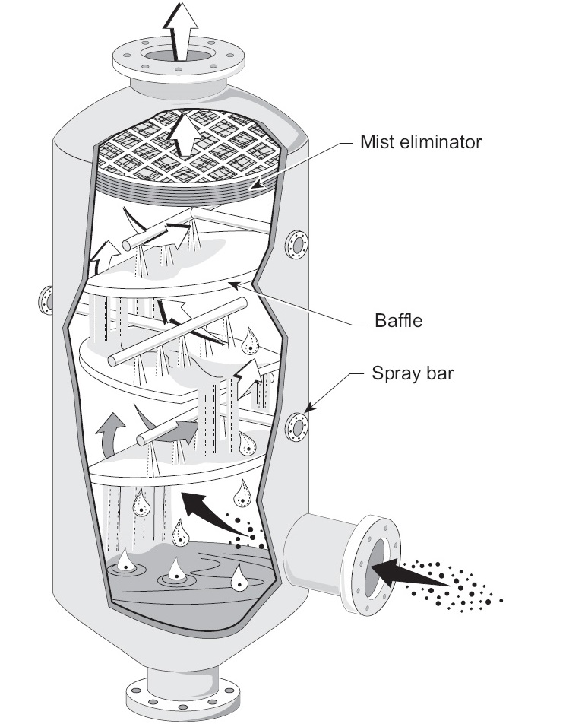
Operating Conditions and Modeling
Concentrations of reactants and products are uniform — perfectly mixed in reactor (0D).
Fluid volume is constant.
Isothermal reactions
The Reaction Engineering interface is used for modeling the removal of chlorine by liquid solution (wet scrubber).
Example of a wet scrubber.
Image courtesy of the EPA, under the public domain agreement

Slide 4
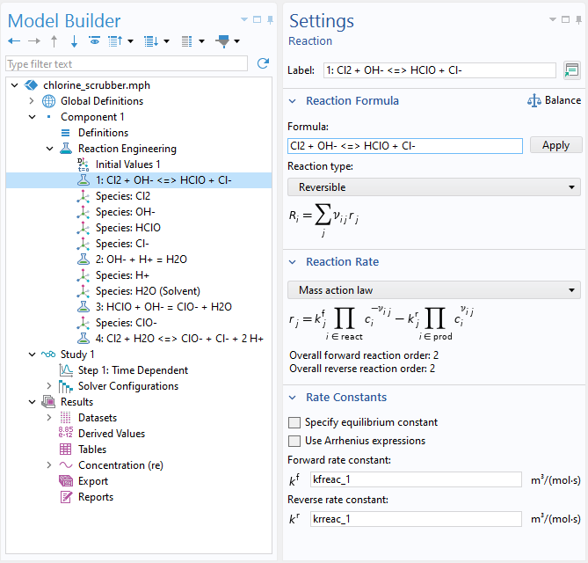
Model Setup
Two reversible reactions:
  Cl₂ + OH⁻ <=> HClO + Cl⁻
  Cl₂ + H₂O <=> ClO⁻ + Cl⁻ + 2H⁺
Two equilibrium reactions:
  H₂O = H⁺ + OH⁻
  HClO + OH⁻ = ClO⁻ + H₂O
An equilibrium reaction is a special reversible reaction whose reaction rate is very fast (compared to other reactions).

Slide 5
Assumptions
Concentrations of H₂O and HCl (in excess) are assumed constant.
Water solution is chlorine saturated.

Slide 6
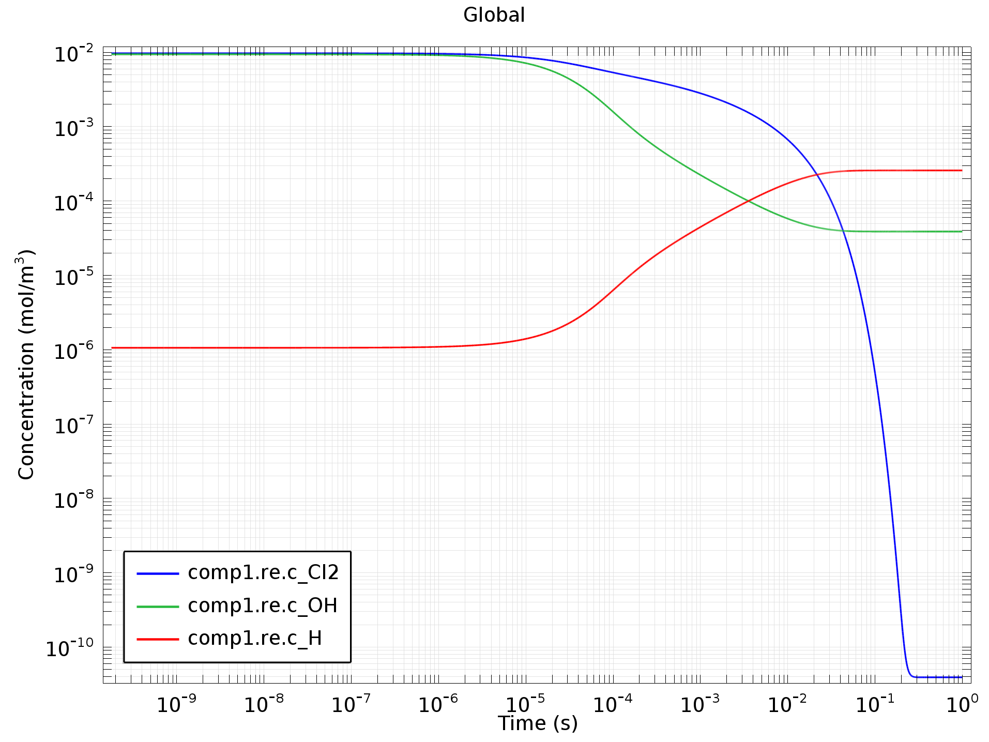
Results
The chlorine concentration is reduced from 10⁻² to 10⁻⁶ mol/m³ after t = 20 ms.
Rate-limiting step is mass transport.

