Slide 1
Oxide Jacking of Concrete
COMSOL

Slide 2
Background
Oxide jacking is the process by which reinforced concrete cracks, due to the corrosion of the reinforcing rebar rods
  The corrosion process causes growth of an oxide layer on the rebar, which in turn causes internal stresses in the concrete
  As the corrosion process continues, the concrete will eventually crack, compromising the structure
In the present model, a 2D model for oxide jacking is presented
  The corrosion process is driven by oxygen reduction
  Oxygen diffuses in the concrete block
  The rebar and concrete surroundings are modeled as linear elastic materials, with strains in each time-step based on the thickness of the oxide layer
  As a simplification, only one piece of rebar is included

Slide 3
Included Phenomena and Physics Interfaces
Corrosion
  Tertiary current distribution with a supporting electrolyte description
  The electrical conductivity of concrete is modeled as a function of pore water saturation
  Oxygen diffusion from an outer edge toward the rebar
  Electrode reactions: Oxygen reduction, iron oxidation with rust formation, and hydrogen evolution
Structural mechanics
  Steel rebar and concrete modeled as two different linear elastic materials
  Volumetric expansion of rebar driven by the formed oxide layer
  The effect of volumetric expansion due to oxide formation is accounted for using a scalar damage model
Material data for concrete and Steel AISI 4340 is used in the structural analysis

Slide 4
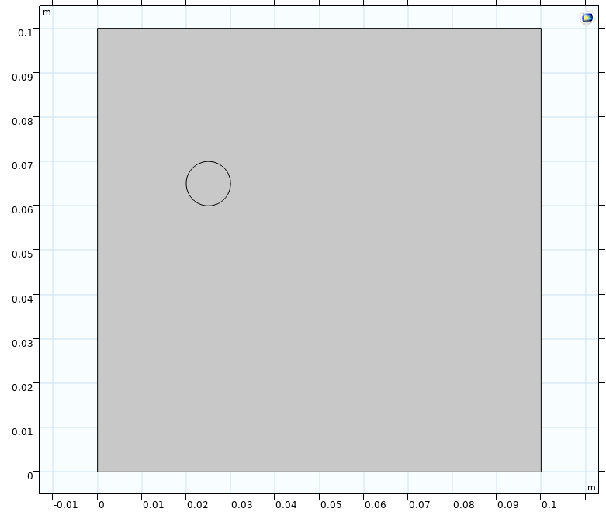
Model Definition
Steel
rebar
2D model with one piece of rebar
Oxygen diffuses from the exposed outer surface
Oxygen is reduced on the rebar surface, causing oxidations of Fe. Iron oxide (Fe₂O₃) is formed, causing volume expansion
The effect of the strain due to oxide formation is modeled using the scalar damage model
Outer surface
(air)
Concrete

Slide 5
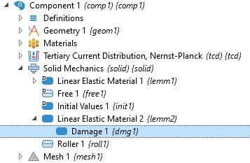
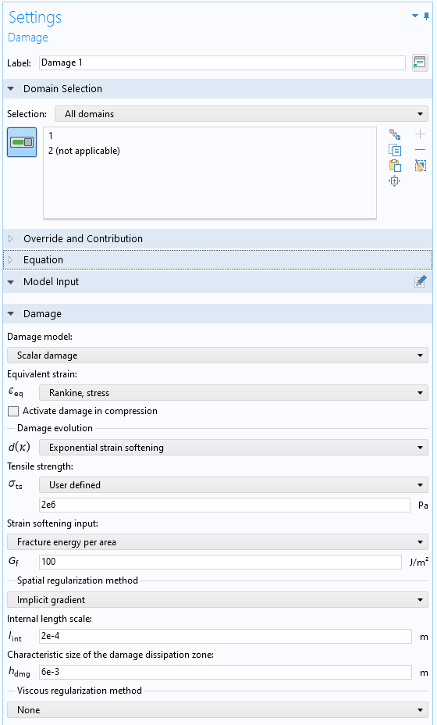
Mechanical Damage
Damage model to describe cracking of the concrete
Damage starts to grow when the stress exceeds the tensile strength
As the stiffness of the material degrades, a crack is formed
Cracks are smeared over a finite width in the domain
Spatial regularization method ensures a mesh objective solution

Slide 6
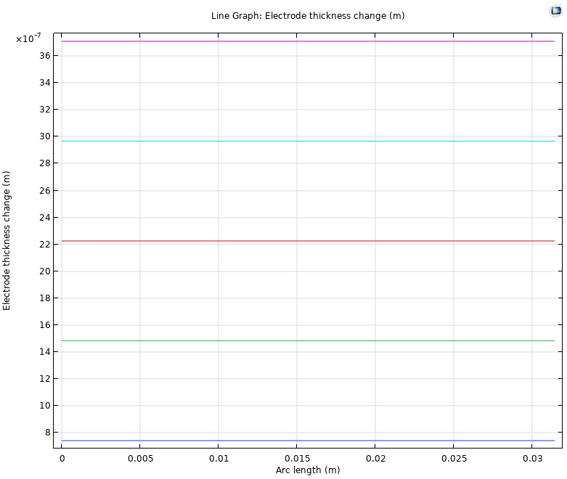
Results
Oxide layer thickness after 150, 300, 450, 600 and 750 days

Slide 7
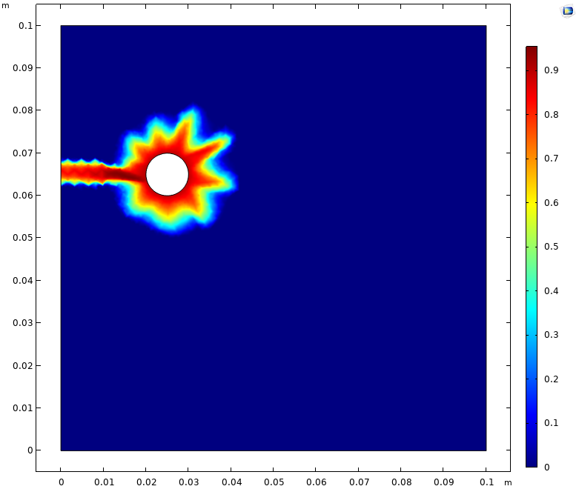
Results
Damage to the concrete after 750 days
A crack has formed and reached the external surface of the concrete. The area surrounding the rebar has been significantly damaged

Slide 8
Concluding Remarks
The coupling of Tertiary Current Distribution and Solid Mechanics allows for description of corrosion-driven cracking of concrete
Possible extensions:
  Include additional internal stresses in the concrete
  Use a more realistic geometry of the rebar and the concrete structure in a full 3D model

