Slide 1
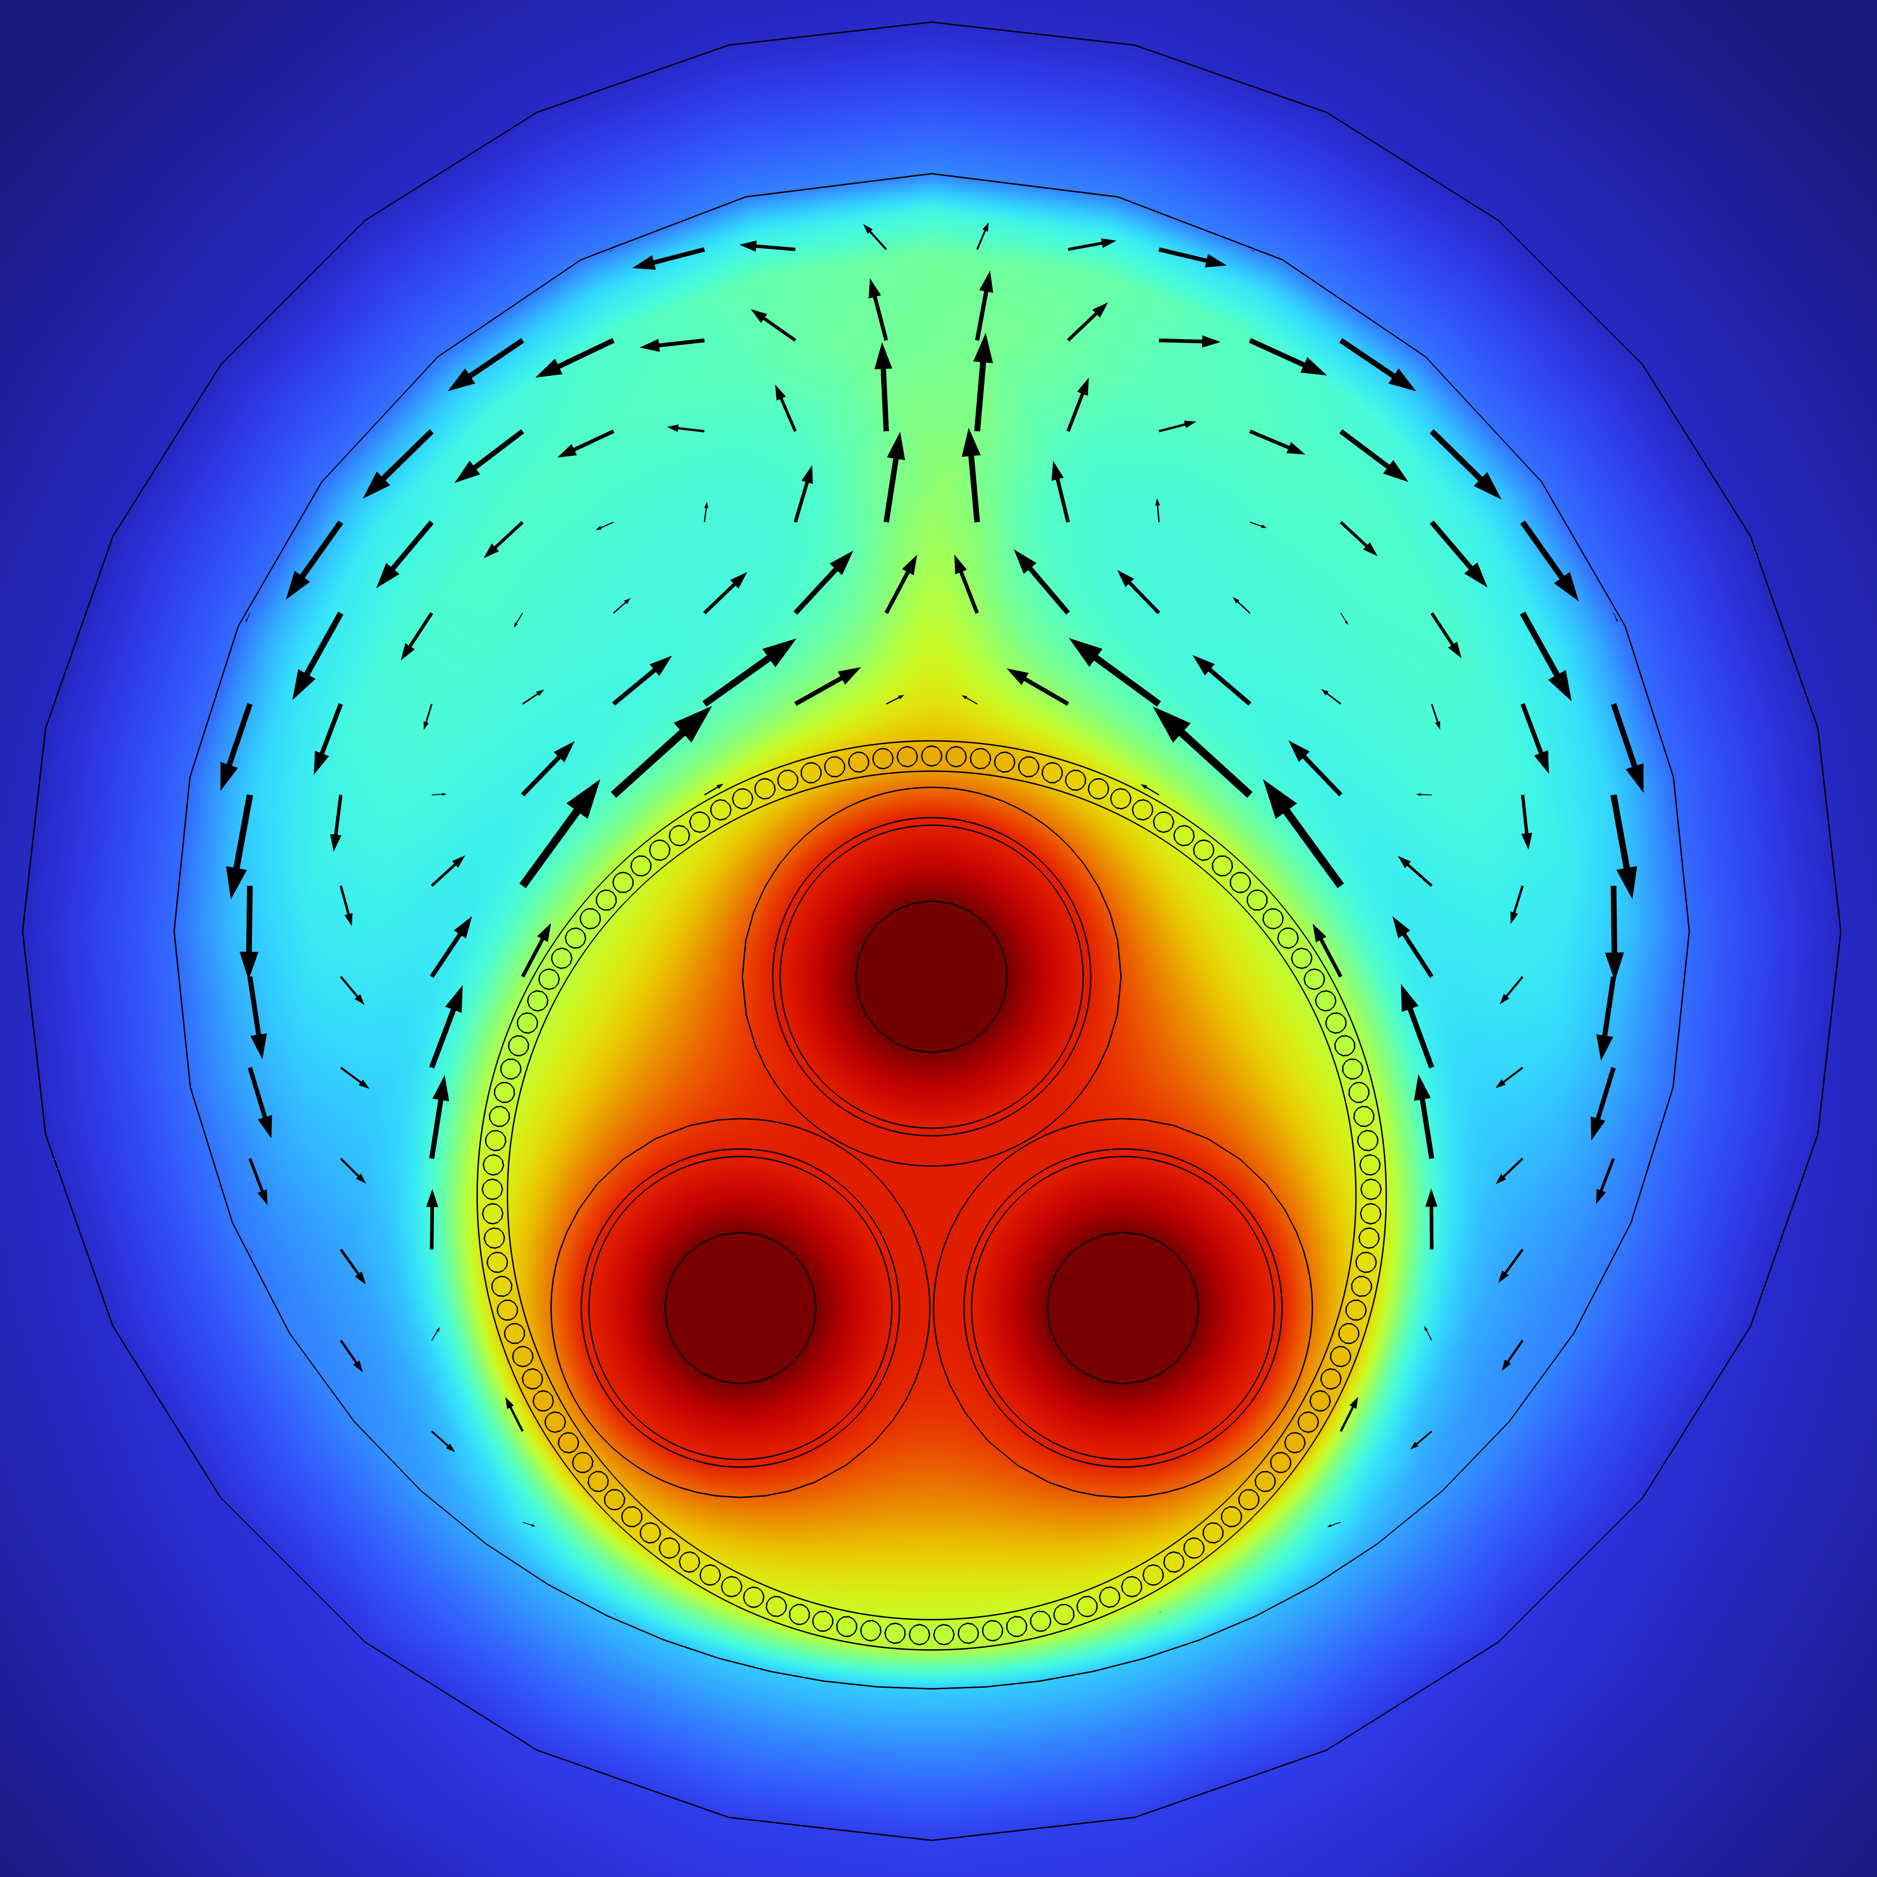

Taking a detailed cross section out of a 3D model
To increase performance and accuracy.
J. Krah
Services Nordic, Vattenfall, Solna, SE, Sweden

Slide 2
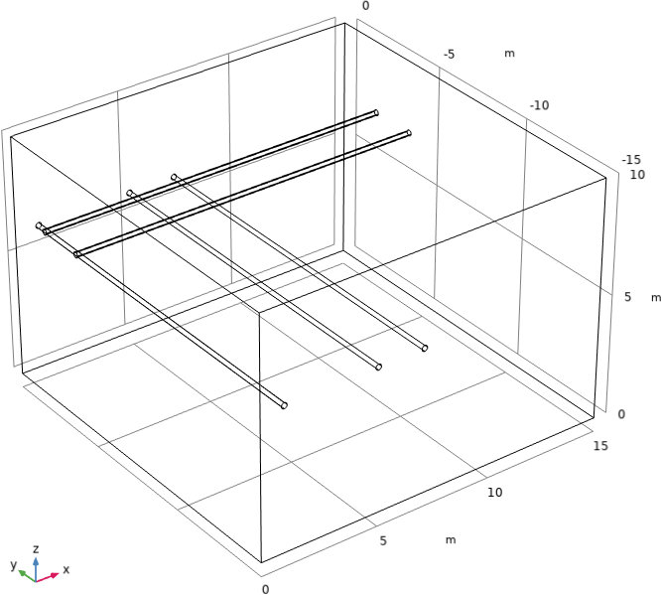
Introduction
Problem: Avoid overheating of cable insulation.
Task: Locate the hot-spot temperature.
3D challenges:
Crossing in ground
J-tube

Slide 3
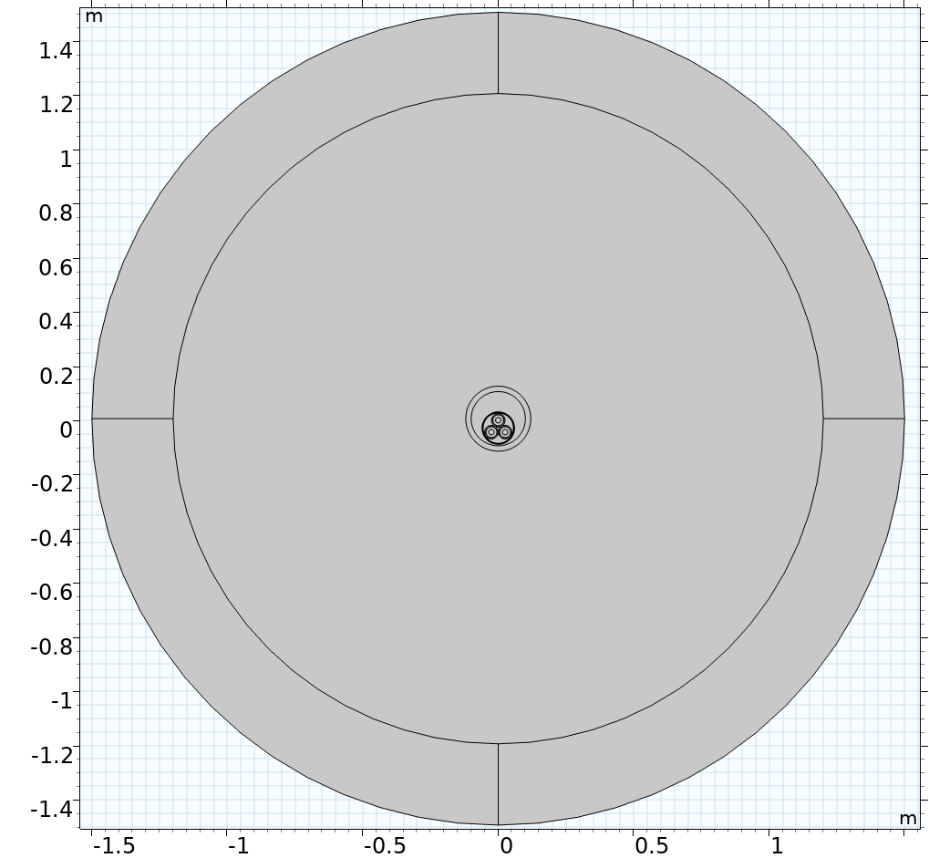
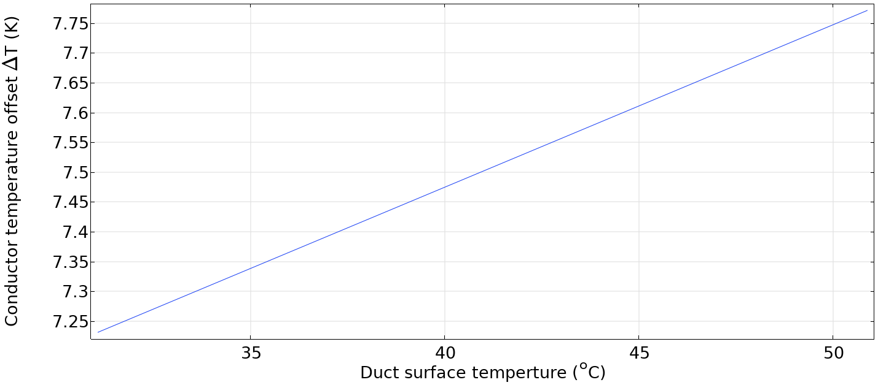
Methods and use of COMSOL Multiphysics®
AC/DC and heat transfer module.
Split the 3D model into two parts.
Replicate the results of the best 3D model.
Duct surface boundary condition:
$$q=q_{0}\left(1+α_{Cu}\left(ht.Tvar + 7.5 K−20 °C \right)\right)$$

Slide 4
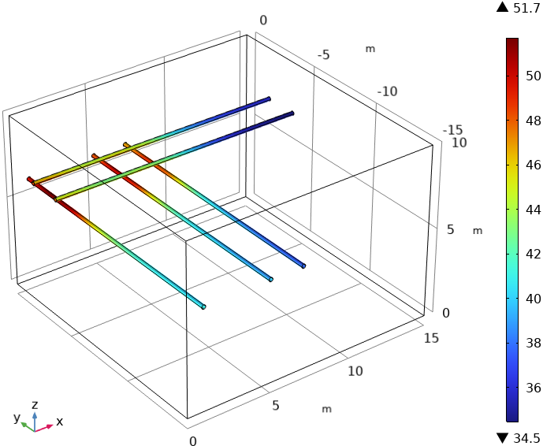
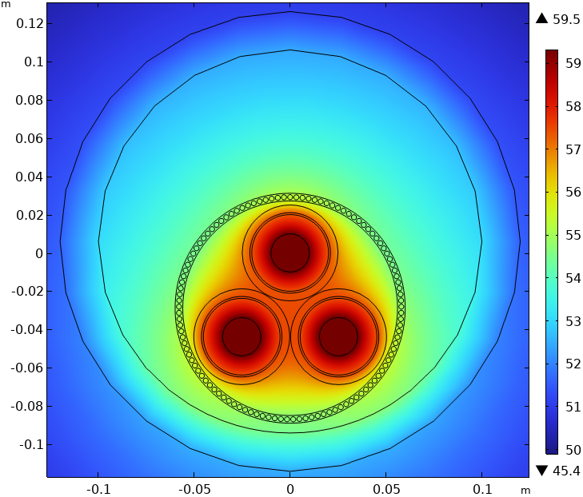
Results
 | 3D | Segregated
Mesh | Extremely fine | Finer
DOFs | 114 Millions | 1.6 Millions
Physical memory | 303 GB | 8 GB
Solution time | 45 min 11s | 2 min 15 s
Hot spot duct | 50.4°C (50.9°C) | 51.7 °C
Hot spot cable | 57.3 °C (59°C) | 59.5 °C
Possible physics | Heat conduction | Full multiphysics
Improvements | Mesh scaling | Lazy approach

Slide 5
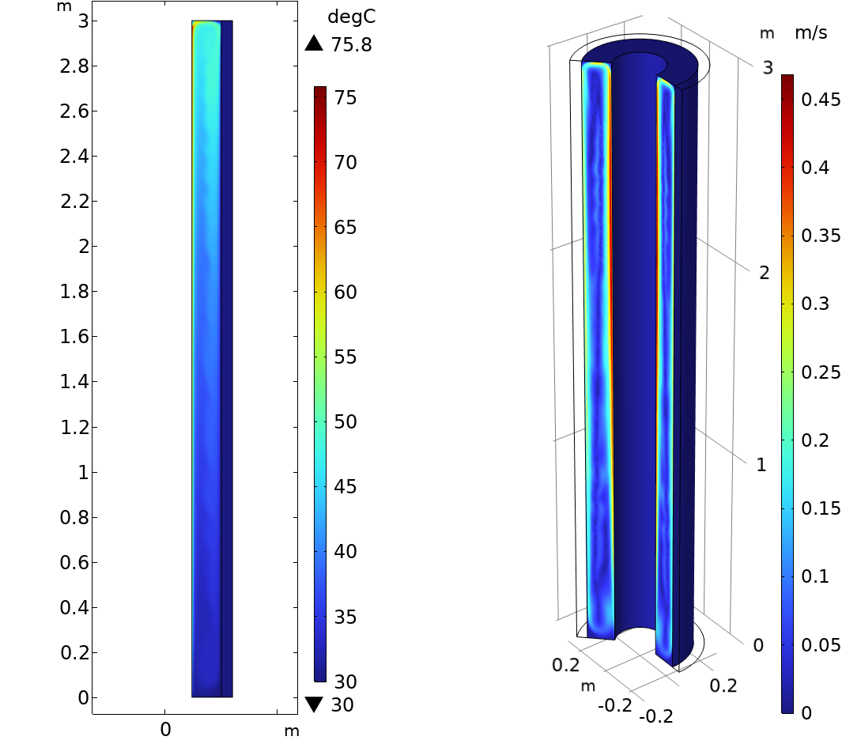
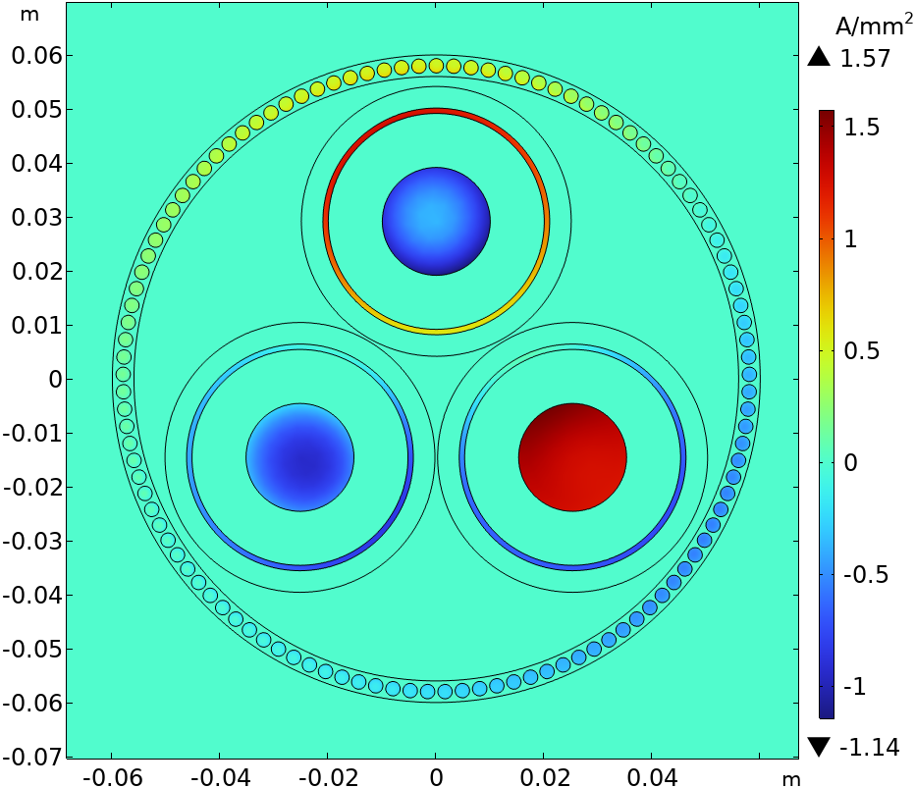
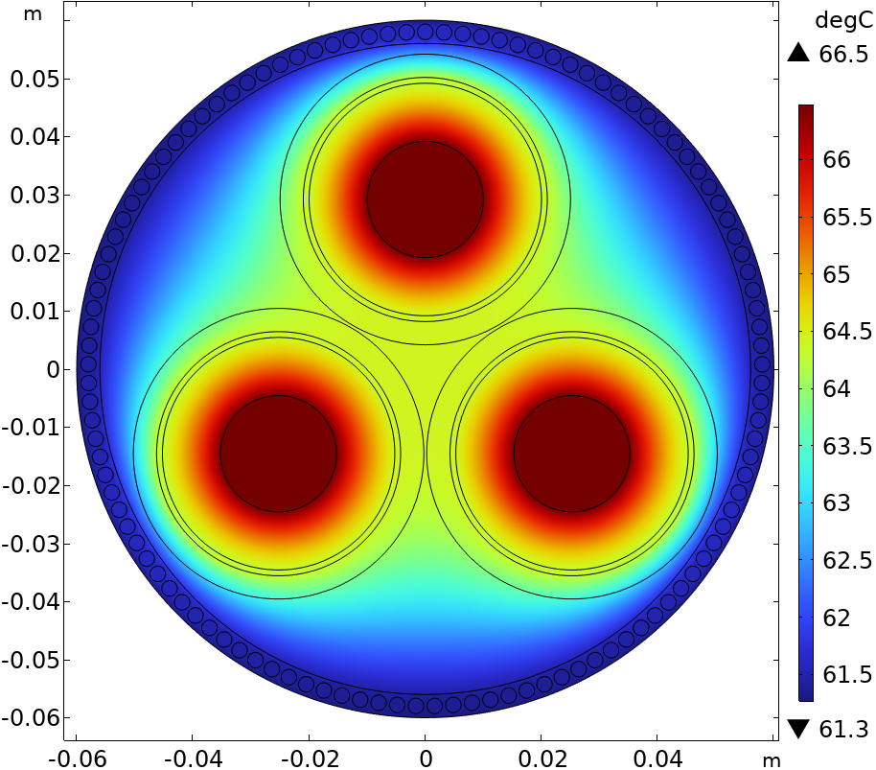
Results
Further results for the J-tube application.
Lazy approach works well for J-tube case.

Slide 6
Conclusions
Segregated model can replace a 3D model with the same physics.
It is conservative neglecting axial heat flux in conductors.
It can cope better with multiphysics than a 3D model.
It uses a fraction of the memory and the solution time.
In special cases of model split the approach can be simplified.

