Slide 1


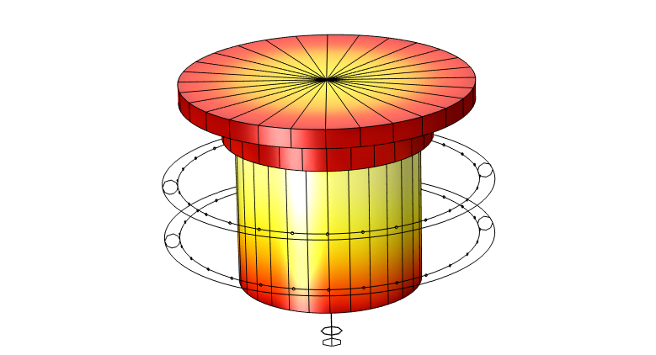

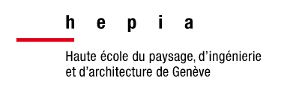
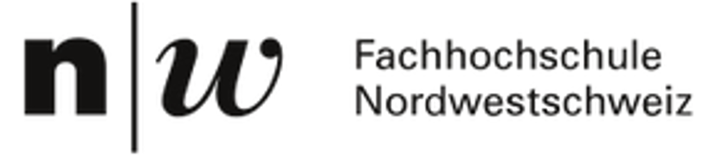

Simulation of a Bimetallic Alloy Cooling Process
R. Rozsnyo¹, A. Masserey¹, F. Carrard¹, V. Sanchez Mejia¹, N. Hofmann², S. Maas², M. Hotic², P. Schoass², H. Freisse³, F. Lienard³
1. hepia, HES-SO Geneva, University of Applied Sciences and Arts Western Switzerland 2. FHNW, University of Applied Sciences and Arts Northwestern Switzerland 3. Kugler Bimetal SA, Geneva, Switzerland

Slide 2
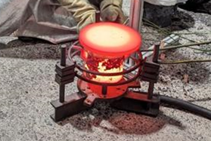
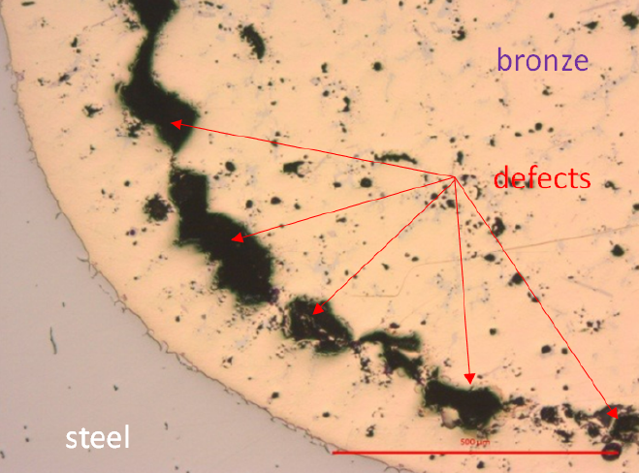
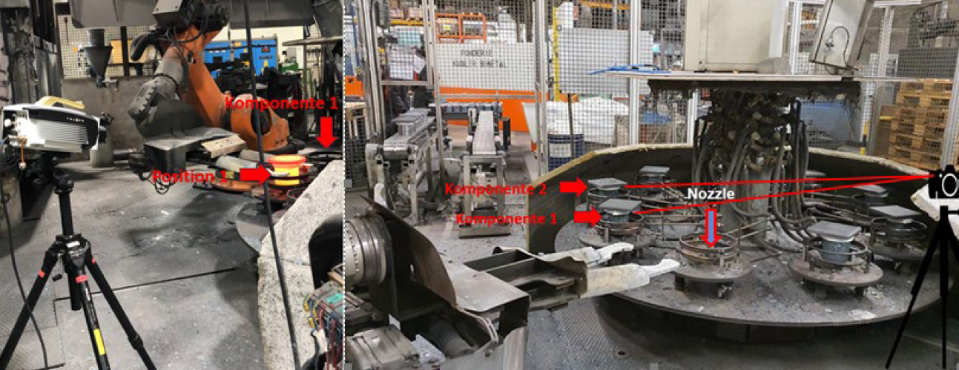
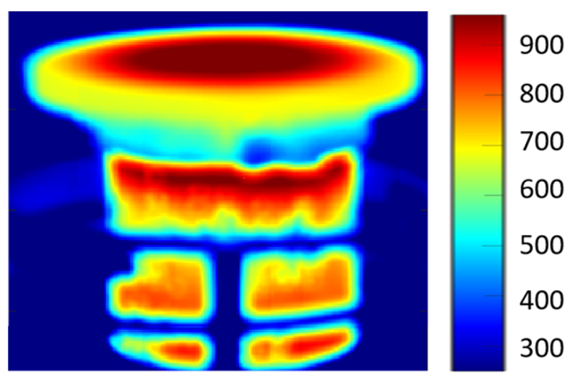
Introduction
The Project
- Numerical Modelling of an Industrial Process for Bimetallic Alloy Casting (MIPBAC)
- Innosuisse Project (Swiss Innovation Agency, Bern-CH, ref. 102.365)
Goals
- Reduce shrinkage, porosity and cracks in bimetallic alloys (Steel-Tokat) by optimization of the cooling process
Challenges
- Modeling the process with COMSOL Multiphysics
- Material characterization
- Experimental validations

Slide 3
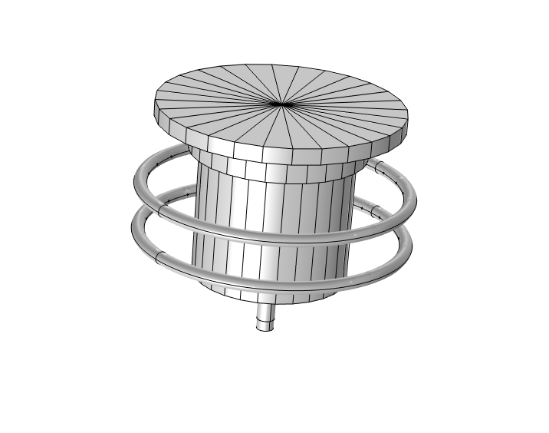
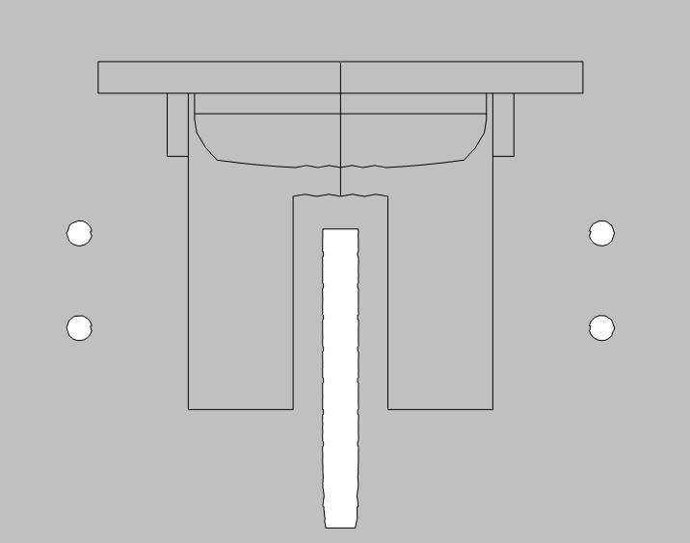
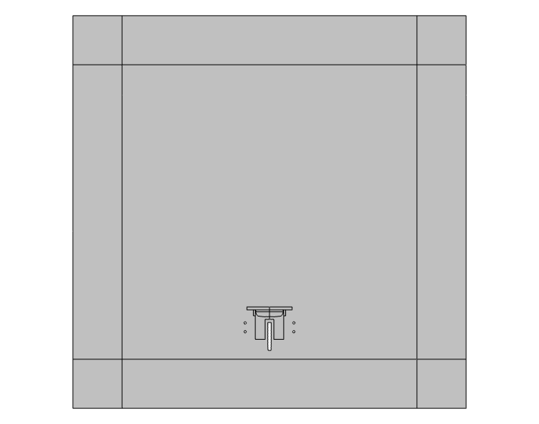
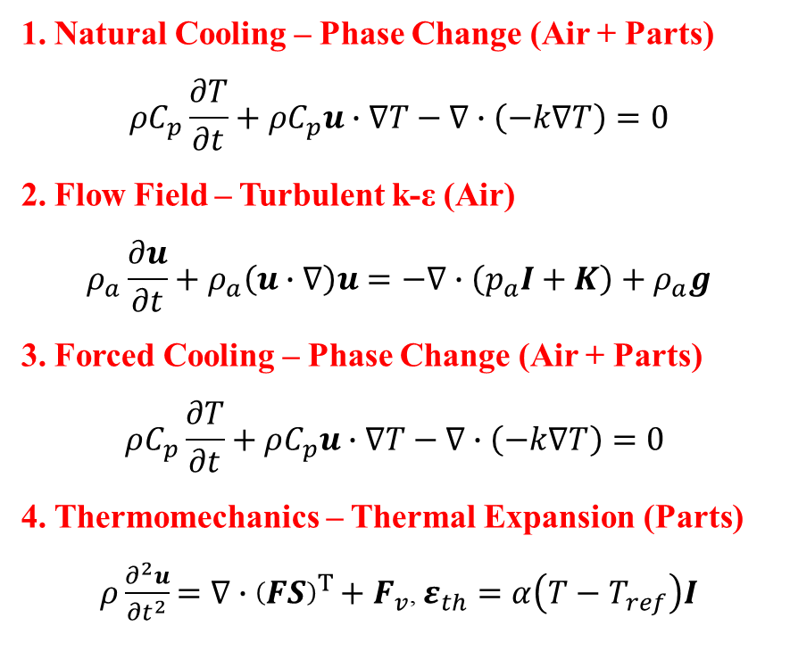
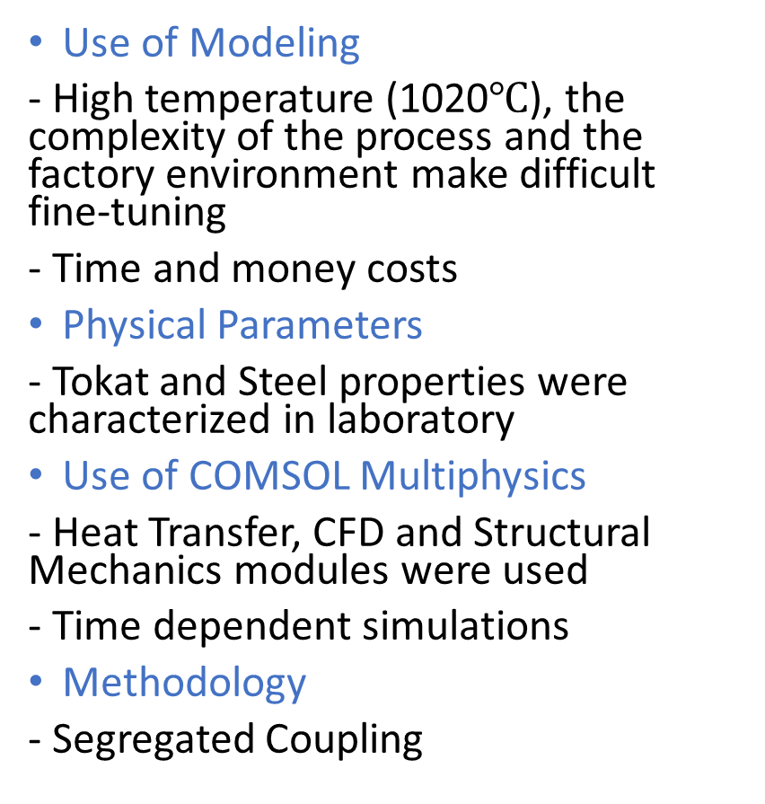
Methods and Use of COMSOL Multiphysics
Use of Modeling
- High temperature (1020$℃$), the complexity of the process and the factory environment make difficult fine-tuning
- Time and money costs
Physical Parameters
- Tokat and Steel properties were characterized in laboratory
Use of COMSOL Multiphysics
- Heat Transfer, CFD and Structural Mechanics modules were used
- Time dependent simulations
Methodology
- Segregated Coupling
1. Natural Cooling – Phase Change (Air + Parts)
$$ρC_{p}\frac{∂T}{∂t}+ρC_{p}u∙∇T−∇∙\left(−k∇T\right)=0$$
2. Flow Field – Turbulent k-ε (Air)
$$ρ_{a}\frac{∂u}{∂t}+ρ_{a}\left(u∙∇\right)u=−∇∙\left(p_{a}I+K\right)+ρ_{a}g$$
3. Forced Cooling – Phase Change (Air + Parts)
$$ρC_{p}\frac{∂T}{∂t}+ρC_{p}u∙∇T−∇∙\left(−k∇T\right)=0$$
4. Thermomechanics – Thermal Expansion (Parts)
$ρ\frac{∂^{2}u}{∂t^{2}}=∇∙{\left(FS\right)}^{T}+F_{v}$, $ε_{th}=α\left(T−T_{ref}\right)I$

Slide 4
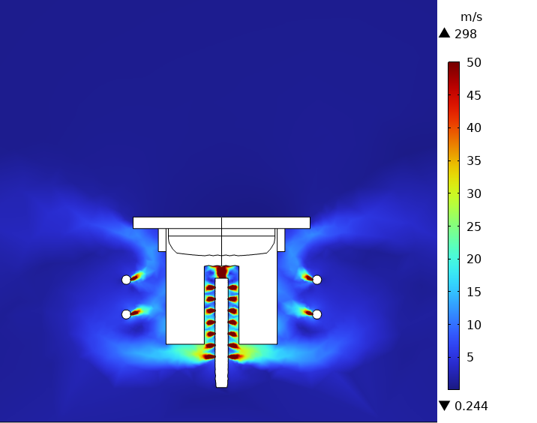
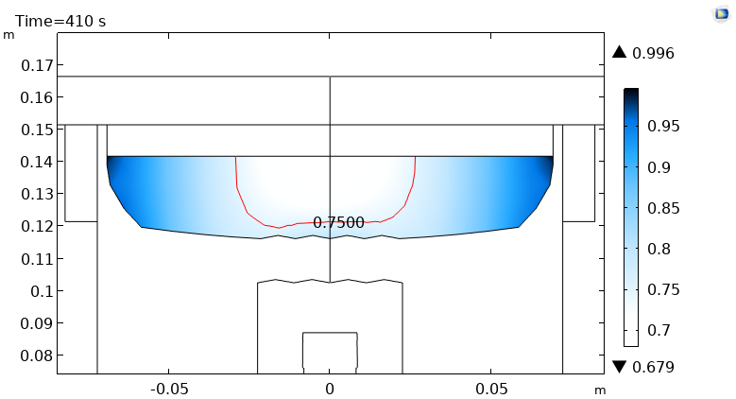
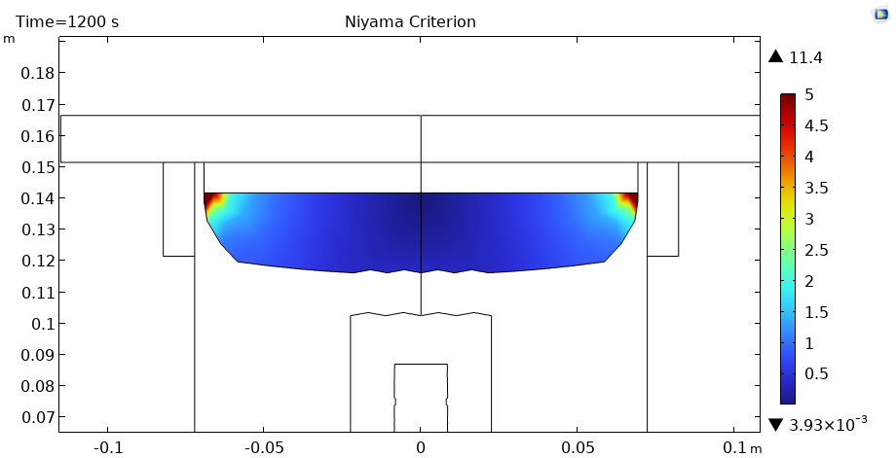
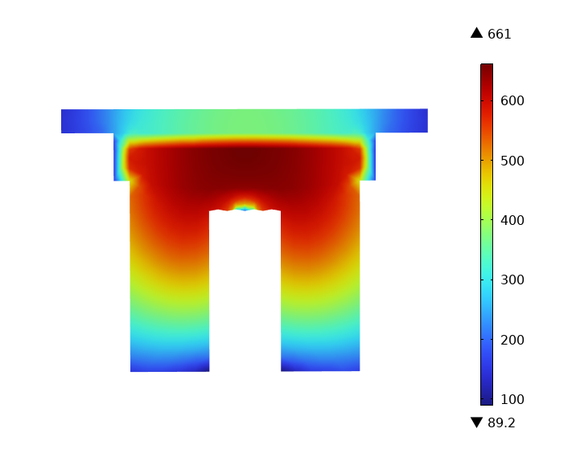
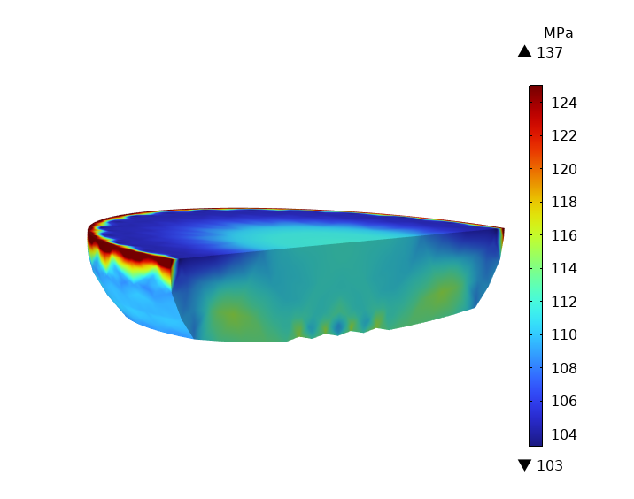
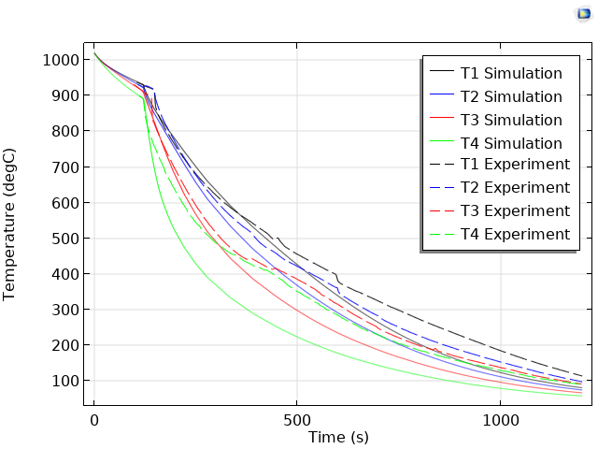
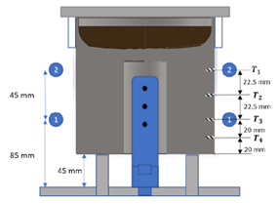
Results

Slide 5
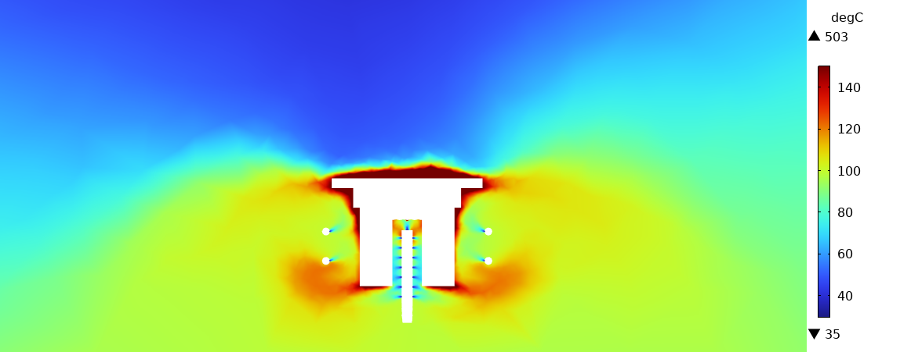
Conclusions
COMSOL Multiphysics
Right tool for the simulation of the cooling process :
- Easy setup of the material user data
- Easy setup to couple physics
- Efficient postprocessing tools
Simulation Results
The model we made gives coherent results in comparison with experiments. However, experiments were made in situ in the factory under real production conditions. This makes the comparisons more difficult because the factory environment cannot be fully controlled.
Impact of Simulation Results
- Validation of the current process
- Sensitivity on cooling air flow (stability)
- Effect of the oxydation of the steel
- Potential effect of steel plastic residual déformations
- Design of an improved cooling system

