Slide 1
Numerical Modeling of Phononic Crystal-based Ventilated Noise Barrier for Traffic Noise Attenuation
Noman Ahsan, Luca Sangiuliano, Luca D'Alessandro, Paul Charkaluk, Matteo Selvatici, Paulo Amado-Mendes, Luís Manuel C. Godinho
COMSOL Conference 2024 Florence
October 22–24
Florence Teatro del Maggio Musicale Fiorentino, Florence, Italy

Slide 2
1
Introduction
2
Objective and Modeling
3
Stopband Analysis on Unit Cell
4
Sound Transmission Loss Analysis on semi-infinite extended barriers
5
Sound Transmission Loss Analysis on finite height barrier
6
Summary and Next Steps

Slide 3
1
Introduction
2
Objective and modeling
3
Stopband Analysis on Unit Cell
4
Sound Transmission Loss Analysis on semi-infinite extended barriers
5
Sound Transmission Loss Analysis on finite height barrier
6
Summary and next steps

Slide 4
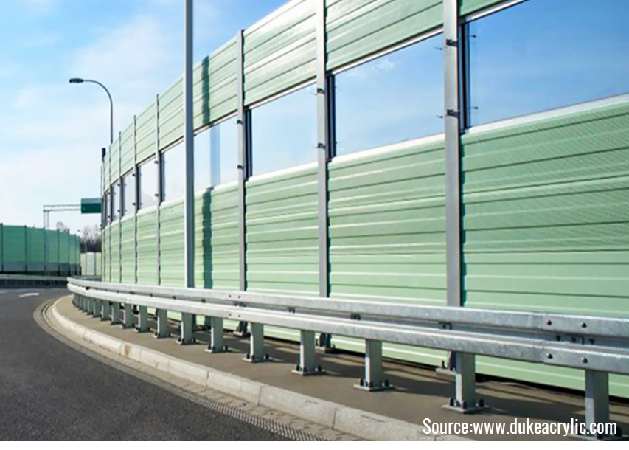
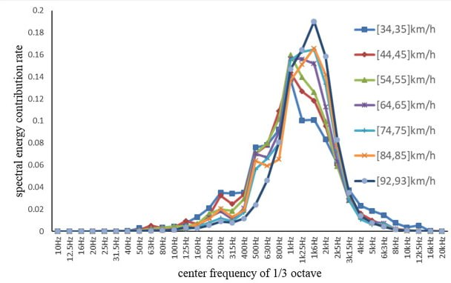
Noise Pollution and Current Mitigation Strategies
Heavy traffic, constant noise, discomfort
Stress, hearing impairment, ecosystem imbalance,
Barriers placed to reduce noise propagation
Tall structures, absorb, reflect, and deflect sound
Concrete, glass, steel, materials used
Sound block Barrier [1]
Road traffic Noise Spectrum [2]

Slide 5
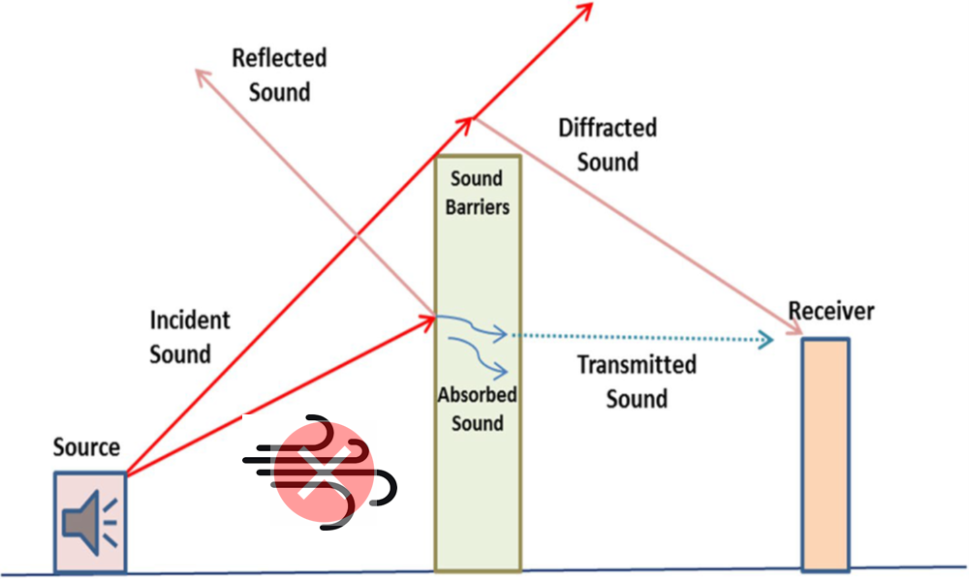
Problem Statement
Limit noise barrier height to 2-3m due to high wind load
High wind load leads to high rotational loads
Blocks airflow and affect ventilation
Prevents wind deflection, creating a high-pressure zone
Bulky design adds to structural constraints and high visual impact on the landscape
More material utilized due to high effective area
Schematics showing how these barriers have constraints [3]

Slide 6

Possible Innovative Solution:
Metamaterial Ventilated Barriers
Acoustic Metamaterials for sound Insulation/Sound Transmission Loss (STL)
Utilize periodic structures to manipulate sound waves
Structure consists of regularly spaced unit cells
Designed to control sound transmission or achieve sound insulation
Manipulates wave behavior through scattering, interference, resonance, and absorption
Effective for achieving specific frequency ranges of sound insulation
Less material utilized and sustainable
Other types
Periodic Structures
(a) 1-D sonic crystal consisting of periodically arranged plates; (b) 2D sonic crystal with cylinders arranged in a square array; (c) 3D sonic crystal consisting of a periodic arrangement of spheres in a cubic arrangement [4].

Slide 7
1
Introduction
2
Objective and modeling
3
Stopband Analysis on Unit Cell
4
Sound Transmission Loss Analysis on semi-infinite extended barriers
5
Sound Transmission Loss Analysis on finite height barrier
6
Summary and next steps

Slide 8
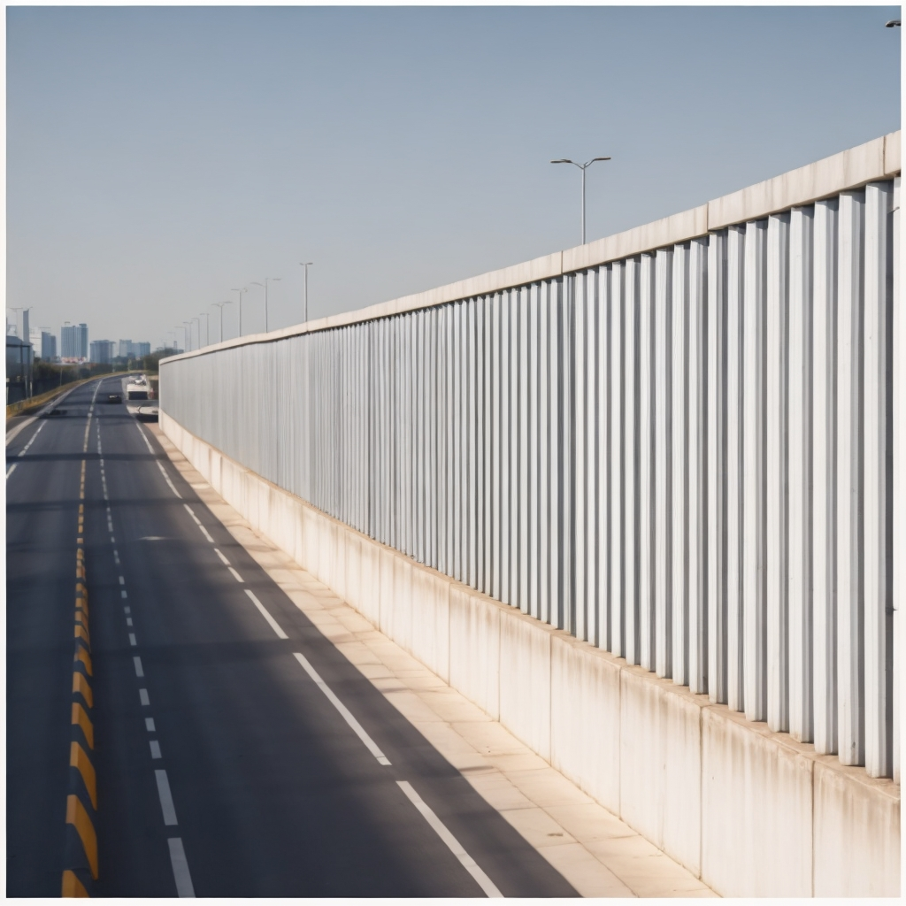
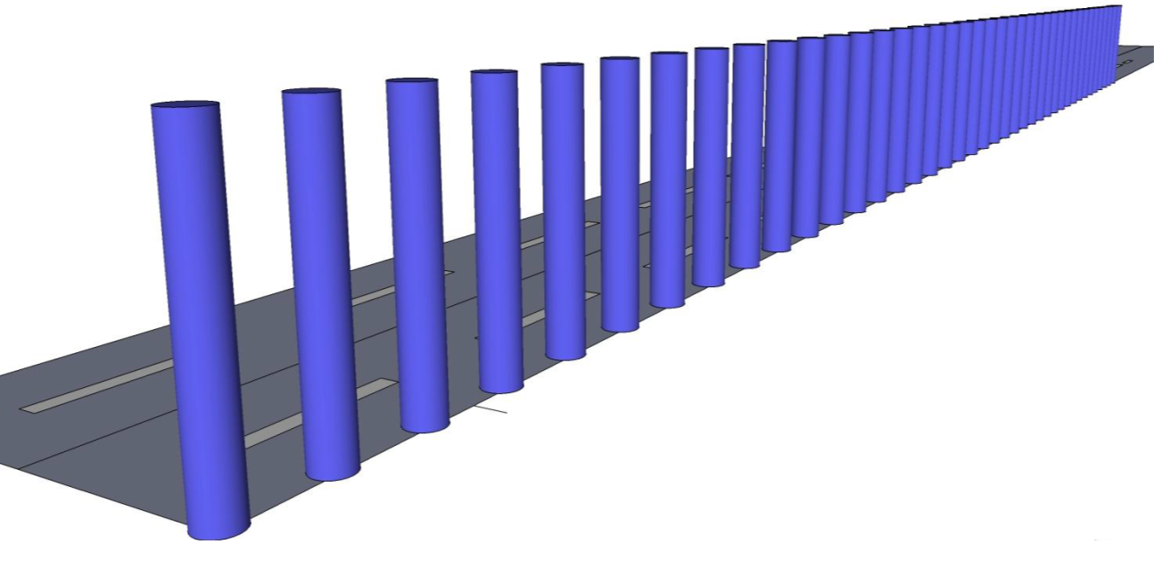
Objectives of the current study
Target traffic noise with a ventilated metamaterial barrier
Propose design guidelines for metamaterial ventilated barrier
Investigate the Sound Transmission Loss (STL) for idealized and in-situ conditions
Compare Unit Cell (UC) infinite modeling to finite size modeling
Investigate the effect of geometrical parameters, incident angles, and the number of UCs
Provide a baseline for future studies in numerical modeling and design of Metamaterial Ventilated Barriers

Slide 9
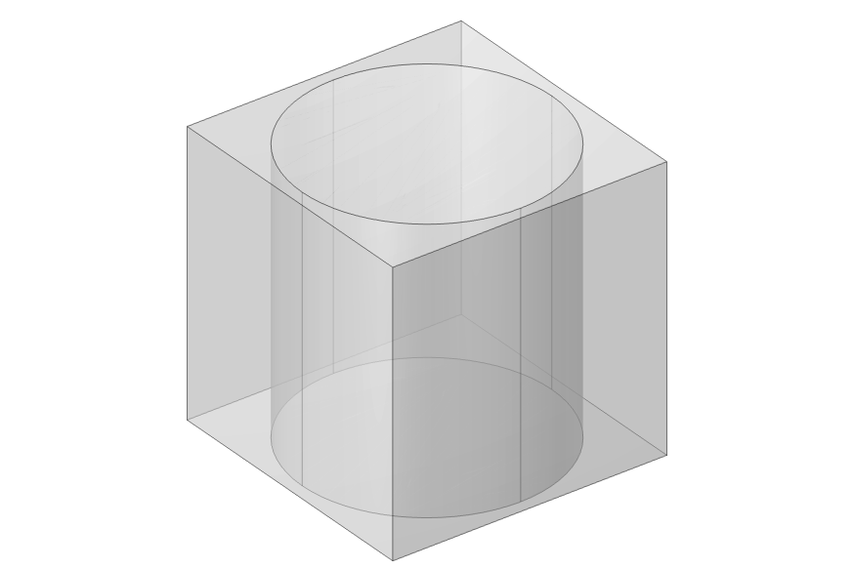
Methodology
Multiple noise barriers placed vertically with spacing for airflow
Stopband frequency determined by barrier parameters
Proposed unit cell design and numerical model
Utilizes Pressure Acoustics in the frequency domain
Narrow region acoustics modeled for accuracy
Considerations include barrier diameter, gap, and height
Modeled as plane wave incidence and diffuse field conditions
Transmittance Plane
Periodic Boundary Conditions
PML
Background Pressure
Rear Air Domain
PML
y
θ
Wave
x
Periodic Boundary Conditions
z
Sound Hard Boundary

Slide 10
1
Introduction
2
Objective and modeling
3
Stopband Analysis on Unit Cell
4
Sound Transmission Loss Analysis on semi-infinite extended barriers
5
Sound Transmission Loss Analysis on finite height barrier
6
Summary and next steps

Slide 11
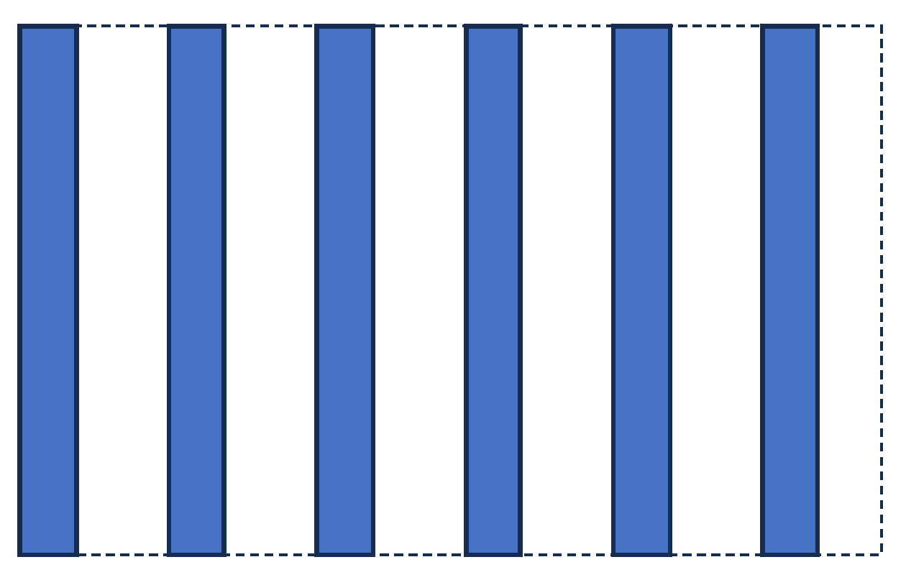
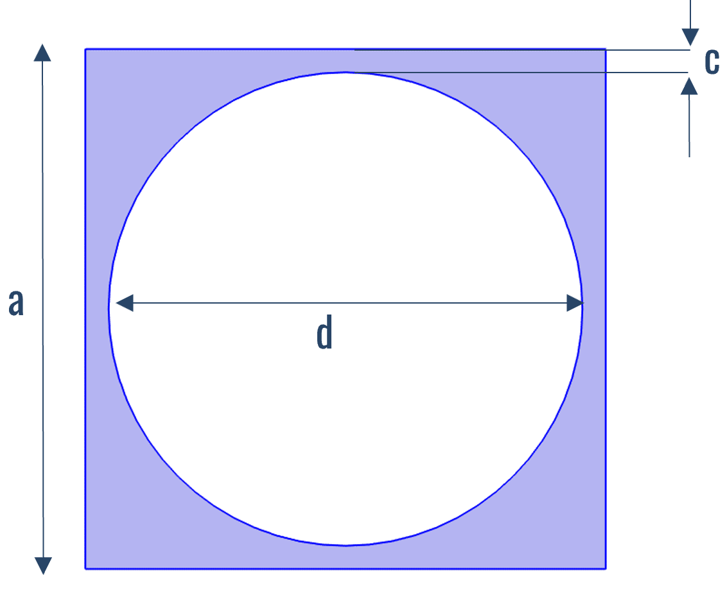
Proposed UC Model and Analyses
Unit Cell design proposed for barrier representation
Model integrates pressure acoustics and narrow region acoustics
Considered thermo-viscous losses
Model sound wave-barrier interaction, considering geometry and periodicity
Analysis conducted to assess unit cell performance and validate model:
    Stopband Analysis of Unit Cell
    Parametric Analysis for spacing order of Unit Cells
    Parametric analysis for geometric variations
    Infinite Unit Cell Modeling (Idealised Conditions)
    Finite Unit Cell Modeling (in-situ Conditions)
Gap
Diameter
Height
Top View of Unit Cell
Front View
∞
∞
∞
∞

Slide 12
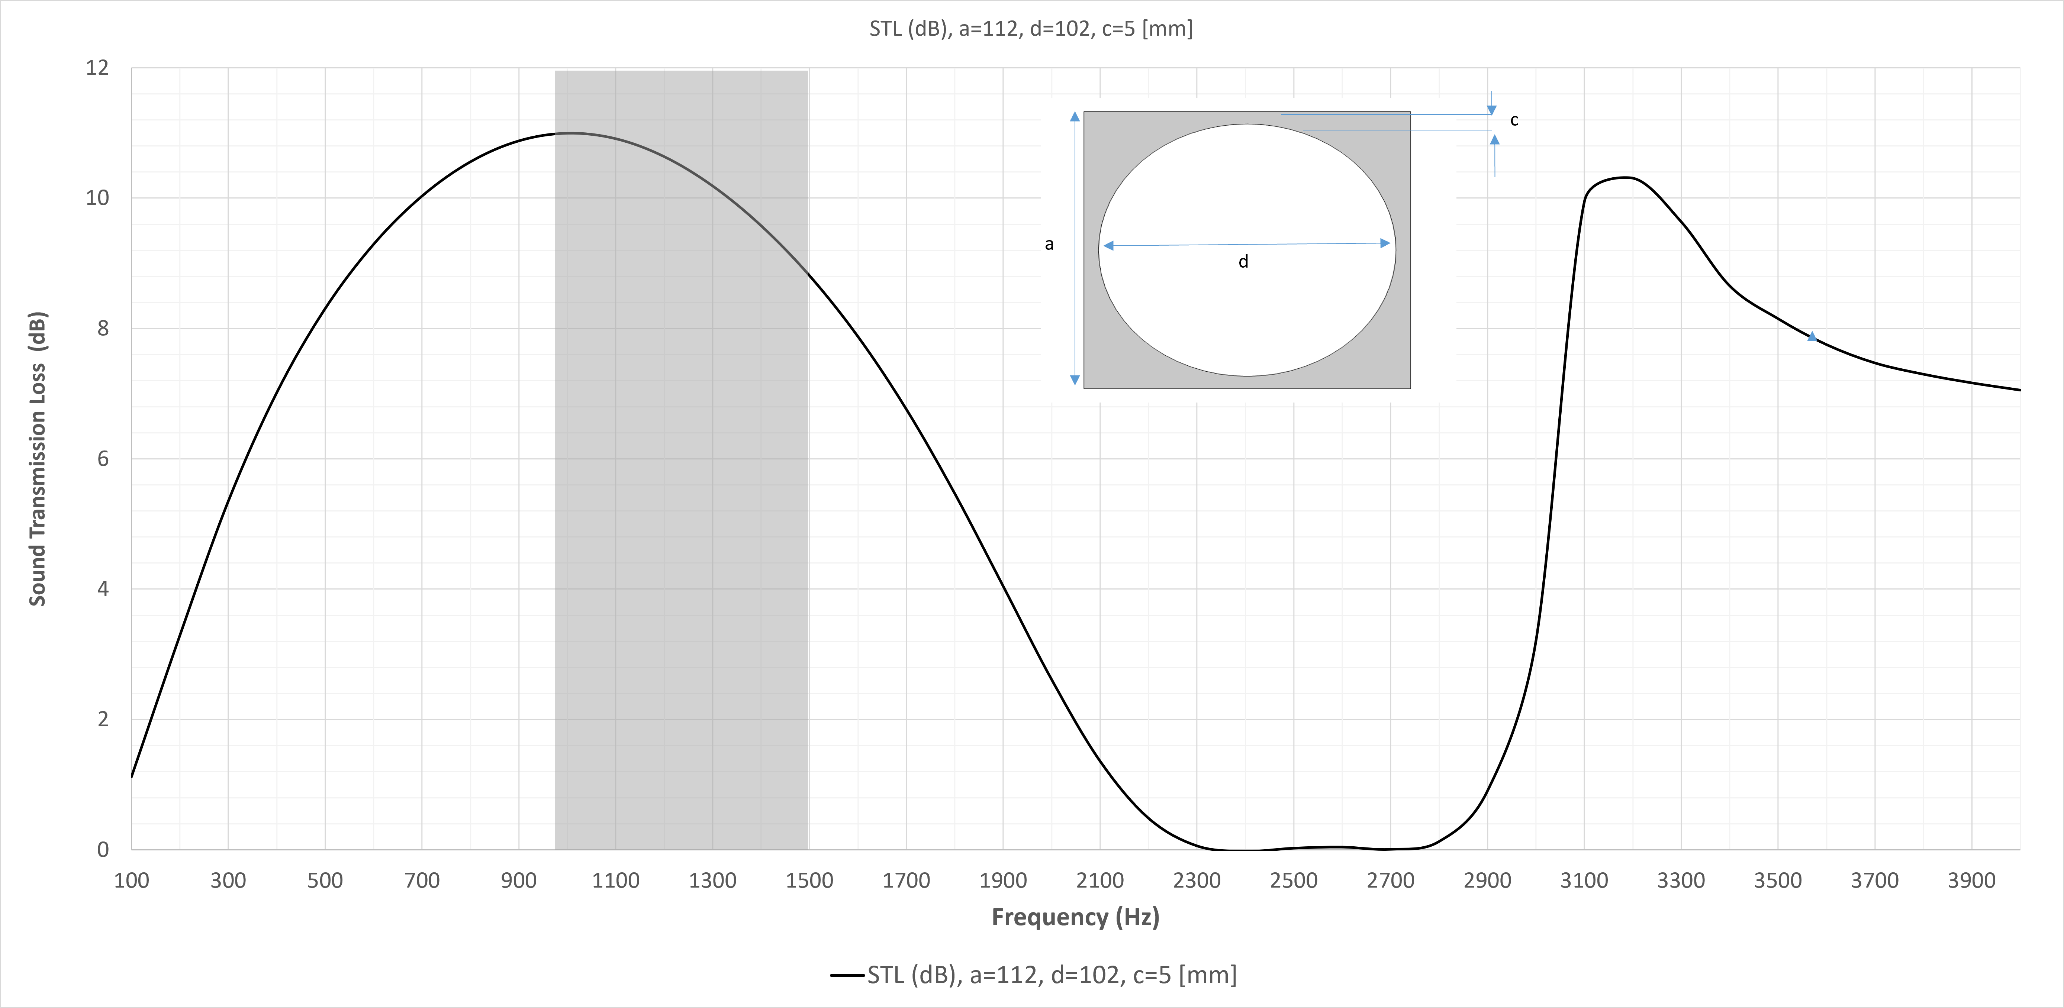
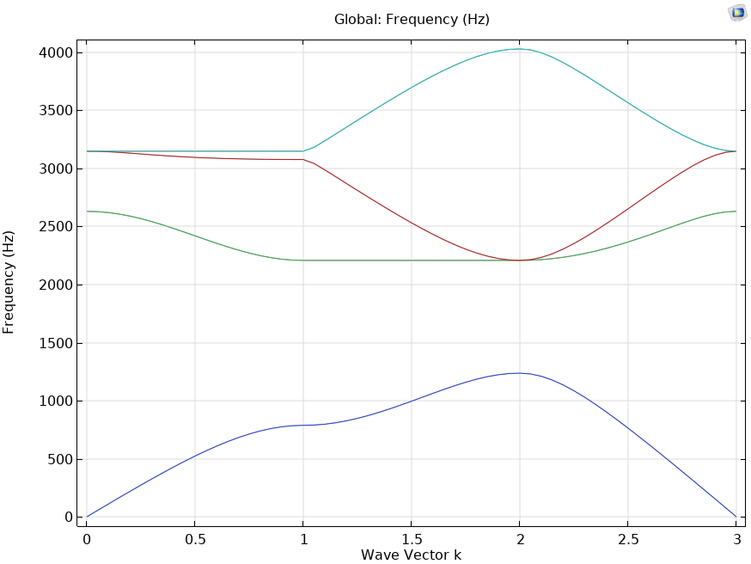
Stopband Analysis of Unit Cell
∞
The stopband frequency range of 1250-2200 Hz
Corresponds closely to the frequencies of the traffic noise spectrum
By targeting this frequency range, the barrier can efficiently attenuate the most noise sources.
∞
∞
∞
Frequency (Hz)
Wave Vector (k)
Complete Stopband 1250 – 2200 Hz
Road traffic Noise Spectrum [2]

Slide 13
1
Introduction
2
Objective and modeling
3
Stopband Analysis on Unit Cell
4
Sound Transmission Loss Analysis on semi-infinite extended barriers
5
Sound Transmission Loss Analysis on finite height barrier
6
Summary and next steps

Slide 14
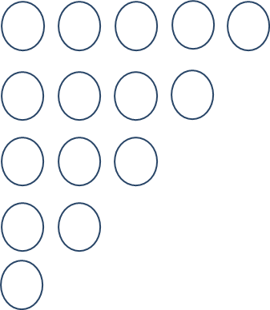
Sensitivity Analysis: Number of Unit Cells
∞
Incoming Wave
5UC
4UC
3UC
4UC
1UC
Different Scales
∞
Barriers extend infinitely vertically and perpendicular to wave propagation
Evaluated the effect of varying unit cell numbers along wave direction
Reduction of unit cells impact sound attenuation due to less scattering.
Spacing order coincidence with wavelength affects frequency shift and creates conditions for constructive interference (Braggs Effect).

Slide 15
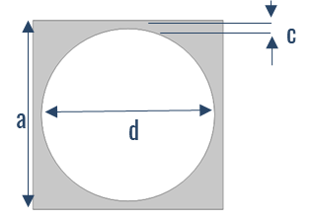
Geometric Analysis of Unit Cell
Incoming Wave
∞
1UC
∞
Parametric analysis varies gap (c) and barrier diameter (d) for STL influence.
Increasing unit cell diameter enhances STL but reduces ventilation.
Wider gaps compromise noise mitigation but improve ventilation.
Sensitivity analysis explores barrier diameter and gap effects on stopband.
This relationship validates the barrier's ability to block specific frequencies.
Despite STL values, getting a peak within the same stopband frequency range.
Identify design configurations that maximize noise reduction effectiveness.
Unit Cell Symmetry and Homogeneity

Slide 16
1
Introduction
2
Objective and modeling
3
Stopband Analysis on Unit Cell
4
Sound Transmission Loss Analysis on semi-infinite extended barriers
5
Sound Transmission Loss Analysis on finite height barrier
6
Summary and next steps

Slide 17
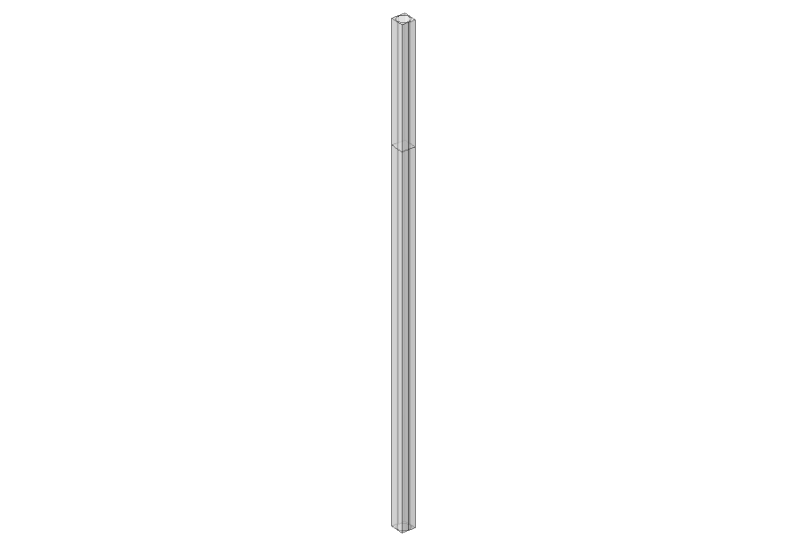
Semi-Infinite and Finite Unit Cell Modeling
∞
Infinite Unit Cell
Incoming Wave
Transmitted Wave
Infinite Unit Cell
∞
∞
∞
Finite Unit Cell
Finite height Unit Cell
Incoming Wave
Transmitted Wave
4m
∞

Slide 18
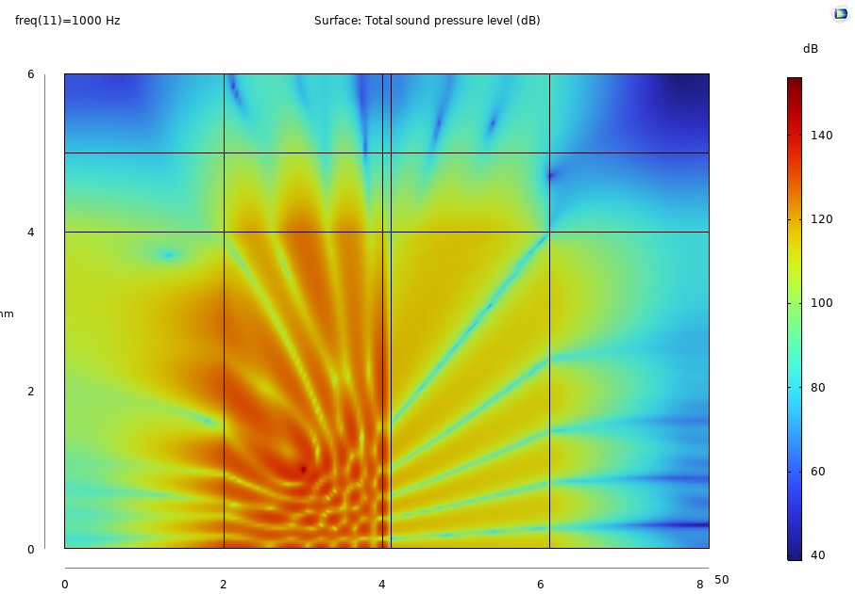
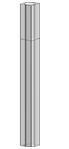
Results Comparison
In plane-wave behavior, finite barrier height influences acoustic behavior, and STL decreases.
Idealized conditions provide maximum potential for noise attenuation.
In the diffuse field, infinite UC got STL Peak at 1600 Hz and finite Unit Cell at 800 Hz.
Wave Bypassing and Diffraction around finite height barrier cause STL reduction.
These results give theoretical and practical insights into noise barrier effectiveness evaluation.
Sound Pressure Level at 1000 Hz

Slide 19
1
Introduction
2
Objective and modeling
3
Stopband Analysis on Unit Cell
4
Sound Transmission Loss Analysis on semi-infinite extended barriers
5
Sound Transmission Loss Analysis on finite height barrier
6
Summary and next steps

Slide 20
Summary and Next Steps
In this work, our research attention was focused on:
    Preliminary design baseline of a Ventilated Barrier
    Mitigating mid-range frequency traffic noises in 1000–2500 Hz
    Providing numerical guidelines to assess sound insulation of noise barriers
Model shows the behavior of unit cells under different boundary conditions
STL computed for both idealized conditions and in-situ and results validating the model.
Will investigate adjustments to the unit cell design to target broader or more specific frequency ranges.
Will analyze airflow and ventilation effectiveness to strike the best balance between noise reduction and air circulation.
Will extend to model sandwiched barriers, Helmholtz structures, Helmholtz resonators, or square and rectangular shape barriers.

Slide 22
Aknowledgement
We gratefully acknowledge the European Commission for its support of the Marie Sklodowska Curie program through the Horizon Europe DN METAVISION project (GA 101072415)
Bibliography
www.dukeacrylic.com
Arpan Gupta, “A Review on Sonic Crystal, Its Applications and Numerical Analysis Techniques,” Physical Foundations of Engineering Acoustics, V60, 2014, P 223-234
Laxmi, Vijaya, Chaitanya Thakre, and Ritesh Vijay. "Evaluation of noise barriers based on geometries and materials: a review." Environmental Science and Pollution Research (2022): 1-17.
Yang, Weijun et al. "The calculation of road traffic noise spectrum based on the noise spectral characteristics of single vehicles." Applied Acoustics 160 (2020)

