Slide 1


A numerical model for the unified analysis of soil sedimentation-consolidation phenomena
F. Cecinato¹, G. Della Vecchia²
1. Dipartimento di Scienze della Terra “A. Desio”, Università degli Studi di Milano, Italy.
2. Dipartimento di Ingegneria Civile e Ambientale, Politecnico di Milano, Italy.

Slide 2
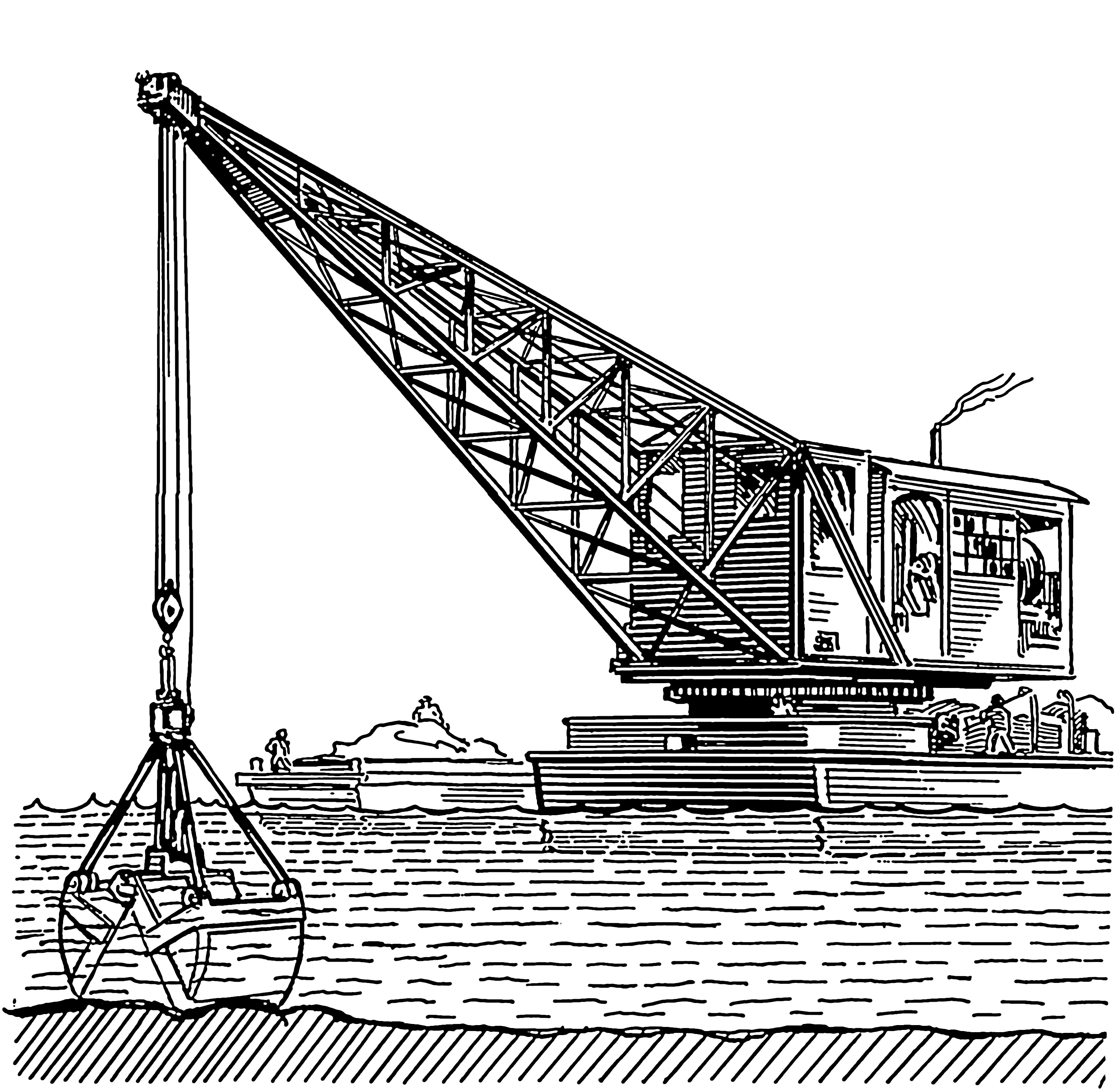
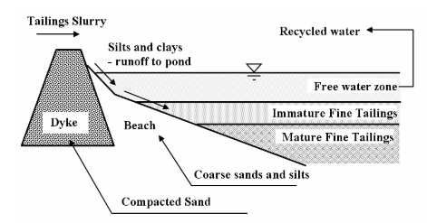
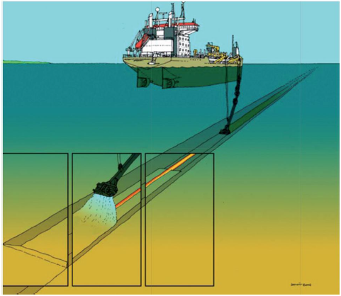
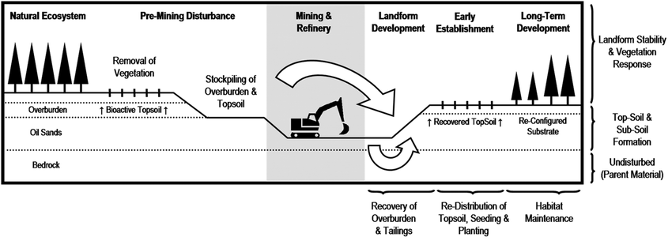
Relevant engineering applications
Dredging
Oil sand tailings
(Jeeravipoolvarn, 2010)
Land reclamation
Submarine pipeline trench backfilling
(Stijn Biemans 2012)
(Audet et al. 2015)
Notes:
To start off, here is an overview of some relevant engineering applications of our model
Land reclamation as an efficient method for re-using dredged materials.
Relevant also for oil sand tailings, but in general for fine tailings from the mining industry, and understanding the timing and volumes involved is key to efficient design
Pipeline backfilling tyipically involves sand instead of clay, but understanding how sand settles is key to designing pipeline installation
All these problems involve both physical processes of sedimentation and consolidation. But what are they?

Slide 3
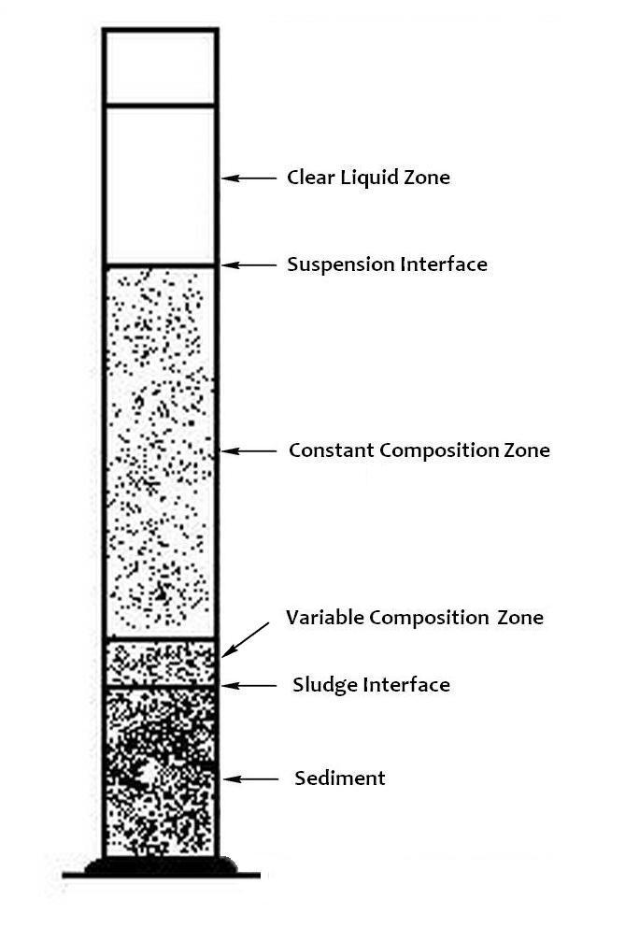
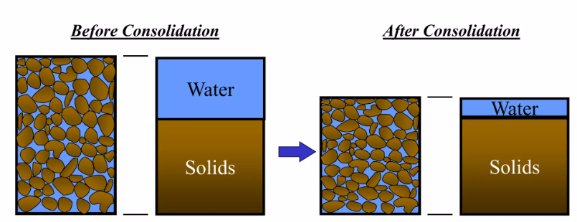
(1) Sedimentation & (2) Consolidation
Deposition of solid material from a fluid from a state of suspension
  «Fluid» state
  Absence of interparticle force chains
Gradual volume reduction in saturated soil due to pore fluid drainage
  «Solid» state
  Formed sediment network structure able to carry its own weight
Irfan (2016)
Notes:
Interrelated processes occurring successively

Slide 4
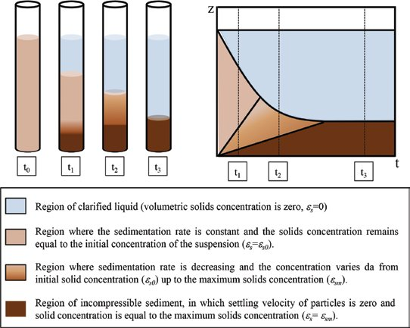
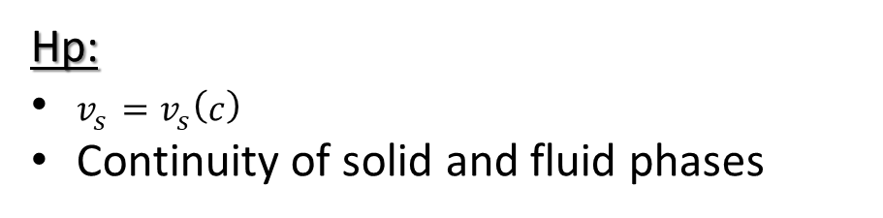
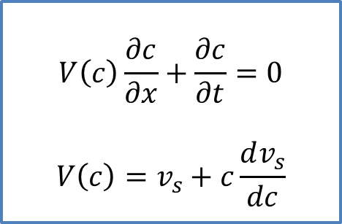
(1) Kynch’s theory of sedimentation
Hp:
$v_{s}=v_{s}\left(c\right)$
Continuity of solid and fluid phases
$$V\left(c\right)\frac{∂c}{∂x}+\frac{∂c}{∂t}=0$$
$$V\left(c\right)=v_{s}+c\frac{dv_{s}}{dc}$$
Eulerian coordinate formulation
c = solid mass per unit volume
Hindered settling equation
(Kynch 1951)
Notes:
To model sedimentation we referred to Kynch’s hindered settling theory for sedimentation
based on the continuity equation and the assumption that at any point in the suspension the velocity of fall of a particle vs depends only on the local concentration of particles c
The analytical solution with method of characteristics is illustrated on the RHS: typical 1D situation starting from a uniform concentration suspension and then settling over time defining different zones of: clear liquid, constant and variable concentration, and solid sediment.

Slide 5
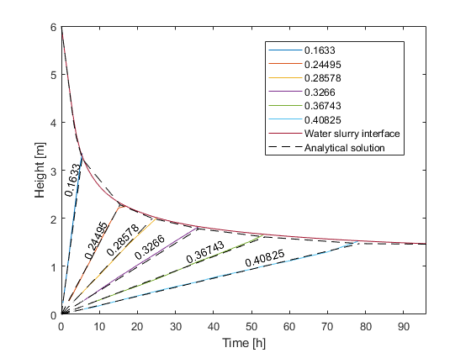
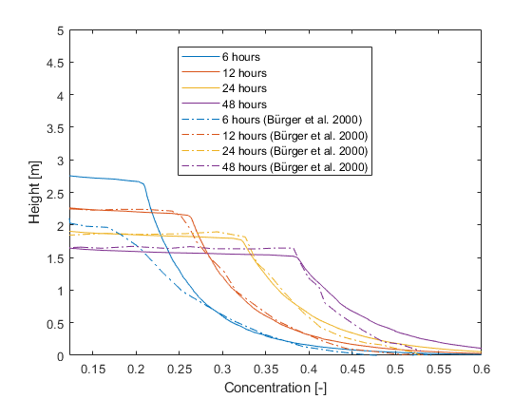
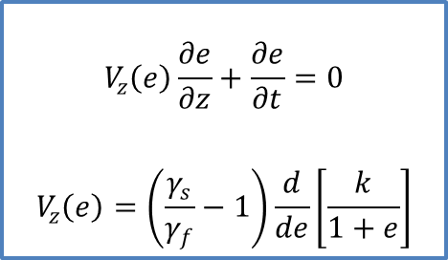
Kynch’s theory numerical implementation
Comsol implementation in Lagrangian coordinate
Comparison with analytical and numerical solutions from literature
$$V_{z}\left(e\right)\frac{∂e}{∂z}+\frac{∂e}{∂t}=0$$
$$V_{z}\left(e\right)=\left(\frac{γ_{s}}{γ_{f}}−1\right)\frac{d}{de}\left[\frac{k}{1+e}\right]$$
Comparison with analytical solution (characteristics)
Evolution of solid-liquid interface position & constant concentration lines
Comparison with numerical solution of Bürger et al. (2000)
Notes:
Rewritten in Lagrangian coordinates and implemented using “stabilized convection-diffusion equation” interface
The solution provides (left) the evolution of solid-clear liquid interface and lines of constant concentration over space and time
In terms of evolution of concentration vs height of the suspension at different times, we can see our predictions in comparison with a literature solution on the RHS

Slide 6
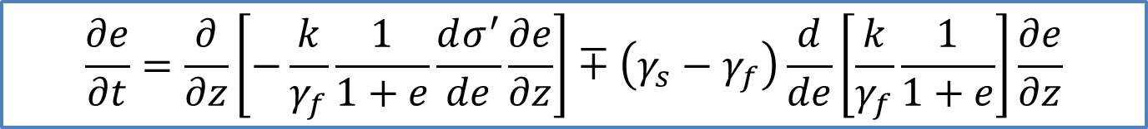
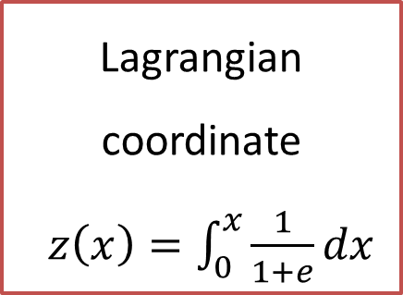
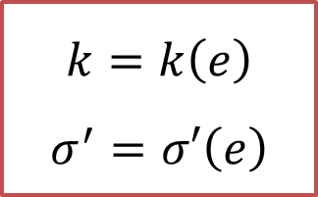
(2) Large strain 1D consolidation theory
Gibson et al. (1967)
Lagrangian coordinate
$z\left(x\right)=\int_{0}^{x}{\frac{1}{1+e}dx}$
Continuity equation for solid and fluid phases
Darcy’s law
$$k=k\left(e\right)$$
$$σ^{′}=σ′\left(e\right)$$
$$\frac{∂e}{∂t}=\frac{∂}{∂z}\left[−\frac{k}{γ_{f}}\frac{1}{1+e}\frac{dσ^{′}}{de}\frac{∂e}{∂z}\right]∓\left(γ_{s}−γ_{f}\right)\frac{d}{de}\left[\frac{k}{γ_{f}}\frac{1}{1+e}\right]\frac{∂e}{∂z}$$
Notes:
Our modelling aim was to join the theories of consolidation and settling, so we started on the one hand from large strain consolidation theory…
The Lagrangian coordinate $z$, defining the thickness of an element of solid material, is related to Eulerian coordinate x as shown.
Lagrangian coordinate z representing the thickness of the solids in the considered suspension layer, automatically satisfying the solids continuity
We come up with the PDE here reported, that was implemented in COMSOL Multiphysics

Slide 7
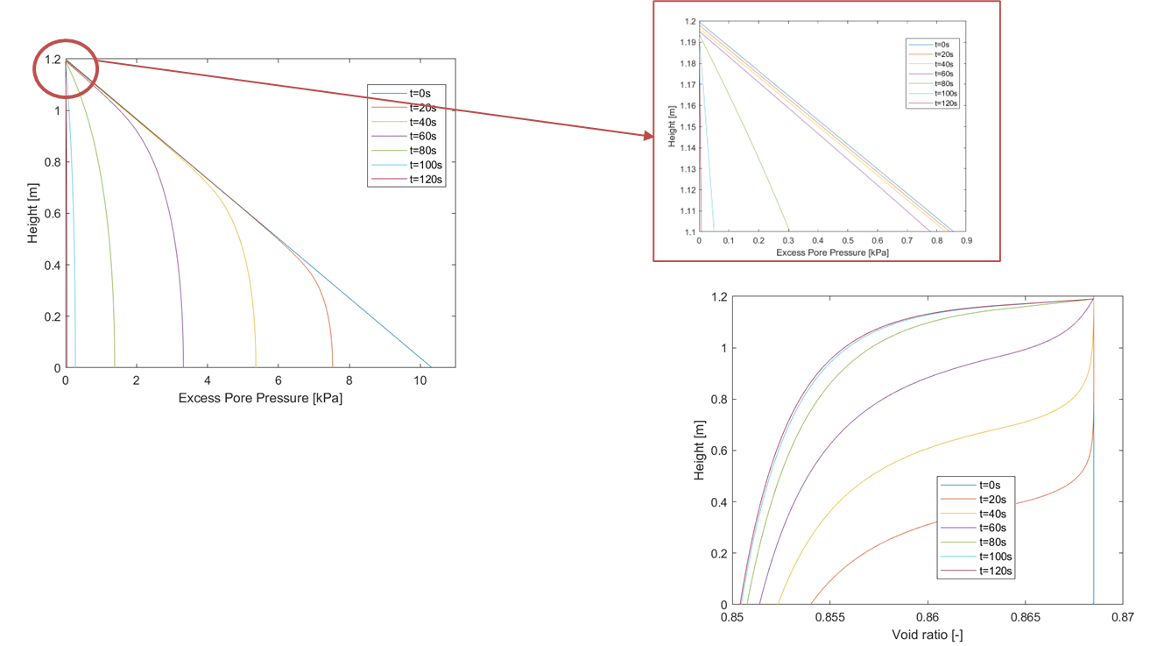
Large strain consolidation numerical implementation
Layer compression over time
Excess pore pressure isochrones
Eulerian coordinate
Void ratio isochrones
Eulerian coordinate
Notes:
Implemented using “coefficient form PDE” interface and validated yielding reasonable results

Slide 8
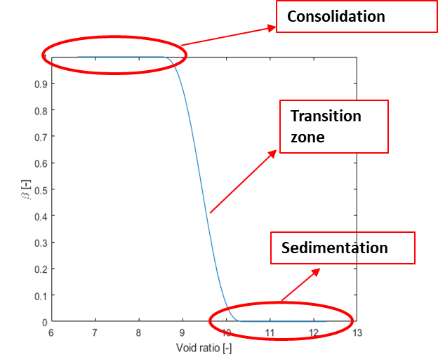

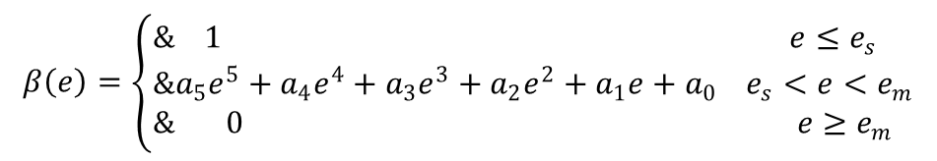
Sedimentation+consolidation:
Interaction coefficient
More general form of effective stress principle via interaction coefficient β(e)
$$σ^{′}=β\left(e\right)(σ−u)$$
Used to model transition between sedimentation and consolidation
Defined via step function
$$β\left(e\right)=\left\{\begin{aligned}& 1 e≤e_{s} \\ &a_{5}e^{5}+a_{4}e^{4}+a_{3}e^{3}+a_{2}e^{2}+a_{1}e+a_{0} e_{s}<e<e_{m} \\ & 0 e≥e_{m}\end{aligned}\right.$$
Step Function in COMSOL Multiphysics
Notes:
Now, to capture processes involving sedimentation and consolidation we adopted an interaction coefficient describing the transition between a fluid state and a solid state.
The coefficient acts on Terzaghi’s effective stress by activating a portion of it during the transition between the two processes

Slide 9
Sedimentation+consolidation
Governing equation
(Pane & Schiffman 1985)
$\frac{∂e}{∂t}=∓\left(\frac{γ_{s}}{γ_{f}}−1\right)\frac{d}{de}\left(\frac{k}{1+e}\right)\frac{∂e}{∂z}+\frac{∂}{∂z}\left[−\frac{k}{γ_{f}\left(1+e\right)}β\left(e\right)\frac{dσ^{′}}{de}\frac{∂e}{∂z}\right]+\frac{∂}{∂z}\left[−\frac{k}{γ_{f}(1+e)}\frac{dβ(e)}{de}σ^{′}\frac{∂e}{∂z}\right]$
Notes:
So the full governing equation joining the two processes is this one.

Slide 10
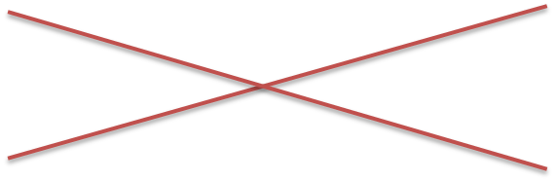
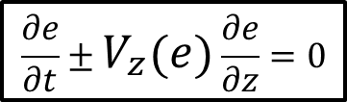
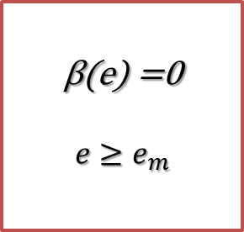
Sedimentation+consolidation
Governing equation
(Pane & Schiffman 1985)
$\frac{∂e}{∂t}=∓\left(\frac{γ_{s}}{γ_{f}}−1\right)\frac{d}{de}\left(\frac{k}{1+e}\right)\frac{∂e}{∂z}+\frac{∂}{∂z}\left[−\frac{k}{γ_{f}\left(1+e\right)}β\left(e\right)\frac{dσ^{′}}{de}\frac{∂e}{∂z}\right]+\frac{∂}{∂z}\left[−\frac{k}{γ_{f}(1+e)}\frac{dβ(e)}{de}σ^{′}\frac{∂e}{∂z}\right]$
Kynch’s equation
β(e) =0
$$e≥e_{m}$$
$$\frac{∂e}{∂t}±V_{z}\left(e\right)\frac{∂e}{∂z}=0$$
Notes:
When beta=0 we recover Kynch equation

Slide 11
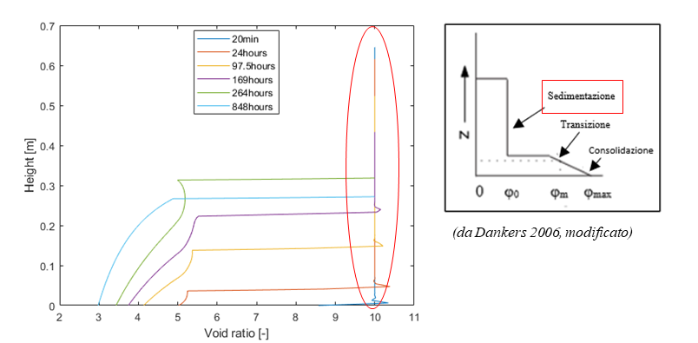
Sedimentation+consolidation
Governing equation
(Pane & Schiffman 1985)
$\frac{∂e}{∂t}=∓\left(\frac{γ_{s}}{γ_{f}}−1\right)\frac{d}{de}\left(\frac{k}{1+e}\right)\frac{∂e}{∂z}+\frac{∂}{∂z}\left[−\frac{k}{γ_{f}\left(1+e\right)}β\left(e\right)\frac{dσ^{′}}{de}\frac{∂e}{∂z}\right]+\frac{∂}{∂z}\left[−\frac{k}{γ_{f}(1+e)}\frac{dβ(e)}{de}σ^{′}\frac{∂e}{∂z}\right]$
β(e) =0
$$e≥e_{m}$$
Notes:
This describes the pure sedimentation phase as shown in the simulation on the RHS

Slide 12
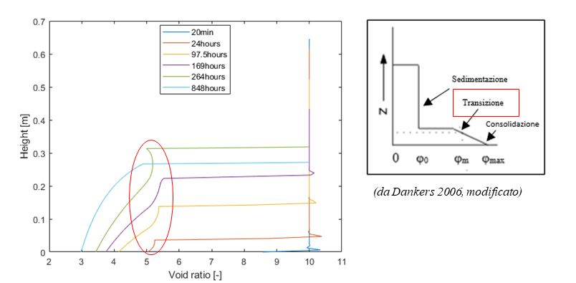
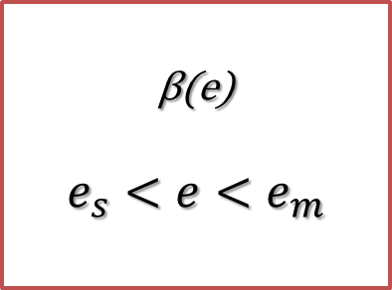
Sedimentation+consolidation
Governing equation
(Pane & Schiffman 1985)
$\frac{∂e}{∂t}=∓\left(\frac{γ_{s}}{γ_{f}}−1\right)\frac{d}{de}\left(\frac{k}{1+e}\right)\frac{∂e}{∂z}+\frac{∂}{∂z}\left[−\frac{k}{γ_{f}\left(1+e\right)}β\left(e\right)\frac{dσ^{′}}{de}\frac{∂e}{∂z}\right]+\frac{∂}{∂z}\left[−\frac{k}{γ_{f}(1+e)}\frac{dβ(e)}{de}σ^{′}\frac{∂e}{∂z}\right]$
β(e)
$$e_{s}<e<e_{m}$$
Notes:
With beta between 0 and 1 we are in the transition phase as shown in the simulation on the RHS

Slide 13
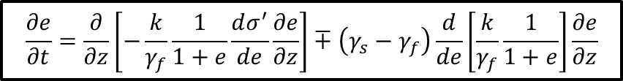
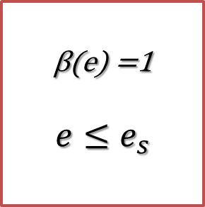
Sedimentation+consolidation
Governing equation
(Pane & Schiffman 1985)
$\frac{∂e}{∂t}=∓\left(\frac{γ_{s}}{γ_{f}}−1\right)\frac{d}{de}\left(\frac{k}{1+e}\right)\frac{∂e}{∂z}+\frac{∂}{∂z}\left[−\frac{k}{γ_{f}\left(1+e\right)}β\left(e\right)\frac{dσ^{′}}{de}\frac{∂e}{∂z}\right]+\frac{∂}{∂z}\left[−\frac{k}{γ_{f}(1+e)}\frac{dβ(e)}{de}σ^{′}\frac{∂e}{∂z}\right]$
Consolidation
Gibson equation
β(e) =1
$$e≤e_{s}$$
$$\frac{∂e}{∂t}=\frac{∂}{∂z}\left[−\frac{k}{γ_{f}}\frac{1}{1+e}\frac{dσ^{′}}{de}\frac{∂e}{∂z}\right]∓\left(γ_{s}−γ_{f}\right)\frac{d}{de}\left[\frac{k}{γ_{f}}\frac{1}{1+e}\right]\frac{∂e}{∂z}$$
Notes:
With beta =1 we recover Gibson’s equation

Slide 14
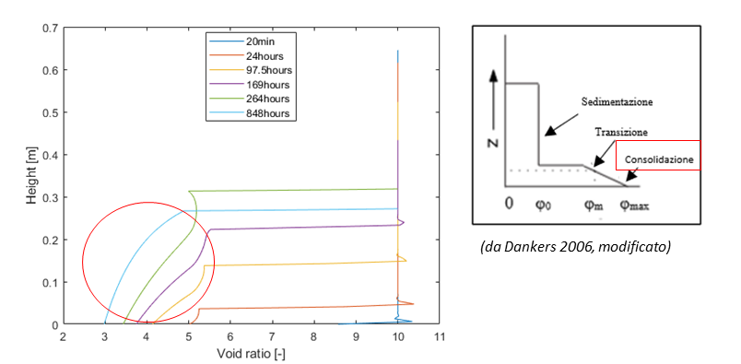
Sedimentation+consolidation
Governing equation
(Pane & Schiffman 1985)
$\frac{∂e}{∂t}=∓\left(\frac{γ_{s}}{γ_{f}}−1\right)\frac{d}{de}\left(\frac{k}{1+e}\right)\frac{∂e}{∂z}+\frac{∂}{∂z}\left[−\frac{k}{γ_{f}\left(1+e\right)}β\left(e\right)\frac{dσ^{′}}{de}\frac{∂e}{∂z}\right]+\frac{∂}{∂z}\left[−\frac{k}{γ_{f}(1+e)}\frac{dβ(e)}{de}σ^{′}\frac{∂e}{∂z}\right]$
β(e) =1
$$e≤e_{s}$$
Notes:
And the material is a soil undergoing consolidation as shown in the simulation on the RHS

Slide 15
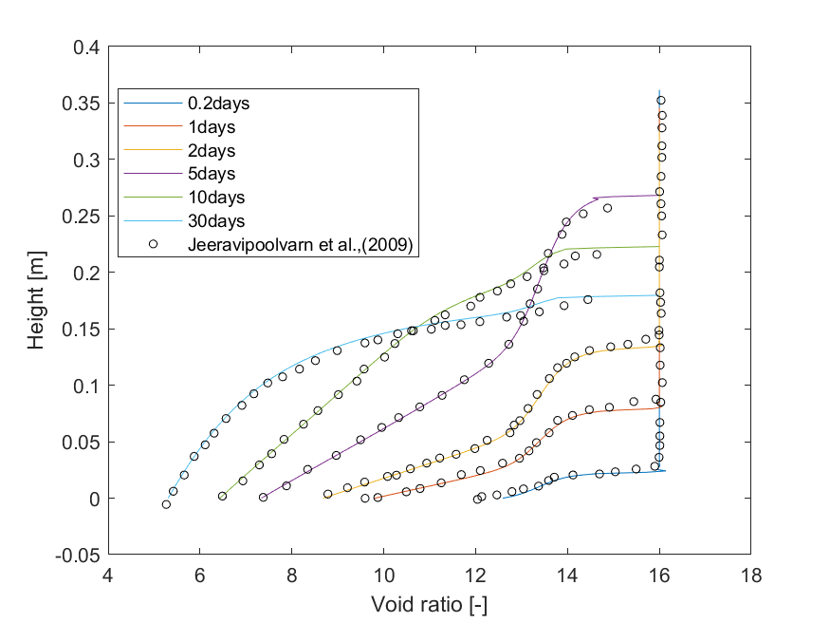

Validation of FE model
Validation against numerical solution (Jeeravipoolvarn 2009)
$$k=Ce^{D}$$
$$e=A{\left(σ^{′}\right)}^{B}$$
$$β=\left\{\begin{aligned}&\left(\frac{1}{E+Fe^{G}}\right), β>β_{t} \\ &β_{t}, β≤β_{t}\end{aligned}\right.$$
Notes:
The numerical model was first tested by comparison with an existing numerical solution, then it was validated by reproducing two different experimental datasets
Void ratio isochrones for a sedimentation-consolidation process involving a clayey soil
It can be observed that over time, a clear water–suspension interface settles and the suspension–soil interface builds from bottom up

Slide 16
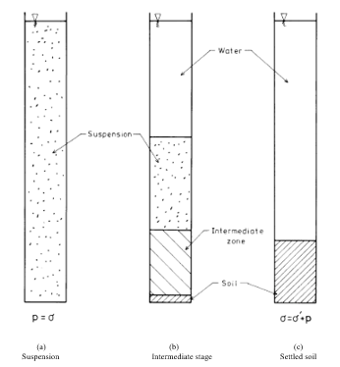
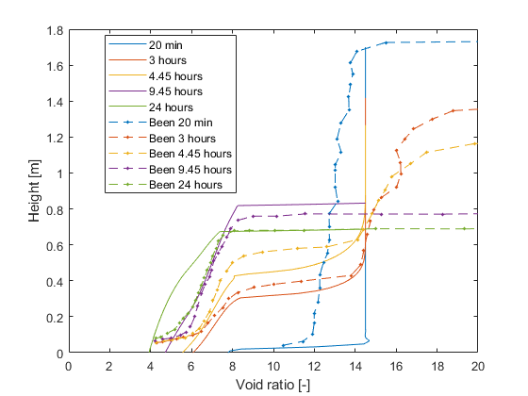
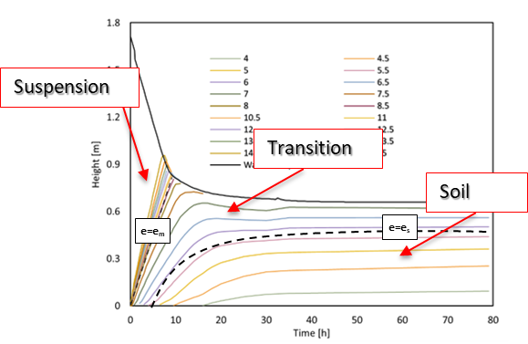
Validation against experimental data
Been 1980
Experiment 7
Notes:
The numerical model was first tested by comparison with an existing numerical solution, then it was validated by reproducing two different experimental datasets
Figure 3 and Figure 4 respectively show the void ratio isochrones and the fall of water-slurry interface curve together with iso-void ratio lines for Been’s experiment #7, involving both sedimentation, transition and consolidation phases

Slide 17
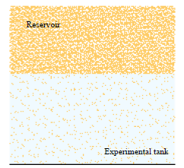
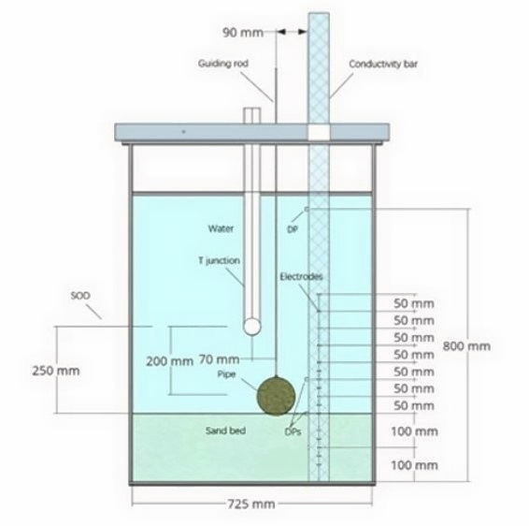
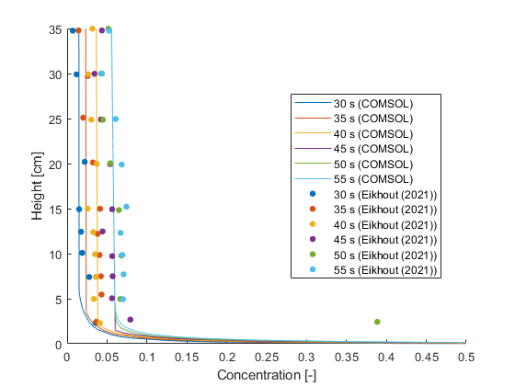
Validation against experimental data
Eikhout 2021
Dummy resevoir representation
Test 1
Notes:
Further model validation was provided by reproducing Eikhout’s [19] backfilling test in a pipe-sand interaction scaled physical model
These simulations, due to the mass inflow at the upper boundary, required the definition of a ‘dummy reservoir’
Figure 5 shows a comparison between simulated and experimentally measured concentration profiles of the sand-water suspension along depth at different times.
Calculation the concentration profile over space and time is essential for further force balance calculations assessing the interaction between the settling sand and the pipeline, with possible trigger of pipe flotation during backfilling.

Slide 18
Conclusions
The numerical model can simulate
  Large-strain consolidation
  Sedimentation
  Sedimentation-consolidation
Model validation against experimental data
  Simulation of sedimentation-consolidation processes involving clayey material
    Application to land reclamation problems
  Simulation of sedimentation due to inflow of sand suspension
    Application to underwater trench backfilling and pipeline-soil interaction problems
Notes:
Previous studies have provided limited detail on the numerical implementation of sedimentation-consolidation models. This work addresses this gap by demonstrating how to numerically implement such a model using COMSOL Multiphysics, a well-established and user-friendly software. This approach does not require advanced numerical expertise, making the model accessible to a broader range of users and facilitating its application in various scientific and engineering contexts, such as submarine pipeline trench backfilling and land reclamation.

Slide 19
THANK YOU FOR YOUR KIND ATTENTION

Slide 20


Large strain 1D consolidation theory
Gibson, England, Hussey (1967)
Hp Terzaghi theory:
Saturated and homogeneous soil
Incompressible solid & fluid
Small strains
Constant permeability and stiffness
Lagrangian coordinate
$z\left(x\right)=\int_{0}^{x}{\frac{1}{1+e}dx}$
$$k=k\left(e\right)$$
$$σ^{′}=σ′\left(e\right)$$
Notes:
Those of you who are familiar with civil and mining engineering might know the Terzaghi 1D consolidation theory, whose hp’s were…
However, we are focusing on a more general version of this theory, suitable for problems with appreciable void ratio and strain changes.

Slide 21
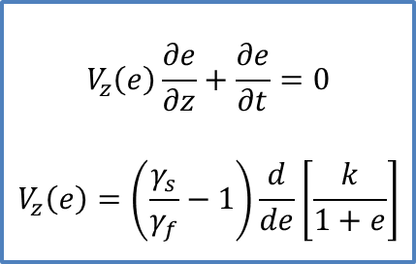
Kynch’s theory numerical implementation
Comsol implementation in Lagrangian coordinate
Comparison with analytical and numerical solutions from literature
$$V_{z}\left(e\right)\frac{∂e}{∂z}+\frac{∂e}{∂t}=0$$
$$V_{z}\left(e\right)=\left(\frac{γ_{s}}{γ_{f}}−1\right)\frac{d}{de}\left[\frac{k}{1+e}\right]$$
Comparison with analytical solution (characteristics)
Evolution of solid-liquid interface position & constant concentration lines
Notes:
Rewritten in Lagrangian coordinates and implemented using “stabilized convection-diffusion equation” interface
The solution provides (left) the evolution of solid-clear liquid interface and lines of constant concentration over space and time
In terms of evolution of concentration vs height of the suspension at different times, we can see our predictions in comparison with a literature solution on the RHS

