Slide 1
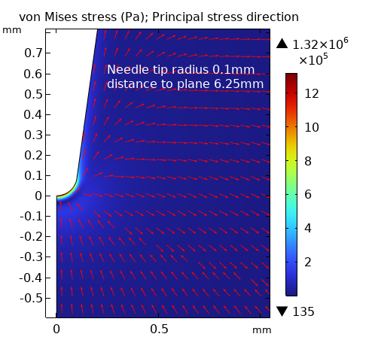
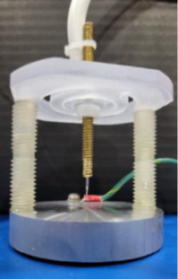
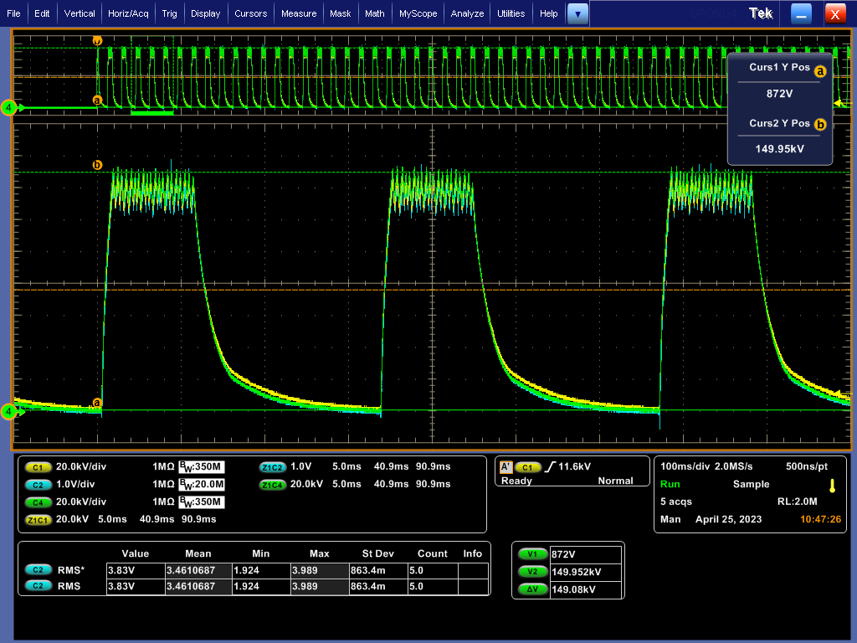
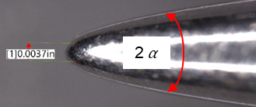

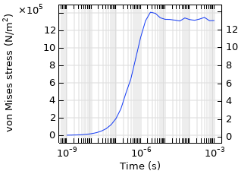
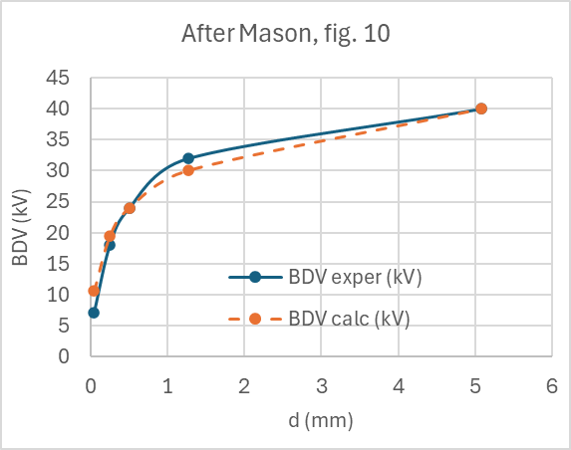
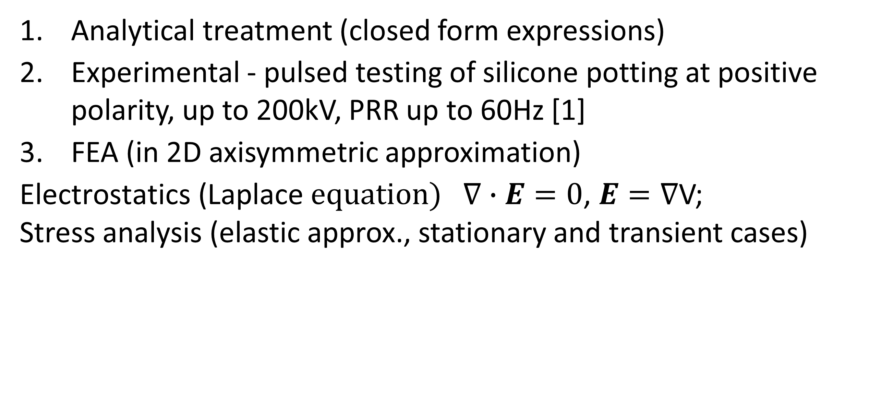
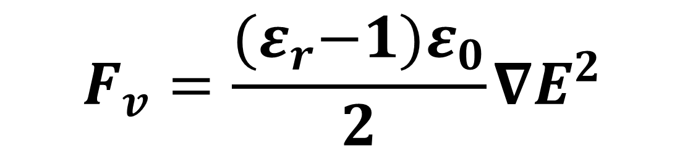
Study of Breakdown of Solid Dielectrics in Divergent Fields with COMSOL Multiphysics
100kV
Electric forces acting on a neutral matter in divergent electric fields generate mechanical stresses, which is invoked as a factor in dielectric breakdown.
A. Pokryvailo
Spellman High Voltage Electronics Corp., 475 Wireless Blvd., Hauppauge, NY 11788, USA
Abstract
Electric forces acting on a neutral matter in divergent electric fields generate mechanical stresses. This mechanism is invoked here as a factor in solid dielectric breakdown (BD) [1]. A closed form analysis for coaxial electrodes shows that electric forces can be of the order of GN/m³. Then point-to-plane case is studied. First, electrostatic analyses for the geometry matching experimental conditions [2] were made. Electric forces that are proportional to gradE² serve as body forces for stress analysis. For practical voltage levels, it predicts stresses of the order of several MPa which exceeds yield stress of many insulating materials. Shear stresses in the vicinity of the needle tip may affect the metal-dielectric boundary. Thus, solid insulation BD can be initiated or assisted by mechanical damage induced by the electric forces in absence of ionization! This mechanism may be a dominant mechanism or a part of a complex of other processes, such as ionization and avalanching, field emission from cathode, crack propagation, etc.
Methodology
Analytical treatment (closed form expressions)
Experimental - pulsed testing of silicone potting at positive polarity, up to 200kV, PRR up to 60Hz [1]
FEA (in 2D axisymmetric approximation)
$\text{Electrostatics}\text{ (}\text{Laplace} equation) ∇∙E=0$, $E=∇$V;
Stress analysis (elastic approx., stationary and transient cases)
FIGURE 1. Left: Sample insulation structure (unpotted). Middle: gramophone needle microphotography. Right: typical test voltage
$$F_{v}=\frac{{(ε}_{r}−1)ε_{0}}{2}∇E^{2}$$
Selected Results
1. Material shear at the HV electrode may be a dominant mechanism of BD initiation by generation of microdefects at the electrode surface, especially at repetitive pulsed voltages. 2. One may estimate forces of the order of 10¹⁰ N/m³ at a dielectric density of 10³ kg/m³, would accelerate the material at 10⁷ m²/s. Time-domain stress analysis bears this out. Thus, stress reduction due to inertia can be ignored at millisecond pulses, and, probably, down to nanoseconds.
FIGURE 2. Left: Illustrating mechanical inertia at pulsed (step) voltage. d=1/4”. Our test data are at 0.5-ms risetime. Right: Breakdown in point-to-plane gaps – comparison of COMSOL simulations to experiment.
A. Pokryvailo, "On the Mechanism of Electromechanical Breakdown of Solids in Strongly Nonuniform Fields in Absence of Ionization and Space Charges," IEEE TDEI, vol. 1, No. 3, pp. 1651-1653, June 2024.
2. A. Pokryvailo, "Pulsed Techniques for Accelerated Electrical Aging of Solid Insulation Materials and Components of HV Power Supplies," 2023 IEEE EIC, Quebec City, QC, Canada, 2023, pp. 1-4.
J. H. Mason, “Breakdown of Solid Dielectrics in Divergent Fields”, Proceedings of the IEE - Part C: Monographs, Vol. 102, Issue 2, 1955, pp. 254-263

