Slide 1
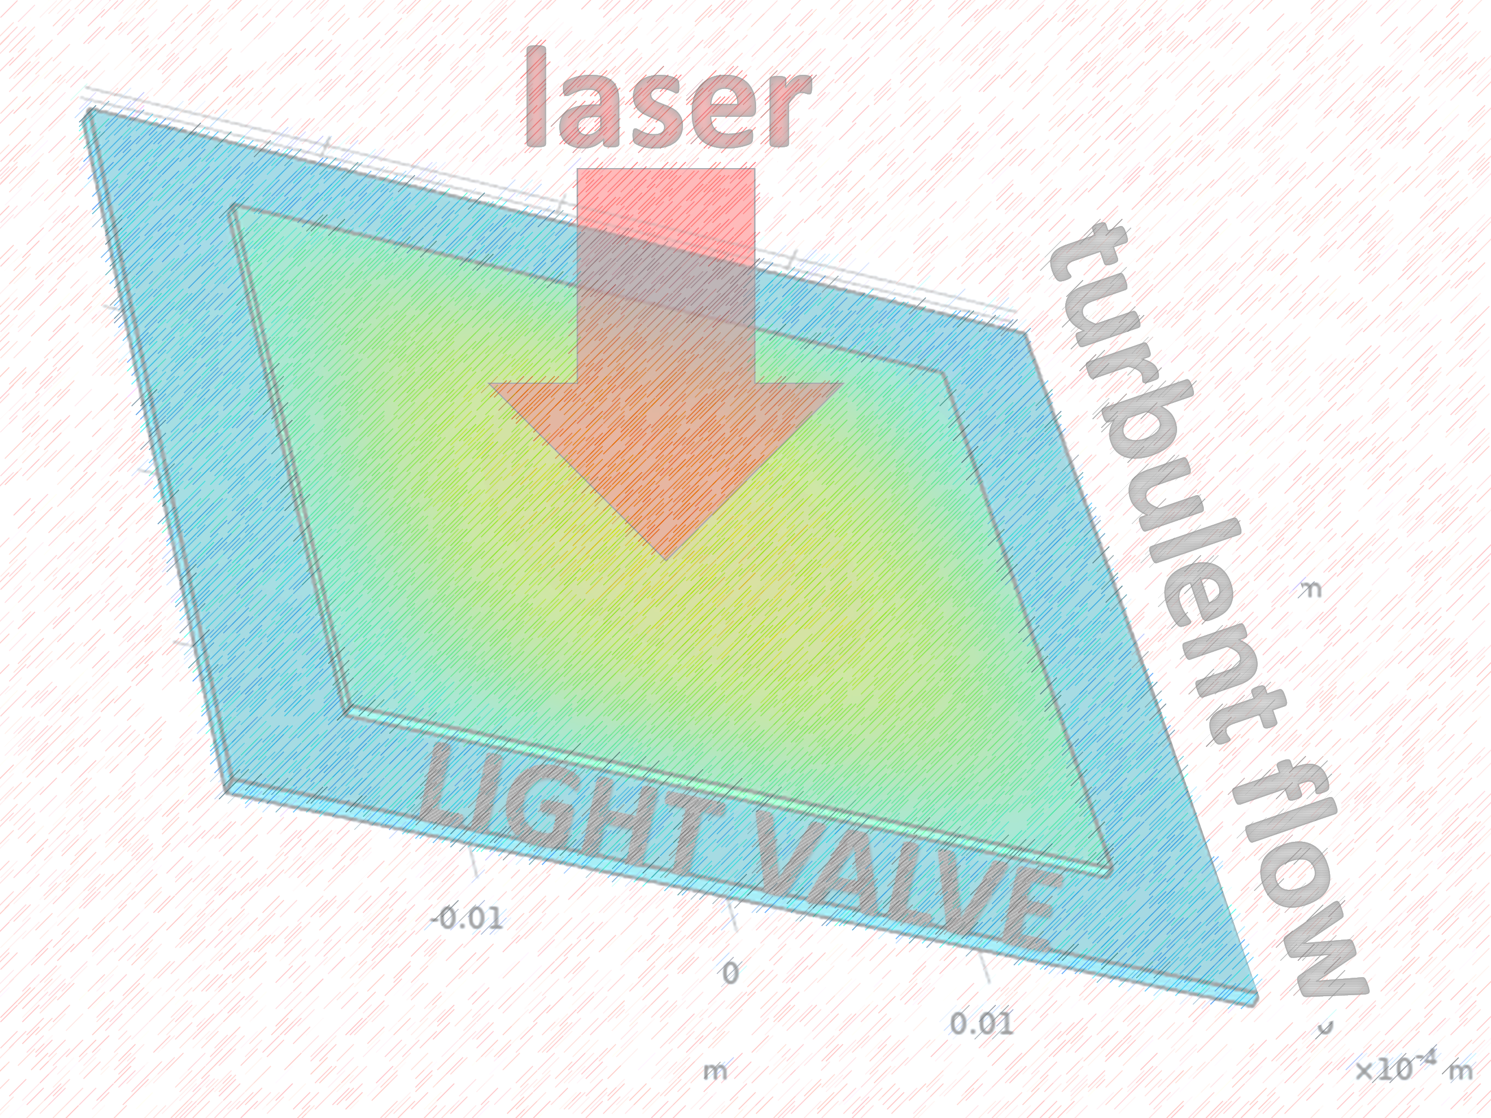

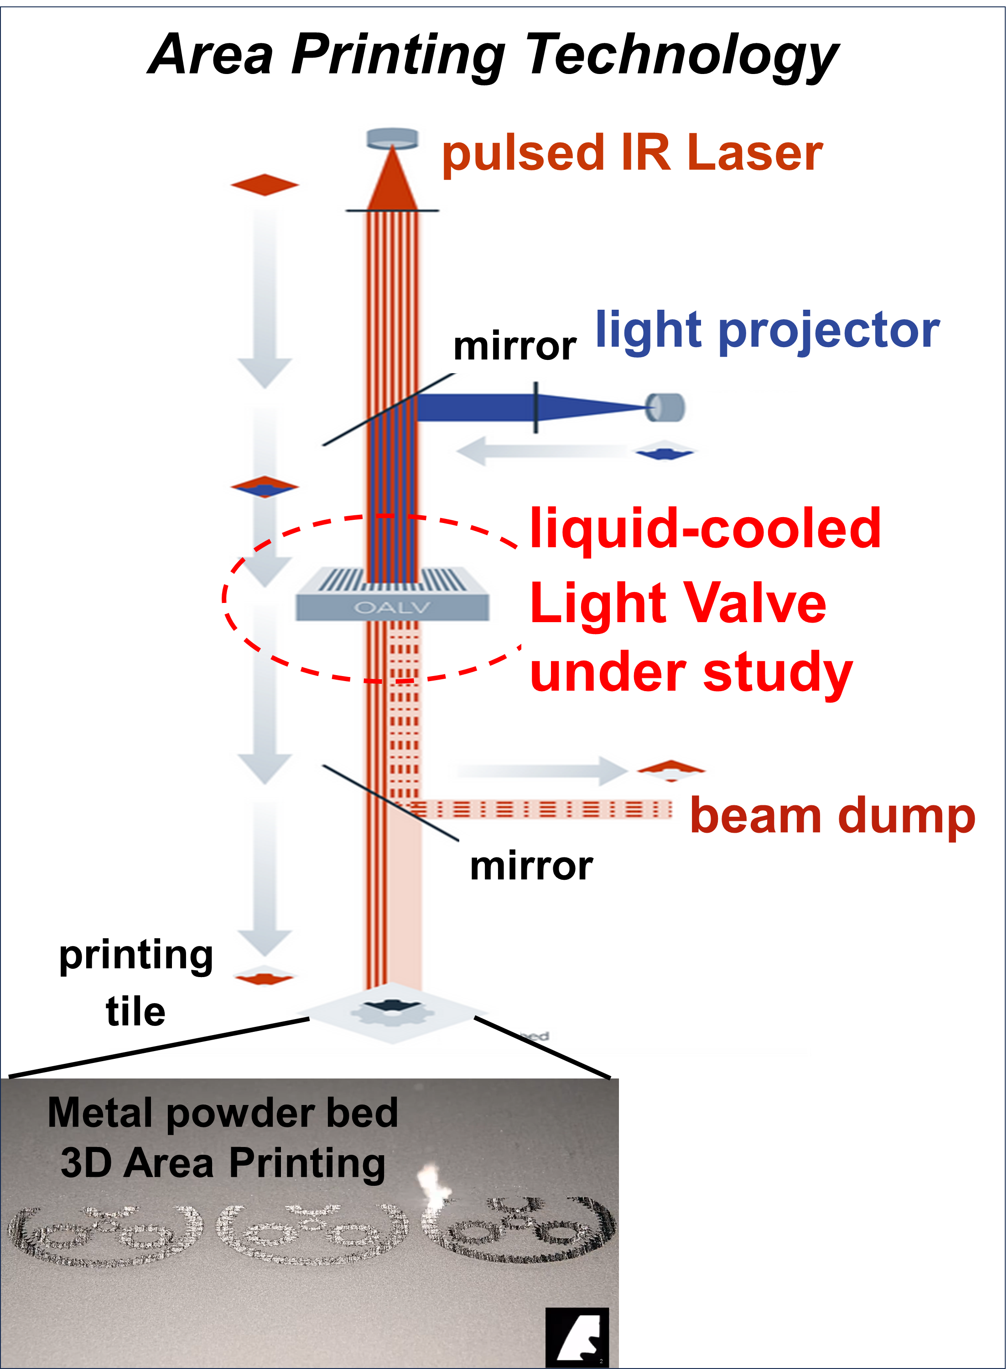
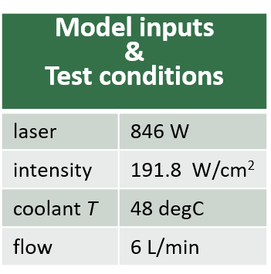
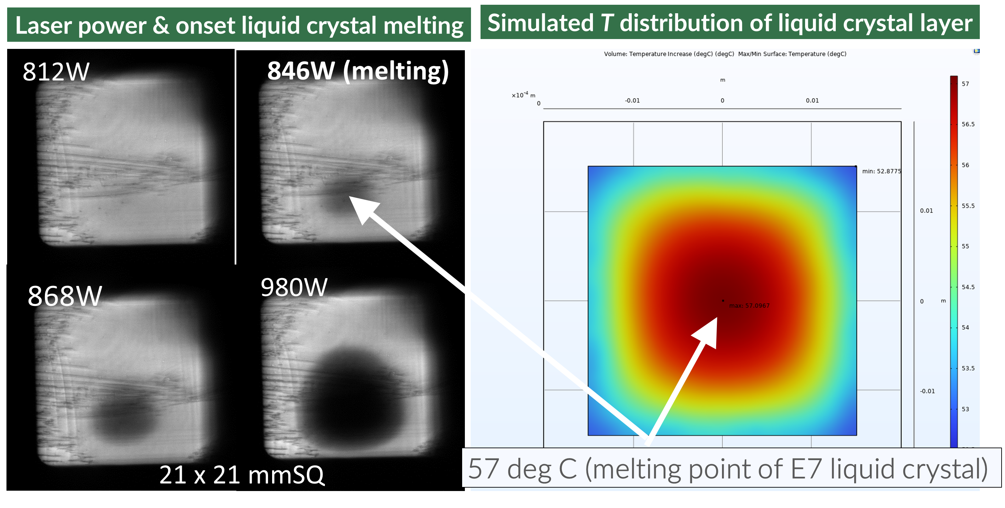

Light Valve Laser Heating in Metal 3D Area Printing®
A light valve dynamically controls the patterning of a high-power laser beam for rapid Area Printing of metals. The design of its cooling requires a validated numerical model of heating of a liquid crystal layer.
Selim Elhadj, Abdul Khan, Joe Gillespie, Cote Leblanc, Andrew Bayramian
Seurat Technologies, 255 Ballardvale St, Wilmington, MA 01887
Introduction
Seurat Technologies uses a unique, optically addressed spatial light modulator (“light valve”) with a photorefractive liquid crystal layer to dynamically pattern laser beams for rapid, high resolution metal 3D printing in its Area Printing® technology¹.
COMSOL finite element (FE) simulations, with input from measured laser absorption, yielded heating and temperature distributions within the light valve under turbulent flow conditions. Temperature rise impacts key liquid crystal optical properties and efficiency. The validated simulations informed liquid-cooling designs, when direct temperature measurements are not readily accessible from the sealed device inside a housing.
Methodology
Light valve laser heating model
Laser beam in absorbing media
Non-isothermal coolant flow using RANS with SST turbulence equations³
Absorption coefficients measured as input to model
Material properties from COMSOL library
2. Validation of the stationary model
Compare experimental laser power that induces E7 liquid crystal nematic-to-isotropic phase transition² (melting) to temperature predicted by the numerical solution (Fig. 2)
Figure 2. Experimental validation of COMSOL FE model of light valve laser heating. The threshold laser power for E7 liquid crystal phase transition² at 57°C appears as a dark spot in cross-polarizer image, consistent with calculations presented.
Figure 1. Area Printing on a metal powder bed. A liquid-cooled light valve is used for dynamic beam patterning. Near 100kW Infrared (IR) patterned beam melts powder layer by layer.
Results
The finite element model of light valve cooling captured within a degree Celsius the laser heating-induced isotropic phase transition of the E7 liquid crystal² layer (Fig. 1). Onset of phase transition appears as a dark spot in the cross-polarizer image of the transmitted beam (Fig. 2). Both materials laser absorption coefficients and turbulent coolant flow physics are critical to derive realistic estimates of the light valve laser heating.
https://www.seurat.com/area-printing
H. Eskalena, M. Okumuşb, S. Özganc, “Electro-optical, thermal and dielectric properties of ternary mixture of E7/6CB/6BA liquid crystal mixture complex”, Optik (187) 223-229, 2019.
F.R. Menter, “Two-Equation Eddy-Viscosity Turbulence Models for Engineering Applications”, AIAA Journal (32), 1994

