Slide 1
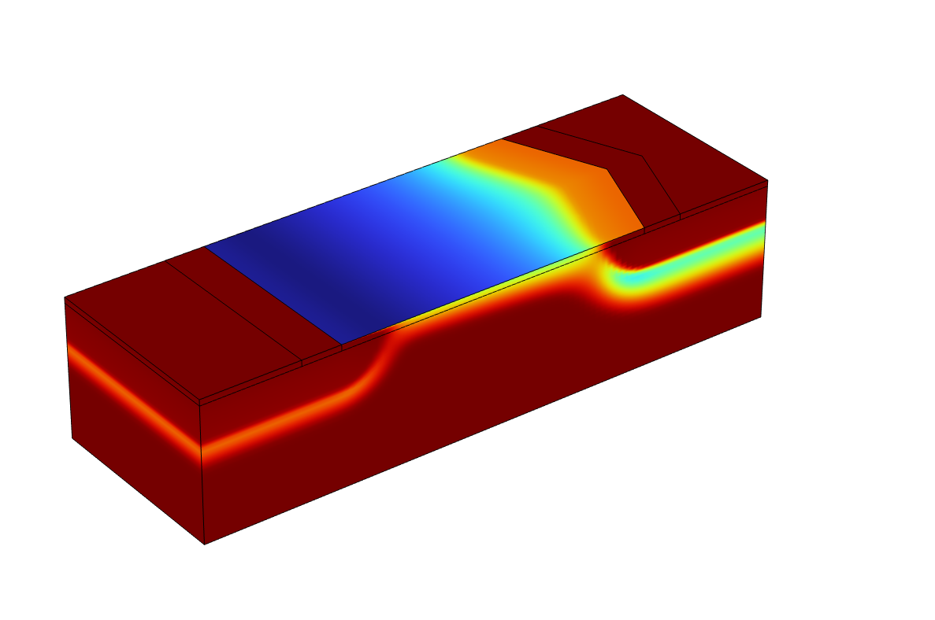
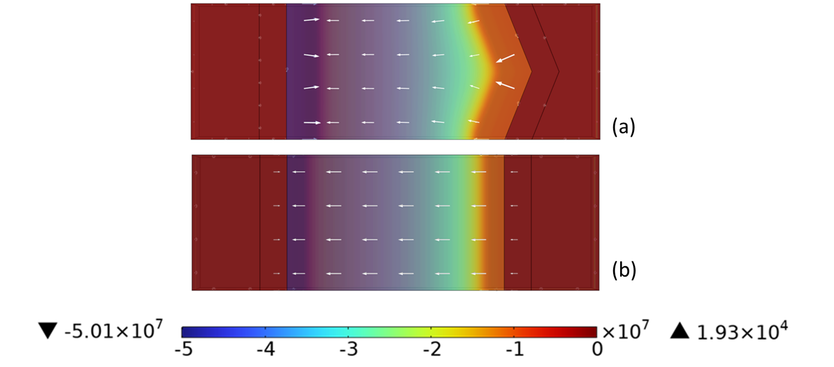
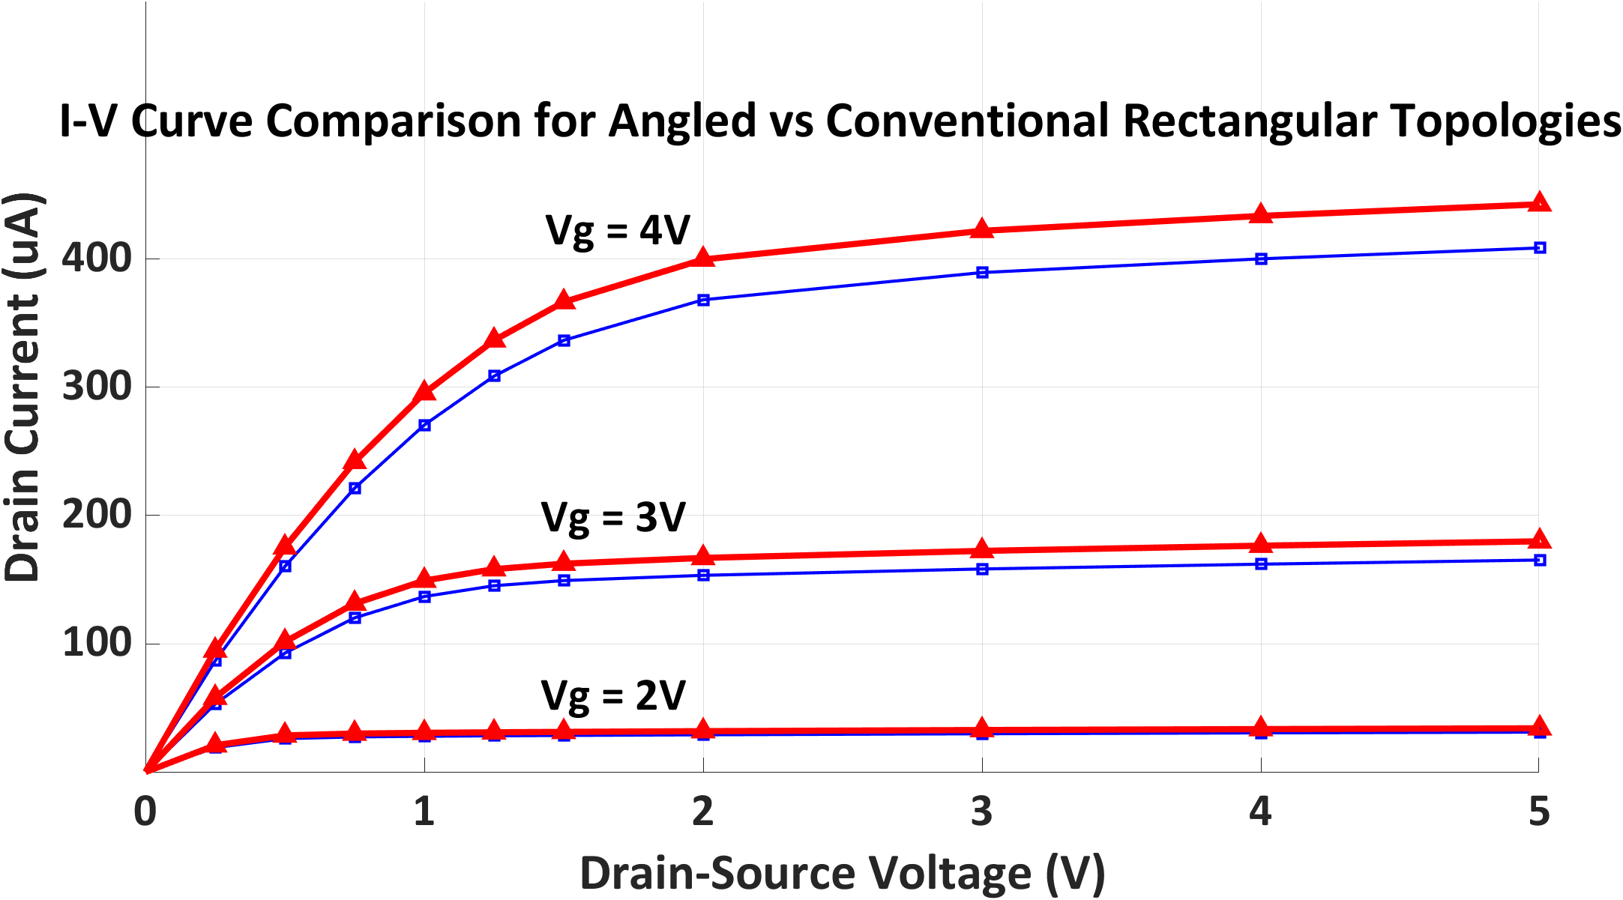

Transconductance Analysis of FET Sensor Channel Topology
Enhance field-effect transistor (FET) performance by investigating the impact of planar channel geometry on conductance, transconductance and consequently, sensitivity.
A. Abu-Libdeh¹, Y. Birjis¹, A. Emadi¹
1. Department of Electrical and Computer Engineering, University of Windsor, Windsor, Canada.
Abstract
As sensors, FETs employ their gate or active channel as a sensing area, where exposure to a target analyte results in a measurable threshold voltage shift or change in drain current. By improving the active area’s design, FET sensor performance can be enhanced.
A critical metric for assessing the sensitivity of FET-based sensors is their transconductance, which can be analyzed from its I-V characteristics.
This study presents a unique approach whereby unconventional planar channel topologies are modeled for a metal-oxide-semiconductor FET (MOSFET). The findings demonstrate that incorporating angled terminals within a FET structure of the same footprint enhances the electric field density, current, and consequently, transconductance compared to the conventional rectangular topology.
Methodology
A conventional rectangular MOSFET and angled channel topology are modeled in 3D with the same gate width-to-length dimensions for fair comparison.
The semiconductor equilibrium study generates initial conditions for computing the output characteristics of the device. To ensure efficient analytical computation, the model is discretized using a swept meshing technique.
For device characterization, the models are plotted for drain-source voltages up to saturation, from 0 V to 5 V, at gate voltages of 2 V to 4 V.
FIGURE 1. Top views of field-current relationship at saturation showing a higher current density for the (a) angled channel topology than (b) conventional rectangular reference.
Results
Incorporating angled terminals within a MOSFET structure of the same footprint enhances its electric field density, current, and consequently, transconductance compared to the conventional rectangular topology.
For the same channel width-length ratio and bias conditions, the angled channel topology exhibits a larger drain current response due to a larger average field density.
For applications in biosensing or environmental monitoring, high current and transconductance are beneficial for the low concentration detection of target analytes. The angle acuteness and geometries with varying vertices provide additional degrees of freedom to modulate FET performance using this design approach.
FIGURE 2. Comparison of I-V curves for conventional rectangular (blue) and angled channel (red) topologies.
S. Hong et al., “FET-type gas sensors: A review,” Sens Actuators B Chem, vol. 330, p. 129240, 2021.
S. M. Sze and K. K. Ng, Physics of semiconductor devices. Wiley-Interscience, 2007.
S. Pinillos et al., “Differentiated Layout Styles for MOSFETs Electrical Behavior in Harsh Environments,” pp. 65–85, 2023.

