Slide 1
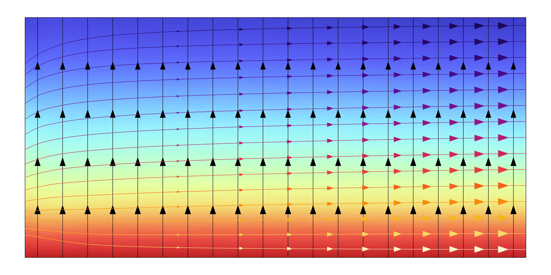
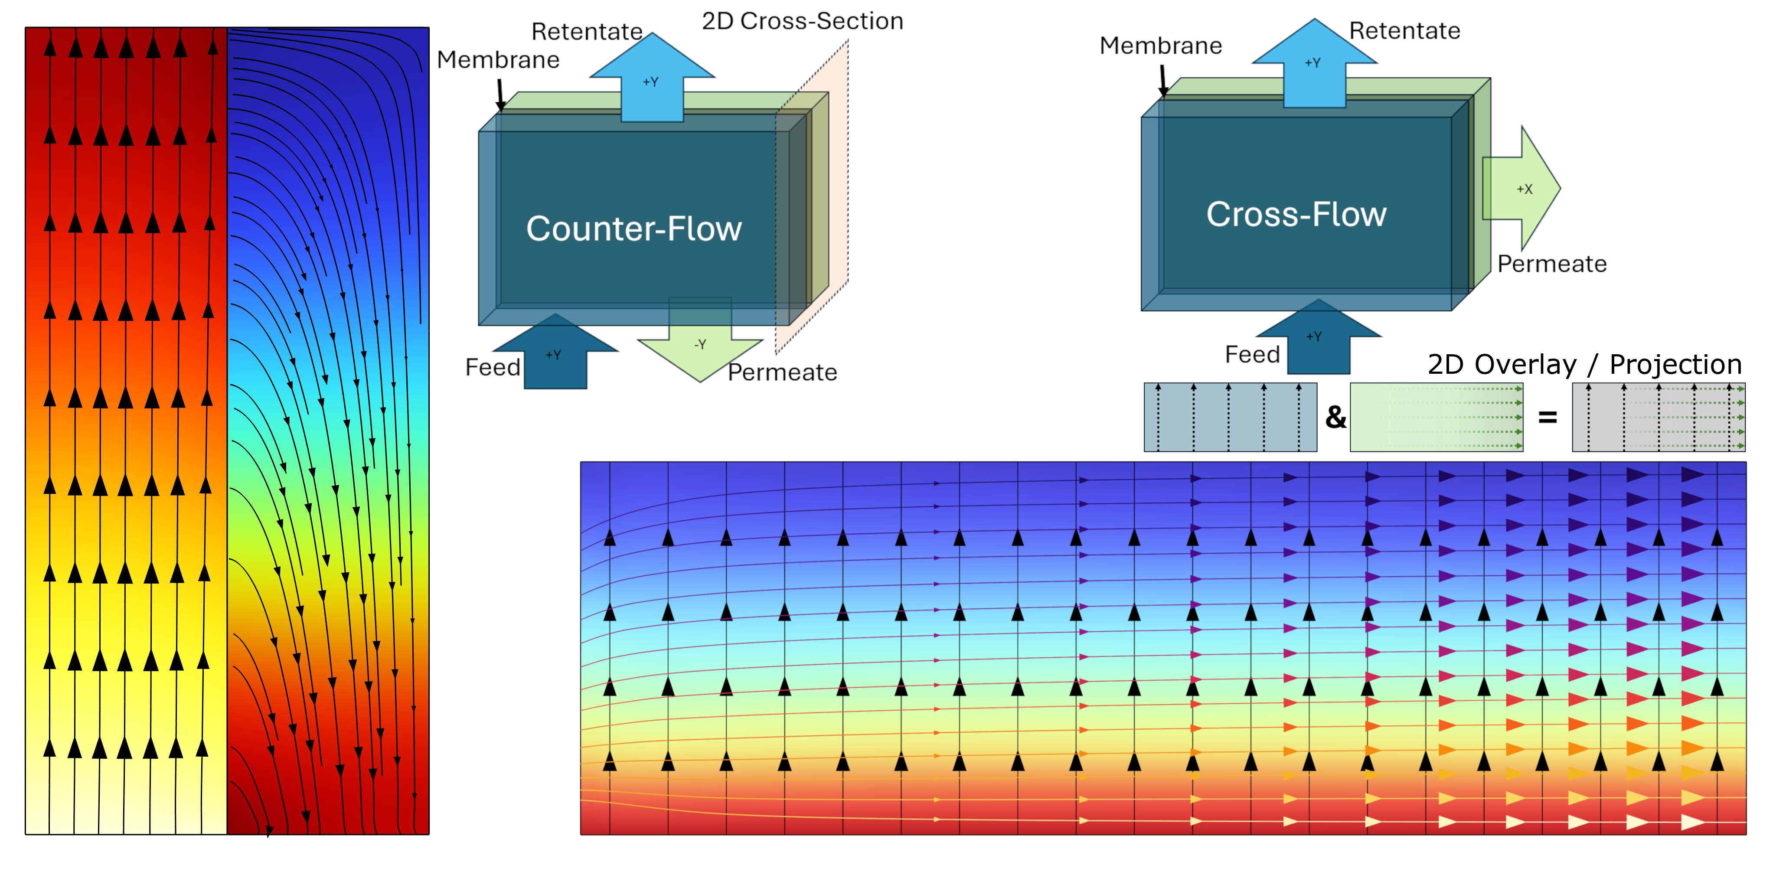
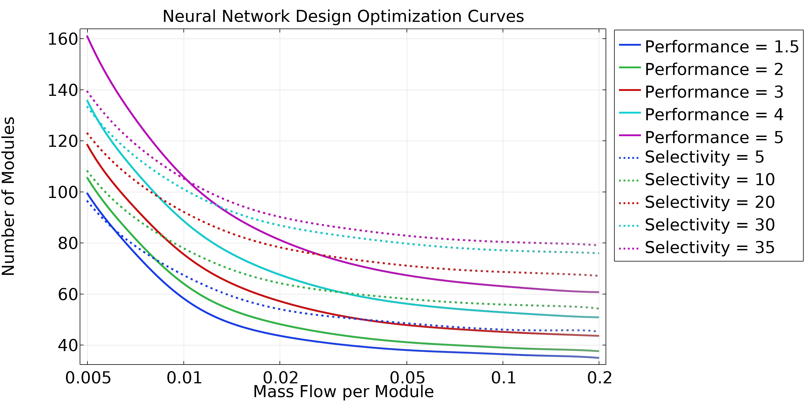

Selectively Permeable Membrane Gas Separation System – Modeling And DNN Tool Development
Models were developed for effectively modeling species transport and the resulting retentate/permeate stream compositions in planar counter-flow and spiral-wound cross-flow membrane modules. Parametric results were processed via DNN to create system design/optimization tools.
J. Frankel¹, J. Anibal¹, E. Jarvis¹, C. Hannon¹
1. Triton Systems, Inc., Chelmsford, MA, USA
Abstract
Selectively permeable membranes are used in a variety of industries as part of filtration, enrichment, and separation processes. Triton Systems developed models of gaseous species separation processes via selectively permeable membranes using COMSOL Multiphysics’s CFD module and its Transport of Concentrated Species sub-module.
Models were created to represent planar counter-flow membrane modules and spiral-wound, cross-flow modules. Parameterization for design study focused on effective membrane properties (overall permeance, selectivity to non-target gaseous species) and membrane module operational parameters (e.g., feed mass flow rate and composition of inlet gas mixture, retentate/permeate pressure), using empirical results to inform parameter ranges. Models were refined and validated, and a Deep Neural Network-based system design optimization tool was created to rapidly produce forward and inverse performance/parameter estimations.
Methodology
A planar membrane counter-flow model was developed using a representative cross-section (FIGURE 1, left) perpendicular to the flow. Species transport across the membrane (center boundary) was modeled as a linear driving force as a function of individual species differential partial pressures (feed vs. permeate) and membrane properties, which is applied as equal and opposite flux into or out of the membrane boundary.
A spiral-wound membrane effectively exhibits cross-flow, and is instead modeled as an unrolled sheet with separate but co-located and coupled fluid flow and species transport physics (FIGURE 1, right). Species transport is similarly computed from membrane properties and local partial pressures, but is applied as a fluid flow mass source term to represent out-of-plane flux. Geometric corrections[1] can be incorporated to increase accuracy.
FIGURE 1. Left: Planar membrane – 2D counter-flow, cross-section model.
Right: Spiral-wound membrane – 2D cross-flow, unwound projection model. Crossing streamlines are representative of separate feed (vertical) and permeate (horizontal) sets of flow and species transport physics within the same domain.
Results
Separation system optimization minimizes the required number of modules as a function of total target species permeation rate, within acceptable ranges of operational/functional parameters. Use of COMSOL 6.2’s Surrogate Modeling feature allowed for thousands of FEA runs within a range of multi-parameter design spaces to be processed into trained neural network predictors with high (>98%) accuracy as compared to discrete test cases. Neural network models were additionally successfully trained for inverse predictions (determining required system parameters based on a set performance level), and system design or “iso-performance” (any result parameter set by the designer – e.g., permeate species concentration ratio) curves can be quickly generated for any parameters or performance levels within the studied range (FIGURE 2). These curves are then used for system sizing and component selection.
FIGURE 2. System design curves generated via surrogate modeling (Deep Neural Network), trained on ~10,000 full FEA trial runs across an array of pseudorandomized parameter spaces.
2. Gu, B., Xu, X. Y., & Adjiman, C. S., “A predictive model for spiral wound reverse osmosis membrane modules: The effect of winding geometry and accurate geometric details”, Computers and Chemical Engineering, vol. 96, pp. 248–265, 2017.

