Slide 1
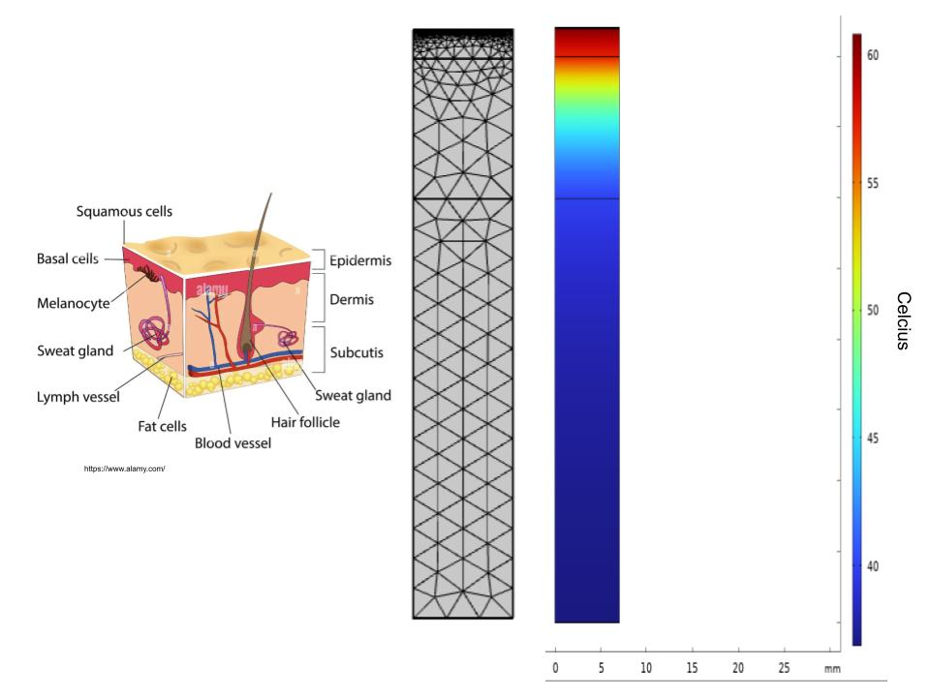
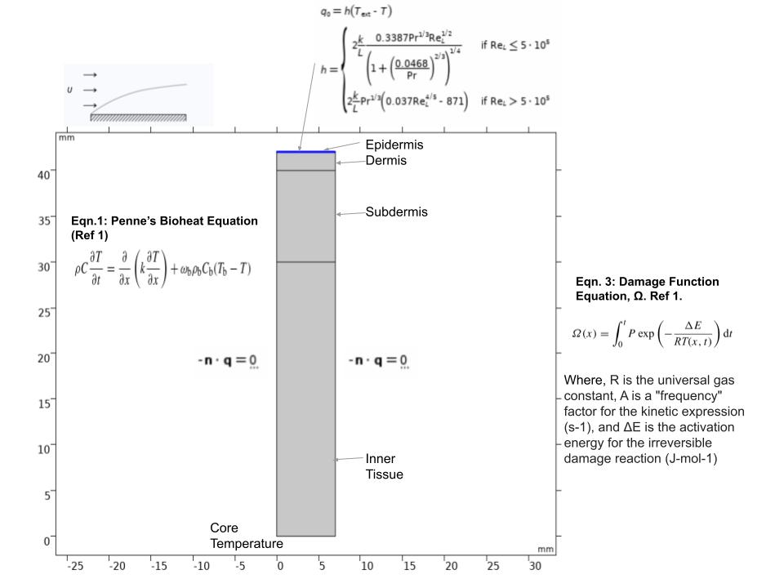
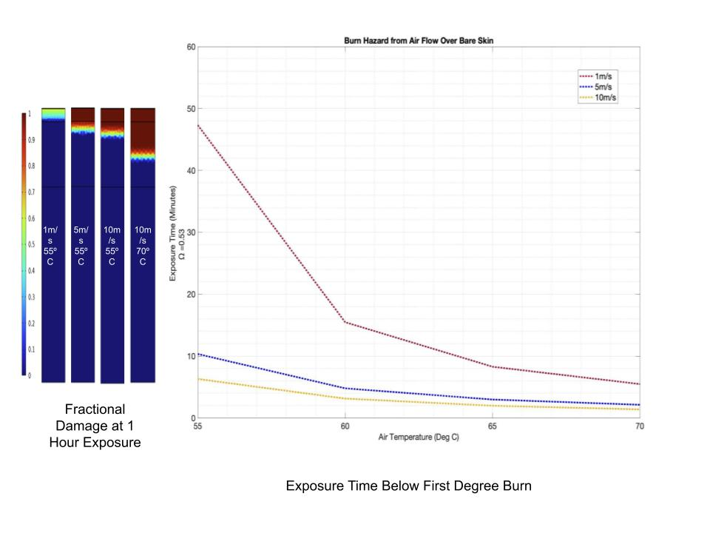

Predicting Skin Burns from Convective Air at Elevated Temperatures
Consumer electronic products are often cooled by air-convection to keep them operating at optimum performance. Air vented at elevated temperature and directed to skin may cause user discomfort and in some cases injury. It is important to understand the levels of air temperatures and velocities that may lead to injury. This study investigates air temperature at 50, 60, 65 and 70 Deg.C and velocities of 1, 5, and 10m/s that may lead to burns.
Sergio Hernandez, P.E.
Meta, Menlo Park, California
Abstract
Convective air at elevated temperatures may lead to skin burns depending on the air temperature and exposure time. COMSOL’s Bioheat-Transfer and Heat-Transfer in Solids interfaces are used to obtain the transient temperature and exposure profiles in the human skin. A simple 2D model is built to simulate the epidermis, dermis, sub-dermis and inner tissue of the skin. COMSOL’s Bioheat interface solves for Pennes Bioheat equation and simulates heat transfer from blood-flow and metabolic heat generation in tissues. To simplify the analysis, heat transfer for a flat plate is used to calculate the heat transfer from hot air to the skin. Then, to determine the level of injury, the damage function method is used. The analysis shows that elevated air temperatures and velocities result in lower threshold for injury. Lower air temperatures and lower velocities result in longer exposure time.
Methodology
COMSOL Multiphysics modeling environment was used to create a 2D model of the human skin. The geometry included the epidermis, dermis, sub-dermis and inner tissue of the skin (Figure 1). Boundary conditions are also shown on Figure 1. The dimensions and thermal properties were similar to previous work (Ref 1). Mesh refinement was conducted to a level where the skin basal temperature was independent of mesh. The heat gain from the hot air to the skin is simulated using the heat transfer boundary for a flat plate. This simplifies the analysis since the flow is not solved and only the solid domain is simulated. Parametric studies were conducted with air temperature at 50, 60, 65, 70 Deg.C and velocities of 1, 5, and 10m/s. COMSOL’s Thermal Damage method was used to estimate the fraction of skin damage, 𝜴. A first-degree burn occurs when there is partial necrosis of the epidermis (Ref 2). First degree burn is assumed to start at 𝜴=0.53 (Ref 1).
Figure 1. (a) Geometry and Boundary Conditions. (b) Penne’s Bioheat equation, (c) Damage Function
Results
The fraction of damage to the skin basal-layer is higher with increased air velocity and air temperature (Figure 2). Exposure times and air temperatures below the iso-velocity curves reduce the risk to skin damage. The fraction of damage is severe at 10 m/s and 70˚C and it is expected that most of the skin layers will be damaged after 1 hour exposure. The threshold decreases with higher temperatures, approaching an asymptote at about 2 minute exposure, air temperature of 70˚C and air velocities of 5m/s and 10 m/s. When using these results, consideration should be given to use safety factors (e.g. x1.5) and to add safety margins. These results can help designers develop thermal management strategies for their electronic devices.
Figure 2. (a) Tissue damage at the end of a 1 hour exposure. (b) Velocity iso-plots for first-degree burn.
(1) S.C. Jiang, N. Ma, H.J. Li, X.X. Zhang, “Effects of thermal properties and geometrical dimensions on skin burn injuries”, Burns 28 (2002) 713–717.
(2) Francesco Colella, et. al., “Contact Burn Injuries. Part I: The influence of object thermal mass”, IEEE 2020

