Slide 1
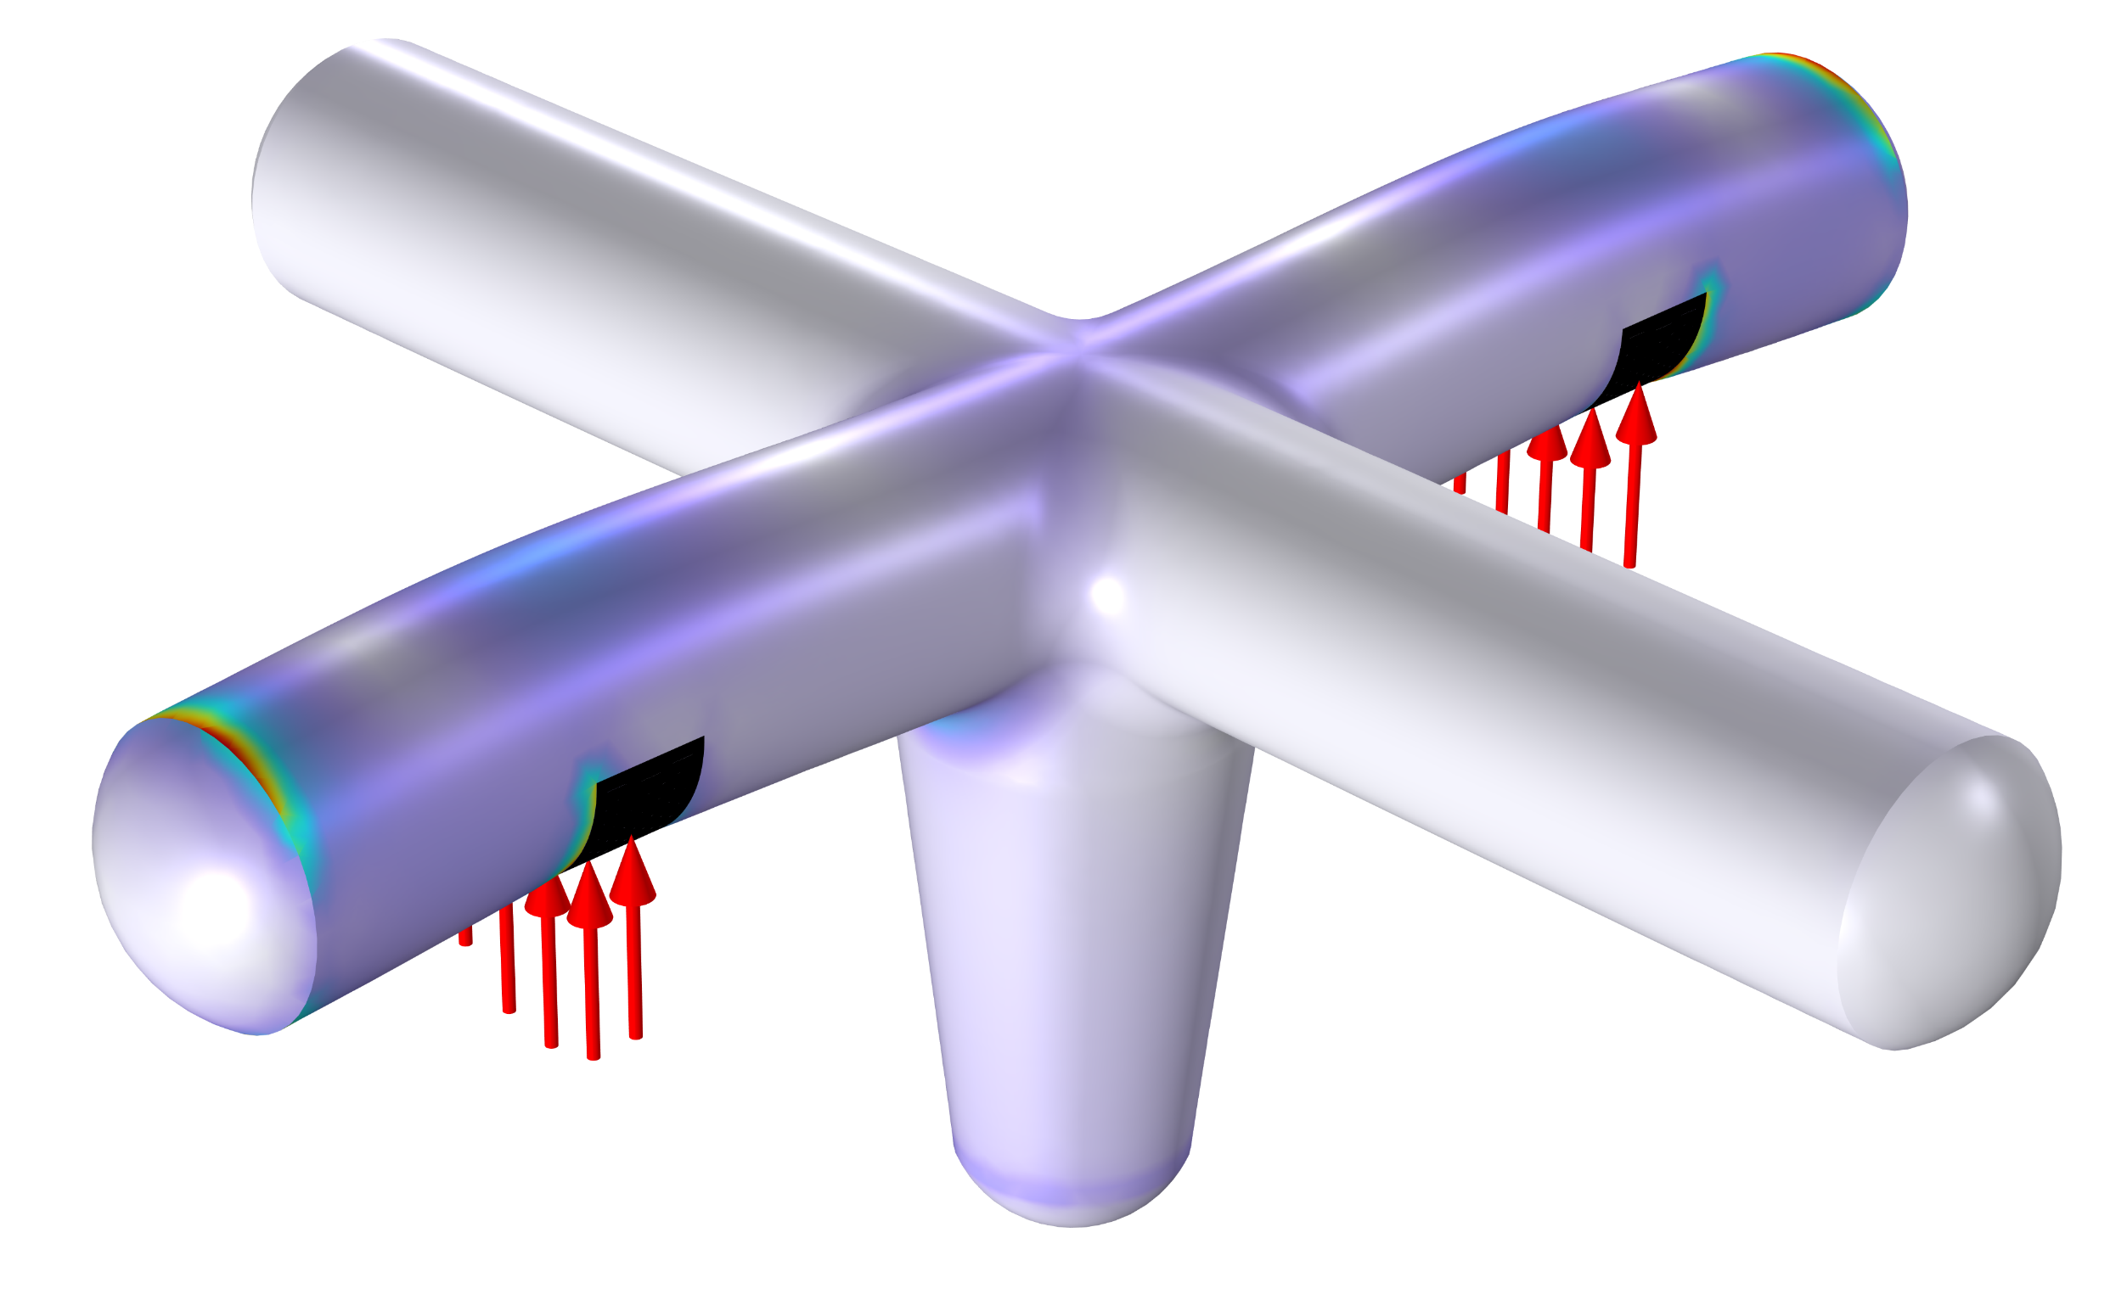
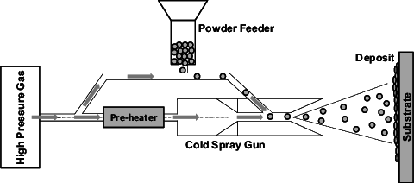
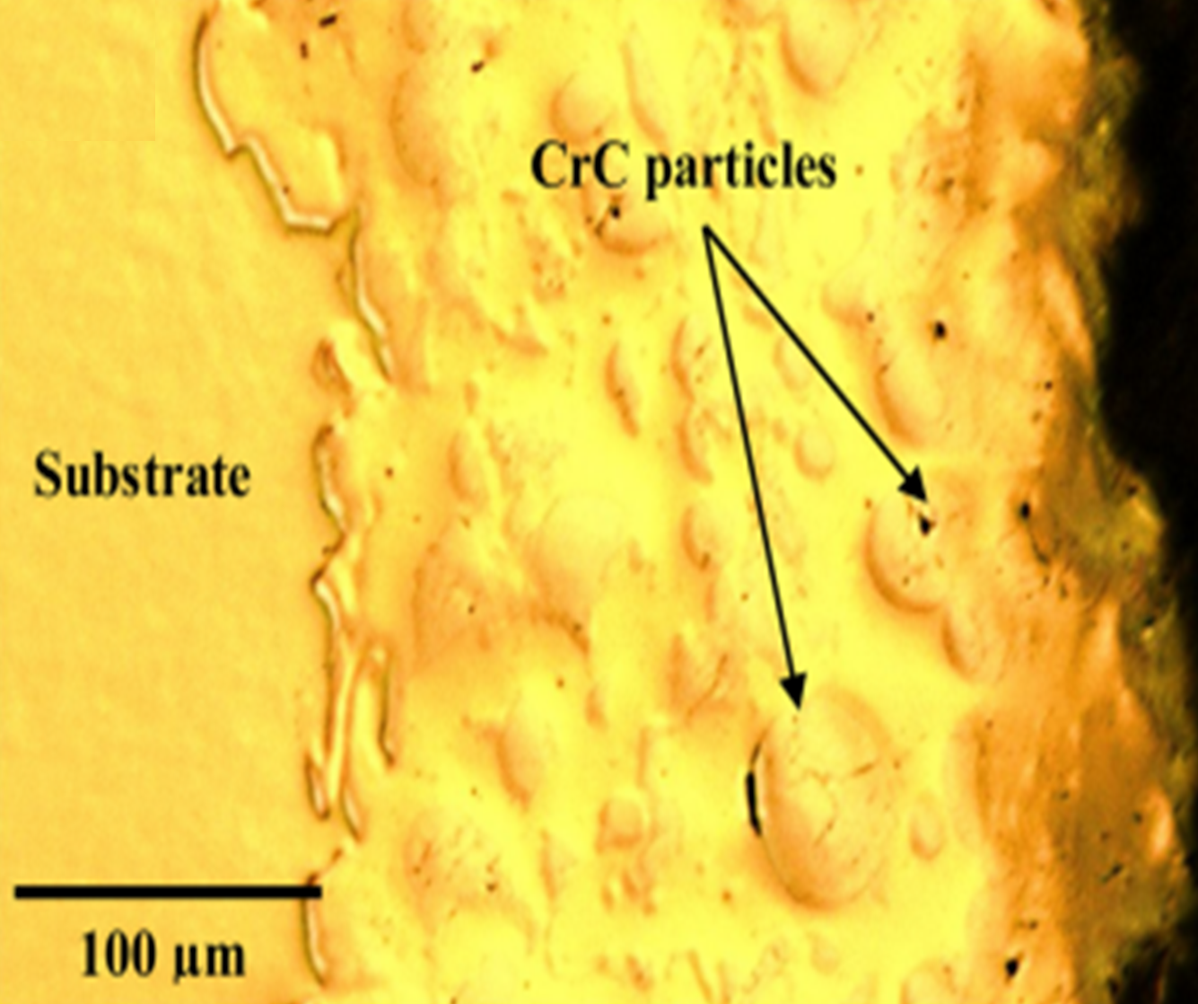
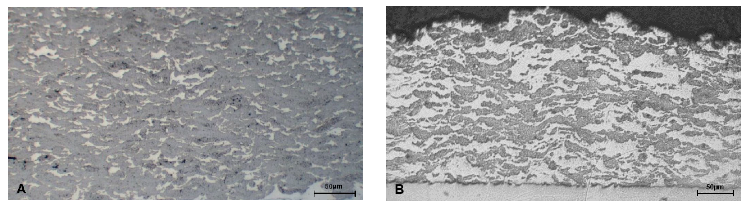
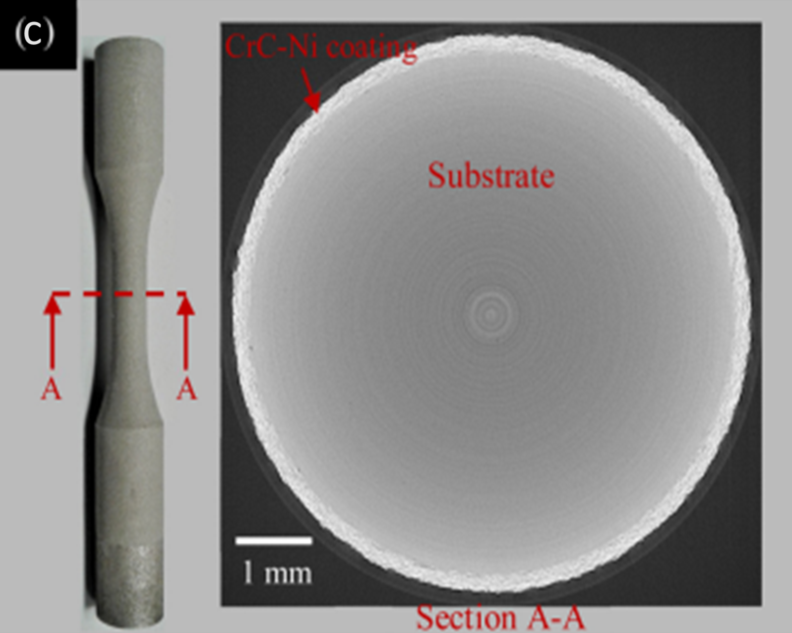
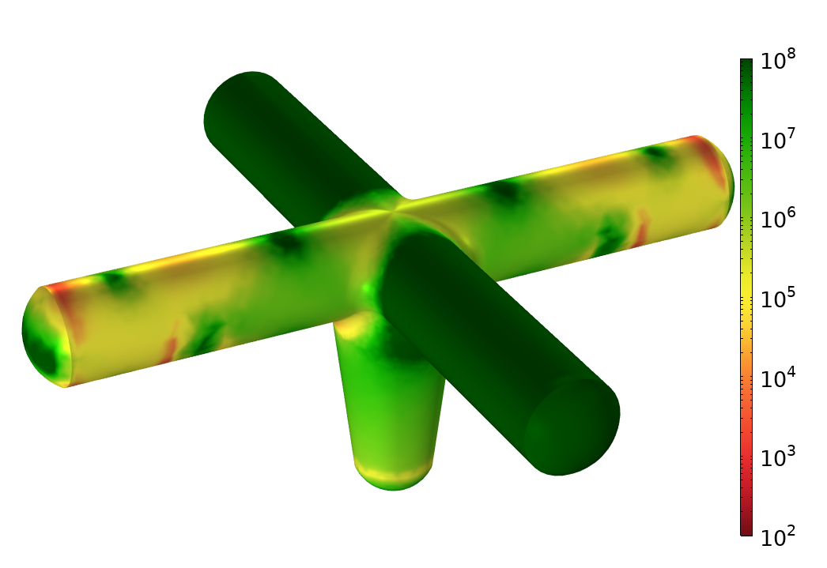
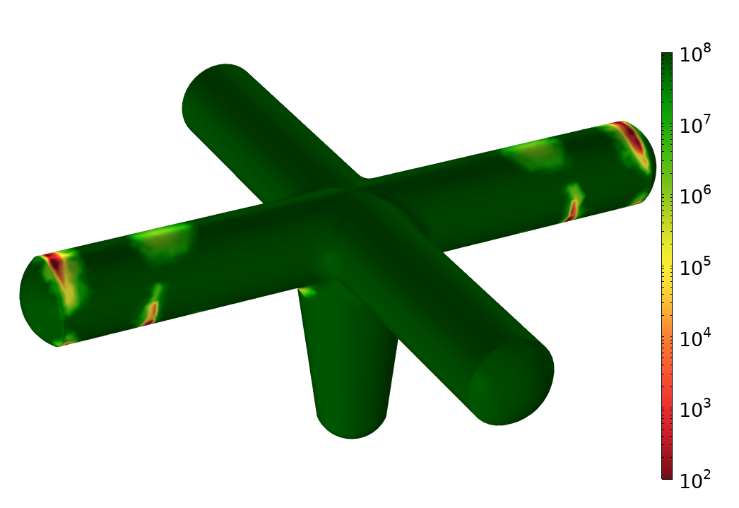

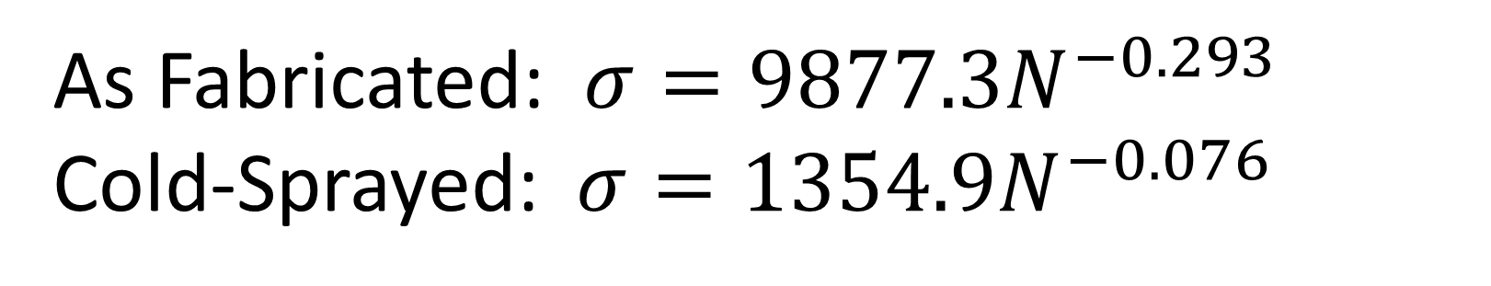
Fatigue Life of Cold Sprayed Multi-Materials
Cold spray technology enables the additive deposition of multi-material and functionally graded coatings with tailored properties, enhancing the fatigue performance of stainless steels. This study uses COMSOL Multiphysics to model and predict the fatigue life of cold spray-coated stainless steel. The model is validated against experimental data and then applied to assess fatigue performance across different geometries and loading conditions, providing insights for optimizing advanced coatings for improved durability.
Geneva Isaacson¹, Abigail Taylor¹, Bryer C. Sousa¹
¹ Triton Systems Inc., Chelmsford, MA, USA.
Introduction & Goals
Cold spray is a process that deposits metal powder at high velocities, permitting material consolidation of multi-materials and functionally graded materials (FGMs) with carefully blended powders. Experimentally evaluating the mechanical performance of new blends is timely and expensive; in turn, COMSOL was used to streamline this process. Research has shown that 15-5 PH Stainless Steel has enhanced fatigue life under multiaxial loading when cold sprayed with an FGM and multi-material CrC-Ni coating [1].
COMSOL was used to match these results and then extrapolate performance predictions for an industry application. Uncoated and coated aircraft Type 1 mock tie-downs were evaluated with realistic fatigue loading conditions, showing cold spray coatings have the potential to improve fatigue life. The insights gained from this approach can enhance the lifetime of components through optimization of multi-material or FGM coatings for corrosion and wear resistance.
A)
Methodology
COMSOL’s Structural Mechanics and Fatigue Modules were employed in a 3D model to investigate the effect of a cold spray coating on stainless steel parts. The fatigue behavior of ASTM E8 dog bone samples is given by best fit equations from experimental S-N curves. Force and moment loads were defined with load groups. Subsequently, the validated model is used to predict the fatigue life of a mock version of a Type 1 aircraft tie-downs under cyclic loading conditions both with and without the graded multi-material cold spray coating.
B)
C)
FIGURE 1. Cold spay diagram including a) deposition of CrC and Ni particles on a substrate, b) macroscopic imagining of WC-based MMC materials [2], and c) FGM sample from experimental fatigue testing [1].
As Fabricated: $σ={9877.3N}^{−0.293}$
Cold-Sprayed: $σ={1354.9N}^{−0.076}$
Results
Uncoated
Cold-Spray Coated
Multi-material cold spray coatings, such as CrC-Ni, offer promising advancements for aircraft tie-downs. Beyond the enhanced fatigue life benefits demonstrated in Figure 2, these coatings also provide superior corrosion resistance in naval environments. The COMSOL lifetime predictions, initially validated against a dog-bone fatigue samples subjected to combined cyclic loading (Ref [1]), exhibit excellent agreement, reinforcing the reliability of these coatings for demanding applications.
FIGURE 2. (Left) An uncoated stainless steel aircraft tie-down mock-up indicates low cycles to failure when subjected to cyclic loading. (Right) After a cold-sprayed, corrosion-resistant CrC-Ni coating is applied, the tie-down shows enhanced fatigue life.
Davoud M. Jafarlou, Gehn Ferguson, Kyle L. Tsaknopoulos, Andrew Chihpin Chuang, Aaron Nardi, Danielle Cote, Victor Champagne, Ian R. Grosse, Structural integrity of additively manufactured stainless steel with cold sprayed barrier coating under combined cyclic loading, Additive Manufacturing, Volume 35, 2020, 101338, ISSN 2214-8604, https://doi.org/10.1016/j.addma.2020.101338.
Heelan, J., Langan, S. M., Walde, C., Nardi, A., Siopis, M., Barth, R., Landry, T., & Birt, A. (2020). Effect of WC-Ni Powder Composition and Preparation on Cold Spray Performance. Coatings, 10(12), 1196. https://doi.org/10.3390/coatings10121196

