Slide 1
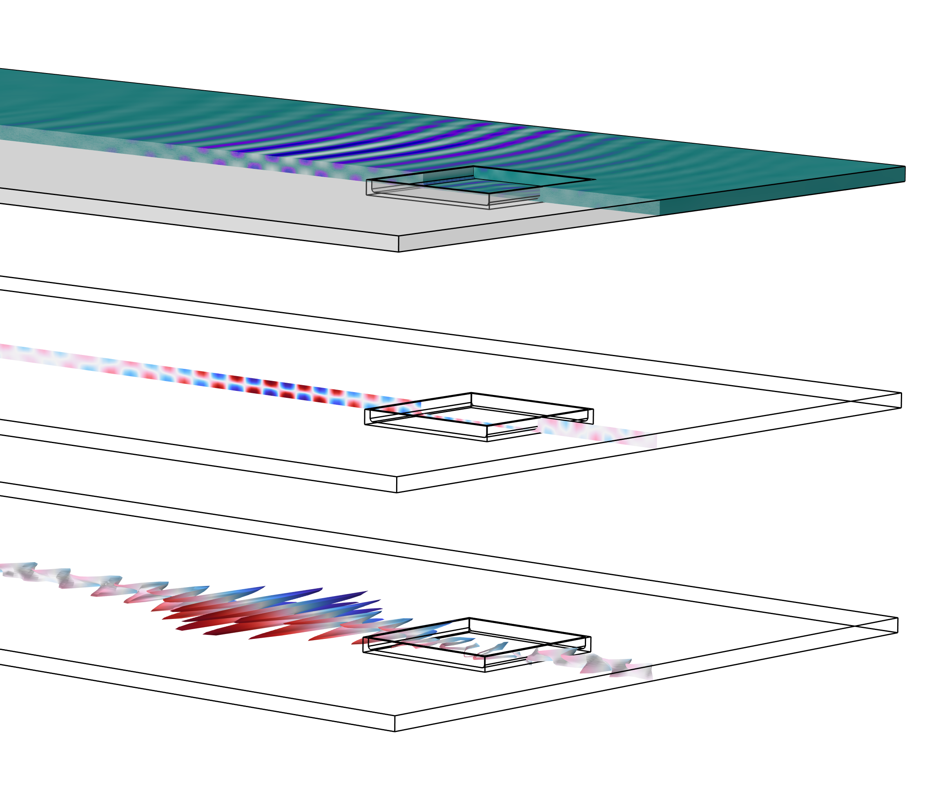
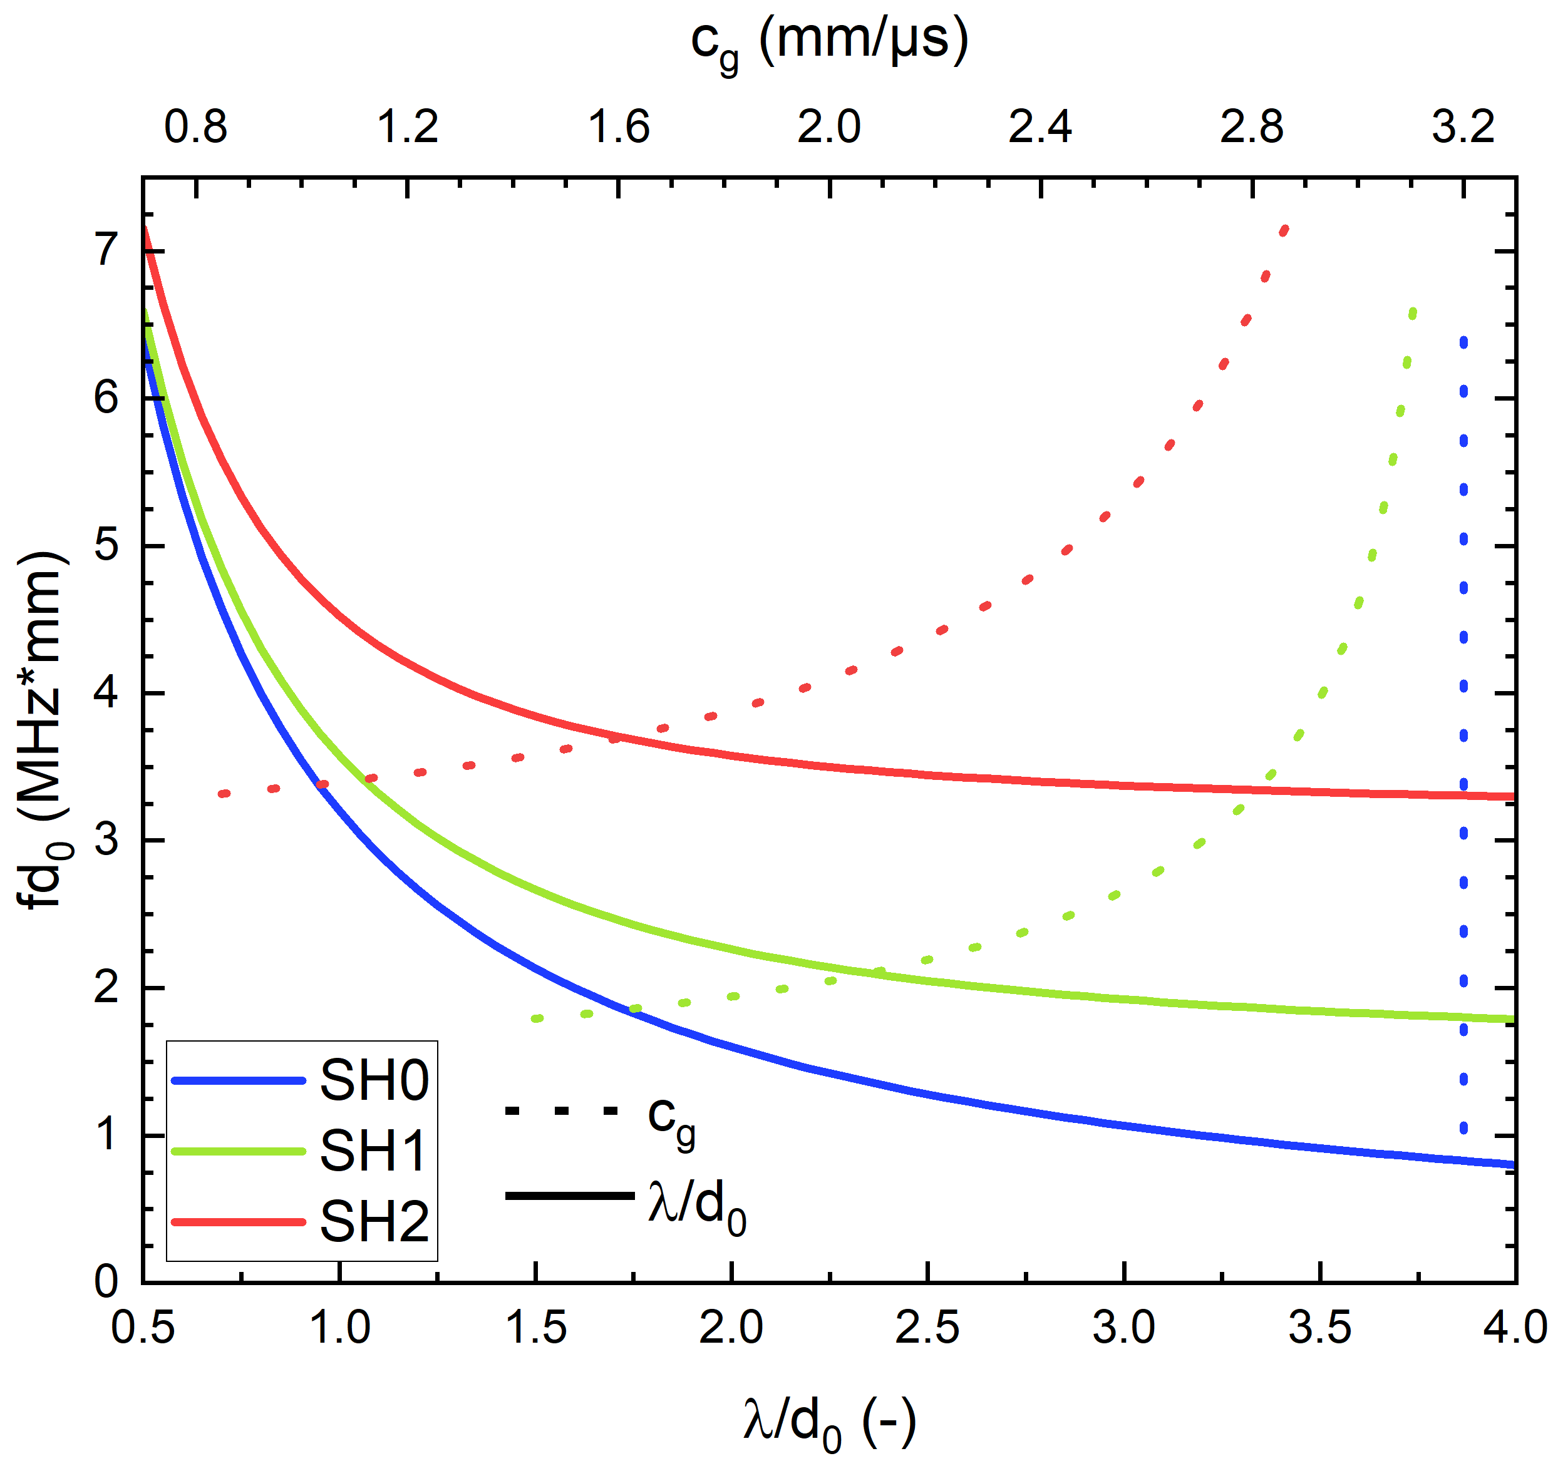
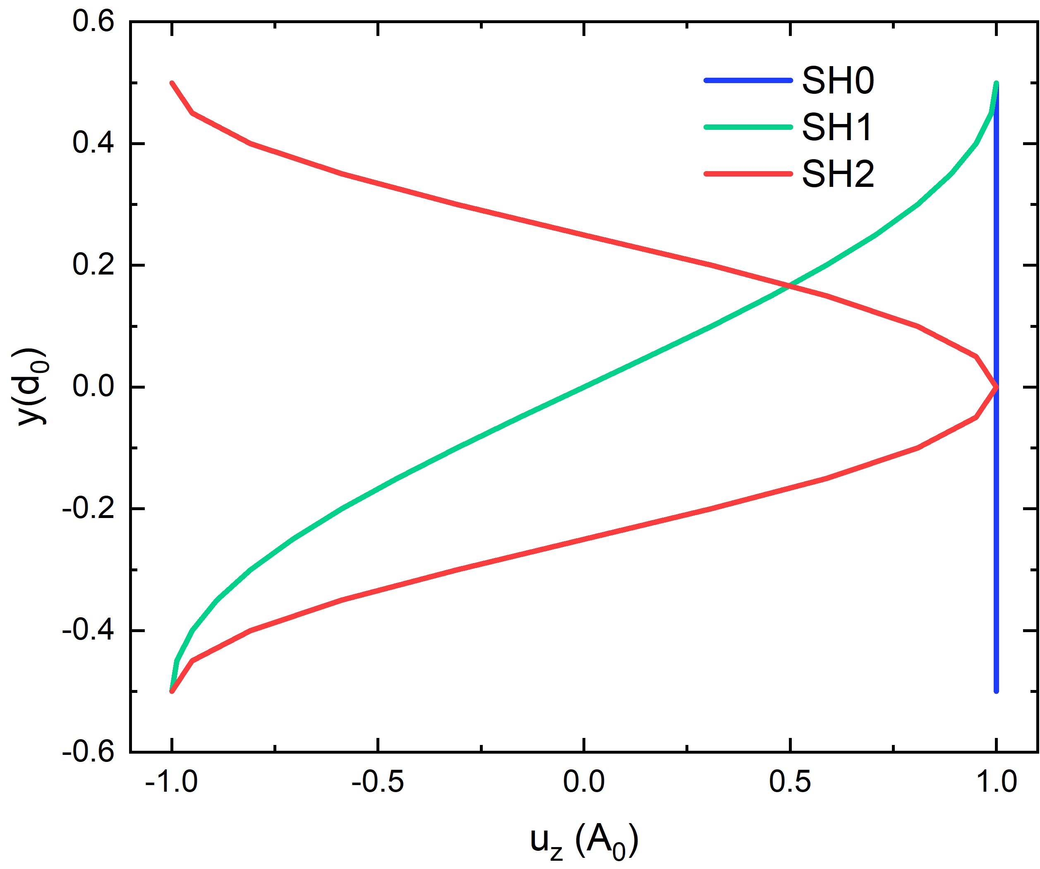
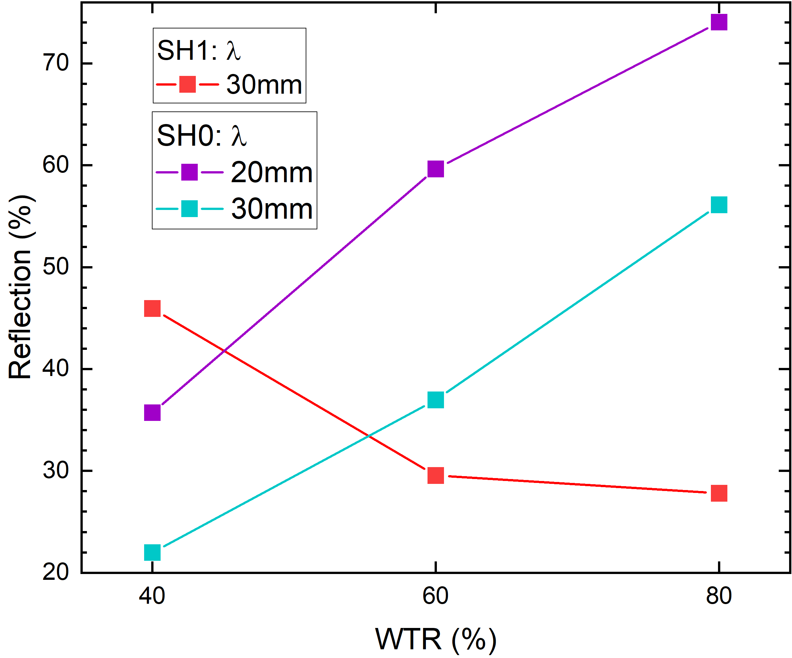
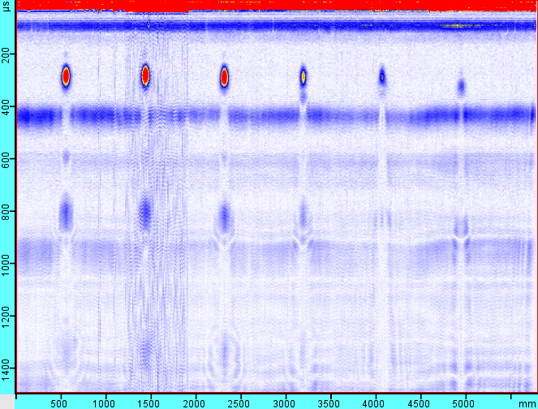

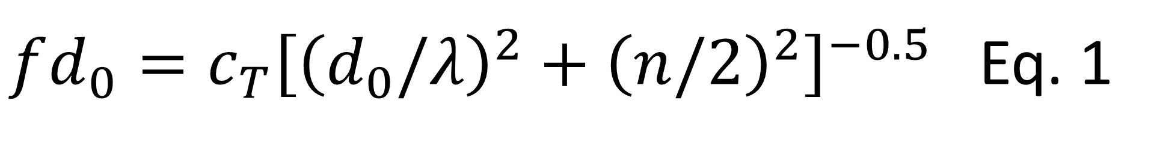
Enhanced corrosion detection with Guided Waves (GW)
Mode selection of guided waves is critical in determining the detectability of corrosion defects. The shape of the corrosion defect also plays a significant role. This work investigates these factors comprehensively.
S. Thieltges¹
¹ Fraunhofer Institute for Nondestructive Testing IZFP, Saarbrücken, Germany
Introduction
Guided Waves (GW) are an established method in non-destructive testing for corrosion detection and, more recently, corrosion quantification. However, due to the physical complexity of GW (Fig 1, left), sensor design—particularly in terms of wavelength and frequency—is not trivial and is highly dependent on the component being tested. Additionally, the sensitivity of corrosion detection is influenced by the geometric properties of the corrosion, further complicating sensor design.
The real sensor design is optimized by analyzing the GW propagation and defect interaction in COMSOL.
Methodology
A simplified model is utilized in the structural mechanics module to simulate GW excitation by an EMAT sensor. The model is solved using a time-explicit formulation. Efficient modeling requires the careful selection of boundary conditions (which influence the geometry size), mesh density, and time resolution, all in accordance with the Courant–Friedrichs–Lewy (CFL) number.
As described in Equation 1, the frequency must be chosen based on the wavelength to target an operating point on the dispersion diagram and successfully excite a GW (Fig. 1 left).
FIGURE 1. Left: Dispersion diagram of GW. Right: Displacement field of a SH0-2 wave.
$fd_{0}={c_{T}\left[{\left(d_{0}/λ\right)}^{2}+{\left(n/2\right)}^{2}\right]}^{−0.5}$ Eq. 1
Results
WTR
The results clearly show that the GW modes interact differently with the corrosion defects. The reflection at the corrosion defect depends on the one hand on the depth of the corrosion defect and on the other hand on the GW mode. This shows that the non-dispersive fundamental mode SH0 is reflected more strongly the deeper the corrosion defect is. In contrast, the dispersive SH1 mode is more sensitive to corrosion defects that are not yet very pronounced in depth. The choice of wavelength also influences the strength of the reflection.
The SH1 mode is therefore particularly suitable for the early detection of corrosion defects.
30%
25%
20%
15%
10%
5%
t (µs)
z (mm)
FIGURE 2. Left: Simulation result. Right: Experimental result.
[1] P. Jäckel, F. Niese and C. Boller. “Quantitative detection of shallow corrosion damage by targeted use of the dispersive behavior of guided wave modes”. In: IWSHM/Stanford (2013). doi: 10.24406/publica-fhg-382439.
[2] C. L. Willey et al. “Guided wave tomography of pipes with high-order helical modes”. In: NDT & E International 65 (2014). PII: S0963869514000449, pp. 8–21. issn: 09638695. doi: 10.1016/ j.ndteint.2014.03.010. [3] R. Howard and F. Cegla. “Detectability of corrosion damage with circumferential guided waves in reflection and transmission”. In: NDT & E International 91 (2017). PII: S0963869517302372, pp. 108–119. issn: 09638695. doi: 10.1016/j.ndteint.2017.07.004.

