Slide 1
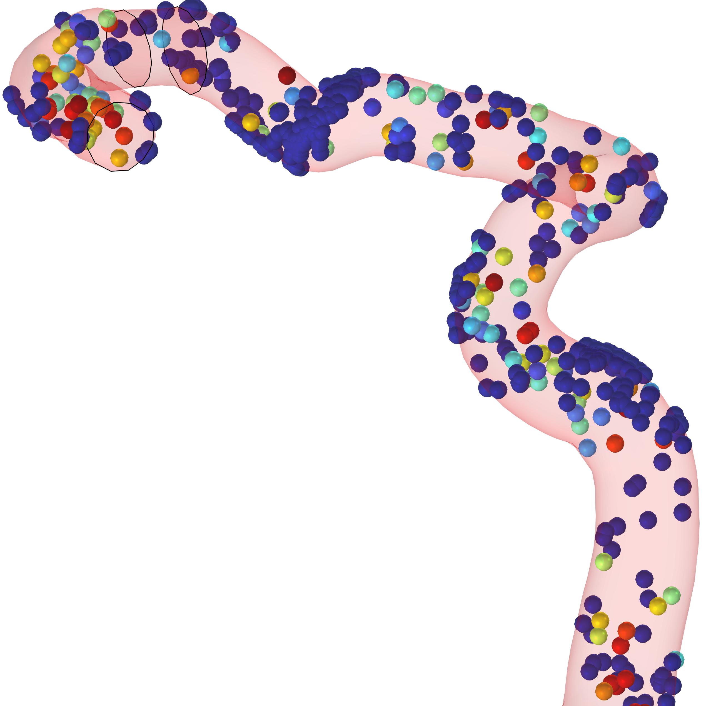
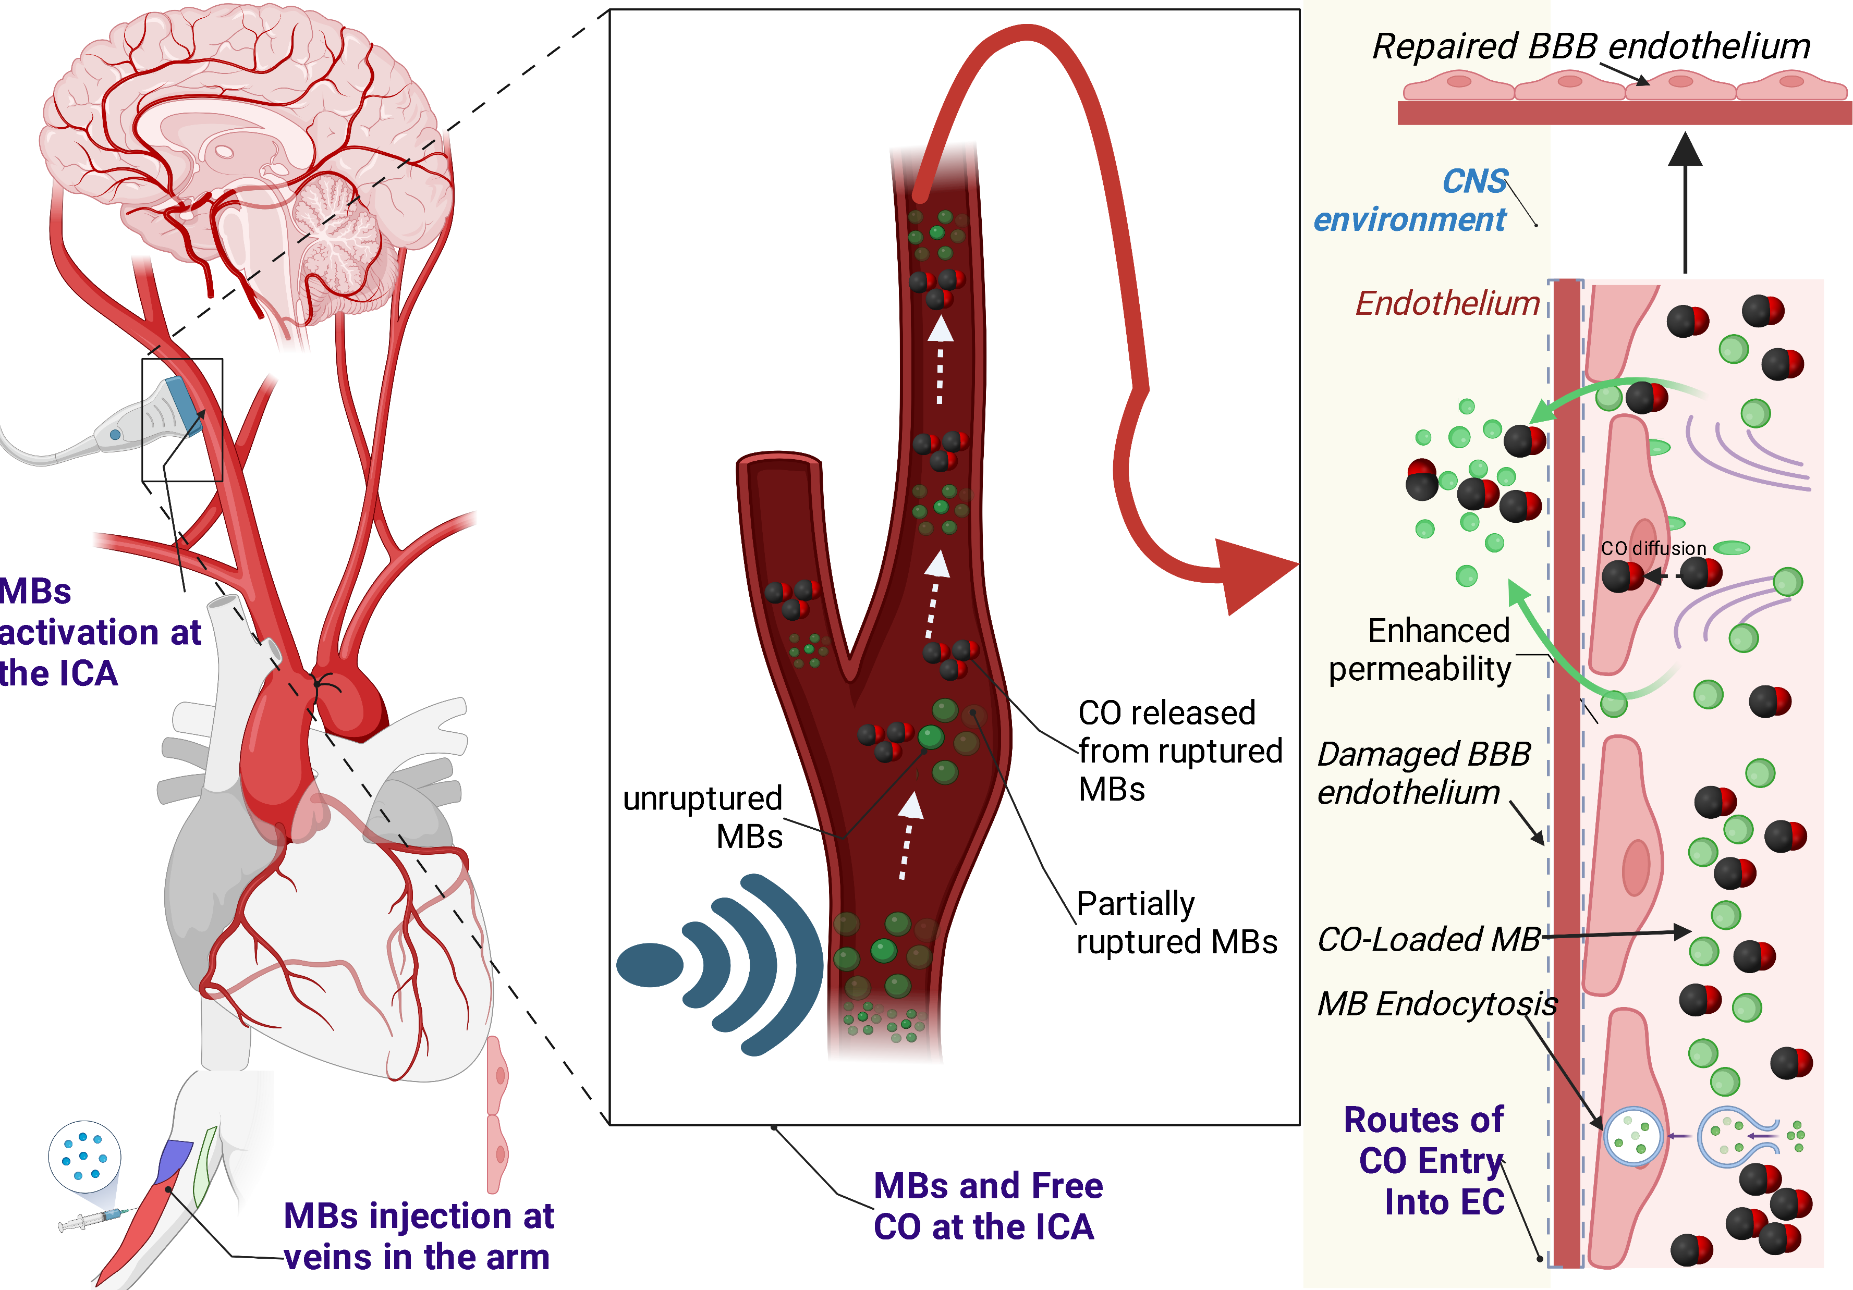
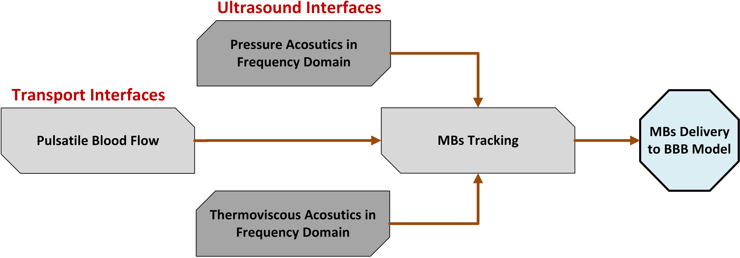
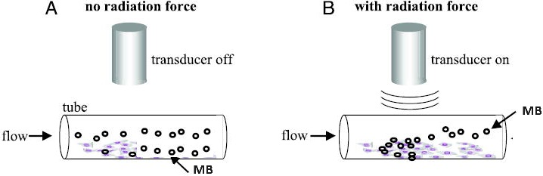
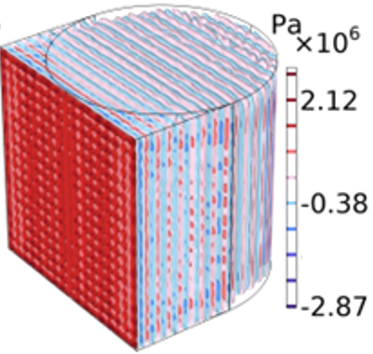
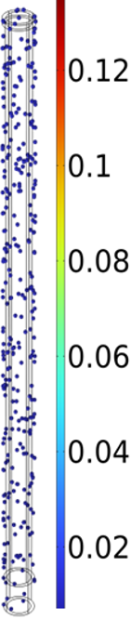
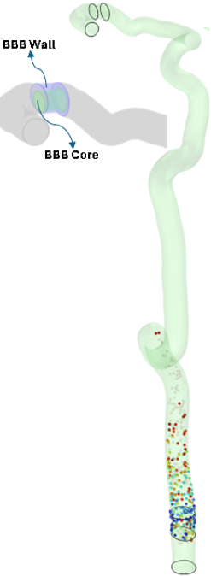
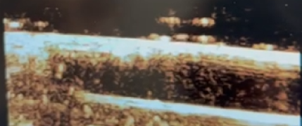

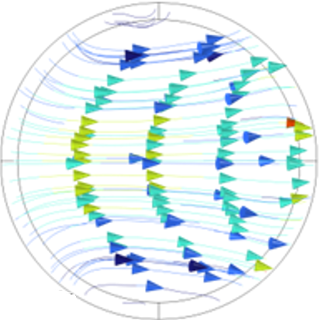
Ultrasound-Sensitive Microbubbles Delivery to treat Vascular Dementia
Vascular cognitive impairment and dementia (VCID) is caused when blood components leak through a disrupted blood brain barrier (BBB), and this increases with age and disease (Ref. 1). A combination of experimental and computational methods were used to understand the effects of ultrasound and tracking of microbubbles (MB) in the internal carotid artery (ICA).
¹Rubens Jourdain, ¹Shirin Changizi, ²Aiguo Han, ¹Venkat Keshav Chivukula and ¹Chris A. Bashur
1. Florida Institute of Technology, Melbourne, USA
2. Virginia Tech, Blacksburg, VA, 24061 , USA
Introduction & Goals
Current VCID treatments disrupt the BBB to deliver drugs to treat cognitive symptoms, but we are developing a unique strategy to repair the BBB and prevent further damage by delivering carbon monoxide (CO) from ultrasound-sensitive MBs.
Previously, we assessed the feasibility of CO gas delivery from CO-loaded MB using in silico modeling (Ref. 2), but we know that some MBs would not rupture. Hence, in this study, in vitro and in silico methods were used to investigate the feasibility of delivering microbubbles to restore the BBB.
Figure 1. Proposed strategy for delivering CO and MBs to cells at the BBB.
Methodology
Experimental: We prepared the MB with a nanoprecipitation method (1.30±0.40 µm) (Ref. 3) and loaded with CO. A gelatin-based phantom was used to determine MB rupture percentage and velocity with ultrasound.
Computational: Laminar pulsatile blood flow through the ICA was modeled in COMSOL® and reached steady state before releasing the MB. The amount that reach the endothelial cells (ECs) at the BBB were modeled with particle tracking and pressure acoustics. The impact of gravity, buoyancy, and MB size were considered. Application of 3, 7, and 18 MHz ultrasound were also investigated. It resulted into 3 separate models: ultrasound only, blood flow only and ultrasound combined with blood flow effects on the MB.
FIGURE 2. Model and ultrasound setup for activating the MB.
Results
No rupture of MBs without ultrasound (Control).
Trend of ↑ MB rupture with ↑ ultrasound intensity.
↑ acoustic pressure with ↑ frequency cause ↑ MB movement.
Ultrasound-induced blood velocity for 7 MHz at steady state.
↑ MB velocity at the center and ↓ velocity at the wall.
No impact of MB size on % MB at the BBB for simple tube, but
noticeable impact in patient specific.
Tortuosity causes regions of ↑ and ↓ MB at the wall.
19.5% average MB reach the BBB at wall with normal blood flow.
Acoustic Forces counteract blood flow and cause MBs to stick at wall, hence, ↓ % MBs reach BBB wall.
* Significance from 0%
FIGURE 3. View of the pipe bend showing the von Mises stress (normalized) and principal stresses for different wall thicknesses.
Thom SR, Fisher D, Xu YA, (2020), PMID: 10655526.
Jourdain and Bashur, Front Pharmacology, (2023), 8:659.
Changizi and Bashur, Journal of Biomedical Material Research, (2024).
Funding source: Community Foundation of Brevard.

