Slide 1
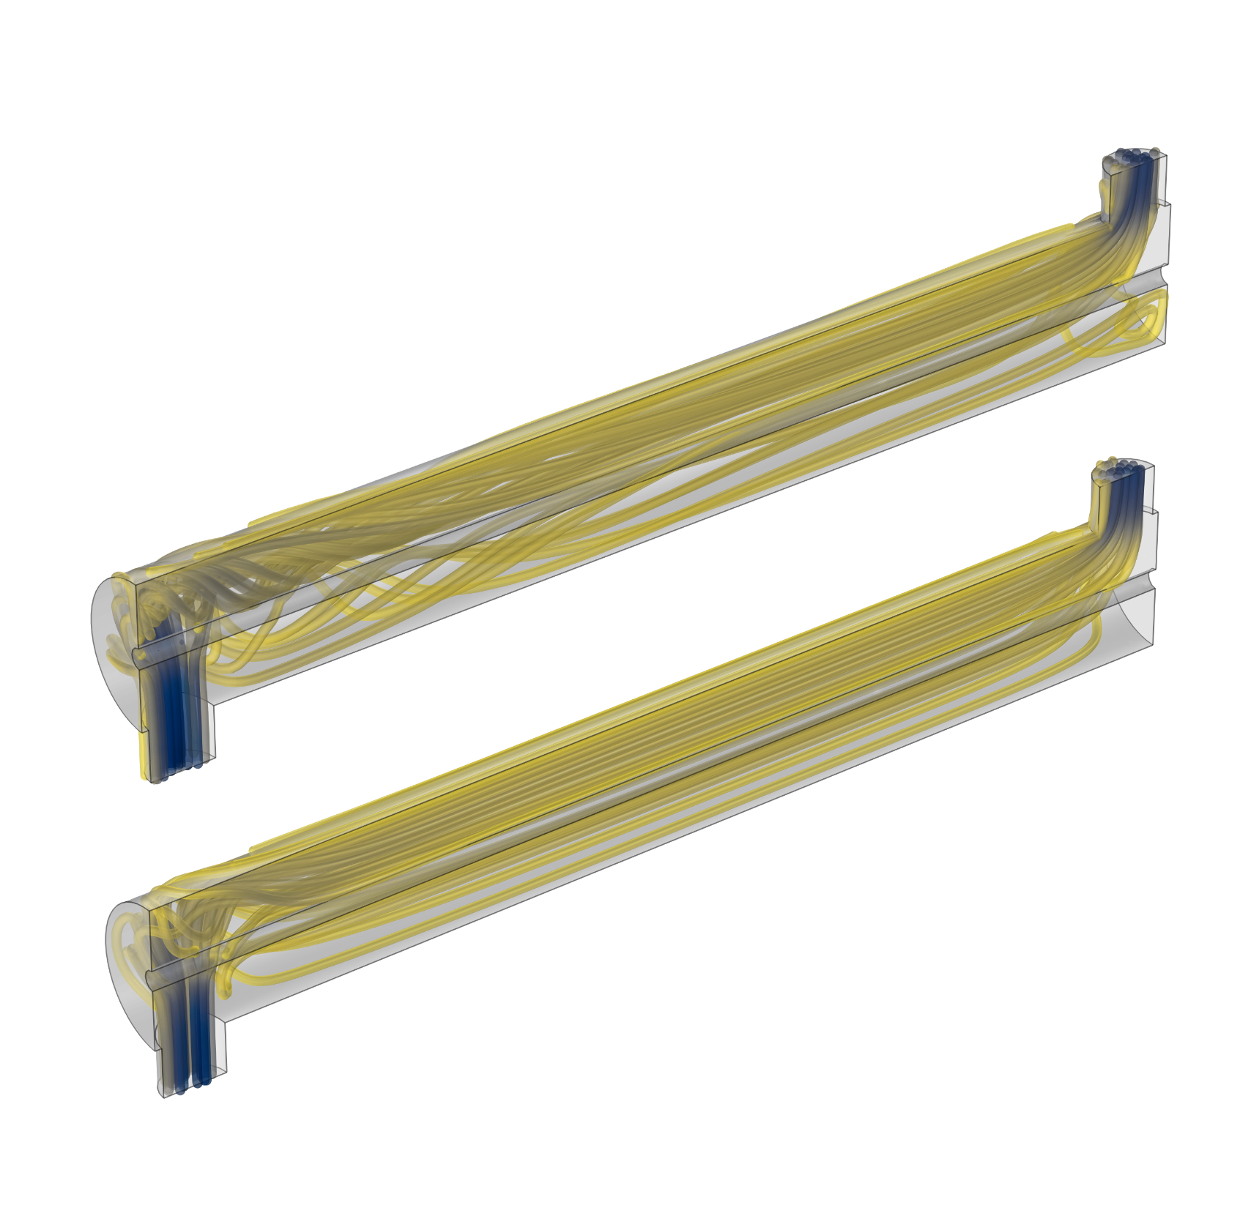
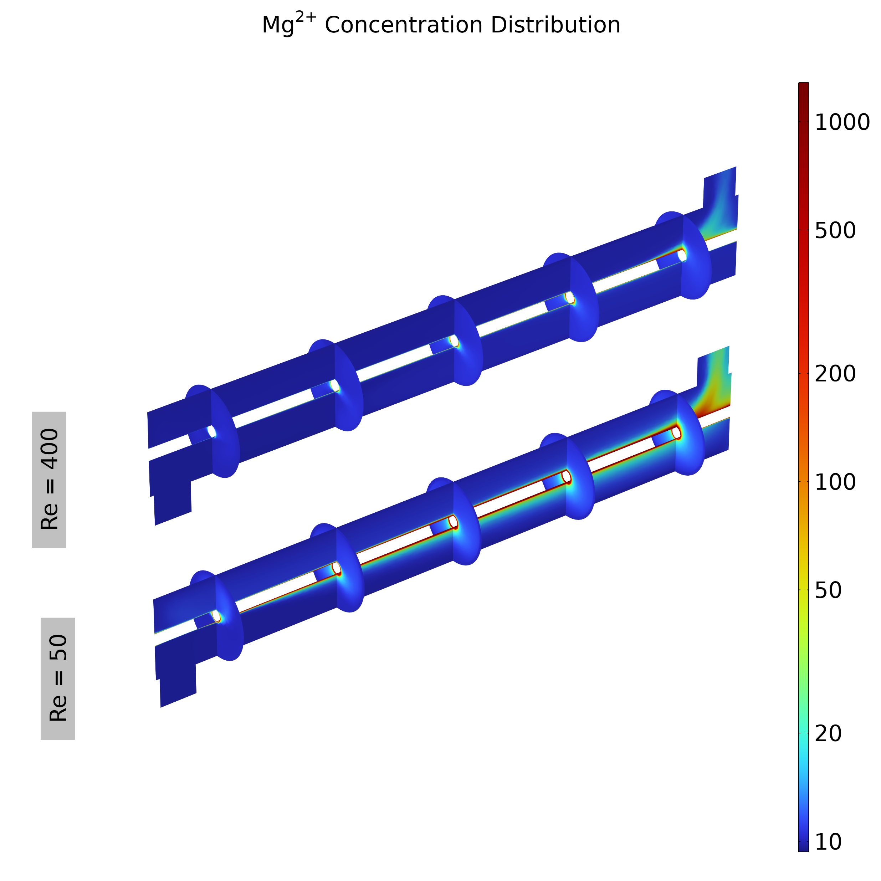
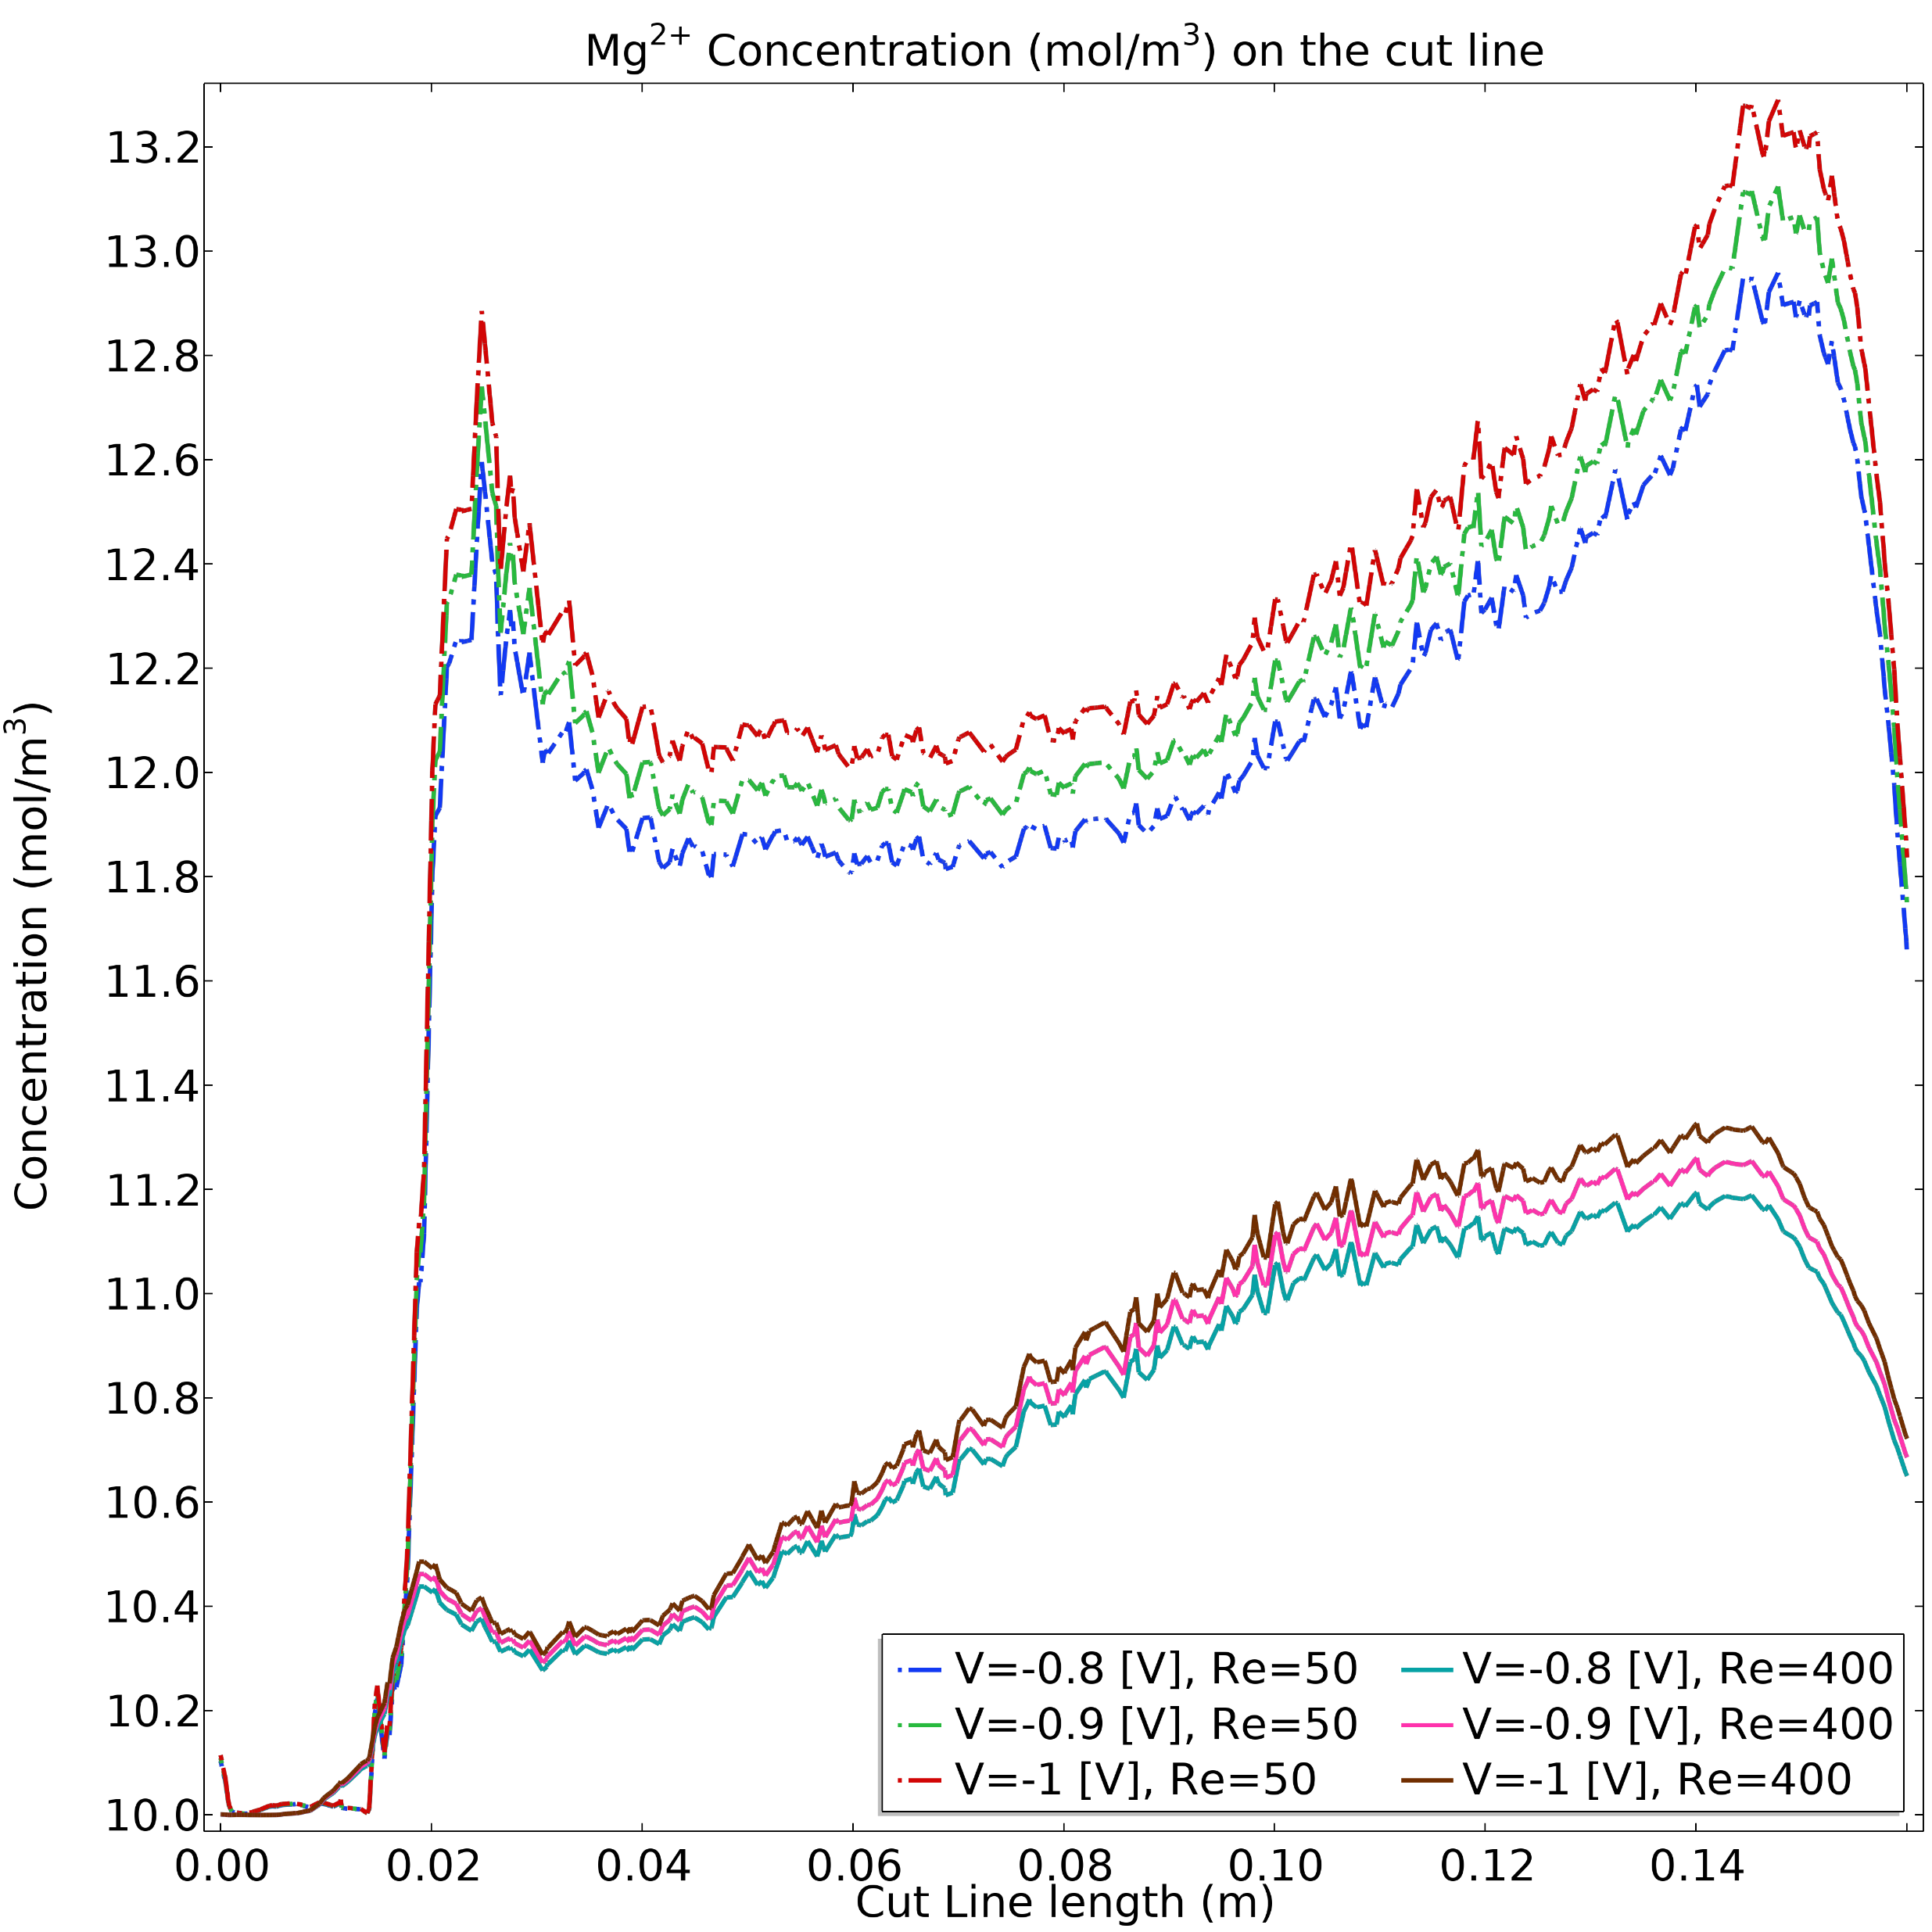
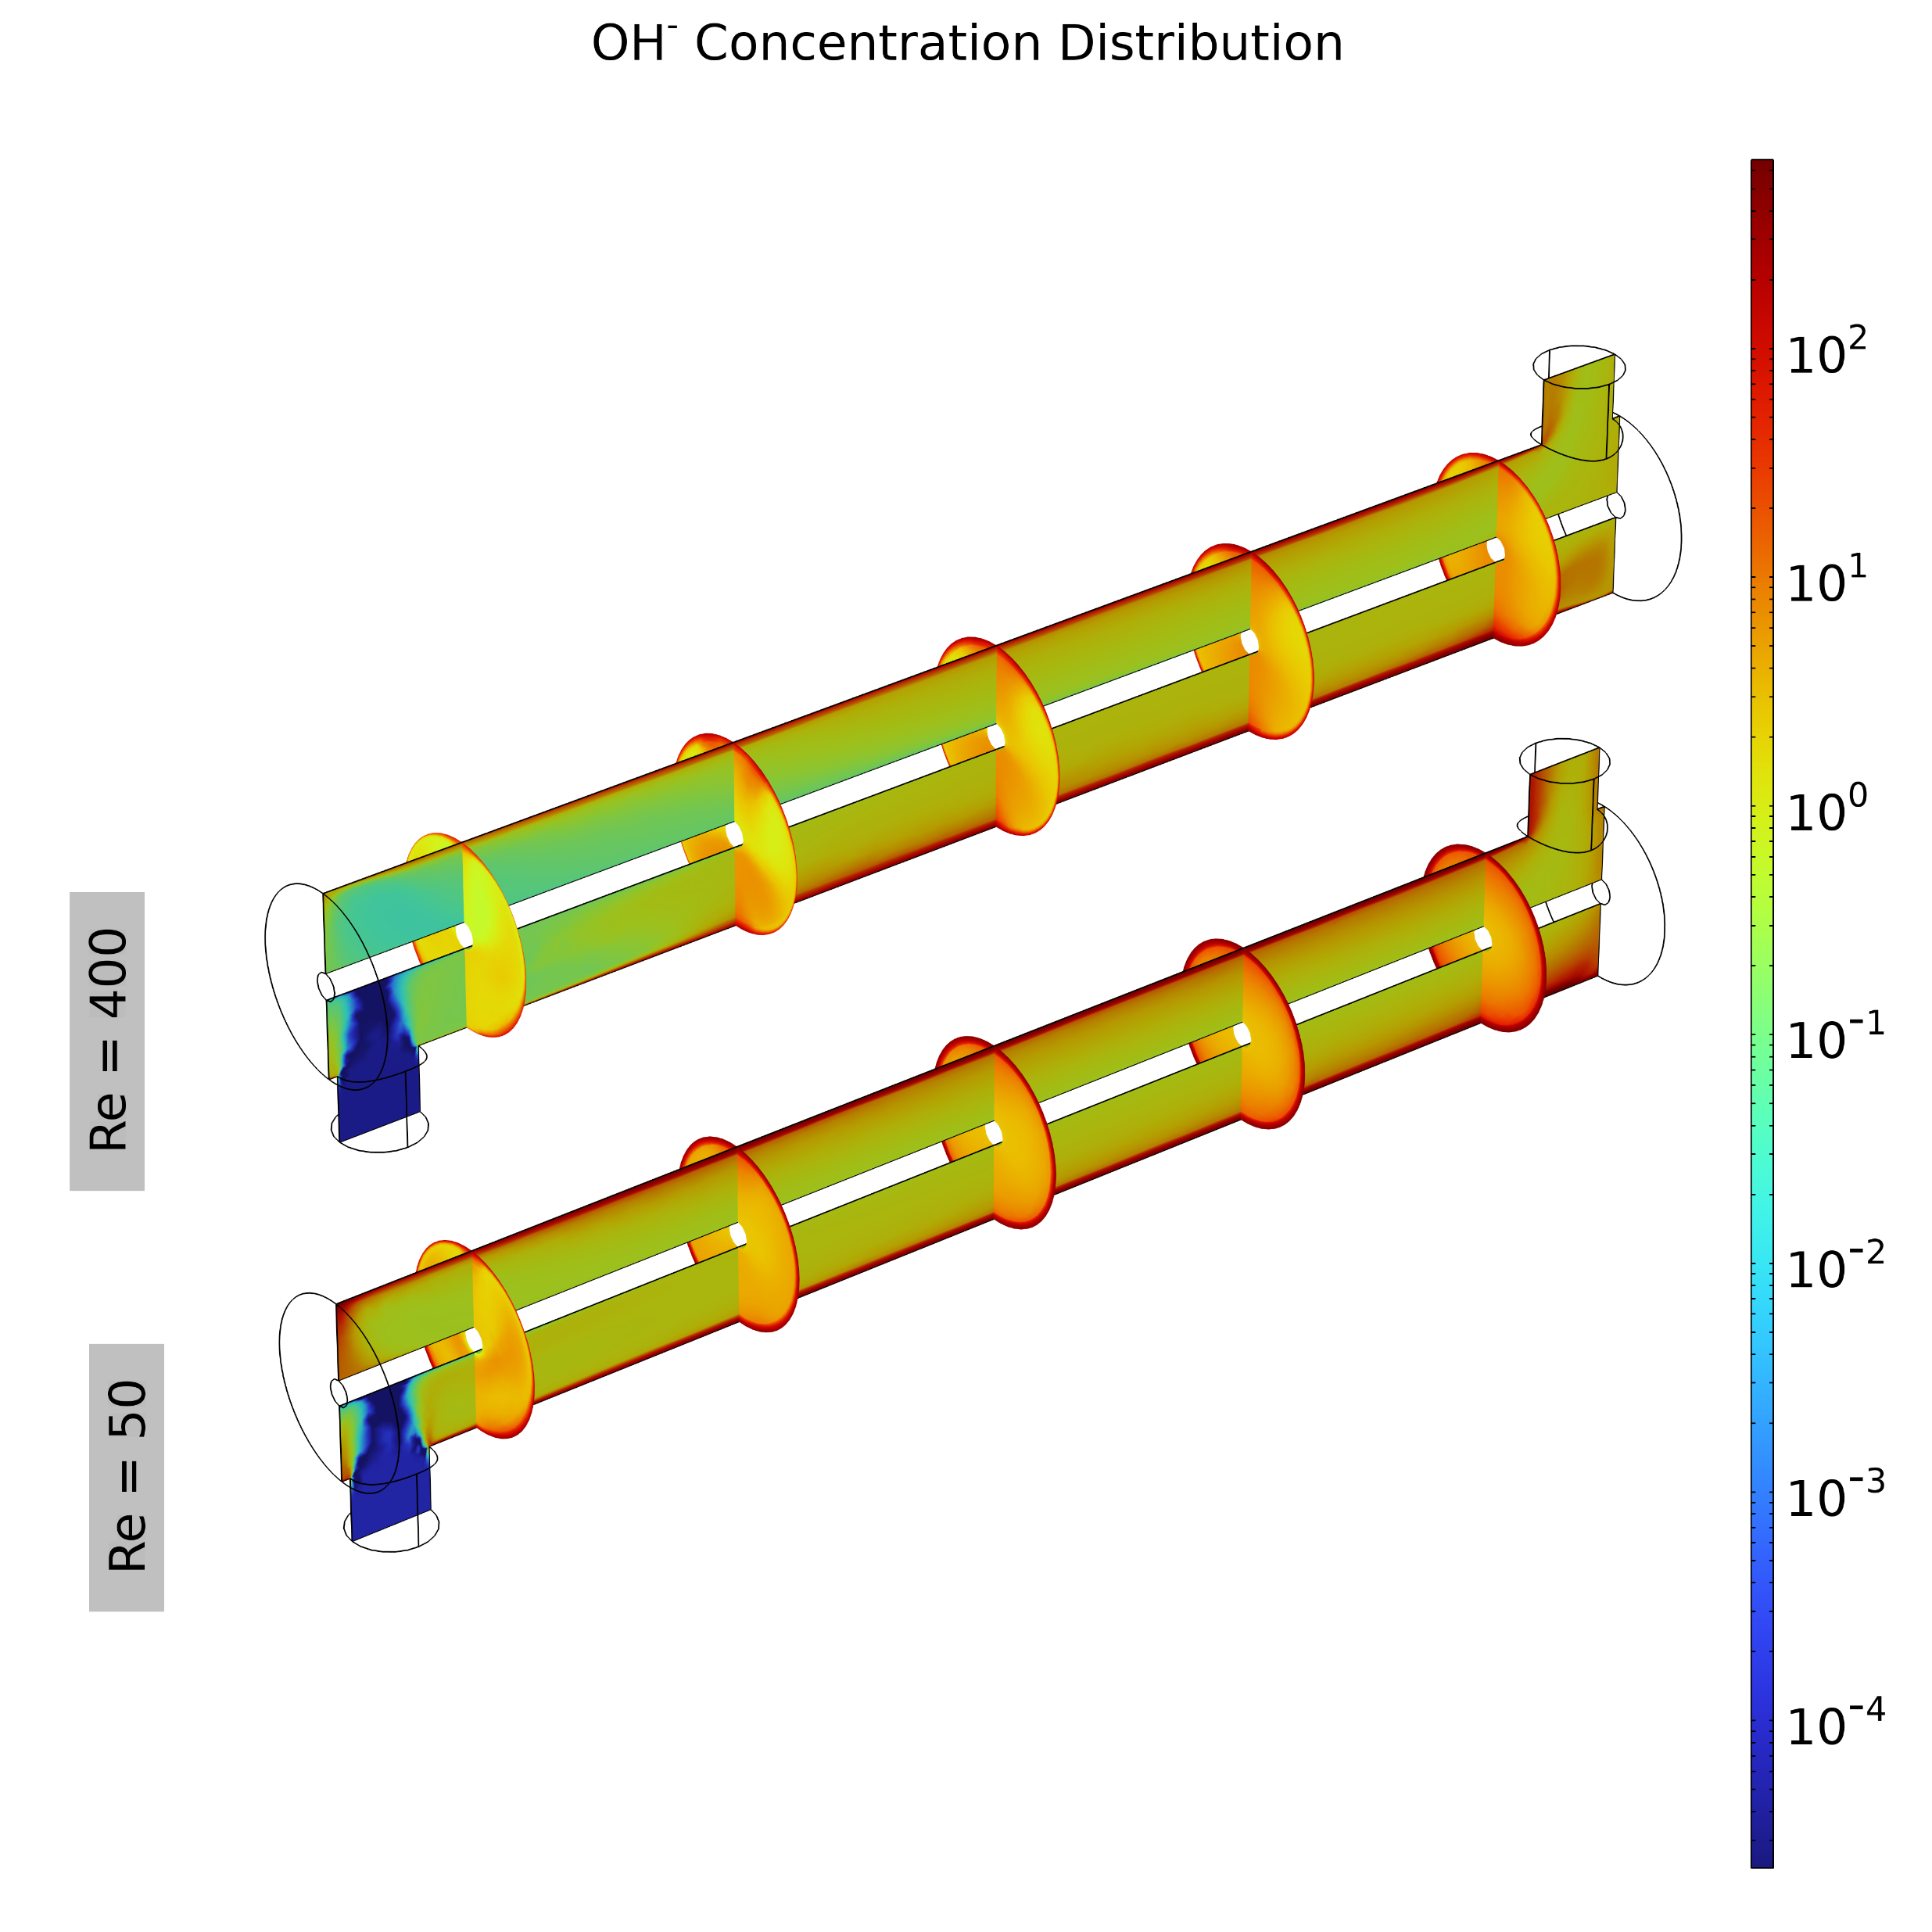
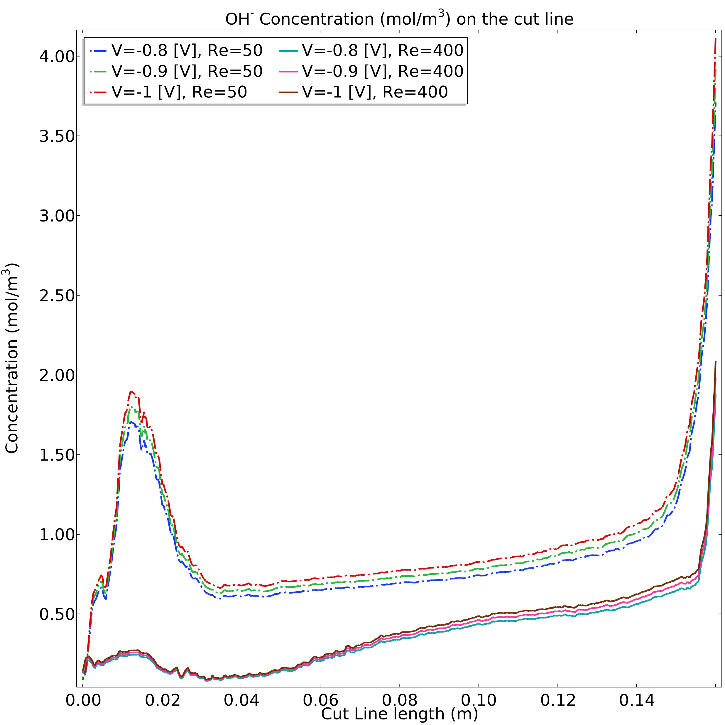
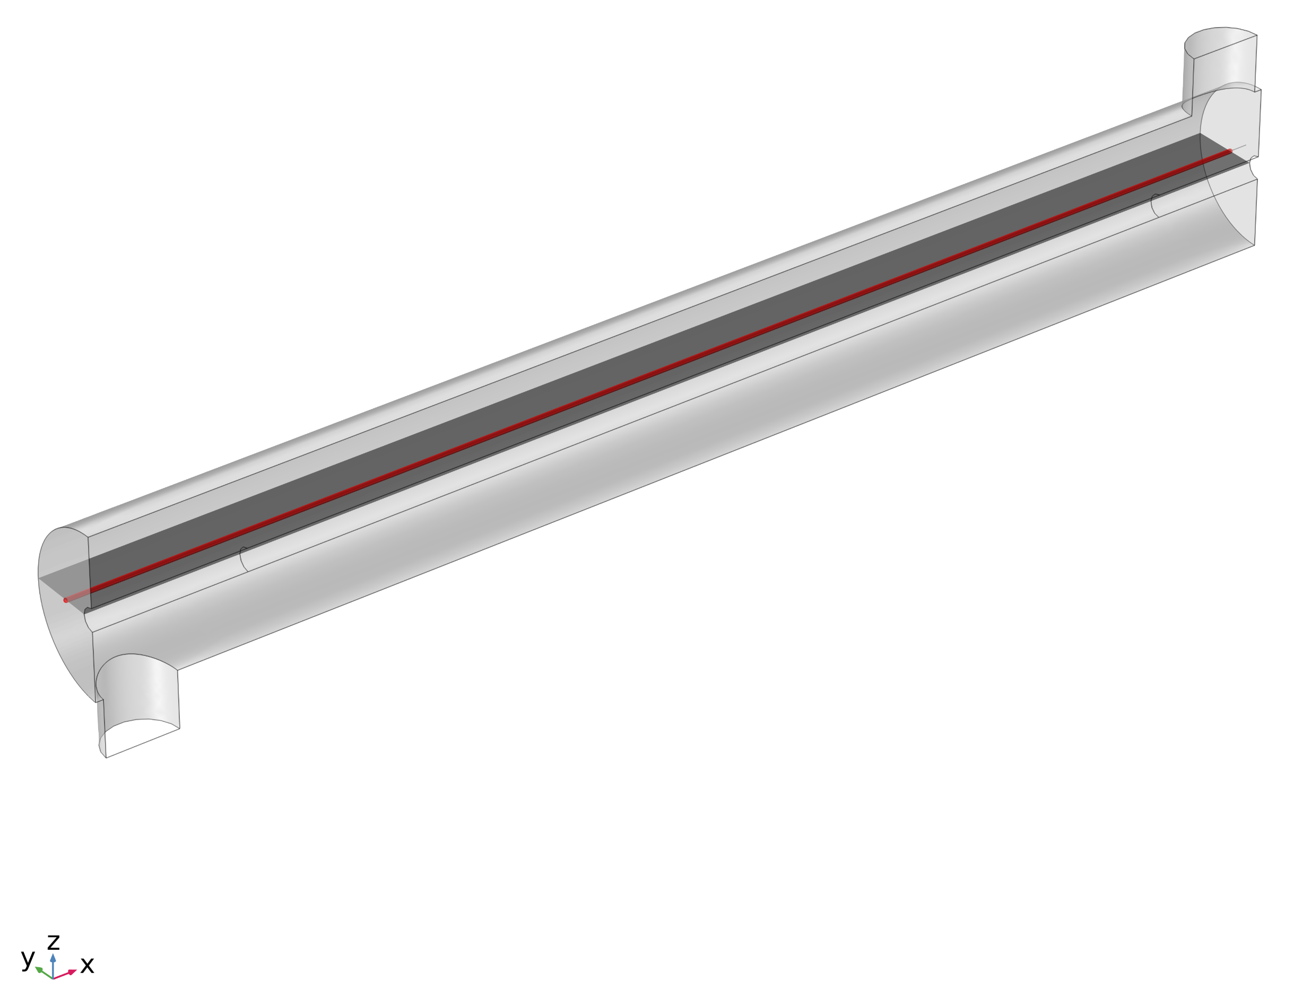

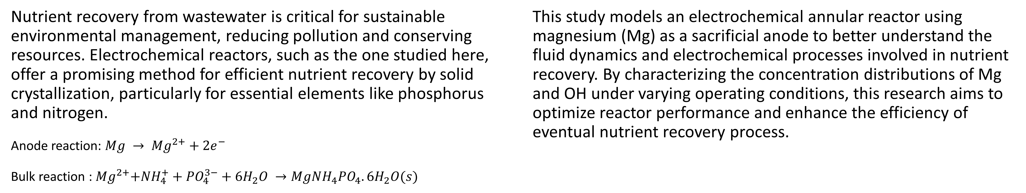
Fluid Dynamics & Electrochemical Kinetics in Annular Reactors: A Study for Resource Recovery
This study characterizes the concentration distribution of Mg and OH in an electrochemical continuous reactor by sweeping operating conditions, specifically inlet flow rates and applied potentials. The findings are crucial for optimizing nutrient recovery processes.
A. Zanganeh¹ and D. A. Daramola^{1,2}
1. Department of Chemical Engineering, Northeastern University
2. Department of Chemistry and Chemical Biology, Northeastern University
Introduction & Goals
Nutrient recovery from wastewater is critical for sustainable environmental management, reducing pollution and conserving resources. Electrochemical reactors, such as the one studied here, offer a promising method for efficient nutrient recovery by solid crystallization, particularly for essential elements like phosphorus and nitrogen.
Anode reaction: $Mg → {Mg}^{2+}+2e^{−}$
Bulk reaction :${ Mg}^{2+}+{NH}_{4}^{+}+{PO}_{4}^{3−}+6H_{2}O →MgNH_{4}PO_{4}.6H_{2}O(s)$
This study models an electrochemical annular reactor using magnesium (Mg) as a sacrificial anode to better understand the fluid dynamics and electrochemical processes involved in nutrient recovery. By characterizing the concentration distributions of Mg and OH under varying operating conditions, this research aims to optimize reactor performance and enhance the efficiency of eventual nutrient recovery process.
Methodology
The study models fluid flow within a 3D electrochemical continuous reactor under stationary conditions. Leveraging symmetry to reduce computational complexity, the fluid dynamics are assumed laminar flow with two distinct Reynolds number (Re), 50 and 400.
The tertiary current distribution is then analyzed using the flow results. Electrochemical kinetics are described by a concentration-independent Butler-Volmer equation and supporting electrolyte is assumed. The mass transfer of species is modeled using the Nernst-Planck equation, with migration effects due to the electric field neglected. Applied potentials are varied at -0.8 V, -0.9 V, and -1.0 V to study their impact on the distribution of Mg²⁺ and OH⁻ ions within the reactor.
FIGURE 1. Left: Magnesium concentration distribution inside the reactor at applied potential -1 V. Right: Magnesium concentration on the cut line at various applied potentials and Re numbers.
Results
The velocity streamlines demonstrate helical flow patterns near the inlet for both Reynolds numbers (Re). At Re = 400, the streamlines are more chaotic and complex, resulting in enhanced radial and axial mixing compared to Re = 50. This rotational flow plays a significant role for species distribution within the reactor. Figures 1 and 2 (left) show higher concentration gradients and thicker boundary layers near the electrodes at lower Re.
Figures 1 and 2 (right), concentration on a cutline in the bulk, reveal higher species concentrations at lower Re, particularly near the outlet. While higher applied potentials increase concentrations, the difference is less significant at higher Re. Generally, lower Re numbers foster controlled crystallization but risks solid deposition and inefficient transport, potentially clogging the reactor. Therefore, the optimal Re should balance preventing deposition and ensuring effective transport while maintaining conditions favorable for solid crystallization, thus optimizing nutrient recovery without compromising reactor performance.
FIGURE 2. Left: Hydroxide concentration distribution inside the reactor at applied potential -1 V. Right: Hydroxide concentration on the cut line at various applied potentials and Re numbers
Acknowledgement
This work is funded by Department of Energy's Office of Energy Efficiency and Renewable Energy (EERE) under the Industrial Efficiency and Decarbonization Office (IEDO) Number DE-EE0009502. The views expressed herein do not necessarily represent the views of the U.S. Department of Energy or the United States Government.
J. Newman et al (2021). Electrochemical Systems. Wiley.
W. Xu et al. "A mathematical model describing the surface evolution of Mg anode during discharge of aqueous Mg-air battery." Journal of Power Sources, Volume (542), Page numbers (231745), 2022.
N. Wang et al. "Discharge and corrosion behaviour of Mg-Li-Al-Ce-Y-Zn alloy as the anode for Mg-air battery." Corrosion Science, Volume (112), Page numbers (13-24), 2016.

