Slide 1
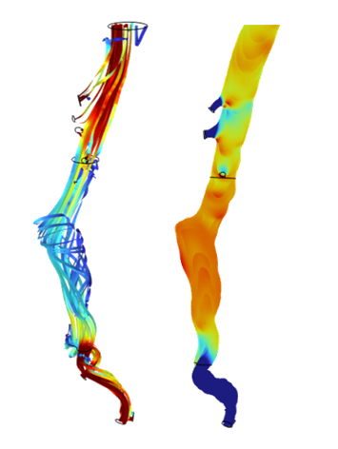
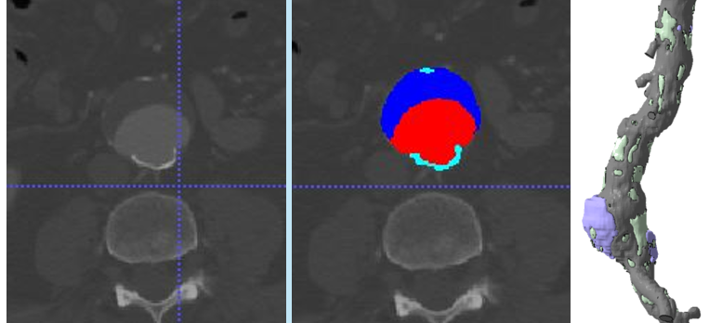
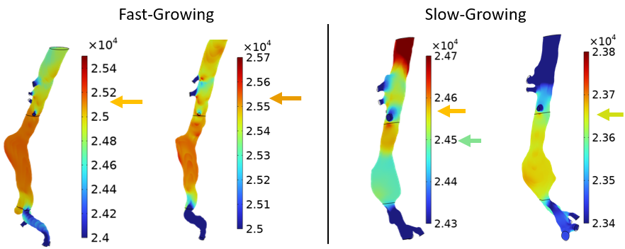

Developing a Growth Prediction Model of Abdominal Aortic Aneurysms
Analysis of blood flow properties within Abdominal Aortic Aneurysms allows for the identification of potential key mechanical parameters that contribute to the aneurysm growth rate.
G. N. Pittas¹, W. Yin¹
1. Department of Biomedical Engineering, Stony Brook University, Stony Brook, NY
Introduction & Goals
Abdominal Aortic Aneurysms (AAAs) are the ballooning of the descending aorta. Intervention only occurs once the growth exceeds a certain threshold. Furthermore, there lacks a predictive model to the growth of these aneurysms.
Previous studies have pointed to potential parameters, but geometric studies alone fail to analyze blood flow parameters. Thus, the goal of the study was to develop computational fluid dynamics models to evaluate how blood flow-induced stress affects AAA growth rate.
This project aims to serve as a basis to create a predictive model for aneurysm growth, providing a better method in preparing treatment to patients with AAAs.
Methodology
Laminar Models – Each patient’s CT-scan was analyzed with the blood volume being selected and traced from slightly above the celiac arteries down to the iliac arteries. Blood was modeled as a Newtonian fluid, and the celiac, mesenteric, renal, and iliac arteries were defined as the pressure outlets. Velocity, surface pressure, and average shear stress were all noted with each simulation.
Fluid-Structure Interaction Models – Each patient’s CT-scan was re-analyzed with each unique domain being traced separately: vessel wall, thrombus, calcification, and blood volume. Each domain is fully coupled. Velocity, surface pressure, and average shear stress will be analyzed in a similar manner. This stage of the project is currently underway.
Figure 1. Creation of the segmentation masks from CT-scan images to generate the 3D patient model shown on the right.
Results
Results from the laminar models demonstrated an increase in average surface pressure over time in fast-growing aneurysms, which decreased in slow-growing aneurysms. Secondly, average shear stress appeared to have an increase over time (data not shown). However, it is important to note that no significant results between the slow- or fast-growing group were noted. While Fluid-Structure Interaction models have not yet been run, the results shown from the beginning tests of the project give the promise in analyzing the blood-flow properties with AAAs. Furthermore, as more cases are analyzed, key mechanical parameters potentially will be identified that correlate to the aneurysm growth rate, serving as the foundation to a predictive model to better the planning in treatment for patients diagnosed with AAAs.
Figure 2. Laminar model results comparing fast-growing (>5 mm/yr) and slow-growing aneurysm (<2.5 mm/yr) surface pressure (Pa) over time.
A, Chandrashekar et al., “Prediction of Abdominal Aortic Aneurysm Growth Using Geometric Assessment of Computerized Tomography Images Acquired During the Aneurysm Surveillance Period,” Annals of Surgery, vol. 277, 2023.
J, Chung, “Epidemiology, risk factors, pathogenesis, and natural history of abdominal aortic aneurysms,” UpToDate, 2021.
C, Figueroa et al., “A coupled momentum method for modeling blood flow in three-dimensional deformable arteries,” Computer Methods in Applied Mechanics and Engineering, vol. 195, 2006.

