Slide 1

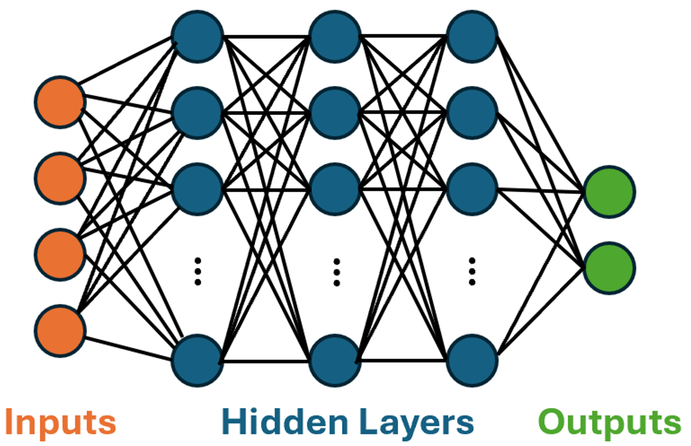
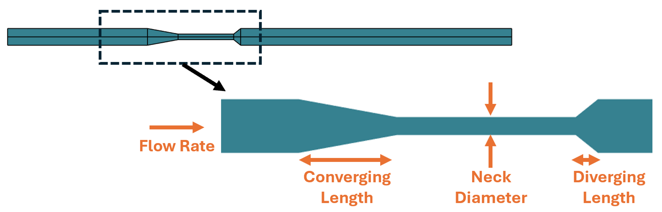
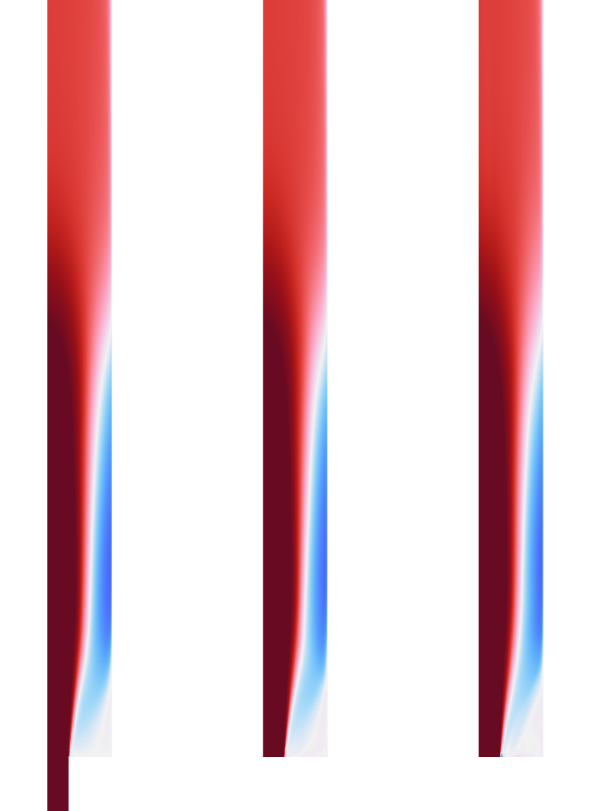
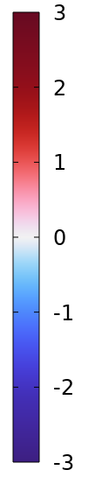
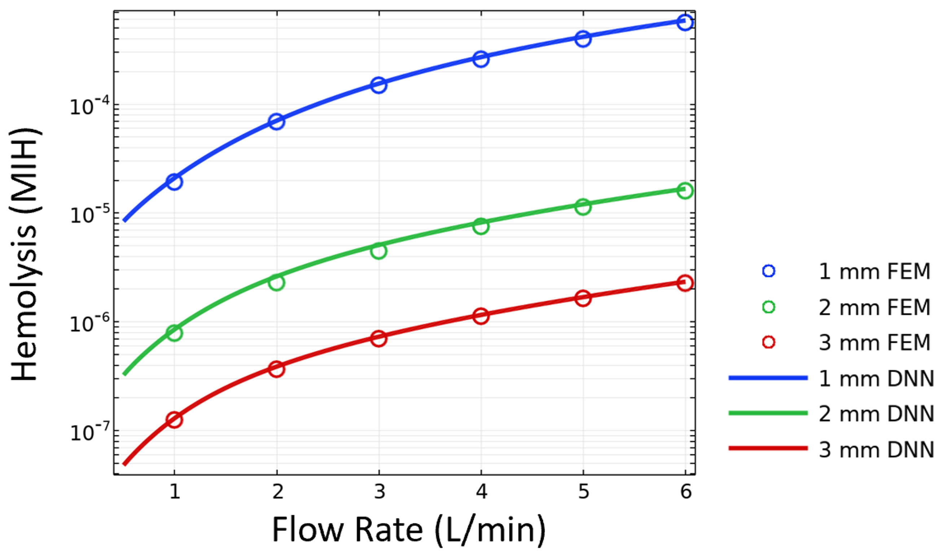


Deep Neural Network Surrogate Model for Blood Damage Modeling in FDA Hemolysis Benchmark
This work uses the Deep Neural Network (DNN) feature introduced in COMSOL Multiphysics® 6.2 to build surrogate models for predicting recirculation zones and hemolysis, a measure of blood damage.
Andrew Spann, Ph.D.
Joseph Barakat, Ph.D.
Matthew Hancock, Ph.D.
aspann@veryst.com
jbarakat@veryst.com
mhancock@veryst.com
Veryst Engineering
Needham, MA, USA
Introduction
The US Food and Drug Administration (FDA) has developed two benchmark geometries for validating numerical simulations used in regulatory submissions¹. The nozzle benchmark consists of a tube with a contraction, neck, and expansion. Our goal is to create a simulation to aid medical device designers in understanding the relationship between device geometry and blood damage. Herein, we define “blood damage” as hemolysis measured by an increase in non-bound hemoglobin in the blood circulating through a device. This quantity is readily measured in experiments², although other considerations such as sublethal damage and thrombosis are important as well. We predict blood velocity and then estimate hemolysis using a power-law relationship as a function of stress³ detailed in our previous COMSOL Conference talk⁴. The hemolysis model output represents the prediction of how much hemoglobin is released to the blood stream due to cell rupture or leakage.
Flow
Methodology
Veryst trained and deployed deep neural network (DNN) surrogate models to provide real-time predictions of velocity and hemolysis. Fluid properties are chosen to match the FDA benchmark protocol published in Herbertson et al.² We allow four adjustable input parameters as shown in Figure 1. For the hemolysis model, we computed mean hemolysis across the flow’s exit with a Design of Experiments sample of 9000 simulations. The DNN contained three hidden layers with 20 nodes each using tanh activation functions. Training consisted of 5000 epochs. Our velocity network consisted of a DNN trained on 500 simulations at 3500 epochs with 32 nodes in each of three hidden layers. Velocity training data consists of all mesh points after expansion, and we set diverging length=0 to focus on recirculation zones.
FIGURE 1. Schematic of nozzle setup. Text labels indicate four parameters varied as inputs to DNN model. Diameter at inlet and outlet is fixed at 12 mm and length of neck region is 40 mm. Diverging and converging lengths can be as low as 0.
Results
Axial Velocity
w/w_{avg}
Hemolysis
In addition to creating a surrogate model to train the velocity components u and w directly on raw data, we created a modified DNN with a physically-informed no-slip hard constraint trained on the deviation of axial velocity w’ from the analytic laminar flow solution w’ = w – (2*Q/A)(1-(r/R)²). Here Q is flow rate, A=cross-sectional area, r=radial coordinate and R=end radius. Both the raw data DNN and the physical hard constraint DNN replicate flow profiles faithfully in turbulent circumstances, which represent most of the underlying training data, but are less quantitative when asked to match the simulation in laminar or transition to turbulence regimes.
Hemolysis predictions are within 10% or better across a broad range of inputs when trained to match the log of hemolysis. Changing the converging and diverging lengths of the geometry had minimal effect on hemolysis both in the FEA and DNN predictions.
FEM
DNN
DNN + Constraint
FIGURE 2. Left: Velocity profiles at Reynolds number Re=6500 replicating FDA geometry showing recirculation after expansion. Right: Hemolysis (MIH, fraction of released hemoglobin) at nozzle endpoint for FDA geometry with variable neck radius and flow rate.
[1] United States Food and Drug Administration. Benchmark dataset for validating computational fluid dynamic (CFD) simulation of blood flow through generalized medical device geometries. DOI:10.5281/zenodo.6629049. 2022.
[2] Herbertson, L.H., et al. Multi-laboratory study of flow‐induced hemolysis using the FDA benchmark nozzle model. Artificial organs, 39(3): 237-248. 2015.
[3] Grigioni, M., et al. A novel formulation for blood trauma prediction by a modified power-law mathematical model. Biomechanics and Modeling in Mechanobiology, 4, 249-260. 2005.
[4] Vanegas, A., Spann, A., & Kermani, A. (2020). Blood Damage Modeling of FDA Benchmark Nozzle. COMSOL Conference Boston. 2020.

