Slide 1
Coordination of Time-Dependent Simulation Parameters Using the Application Builder in COMSOL Multiphysics®
COMSOL Conference Boston, October 2024
Dr. Paul Belk*, Dr. Anna Harrington*
*Boston Scientific Corporation, Boston, MA

Slide 2
Overview
Time-dependent simulations are most interesting when external factors change
The simulation needs to be evaluated before and after each change
  Simulator might not “notice” on its own
  Explicit evaluation required
  If the user is specifying changes, it can be hard for the designer to anticipate them, even with events
Even designers (Model Builder) can have trouble accounting for all changes
The App builder (using Java code) can do this automatically
This is essential for app users… and very handy even for Model designers

Slide 3
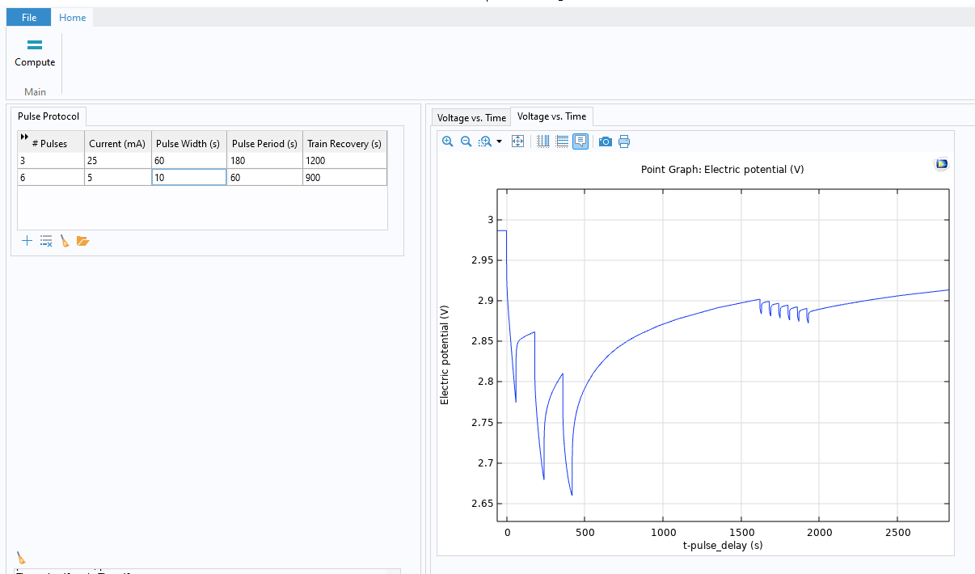
Simple Example: Current Pulse
Li-Ion Battery 1D +1 Model
Anode
Separator
Cathode
Particle
Alternative Use Cases
Boundary conditions
  Concentration
  Temperature
  Flow Rate
  Pressure
  Stress
Material parameters

Slide 4
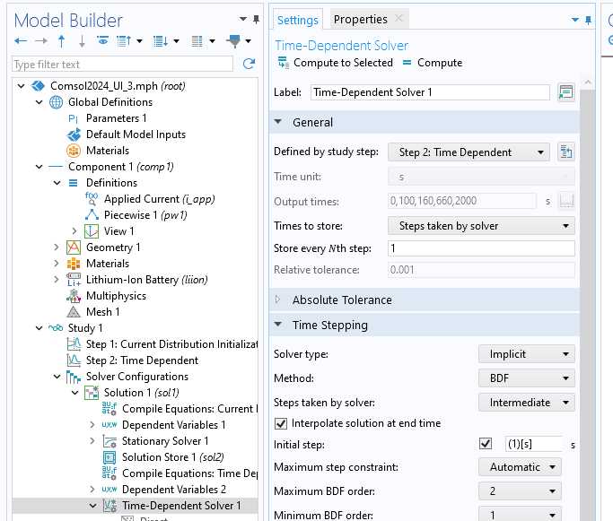
Specify Time-Dependent Solver Settings

Slide 5
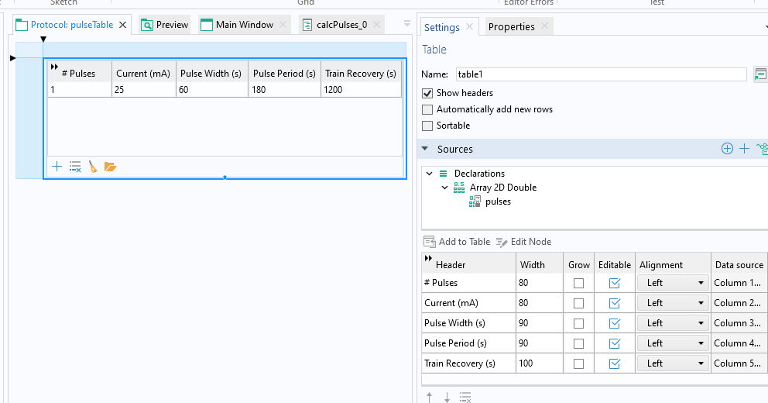
Link Data Structures to UI
Model Builder
Application Builder
Piecewise function
Table Object
Declarations
Methods
Java Code

Slide 6
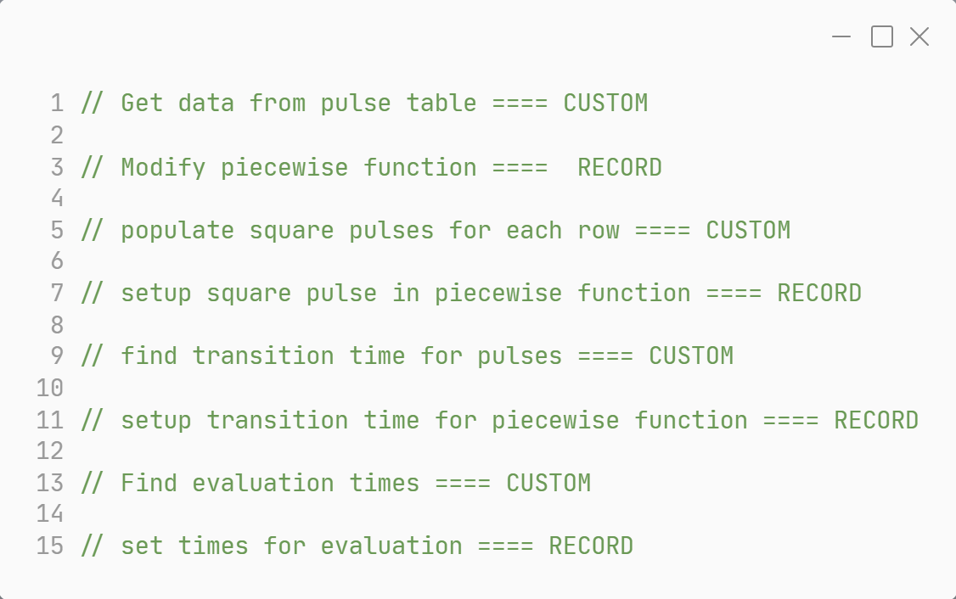
Procedure
Step 0: Create UI in App Builder to specify time-dependent factors
Step 1: Link data structures to UI
Step 2: Specify Time Dependent Solver Settings
Step 3: Comment Method Code
Step 4: Record code to set up conditions
Step 5: Record code to set up evaluation times
Step 6: Modify Method Code
Step 7: Fire and Forget
Method Code Structure

Slide 7
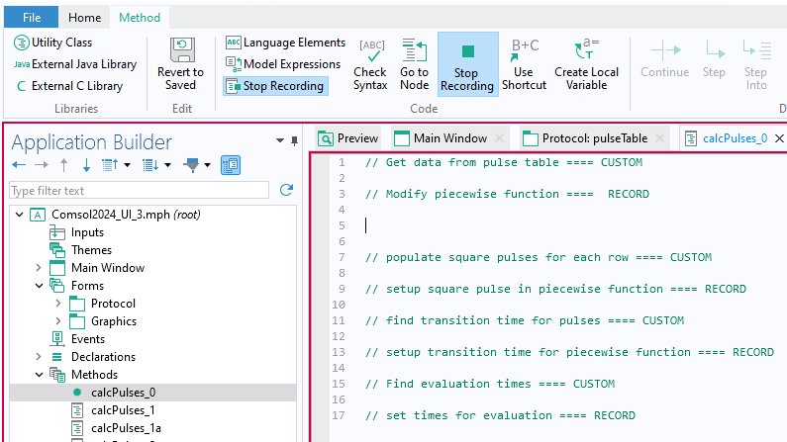
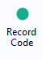
Record Code to Set Up Conditions
Notes:
Record code Button

Slide 8
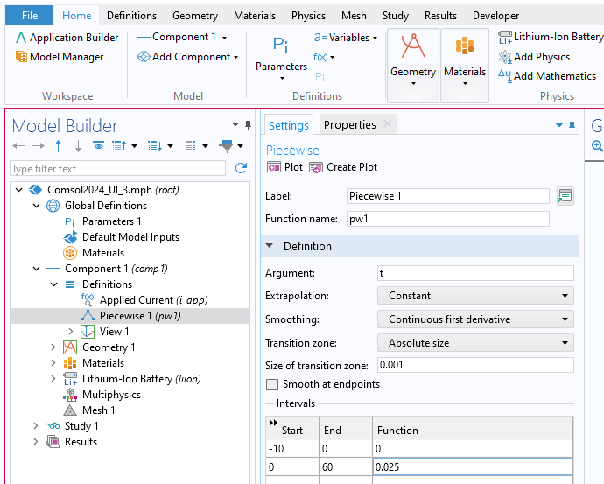
Record Code to Set Up Conditions
While Recording Code:
Create Piecewise Function
Set size of Transition zone
Edit Start, End and Function Intervals
Notes:
Populate a Piecewise Table

Slide 9
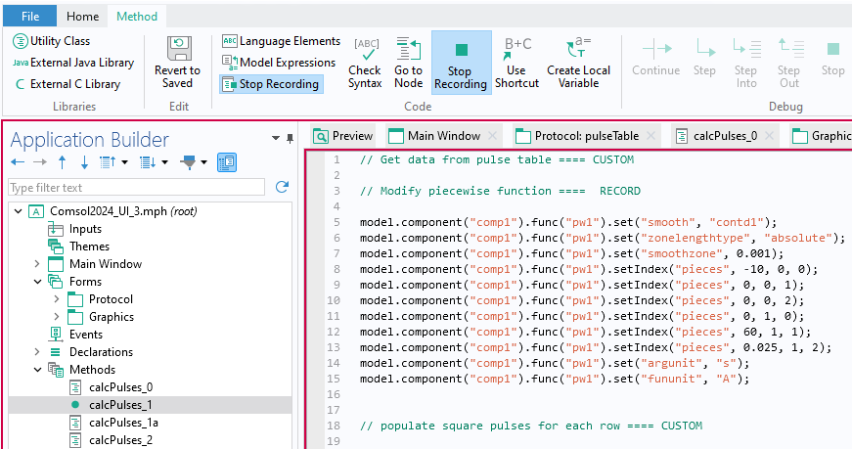
Record Code to Set Up Conditions
Notes:
Back to application builder and voila! COMSOL has dropped code into. Example,

Slide 10
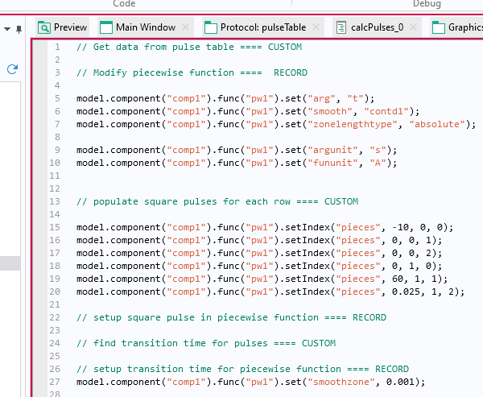
Record Code to Set Up Conditions
Notes:
Spread code out

Slide 11
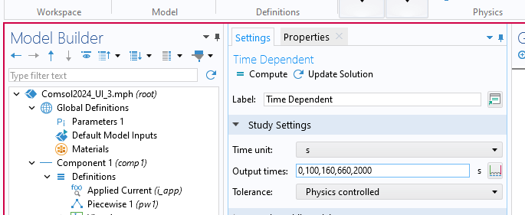
Record Code to Set Up Evaluation Times
While Recording Code:
Edit Output times
Notes:
Critical to put evaluation times

Slide 12
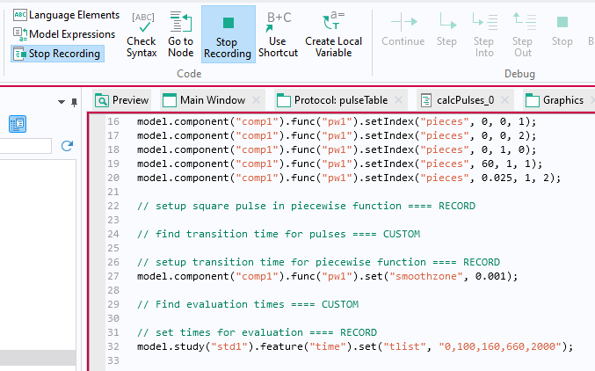
Record Code to Set Up Evaluation Times
Notes:
COMSOL has told us everything we need to setup structure

Slide 13
Method: Inputs
// Get data from pulse table == CUSTOM
// determine number of pieces in piecewise function.
int nPieces = 0;
double minDur = pulses[0][2]; // for transition times
for (int row = 0; row < matrixSize(pulses)[0]; ++row) {
nPieces += pulses[row][0]*2; // each row also has a recovery piece
if (pulses[row][2] < minDur) minDur = pulses[row][2];
if (pulses[row][3] < minDur) minDur = pulses[row][3];
}
int curPiece = 0;
double xTime = minDur/10; // set the transition time based on the shortest pulse
// for each piece (change) in the piecewise, we place two evaluation times
double[] times = new double[2*(nPieces)+4];

Slide 14
Method: Modify Piecewise Function
// setup square pulse in piecewise function == RECORD
for (int pNum = 0; pNum < nPulses; ++pNum) {
// rising edge
times[nTime++] = pTime-xTime+firstPulse;
times[nTime++] = pTime+xTime+firstPulse;
model.component("comp1").func("pw1").setIndex("pieces", pTime, curPiece, StartTime);
pTime += duration;
model.component("comp1").func("pw1").setIndex("pieces", pTime, curPiece, EndTime);
model.component("comp1").func("pw1").setIndex("pieces", current, curPiece, Amplitude);
// falling edge
++curPiece;
times[nTime++] = pTime-xTime+firstPulse;
times[nTime++] = pTime+xTime+firstPulse;
model.component("comp1").func("pw1").setIndex("pieces", pTime, curPiece, StartTime);
pTime += (period-duration);
model.component("comp1").func("pw1").setIndex("pieces", pTime, curPiece, EndTime);
model.component("comp1").func("pw1").setIndex("pieces", 0.0, curPiece, Amplitude);
Notes:
Write a Loop to co through table

Slide 15
Method: Modify Evaluation Times
// Setup transition time for piecewise functions ==== RECORD
model.component("comp1").func("pw1").set("smoothzone", xTime/5);
// Find evaluation times ==== CUSTOM
String timeStr = "0";
for (int i = 1; i < nTime; ++i) {
timeStr += ",";
timeStr += toString(times[i]);
}
// set times for evaluation ==== RECORD
model.study("std1").feature("time").set("tlist", timeStr);
Notes:
String into evaluation times

Slide 16
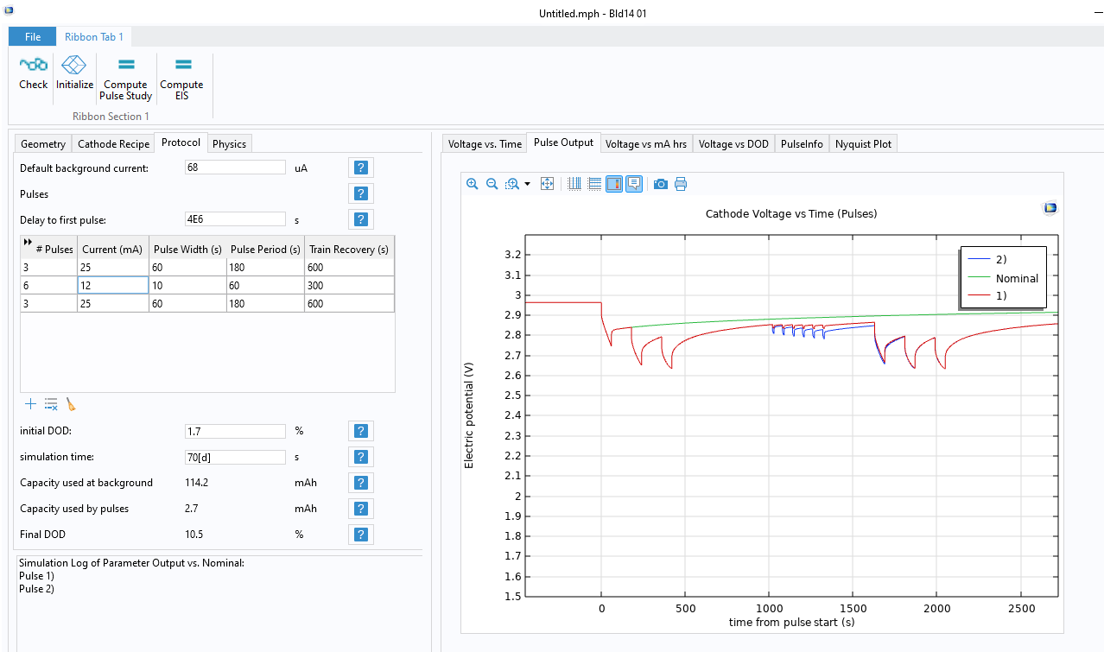
Advanced Capabilities

Slide 17
Key Takeaways
We demonstrate how to customize and model irregularly changing boundary conditions across a wide range of time scales.
The powerful Application Builder creates a user-friendly app which is linked to a customized piecewise function in the model.
To ensure an optimal simulation, evaluation times are recorded and specified to resolve pulse events across large time scales.
This automated approach saves time, reduces errors, and can be applied to many different physics.
Contact
Dr. Paul Belk
Paul.Belk@bsci.com

