Slide 1
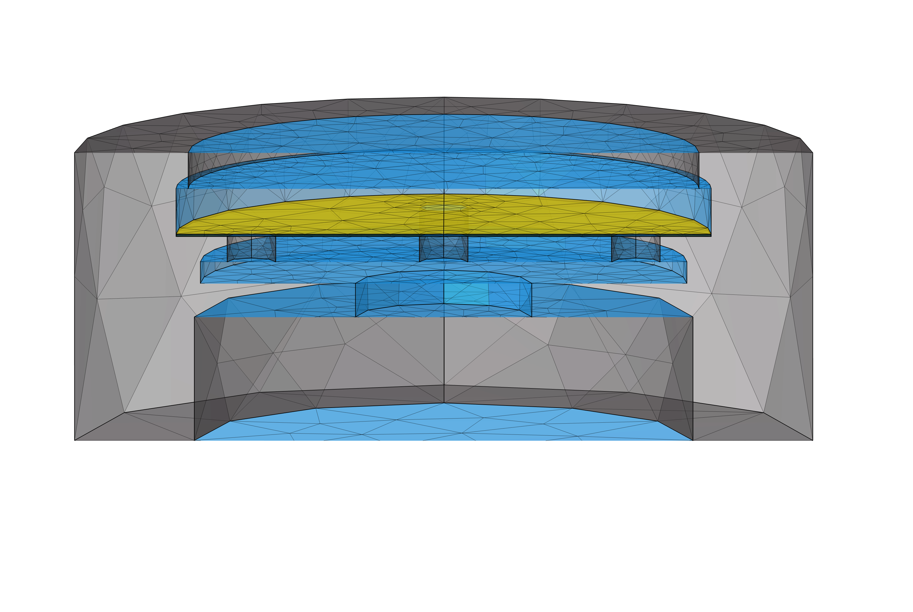
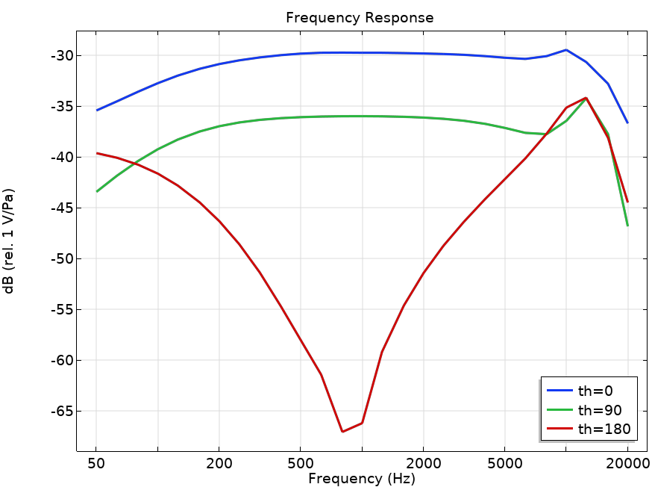
Application for Simulating Acoustic Response of Condenser Microphone Cartridges
Jason Cillo
Senior Acoustical Engineer
Shure, Inc. – Niles, IL

Slide 2
Project Overview
Purpose:
  Reduce number of design iterations to shorten project length for new condenser microphone designs
Goals:
  Use COMSOL to model the frequency and spatial response of a directional condenser microphone cartridge
  Make the model parameterizable and create a GUI for ease of use
Challenges
  Figure out how to build model in a way that geometry changes won’t ‘crash’ it or require setting up the entire model again
  Keep solve time reasonable (minutes) while still getting a result that is close enough to reality that it is worthwhile

Slide 3
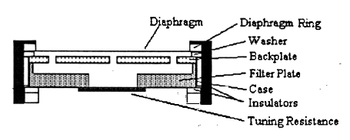
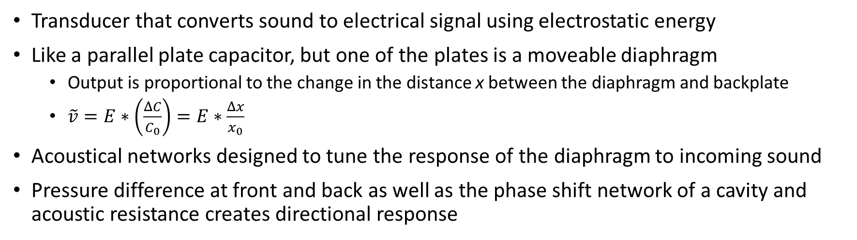

What is a Condenser Microphone?
Transducer that converts sound to electrical signal using electrostatic energy
Like a parallel plate capacitor, but one of the plates is a moveable diaphragm
  Output is proportional to the change in the distance x between the diaphragm and backplate
  $\tilde{v}=E∗\left(\frac{ΔC}{C_{0}}\right)=E∗\frac{Δx}{x_{0}}$
Acoustical networks designed to tune the response of the diaphragm to incoming sound
Pressure difference at front and back as well as the phase shift network of a cavity and acoustic resistance creates directional response
$$x$$
Torio, Guy. “Lumped Element Electroacoustic Modeling for Condenser and Dynamic Transducers” 1996.

Slide 4
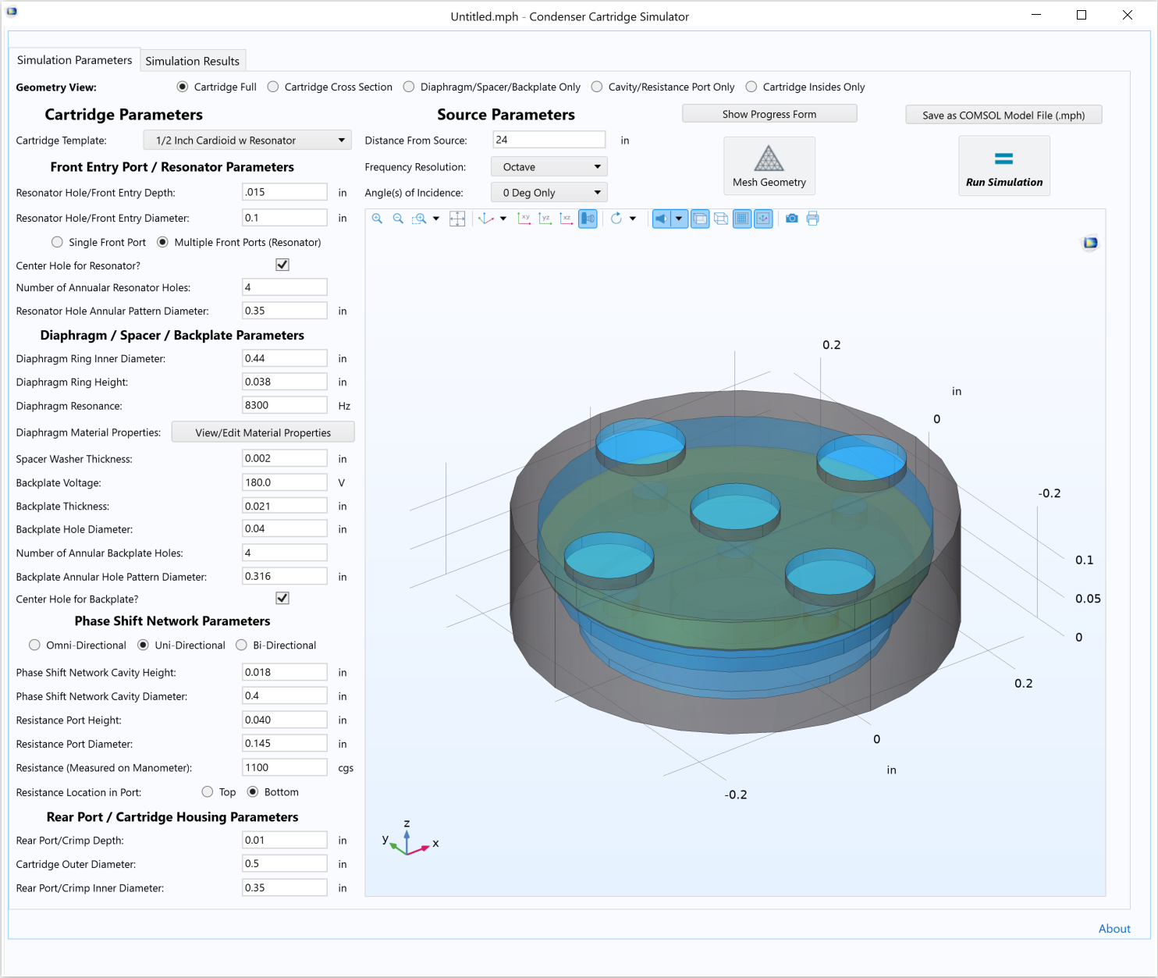
Application Display and User Interface
GUI create with Application Builder
Series of textboxes and radio buttons to create the geometry
Parts are a series of stacked cylinders
Backplate and Resonator geometry setup as series of annular holes
Multiple view options
Set source distance and frequencies
Can save to edit it in model viewer

Slide 5
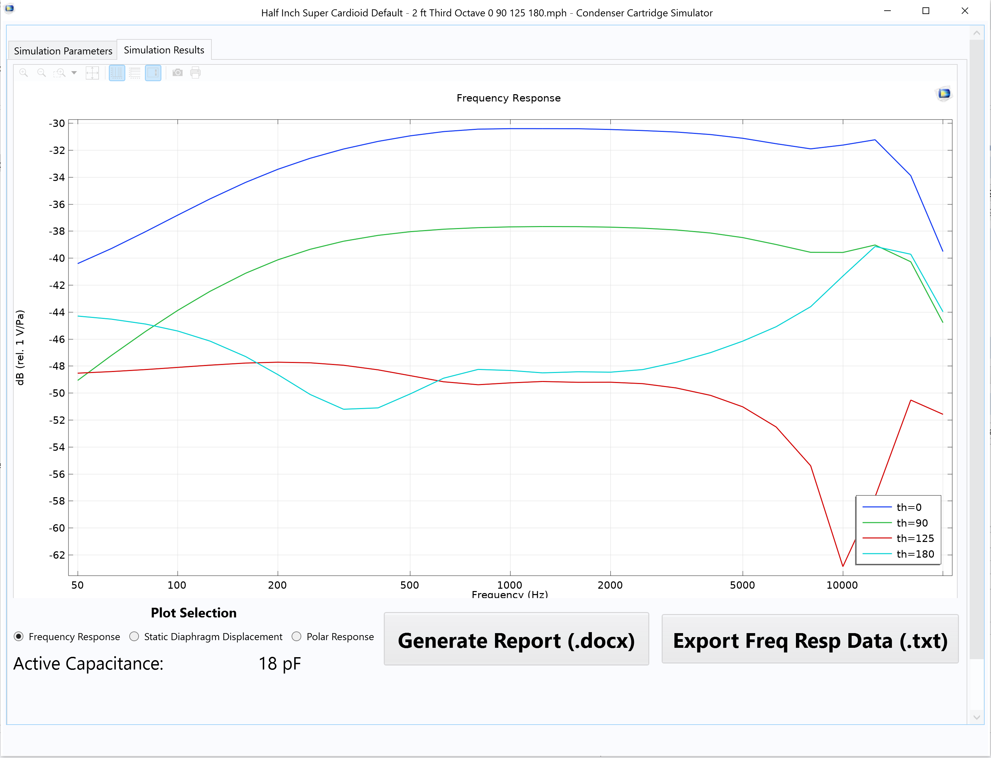
Application Display and User Interface
Results tab shows response plot
  Plot frequency response, polar or static diaphragm displacement
  Cartridge Capacitance shown
Save frequency response data as a .txt file for post processing
Save COMSOL generated report with geometry parameters and results in a .docx format

Slide 6
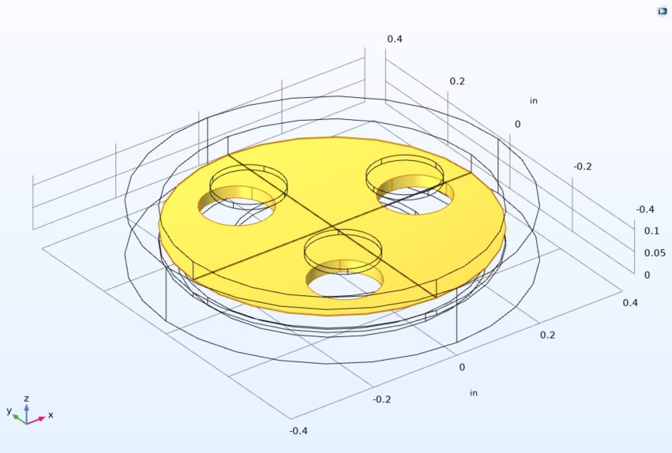
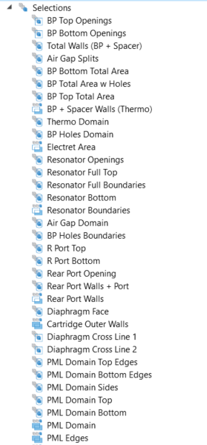
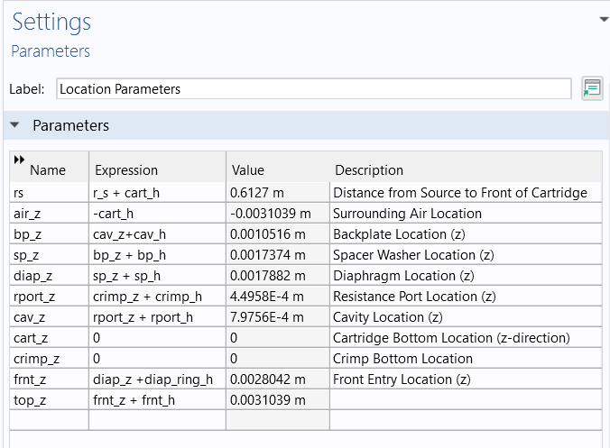
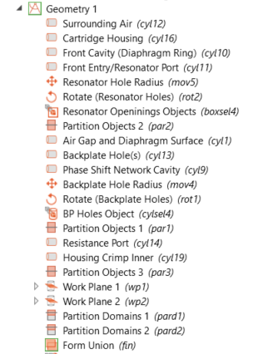
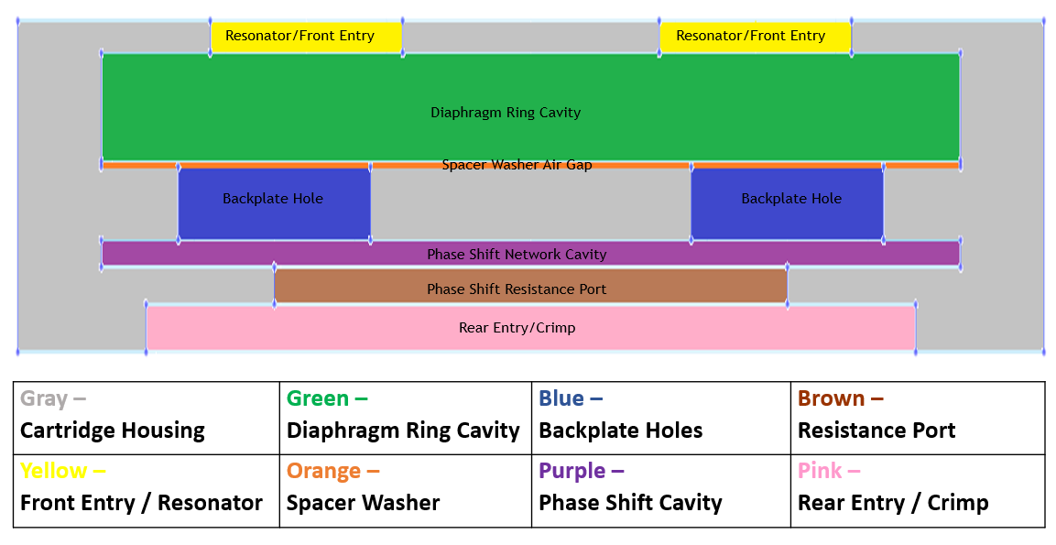
Parameterized Geometry
All geometry is created and selected using parameters
Limiting, but drastically simplifies geometry creation and allows for easy modifications

Slide 7
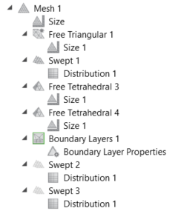
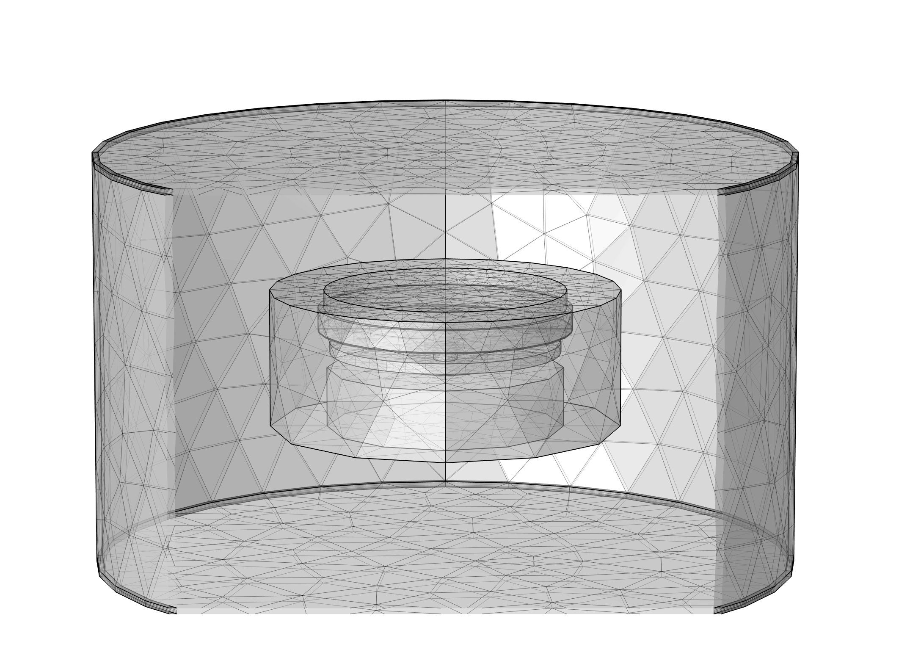

Model Geometry and Mesh
Meshing is controlled by geometry selections
Swept mesh used through the diaphragm/backplate air gap and in perfectly matched layer in bounding air volume around the cartridge
Moving mesh applied to diaphragm
Boundary Layers applied to backplate hole and air gap boundaries
Notes:
-Cartridge is in enclosed air, source wave travels to front and back of cartridge. Crucial part of directionality

Slide 8
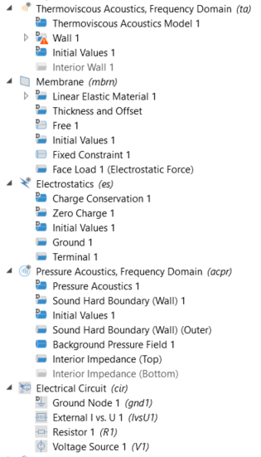
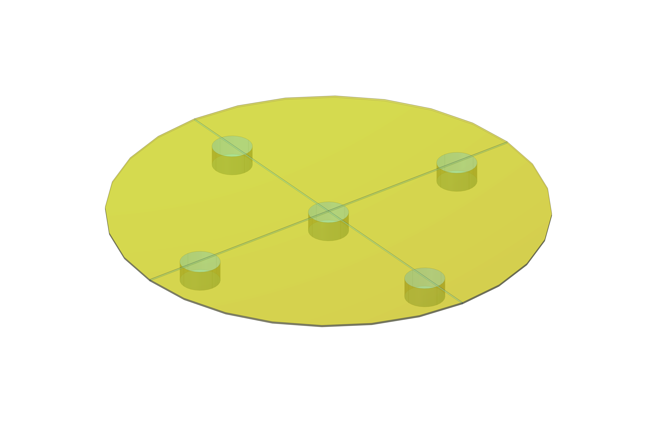

Physics and Multiphysics Couplings Applied
Thermoviscous Acoustics applied between diaphragm and backplate account for losses in thin air gap region
Diaphragm uses Membrane Physics
  Couples to both Acoustics Physics on one side each
Electrostatics and Electrical Circuit
  Diaphragm is grounded
  Bias Voltage applied through circuit
Reference COMSOL Model: Brüel & Kjær 4134 Condenser Microphone
Coupled to Pressure Acoustics for the rest of the model
  Air outside of cartridge allows for diffraction to be accounted for
  Allows phase difference between sound at front and back to be accounted for

Slide 9
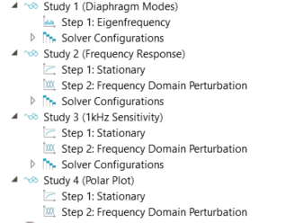
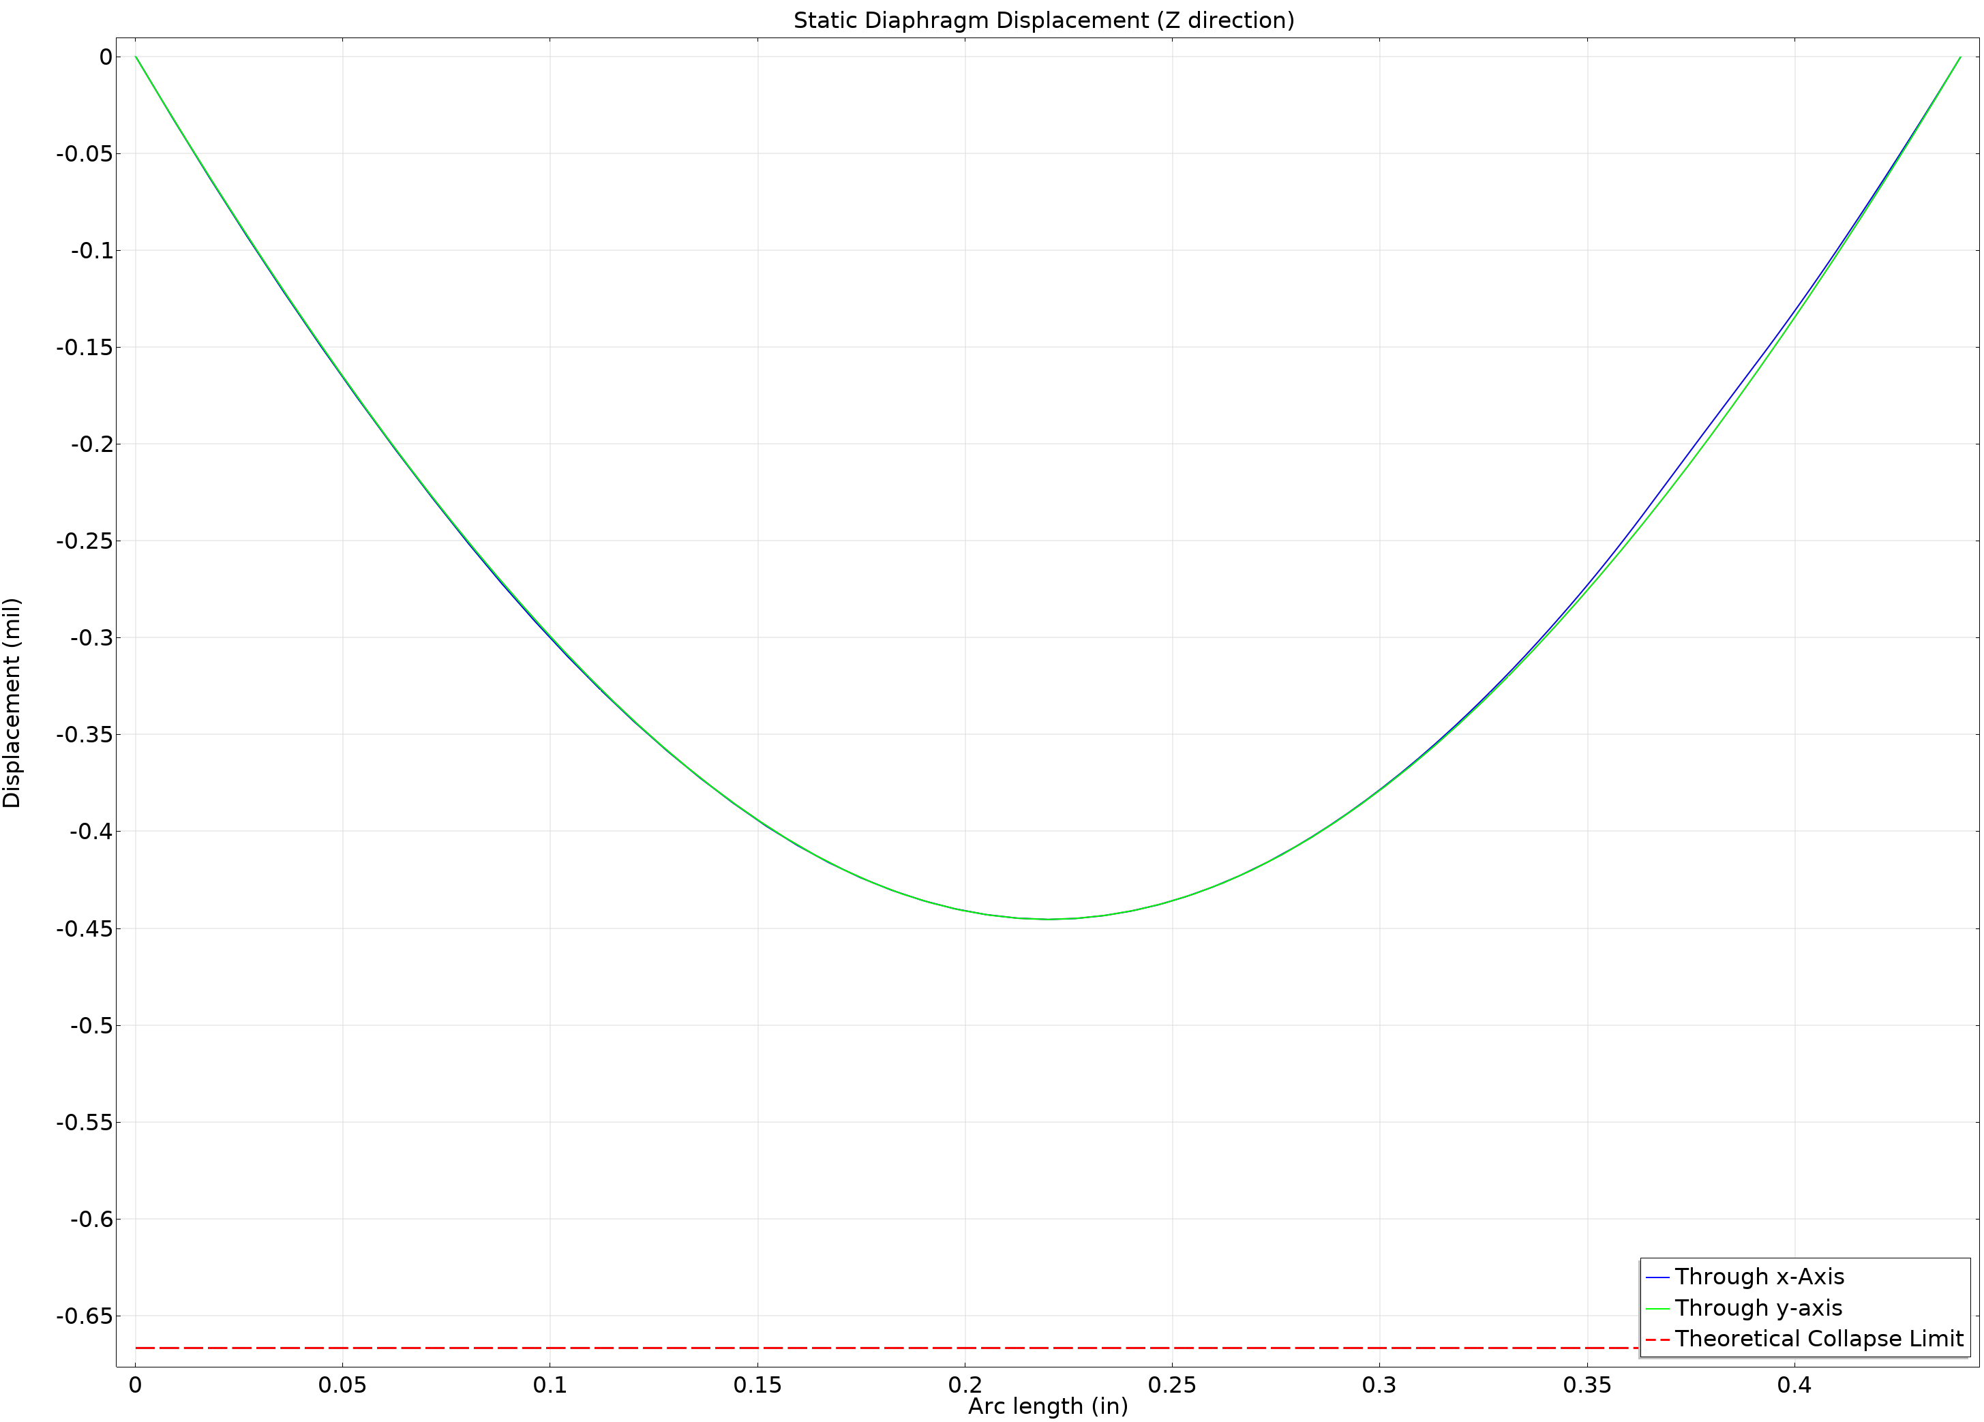
Model Study and Results
Two study steps
  Stationary – solves for electrostatic force and deflection of diaphragm
  Frequency Domain Perturbation – solves for mic response to incoming pressure wave
Study parameters set in application
  Frequencies, Auxillary Sweep of Incidence Angles
Generates plots for the results window
  Static Diaphragm Displacement
  Frequency Response
  Polar Response (if study set for it)

Slide 10
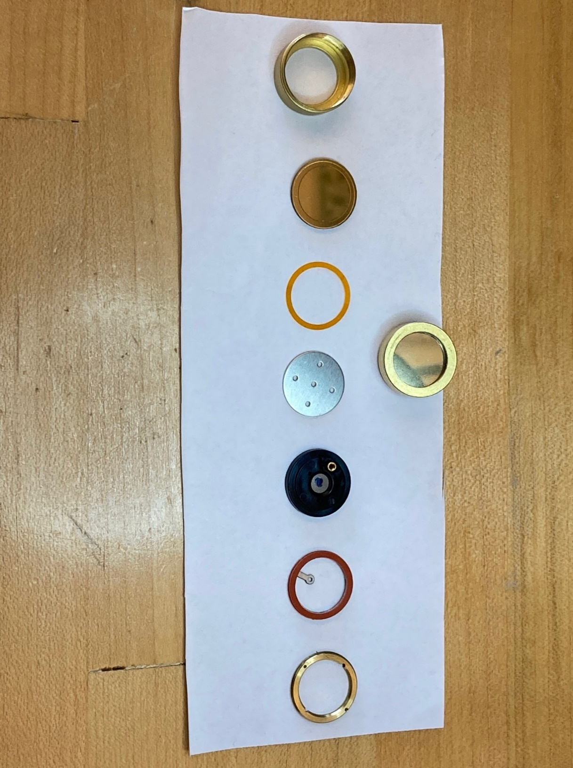
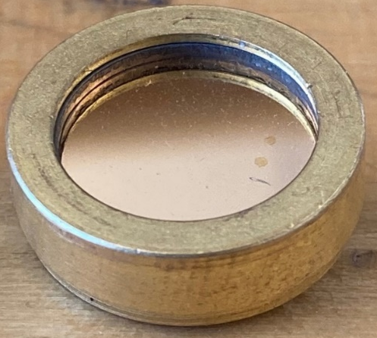
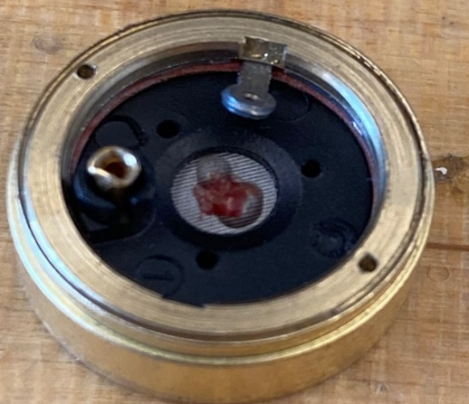
Validation of Sample Half Inch Design
As a quick check of the model, simulation of a design was compared to a measured prototype
½” diameter, cardioid polar pattern cartridge built and tested
Model simplifies features of the geometry, but created quickly
  Some edges chamfered and features like contact pin omitted
  Phase shift network cavity geometry simplified
  Acoustical parameters measured and included

Slide 11
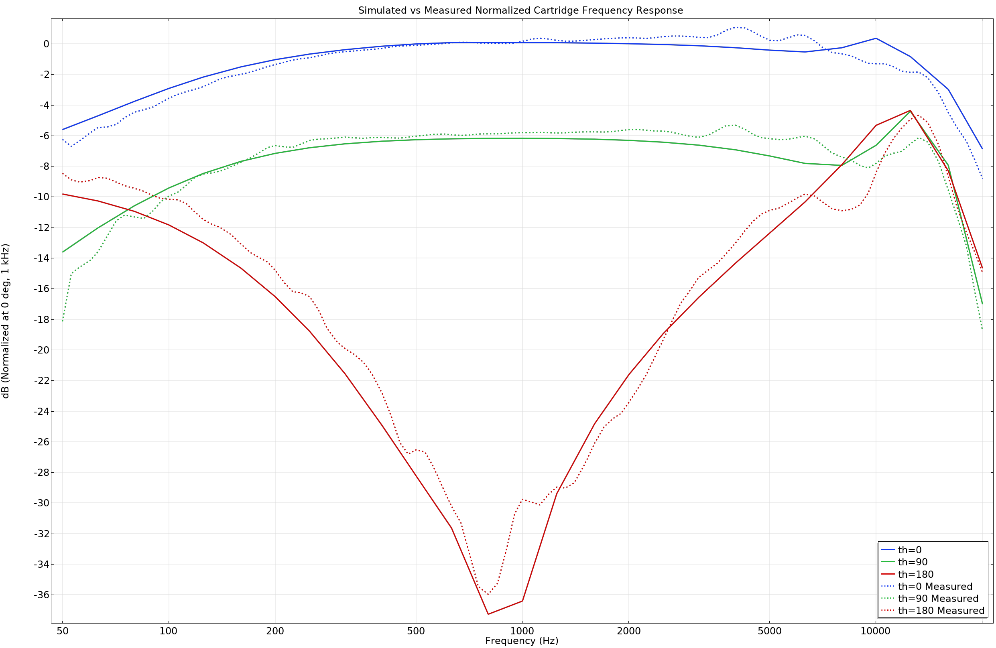
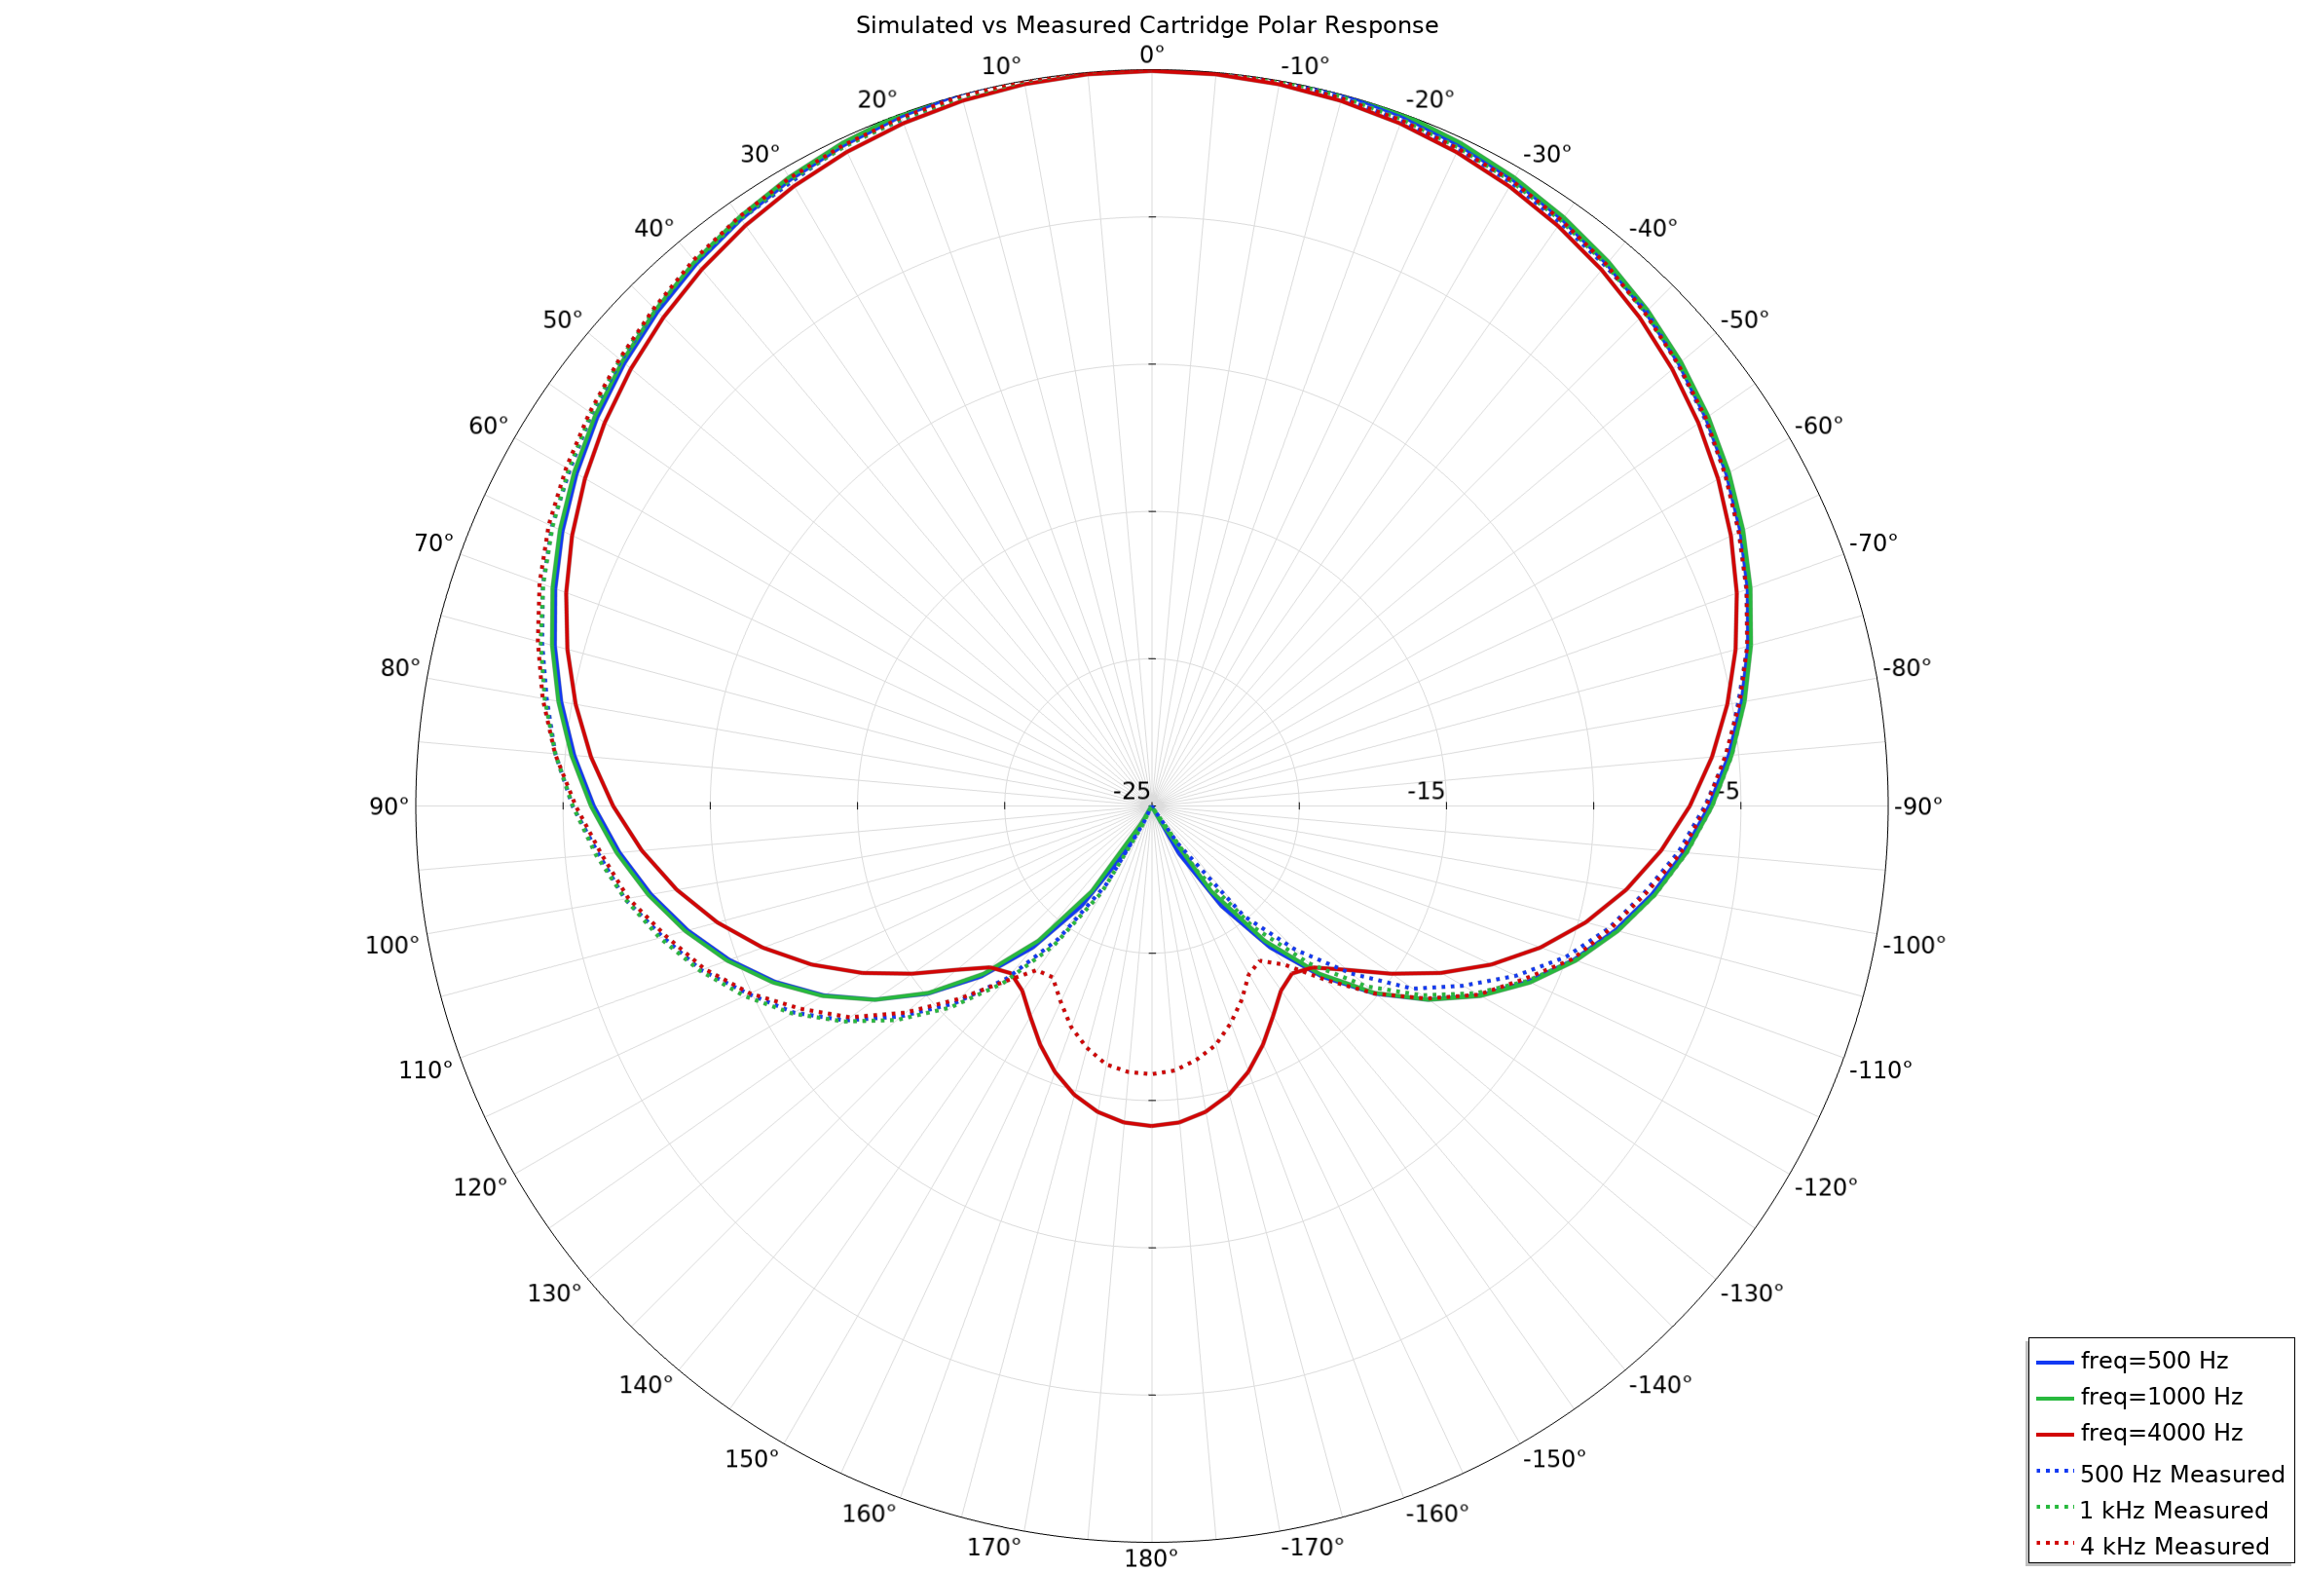
Validation of Sample Half Inch Design
Simulation vs Measured difference is only a dB or two at most frequencies
Simulated – Solid lines; Measured Response – Dashed lines

Slide 12
Conclusion
Parameterized geometry and the application GUI can drastically simplify a complex model and allow for quick edits
Directionality of a microphone cartridge can be simulated well in COMSOL
Condenser cartridge frequency responses can be simulated with a reasonable correlation to built prototypes
Methodology in the model could be used to simulate more complex geometries
Additional Work: examining thermal losses in the phase shift network cavity for smaller designs

Slide 13
Thank You!
Questions?

