Slide 1
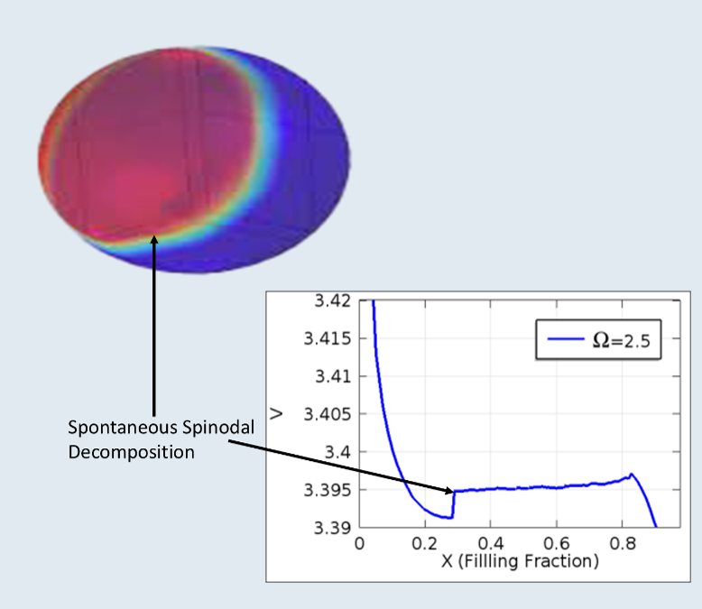
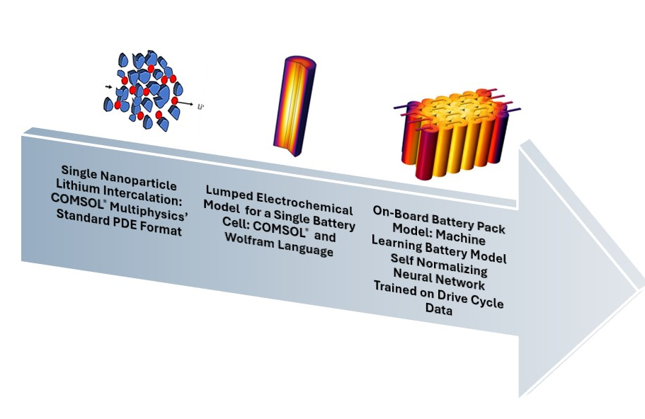
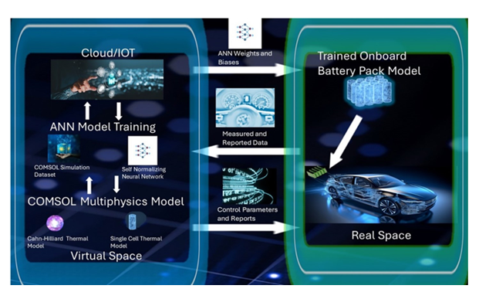
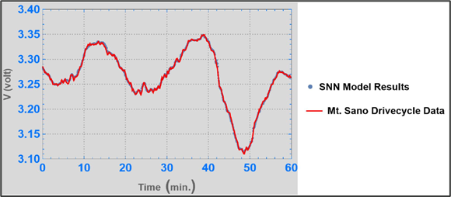

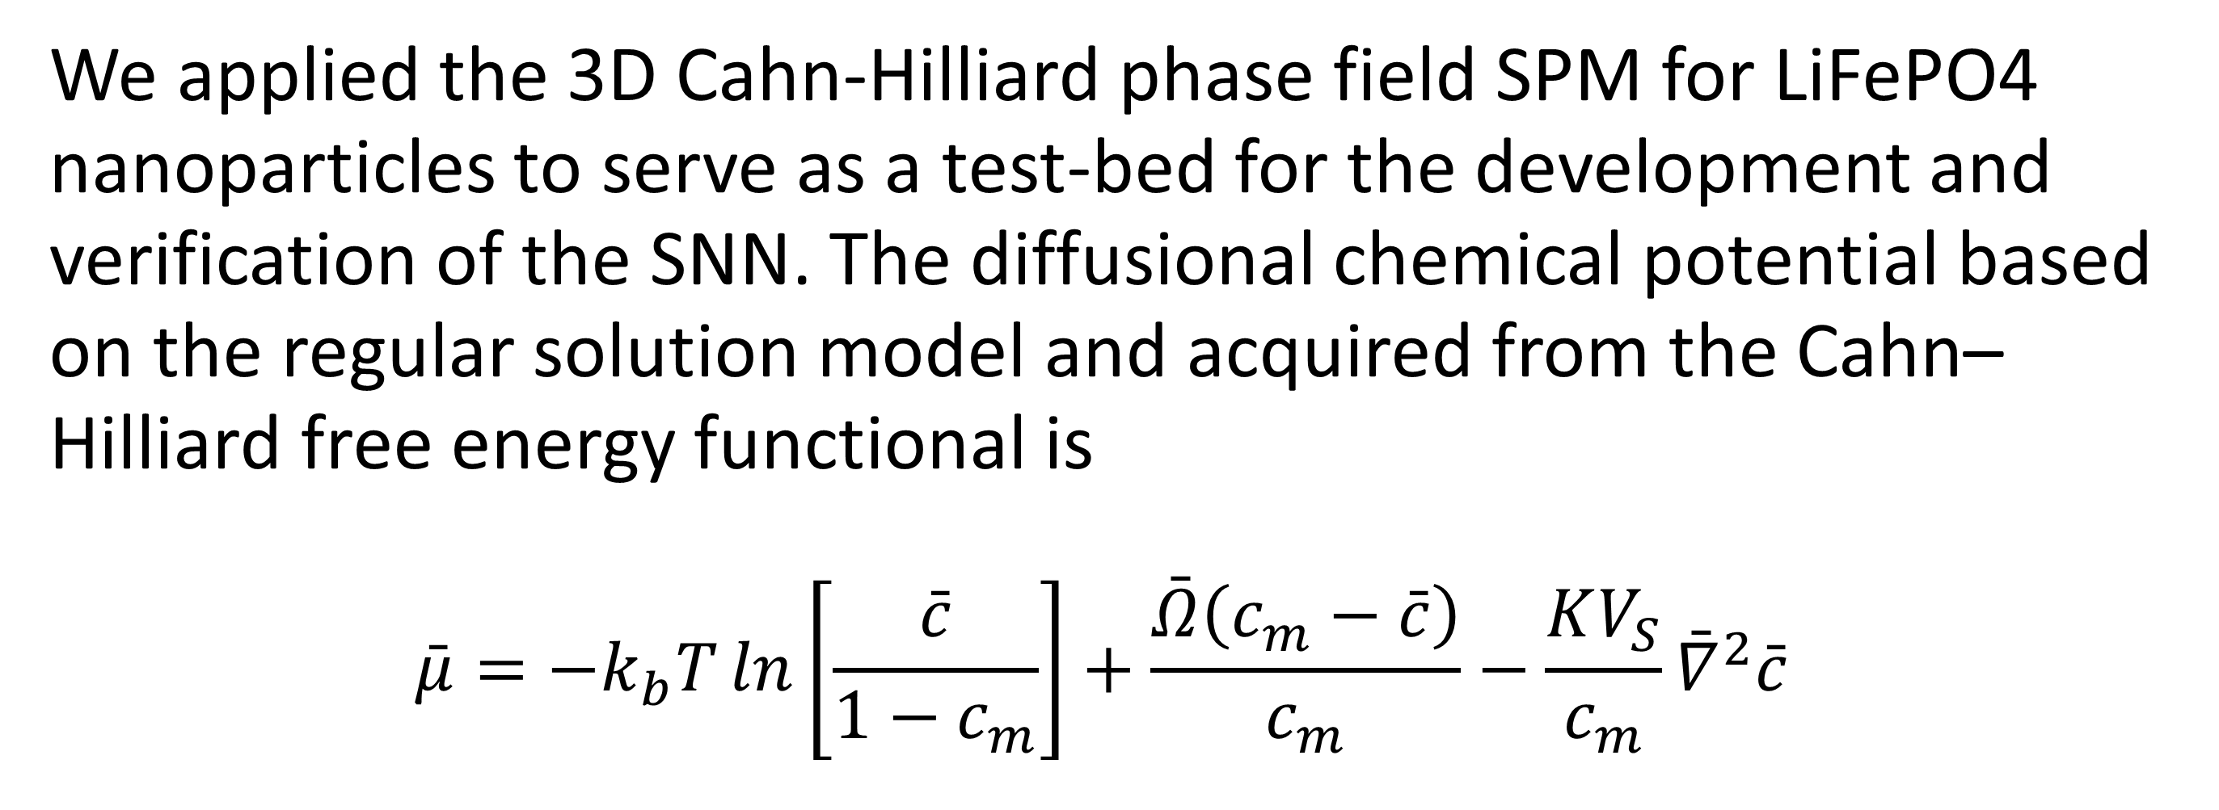
A Digital Twin Approach For Battery Management Systems For Electric Vehicles
Realizing the digital twin concept for electric vehicle battery management systems through multi-physis, multi-scale simulation and machine learning.
Roger Painter ^{1,*}, Ranganathan Parthasarathy ¹, Lin Li ¹, Irucka Embry ², Lonnie Sharpe ³ and S. Keith Hargrove ⁴
Department of Civil Engineering, Tennessee State University, Nashville, TN 37209, USA
EcoC²S, Nashville, TN 37206, USA; iembry@my.tnstate.edu
Department of Mechanical Engineering, Tennessee State University, Nashville, TN 37209, USA;
Tuskegee University, Tuskegee, AL 36088, USA
Abstract
The digital twin concept enables the integration of complex multiphysics and multidimensional models and simpler reduced order models (ROM). Our approach to developing a digital twin simulation of lithium-ion batteries for electric vehicles utilized a dataset generated from the COMSOL® Multiphysics simulation of the Cahn-Hilliard equation for a single particle model (SPM) of a lithium iron phosphate (LiFePO4) cathode. The ROM was then developed by utilizing experimental data for an A123 Systems 26650 2.3 Ah cylindrical battery to train a self-normalizing neural network (SNN). Finally, the ROM was verified as an on-board battery management system (BMS) for ambient temperatures ranging from 253 to 298 K and discharge rates ranging from 1 C to 20.5 C.
Methodology
We applied the 3D Cahn-Hilliard phase field SPM for LiFePO4 nanoparticles to serve as a test-bed for the development and verification of the SNN. The diffusional chemical potential based on the regular solution model and acquired from the Cahn–Hilliard free energy functional is
$$\bar{μ}=−k_{b}T\ln\left[\frac{\bar{c}}{1−c_{m}}\right]+\frac{\bar{Ω}\left(c_{m}−\bar{c}\right)}{c_{m}}−\frac{KV_{S}}{c_{m}}{\bar{∇}}^{2}\bar{c}$$
FIGURE 1. Left: Depiction of our Multi-Physics, Multi-Scale Lithium-Ion Battery Model and Simulation. Right: Visualization of the Implementation of the On-board Self Normalizing Neural Network Model.
Results
We tested and verified the SNN for a 1 C discharge rate for ambient temperatures ranging from 253 to 298 K. The model results were also compared to experimental results for discharge rates ranging from 1.0 to 10.6 C for an ambient temperature of 298 K. Finally, we validated the trained SNN using the harsh road test dataset: Up Mount Sano in Huntsville, AL as shown in Figure 2.
FIGURE 2. Validation Of the Self Normalizing Neural Network Model for Harsh Drive-Cycle Data.
Painter, R.; Embry, I.; Sharpe, L.; Hargrove, S.K. A Reduced Order Thermal Model for Lithium-Ion Batteries Derived from the Cahn-Hilliard Equation. In Proceedings of the 2020 COMSOL® Conference, Boston, MA, USA, 7–8 October 2020.
Bai, P.; Cogswell, D.; Bazant, M.Z. Suppression of phase separation in LiFePO₄ nanoparticles during battery discharge. Nano Lett. 2011, 11, 4890–4896.
Zeng, Y.; Bazant, M. Cahn-Hilliard Reaction Model for Isotropic Li-Ion Battery Particles. MRS Proc. 2013, 1542, 0201.

