Slide 1
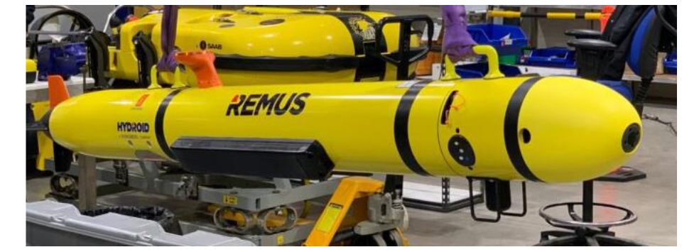
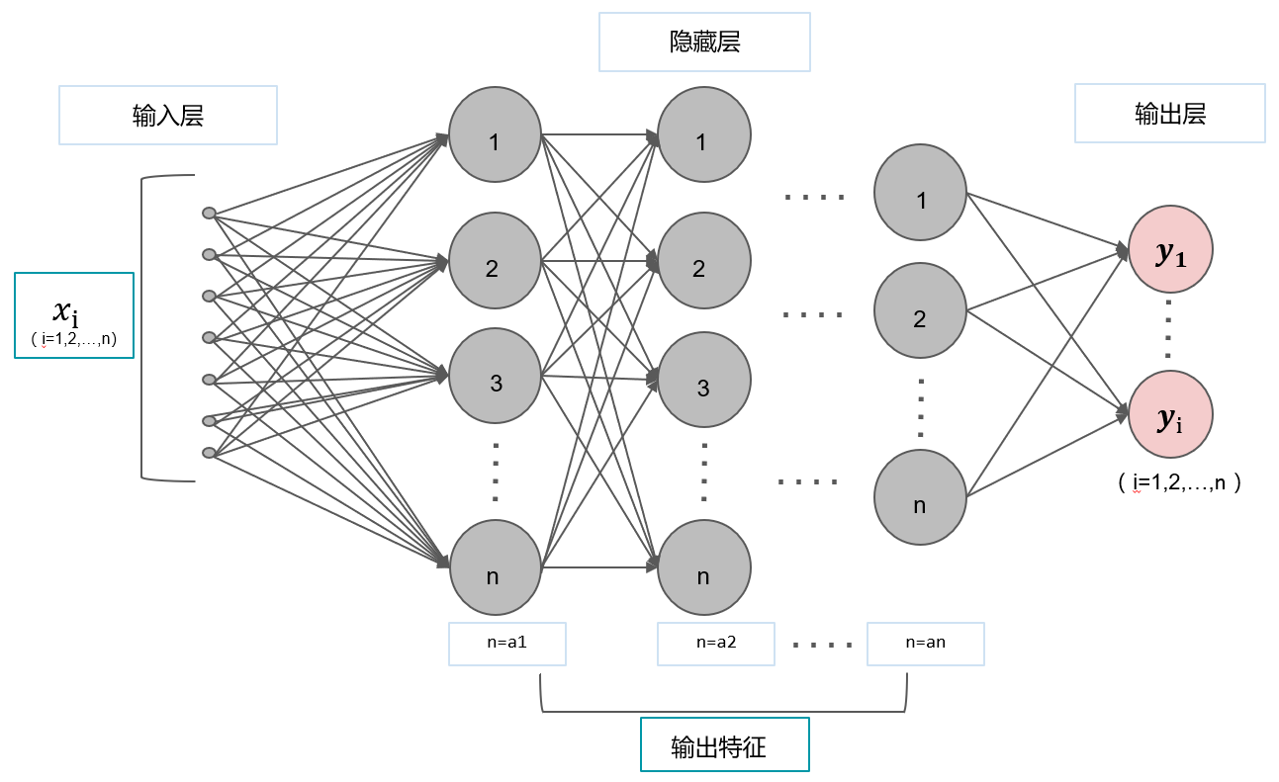
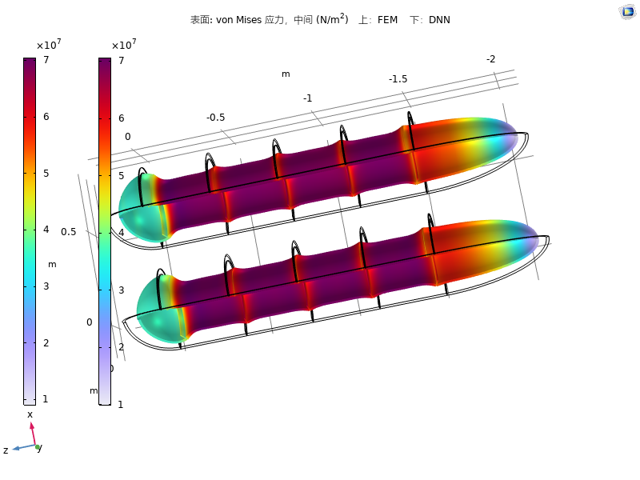
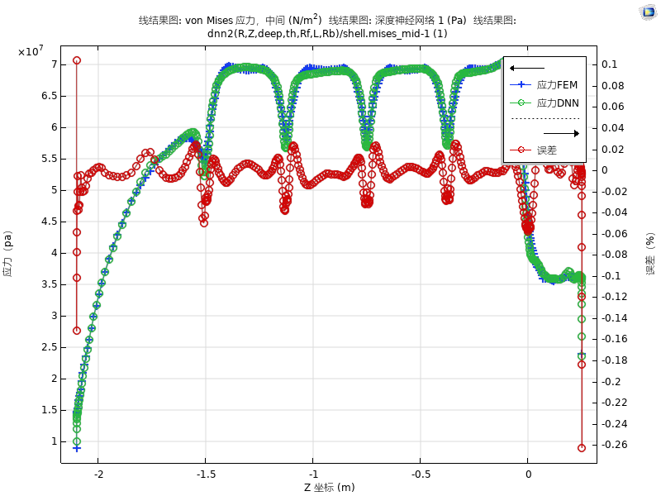
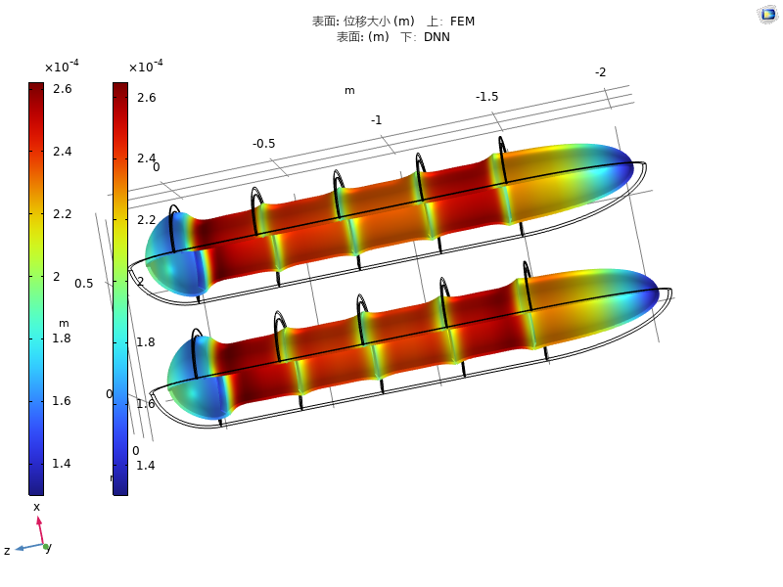
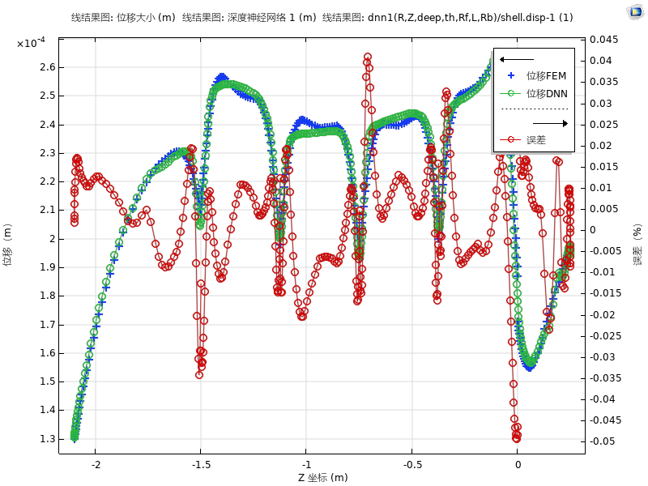
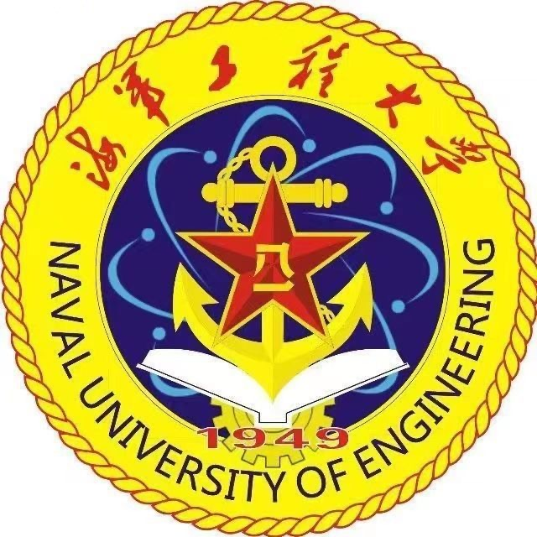
Intelligent prediction of compressive strength prediction of deep-sea UUV
This study focuses on the prediction of pressure hull structural compressive strength for deep-sea unmanned underwater vehicles. By constructing a deep neural network model, the study achieves high-precision intelligent forecasting of global stress and deformation in pressure hulls at the second level.
Zhenhua Zhang¹,Kaifeng Zhang¹,Yilin Qu¹
1.Naval University of Engineering
Introduction & Goals
Unmanned underwater vehicles (UUVs) serve as highly maneuverable underwater combat platforms. By optimizing the hull pressure hull structure design and reducing the weight of the pressure hull structure, their combat capabilities can be enhanced to achieve further operational objectives. Therefore, transferring deep neural networks from fields such as natural language processing and object recognition to predict the pressure resistance strength of UUV pressure hulls holds significant potential.(Ref. 1)
By leveraging the powerful data processing and learning capabilities of machine learning, this study explores the integration of deep neural networks with pressure hull strength prediction for UUVs. It constructs a nonlinear relationship between the structural parameters of the pressure hull and its structural response, thereby enabling the prediction of pressure hull strength for UUV.(Ref. 2)
Methodology
By comparing the prediction results of the deep neural network model and the finite element model under given operating conditions, the feasibility of the deep neural network model is assessed, enabling rapid evaluation during the preliminary design stage of the pressure hull.
Using the trained deep neural network model, the compressive strength of pressure hulls for unmanned underwater vehicles under different operating conditions and structural parameter combinations is calculated and summarized. Structural parameter combinations that meet design specifications are selected through calculation and screening, resulting in a suitable combination of structural parameters for the pressure hull of the unmanned underwater vehicle.
FIGURE 1. Schematic diagram of deep neural network layer structure.
Results
The model can accurately predict stress distribution and deformation at any location on the shell surface and inside the shell, with calculation time controlled within seconds, greatly improving design evaluation efficiency. After verification, the model's prediction results for the maximum stress of the deep-sea unmanned underwater vehicle's pressure hull showed a relative error of less than 5% compared to the finite element high-fidelity simulation results, demonstrating good engineering applicability. This method provides an efficient and reliable new approach for the design and evaluation of UUV pressure hull structures.
FIGURE 2. Machine learning forecast of underwater vehicle deformation results, showing a comparison between FEM and DNN in terms of stress, stress error, displacement, and displacement error.
1. 翟剑锋. 深度学习在自然语言处理中的应用[J]. 电脑编程技巧与维护, 2013, (18): 74-76.
2. 刘光花, 杨发顶, 程亚伟,等. 基于深度神经网络的火箭图像目标识别与跟踪[J]. 沈阳航空航天大学学报, 2024, 41(04): 59-66.

