Slide 1
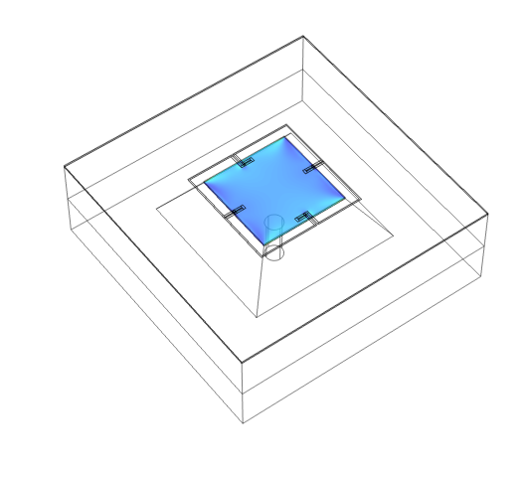
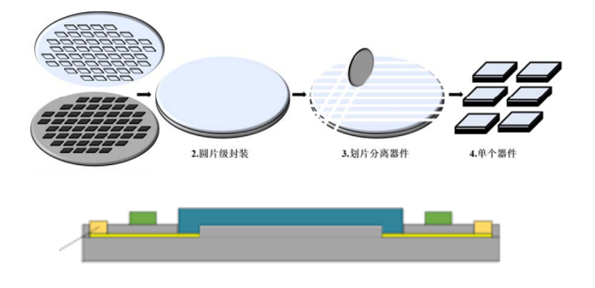
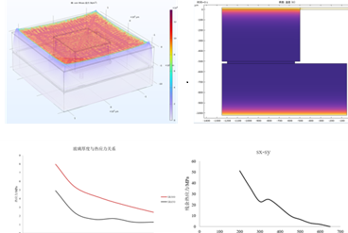
Study on Thermal Stress Simulation and Optimization of Wafer Bonding Method based on COMSOL in 3D
Analyze the thermal stress distribution generated in the bonding process of the wafer, and explore the optimization strategy of the process parameters.
Li Chang¹, Rudan Chen²
1. Hikvision, Hangzhou, China.
2. Hikvision, Hangzhou, China.
Abstract
Temperature fluctuations during the bonding process and thermal stress caused by differences in coefficient of thermal expansion (CTE) between bonding materials are primary contributors to thermal stress. Excessive thermal stress can lead to wafer deformation, cracks, and bond failure, ultimately compromising device reliability and thermal performance metrics such as thermal hysteresis and thermal repeatability.
A three-dimensional multi-physics model was developed based on actual process conditions, integrating thermal conduction, structural mechanics, and electrochemical modules to simulate the evolution of temperature and stress fields during wafer bonding.
This study considers the physical properties of both the wafer and glass materials, along with the effects of glass thickness and bonding area on dielectric film temperature and stress distribution.
Methodology
Anodic bonding is formed by high temperature and direct current high voltage, which causes the migration of sodium ions in the glass to form a depletion layer, and at the same time, strong electrostatic attraction and chemical reaction are generated at the interface, and finally a strong Si-O covalent bond is formed
The maximum stress even occurs on the chip film position. However, it can be improved depending on the thickness, shape, and bonding area of the bonding device (bottom silicon). The lower the stress, the better the device performance.
FIGURE 1. Top: Wafer packaging process. Bottom: Anodic bonding principle
Results
When the relative thickness reaches h/H_mm≈50% (which is considered very thick in practical applications), the stress improvement and distribution change tend to slow down, and when h/H_mm<50%, the stress decreases with the increase of thickness.
At the same time, when the bonding area is smaller, the residual thermal stress of bonding will increase, so the SR value is not too small in practical use.
FIGURE 2. Relationship between stress and thickness & sr
Tanaka S. Wafer-level hermetic MEMS packaging by anodic bonding and its reliability issues[J]. Microelectronics Reliability, 2014, 54(5):875-881.
Zhang X, Tong Y T, Luan J E. Comprehensive Warpage Analysis of Stacked Die MEMS Package in Accelerometer Application[C]// International Conference on Electronic Packaging Technology. 2005:10 -15

