Slide 1
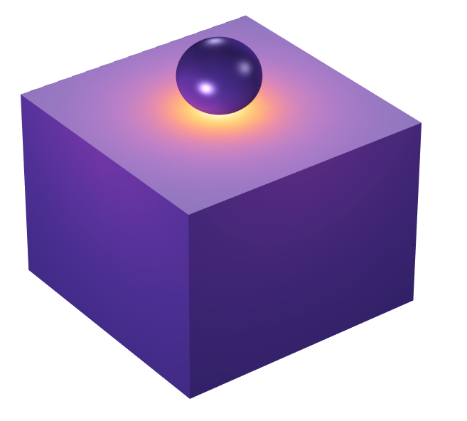
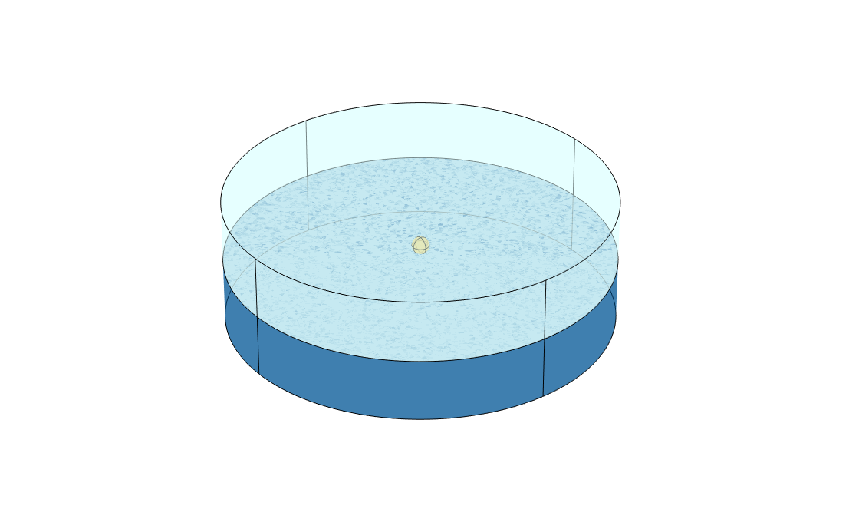
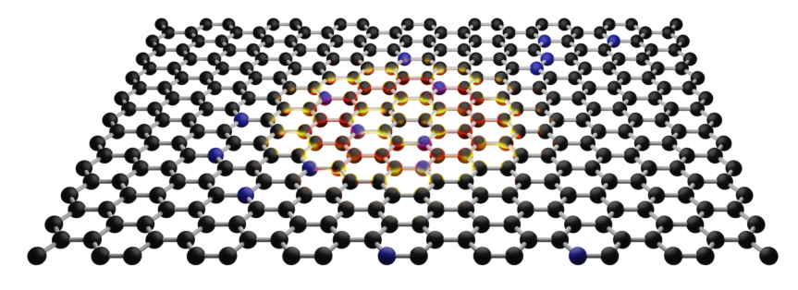
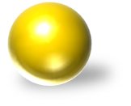
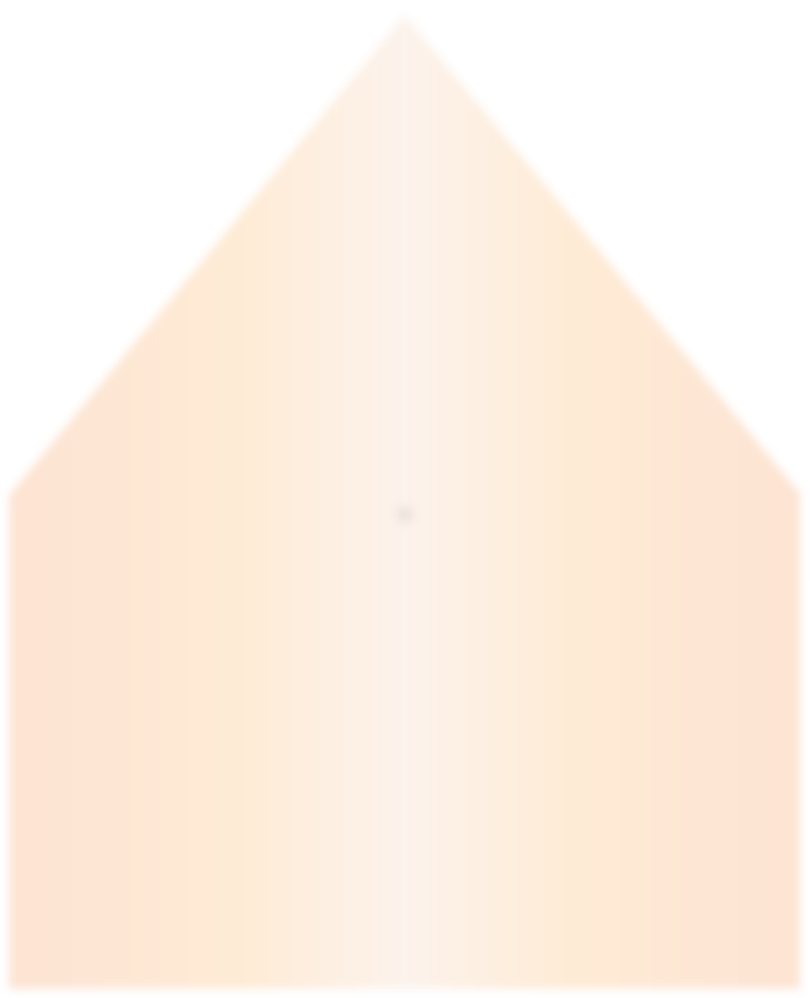
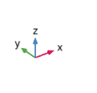

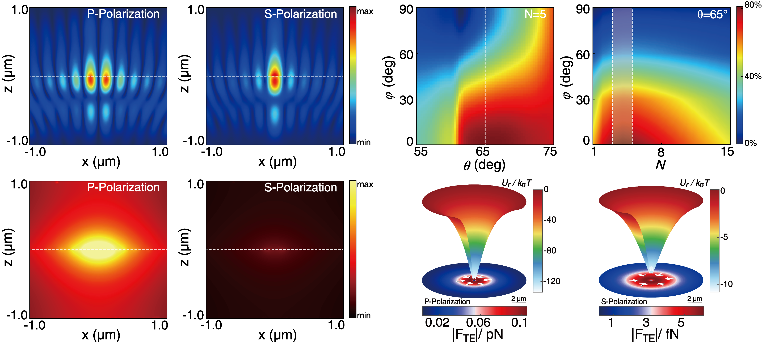


Multiphysics Simulation of a 3D Graphene-based Opto-Thermoelectric Tweezers
Analyzing the underlying optical mechanism of graphene’s selective absorption for ultralow-power particle manipulation.
Y. X. Chen¹, X. Xie², Y. Q. Zhang¹, C. J. Min¹ ¹ Nanophotonics Research Centre, Institute of Microscale Optoelectronics & State Key Laboratory of Radio Frequency Heterogeneous Integration, Shenzhen University, Shenzhen, China. ² Centre for Disruptive Photonic Technologies, School of Physical and Mathematical Sciences, Nanyang Technological University, Singapore, Singapore.
Introduction & Goals
Graphene, as a two-dimensional material with exceptional physical and chemical properties, exhibits highly tunable optical absorption within the visible spectrum. (ref. 1) Its absorption is sensitive to polarization, the number of layers, and incident angles, making it an ideal candidate for dynamic photothermal systems. Leveraging these distinctive characteristics, we simulated a graphene-based opto-thermoelectric tweezer through comprehensive modulation of these properties, demonstrating its capability for ultralow-power particle manipulation. (ref. 2)
(a)
(b)
Methodology
Z
The environment above the graphene is set as water, and the substrate as glass. A polarization-tunable source at 532 nm is used for excitation. A transition boundary condition is applied to replace the extremely thin graphene layer (with a thickness of 0.35 nm) located at the water-air interface. A gold particle is used as a sample to study the forces exerted on it in the thermal fields. This setup allows for the analysis of the Electromagnetic Heating Multiphysics Coupling in graphene, and the subsequent analysis of the forces acting on the particle.
water
θ
Y
φ
X
glass
FIGURE 1. (a) Model geometry in COMSOL. (b) Schematic of a thermoelectric optical tweezer with a graphene substrate. The incident angle (θ) and polarization orientation (φ) jointly influence the absorption rate of the graphene.
(a)
(b)
(e)
(f)
Results
FIGURE 2 shows that, as the polarization orientation (φ) increases, the polarization state transitions from p- to s-polarization, resulting in a monotonic decrease in absorption, approaching near-zero values for pure s-polarization. Simultaneously, due to the synergistic interplay between interlayer charge screening and conductivity saturation, multilayer graphene structures (with N = 3~5 layers) exhibit enhanced absorption efficiency under p-polarization. Polarization-dependent absorption can significantly affect the temperature gradient and the trapping capability. Under p-polarization, the thermoelectric force exerted on the particle surpasses that under s-polarization, and a pronounced and localized potential well exceeding −120 k_{B}T is generated.
(c)
(d)
(g)
(h)
FIGURE 2. (a-b) Normalized electric field distribution, and (c-d) normalized thermal gradient distribution. (e) Absorption as a function of incident angle and polarization. (f) Absorption varies with layer number (N) and polarization orientation (φ). (g–h) Thermophoretic force distribution (bottom) and spatial potential well distribution (top) in the trapping plane when p-polarization and s-polarization, with an incident power of 100 μW.
REFERENCES
1. X. Y. Wang, “Graphene-Based Opto-Thermoelectric Tweezers”, Adv. Mater.,34 , 2107691, . 2. Y. X. Chen, X. xie, “Switchable Graphene-based Opto-Thermoelectric Tweezers with Ultralow-Power Operation”, Adv. Opt. Mater., e01601.

