Slide 1

Asymmetric and symmetric transports of topological interface states in sonic valley Hall insulators
Hai Yang
Kunming University
2025.10.13

Slide 2
Contents:
1. Sysmmetric transports of topological interface states in sonic valley Hall insulators
2. Asymmetric transpots of of topological interface states in sonic valley Hall insulators
3. Conclusions
4. Acknowledgement

Slide 3
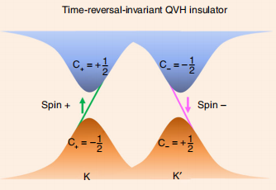
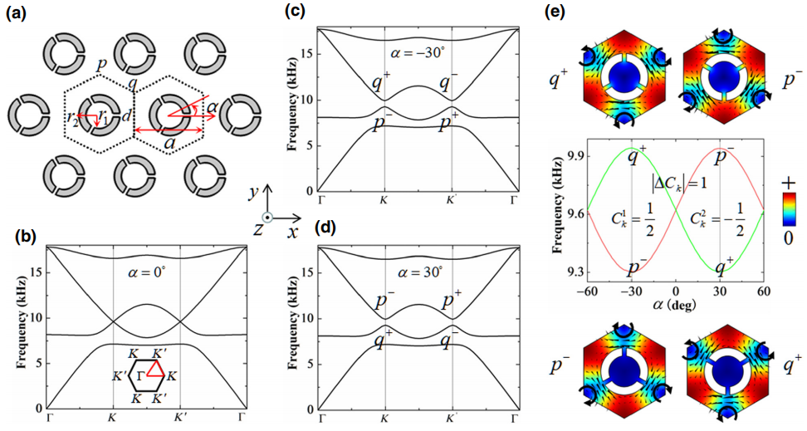
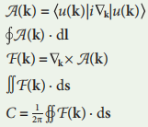
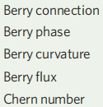


1.1 Sonic valley Hall insulators
Xiujuan Zhang, Meng Xiao, Ying Cheng, Minghui Lu& Johan Christensen. Communication Physics. 1, 97(2018)
BC:
BP:

Slide 4
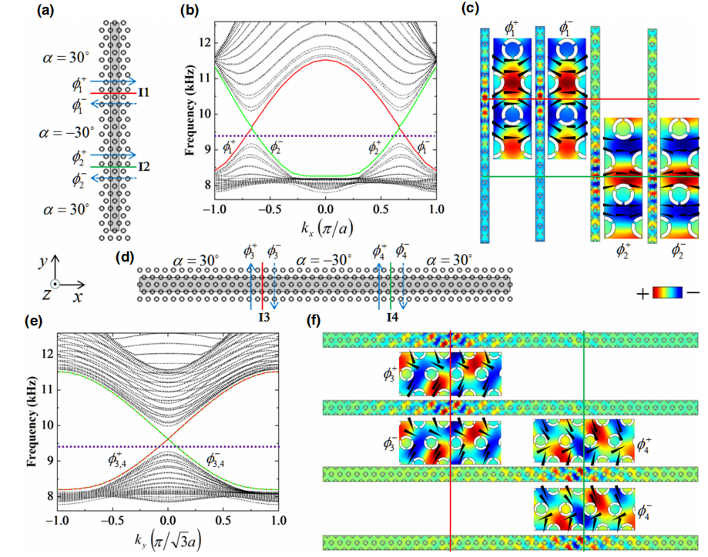
1.2 The dispersion relations of the two heterostructures with zigzag of armchair interfaces

Slide 5
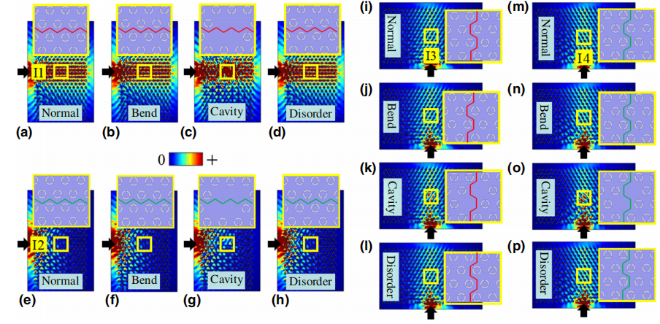
1.3 Robust sound transport for valley interfaces states at 9.3 kHz

Slide 6
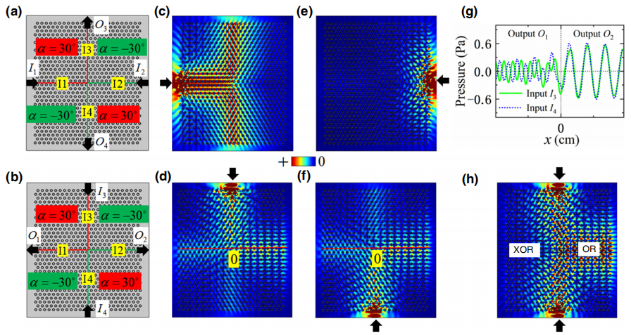
1.4 Acoustic equal splitting of interface states and logic gates

Slide 7
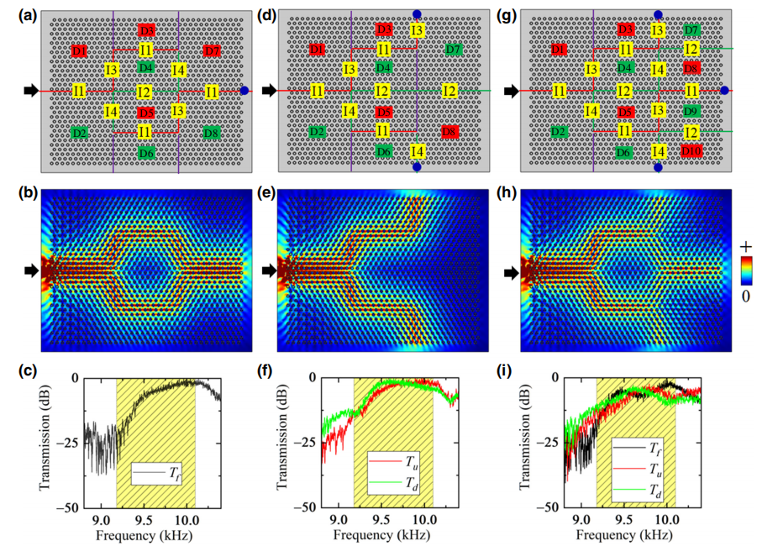
1.4 Acoustic equal splitting of interface states and logic gates

Slide 8
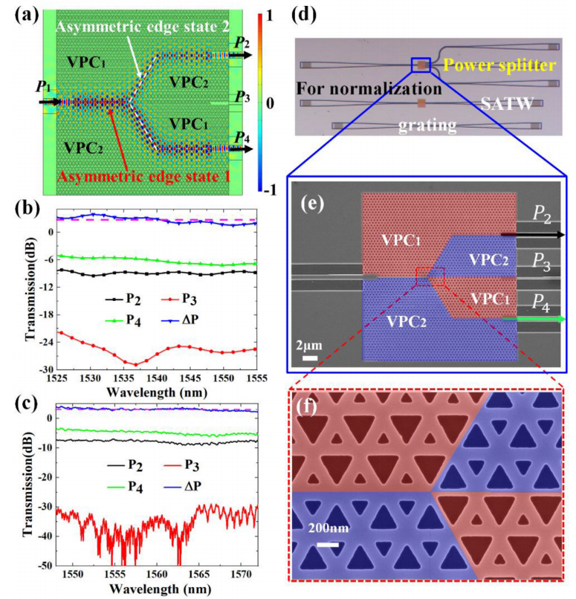
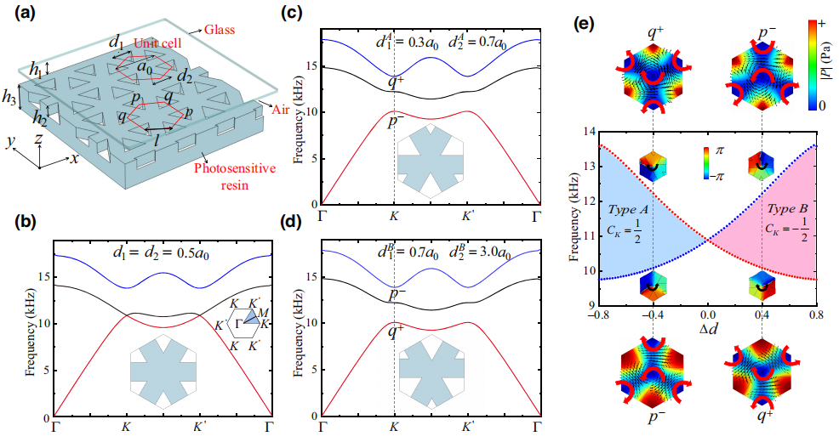
2.1 Asymmetric transpots of of topological interface states in sonic valley Hall insulators
Hongwei Wang, and Yikai Su, et al. Laser Photonics Rev. 16, 2100631(2022)

Slide 9
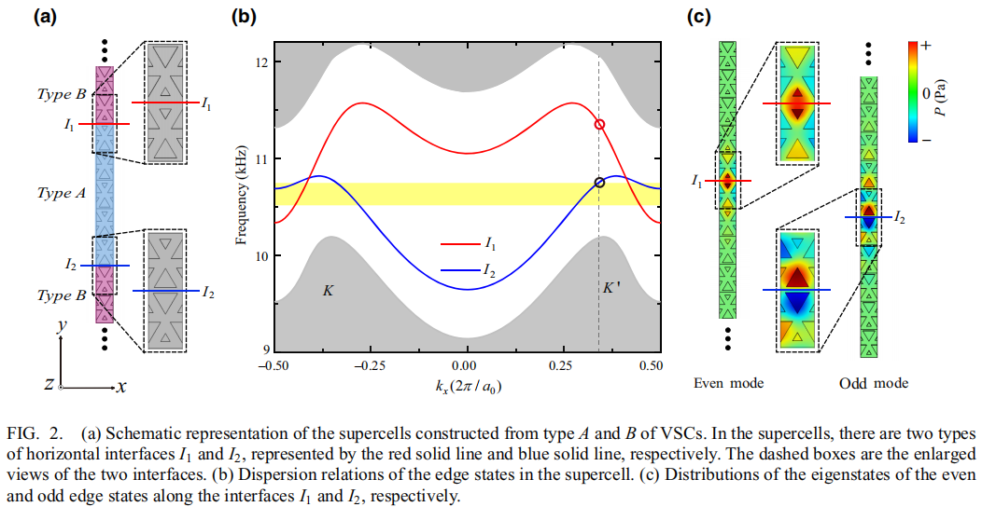
2.2 Dispersion relations of the interface states

Slide 10
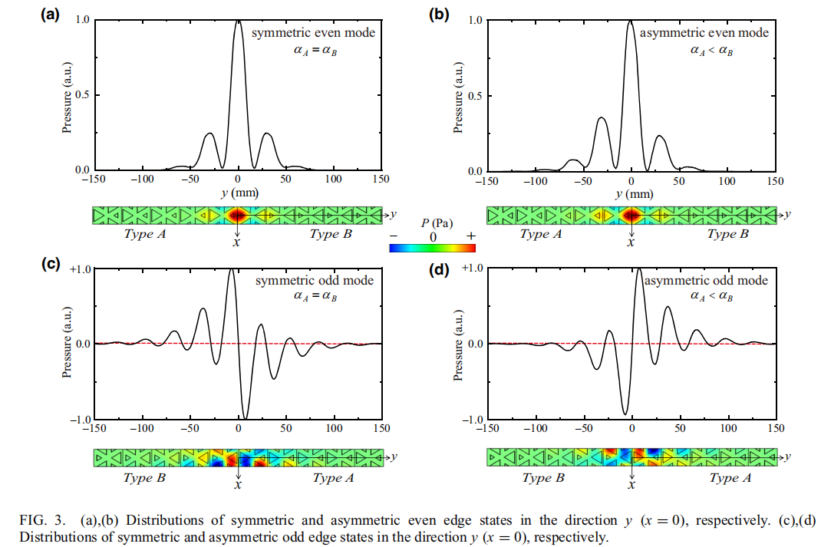
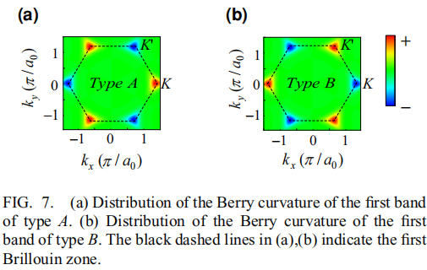
2.3 Distributions of symmetric and asymmetric even
(odd) interface states

Slide 11
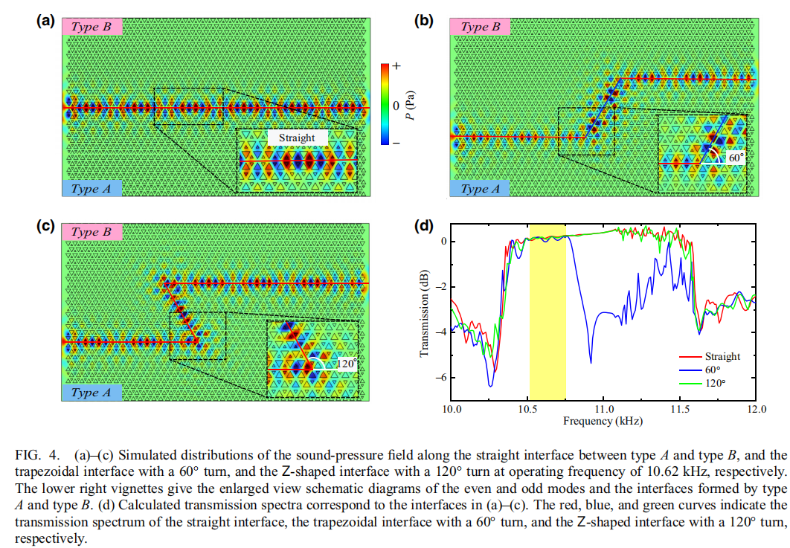
2.3 Distributions of symmetric and asymmetric even
(odd) interface states

Slide 12
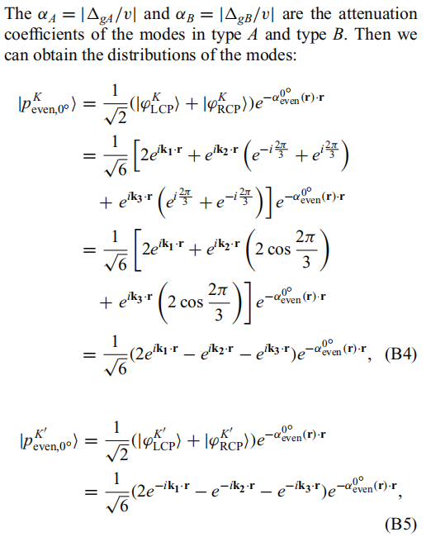
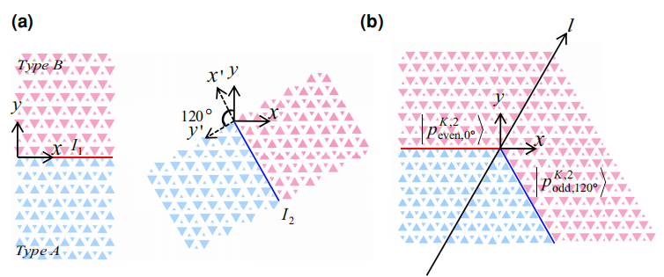
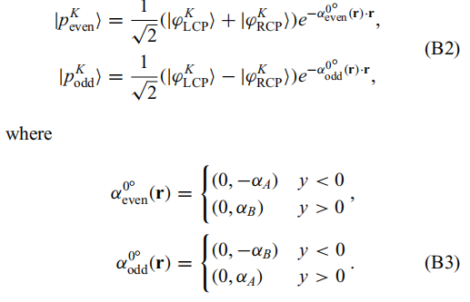
2.4 Mode-coupling mechanism of asymmetric topological interface states

Slide 13
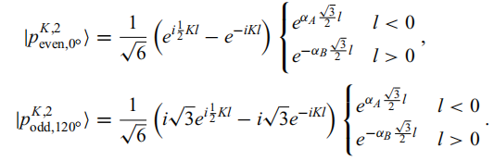


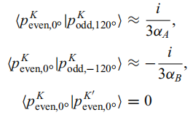


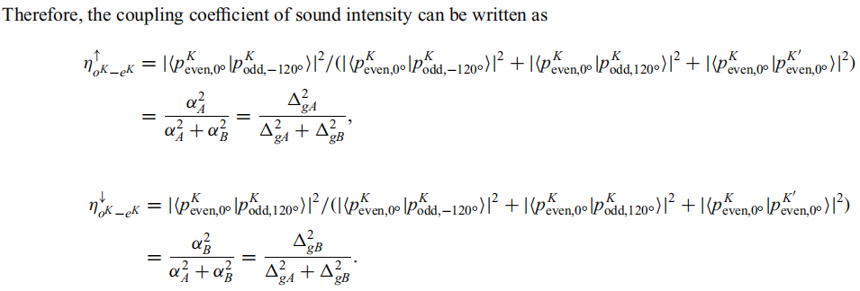

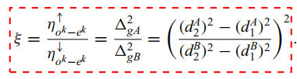

Slide 14
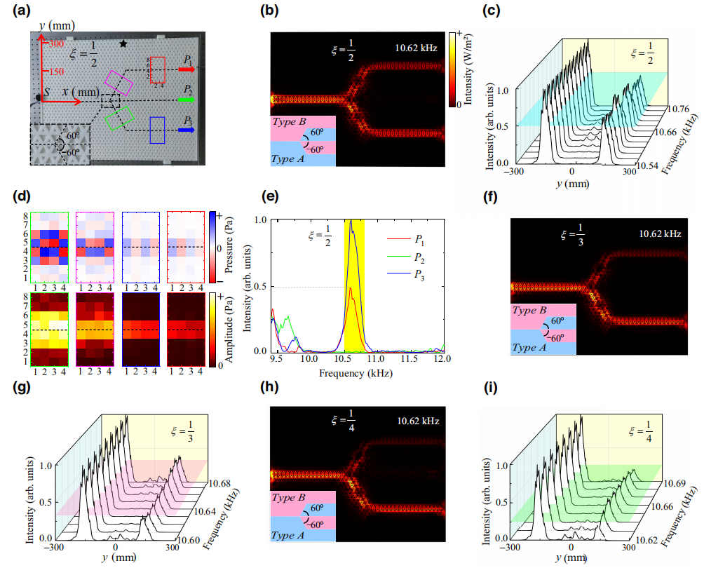
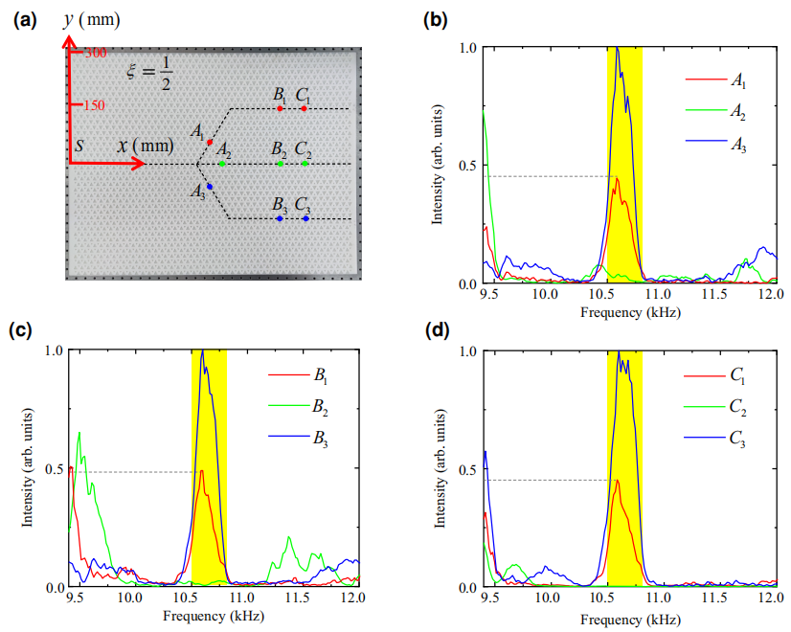
2.5 Asymmetric transport in a sonic valley Hall insulators

Slide 15
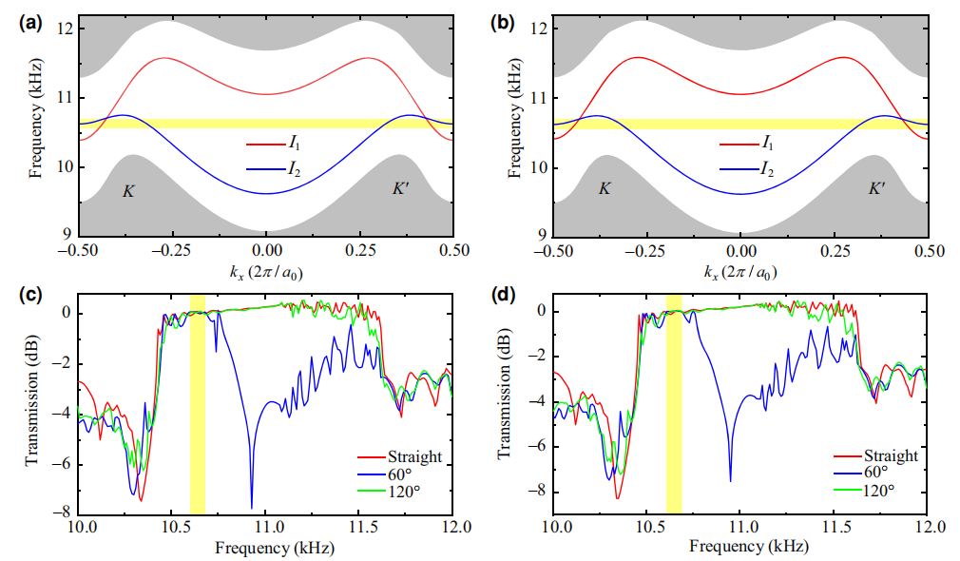
2.6 The range of working frequency

Slide 16
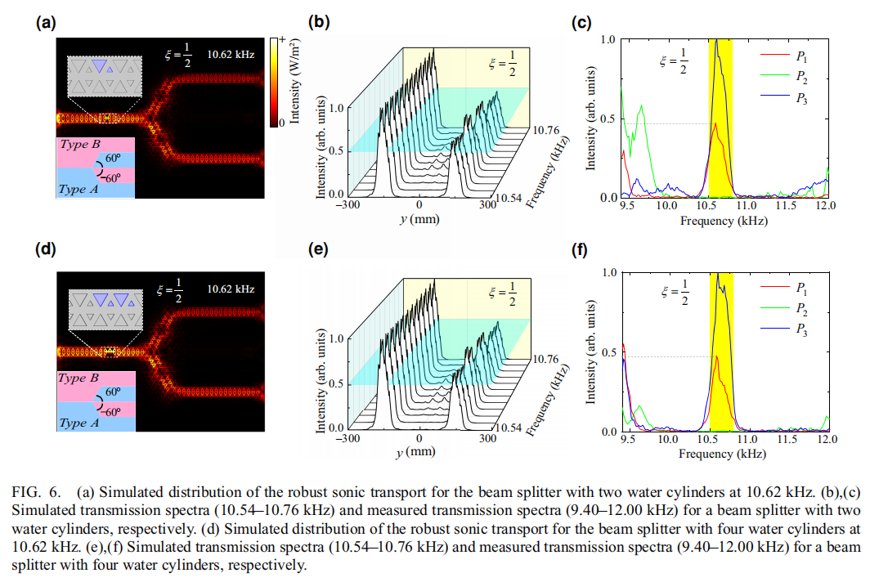
2.6 Robustness of interface states

Slide 17
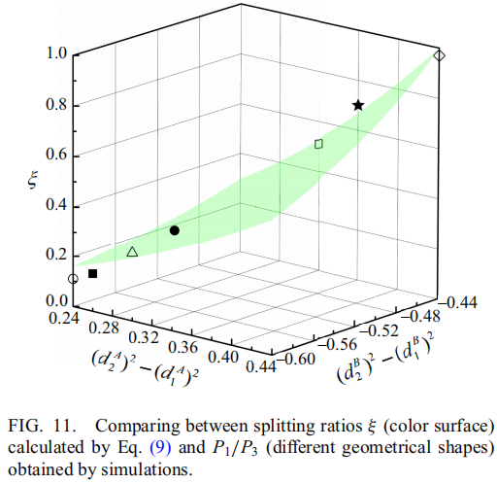
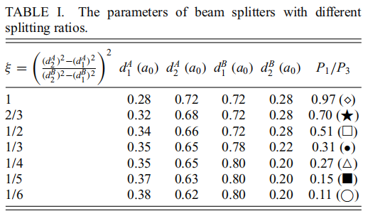
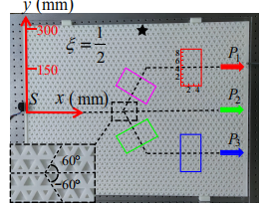
2.6 Quantitative validation of splitting ratios

Slide 18
3. Conclusion
1.By using different interfaces, we realize the acoustic splitting and merging phenomena of the valley interface states in cross waveguides, and demonstrate that there are controllableates in the acoustic merging.
2. Multichannel acoustic topological transport of the valley interface states is demonstrated and verified by simulations and experiments.
3.We develop a beam splitter capable of arbitrary allocation ratios theoretically and experimentally. Compared to traditional sonic topological splitters, this achievement signifies our ability to precisely control the distribution ratio of sonic energy among various paths or regions according to specific requirements.
4. Narrow range of working frequency!

Slide 19
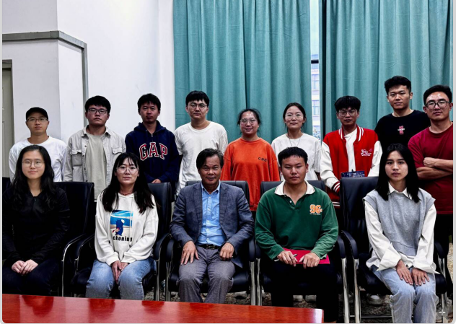
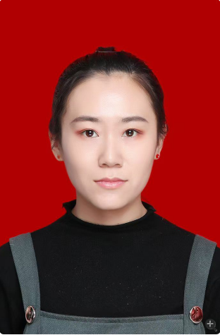
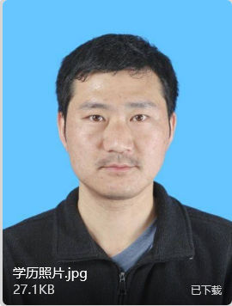
4. Acknowledgement
This work was supported by the National Nature Sci_x0002_ence Foundation of China (Grant No. 12164023), the Yun_x0002_nan Local College Applied Basic Research Projects (Grant
No. 2017FH001-001), and the Yunnan Local College Applied Basic Research Projects (Grant No. 2023Y0884).
特别致谢王振雨和邓程欣同学

Slide 20
谢谢！

