Slide 1
Torsion of an Isotropic Cosserat Elastic Cylinder
COMSOL

Slide 2
Background and Motivation
The Cosserat theory of elasticity incorporates, in addition to the displacement vector as in classical elasticity, the concept of local rotation (or local spin) in the continuum
Each point has six degrees of freedom: three translations and three rotations (microrotations).
This theory can be used to model microinhomogeneous materials, foams, masonries, bones, and so on

Slide 3
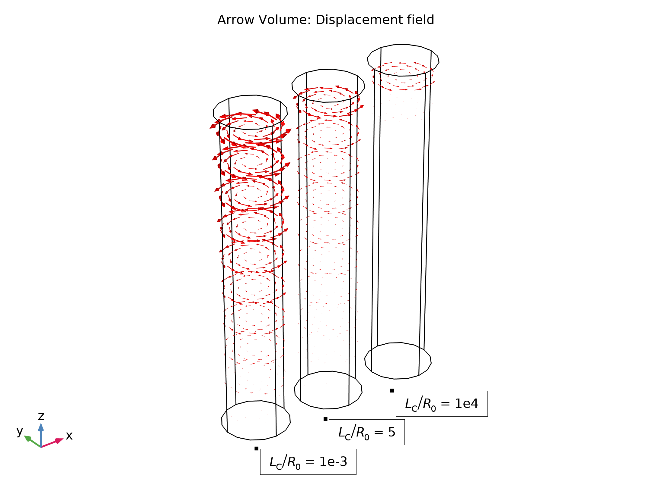
Objective
Demonstrate how to extend the built-in linear elastic material model to a Cosserat material through the addition of microrotation degrees of freedom
A cylindrical bar under pure torsion is analyzed and the effect of the Cosserat length scale parameter on the response is studied

Slide 4
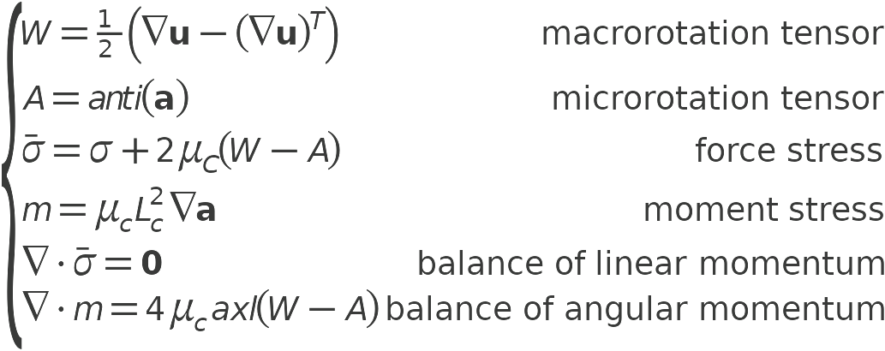
Model Definition
The displacements u and microrotations a are found solving the following system of equations:

Slide 5
Model Definition
The corresponding weak form solved by the finite element method is
Two additional parameters are introduced:
  Cosserat length scale L_{C}
  Cosserat couple modulus μ_{C}
A Parametric Sweep in combination with an Auxiliary Sweep is used to evaluate the effect of these parameters

Slide 6
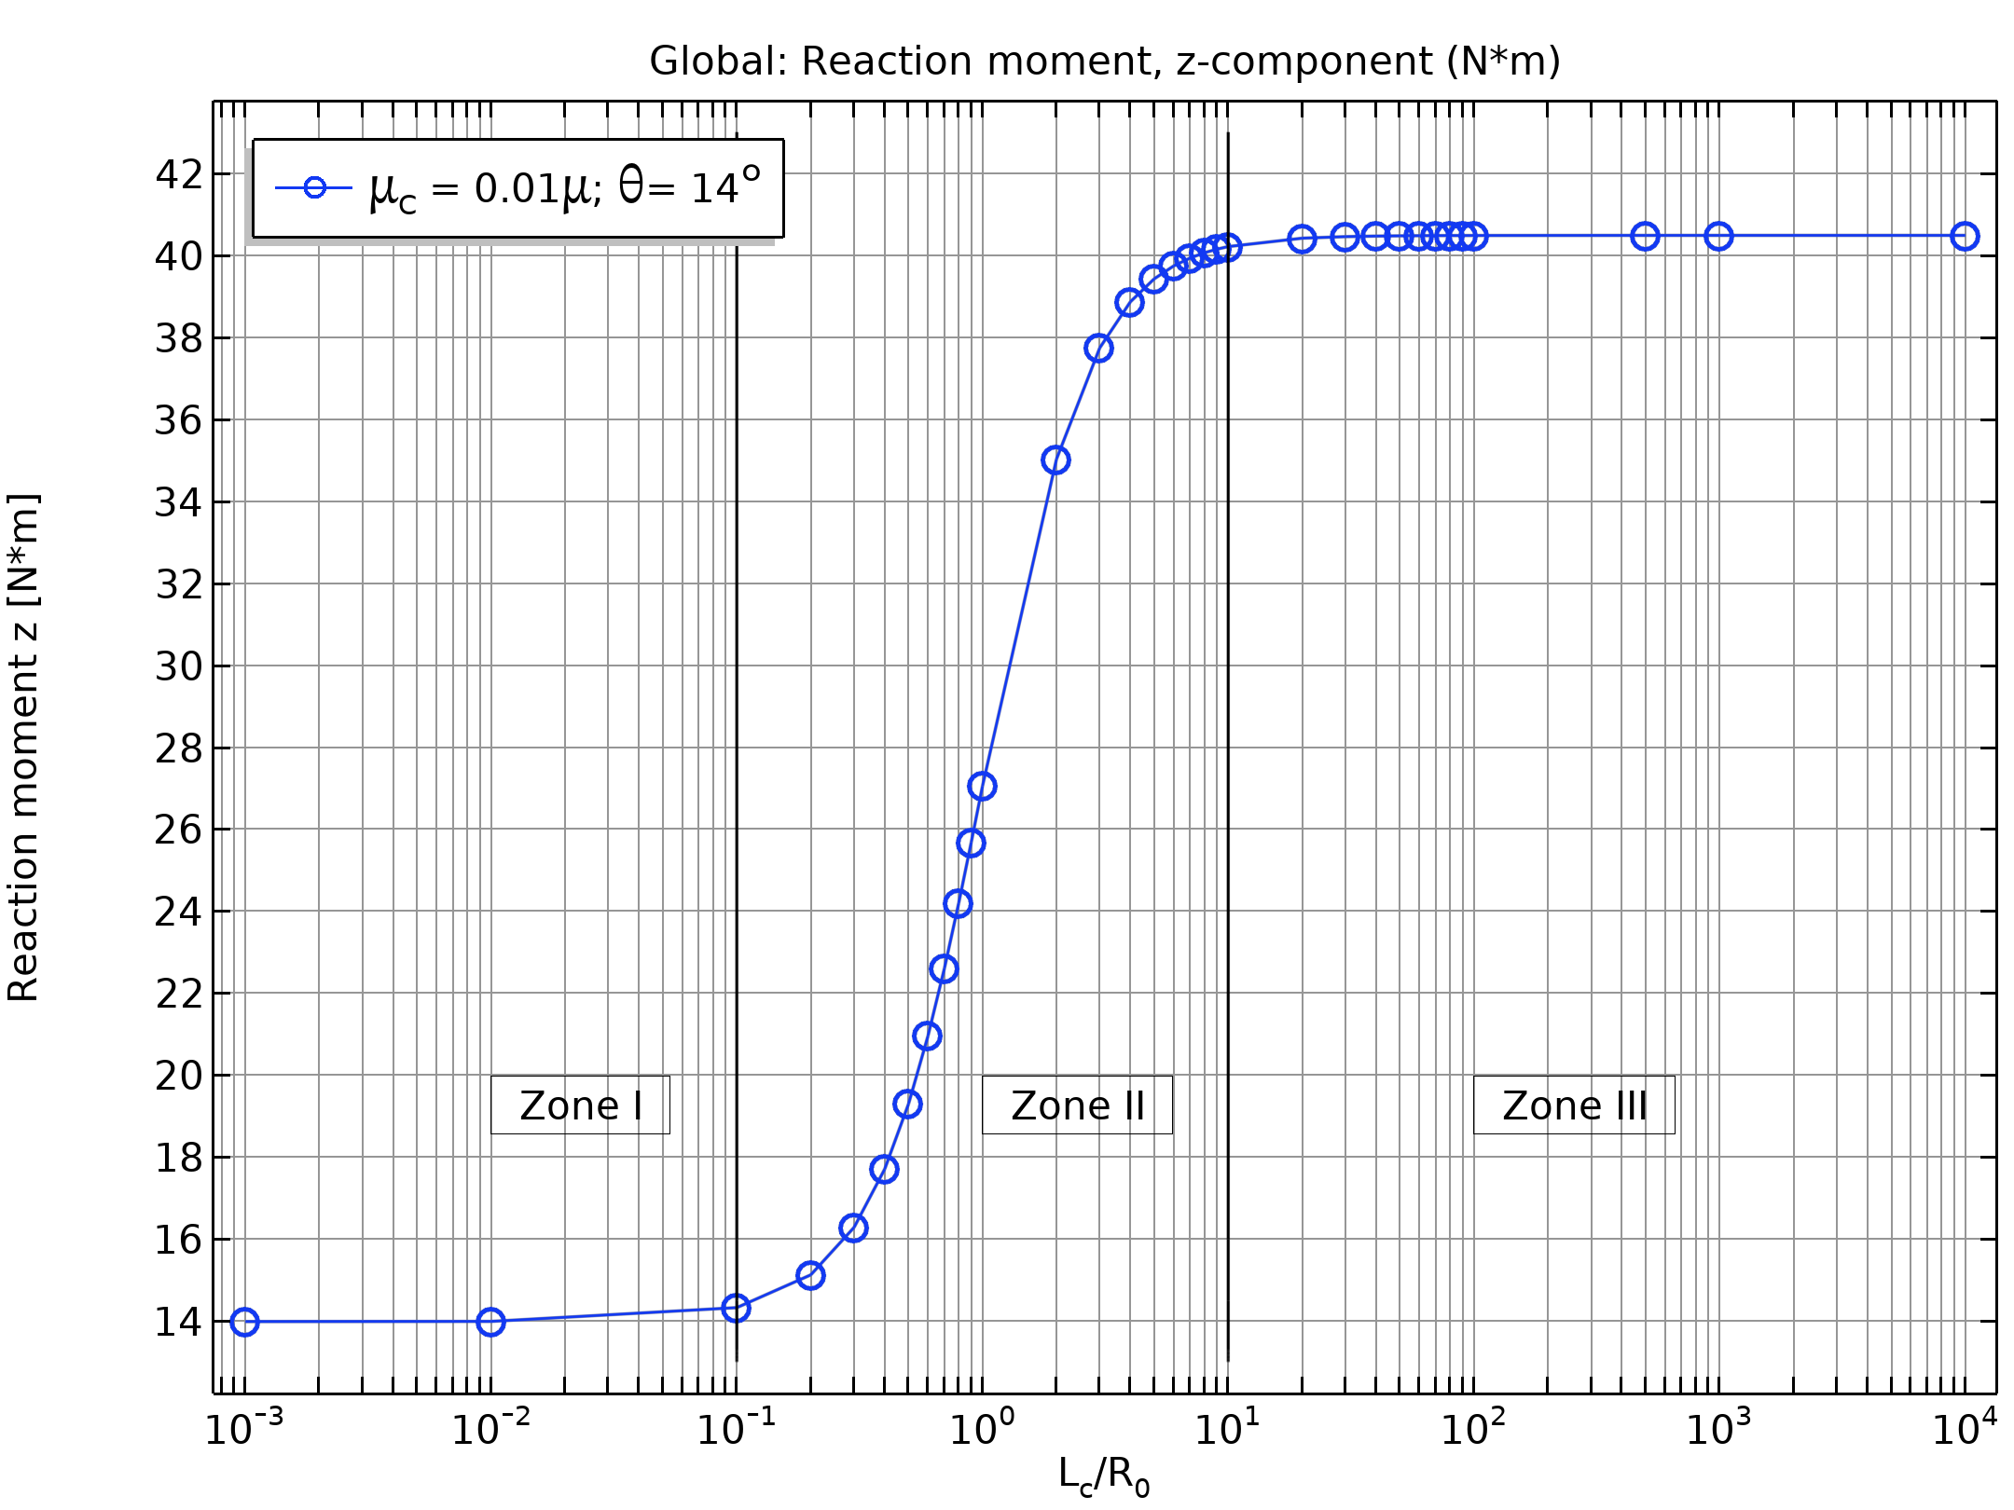
Results: Cosserat length effect
Zone I (L_{c}/R₀ < 0.10): No size effect and the material behaves as a linear elastic solid
Zone II (0.1 < L_{c}/R₀ < 100): There is a transition where the size effect on the solution is clearly visible.
Zone III (L_{c}/R₀ > 100): Cosserat effects dominate and the microrotation is nearly constant
Reaction torque as a function of the Cosserate length parameter

Slide 7
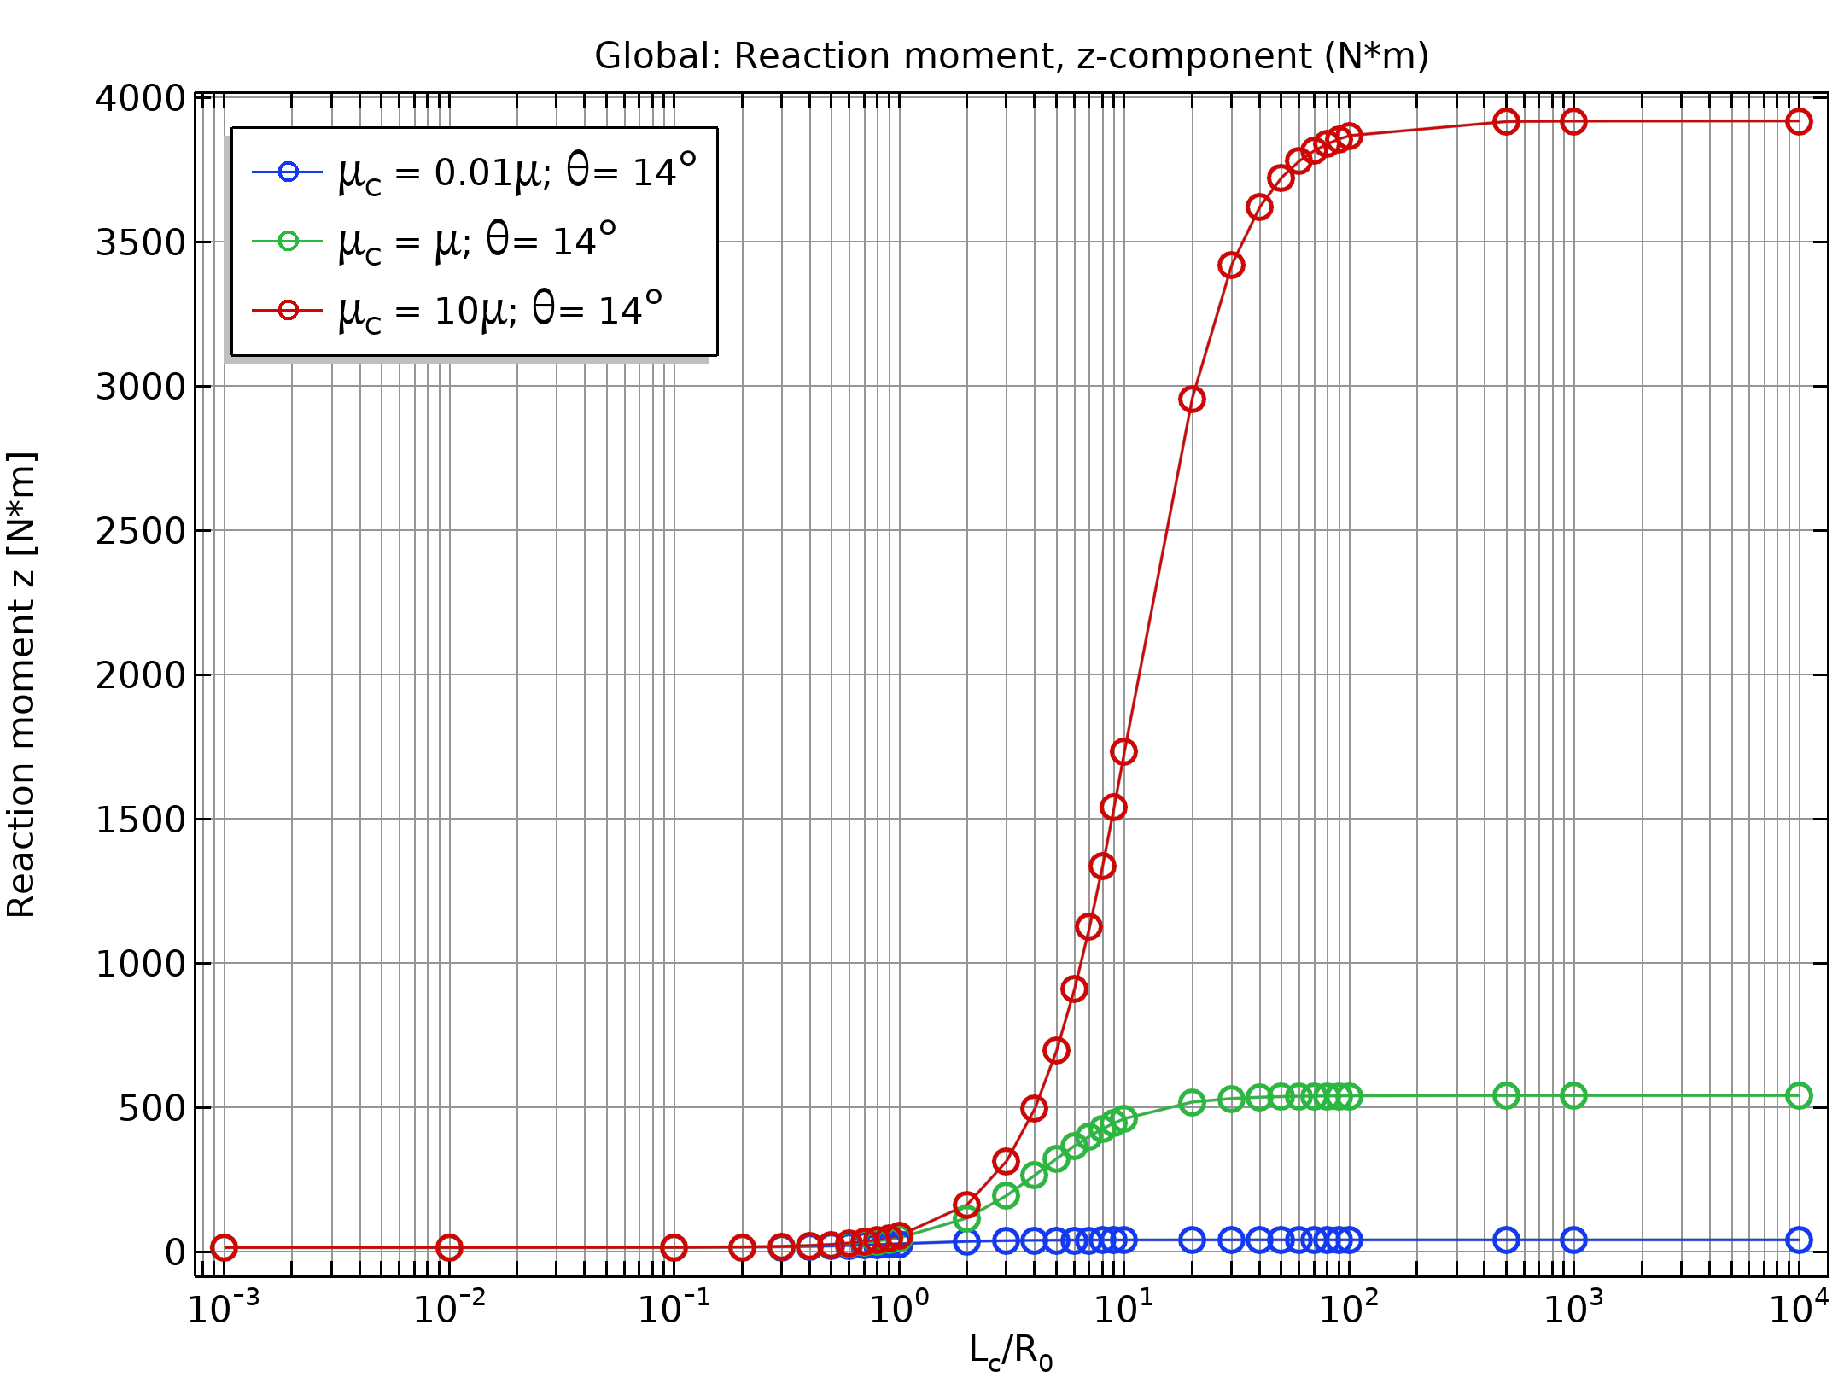
Results: Cosserat couple modulus
The bar becomes stiffer as the coupling μ_{C} between the macro and micro rotations increases
The effect is more visible for higher values of the Cosserat length L_{c}
Reaction torque for different values of the Cosserate couple parameter

Slide 8
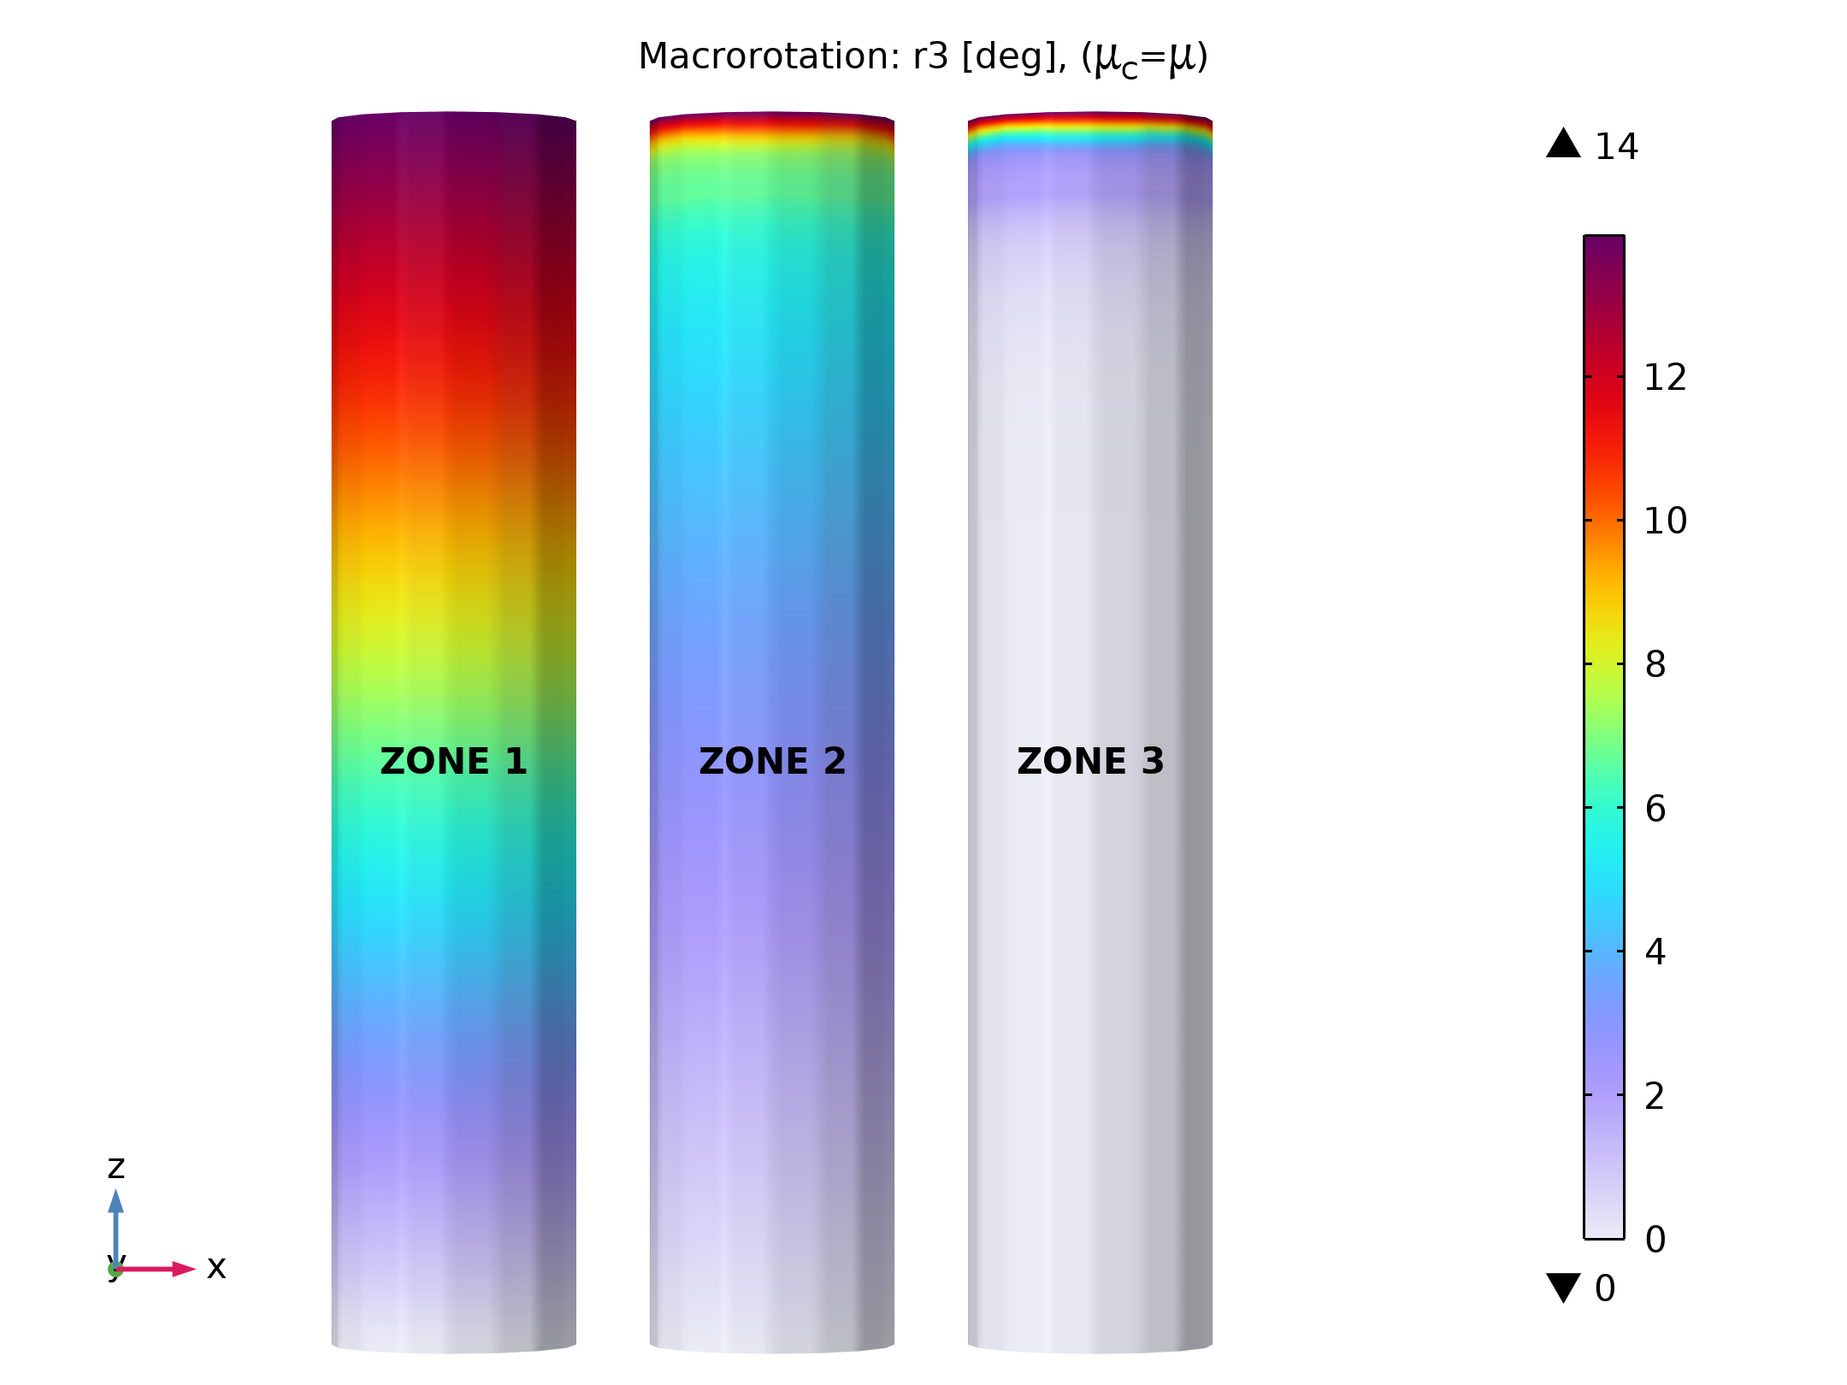
Results: macrorotation
The bar becomes stiffer as the ratio between the parameter L_{c} and the cylinder’s radius R₀ increases. The bar twists only in the proximity of the constrained end
Torsional deformation for different values of the Cosserat length

