Slide 1
Diffusion-Controlled Dendrite Formation Using the Level Set Method
COMSOL

Slide 2
Overview
The present model demonstrates diffusion-controlled electrodeposition of copper on microstructured band electrode arrays (MEA).
Mass transport by Fickian diffusion of copper ions is solved using the Transport of Diluted Species interface.
Dendrite formation as a consequence of diffusion-controlled electrodeposition is captured using the Level Set interface.
The electrodeposition velocity is prescribed in terms of diffusive flux in the model.
The dendrite formation is found to be more predominant for the peripheral electrode in MEA when compared to the inner electrodes in MEA.

Slide 3
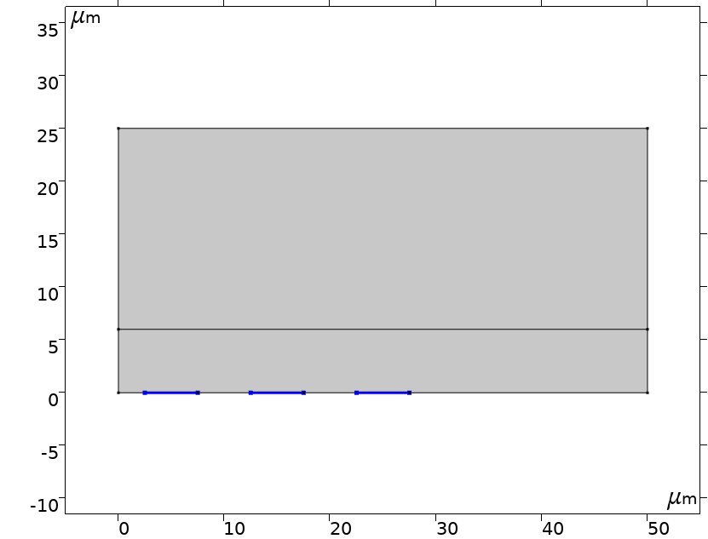






Model Geometry and Setup
$$c_{i}=c_{i,b}$$
Electrolyte
$$\frac{∂c_{i}}{∂t}+∇∙\left(−D_{i,eff}∇c_{i}\right)=0$$
$D_{i,eff}={ε_{l}D}_{i}$ $+(1−{ε_{l})D}_{d}$
$$c_{i}=c_{i,b}$$
$$c_{i}=0$$
$$c_{i}=0$$
$$c_{i}=0$$
Copper MEA
(Depositing boundary)

Slide 4


Model Setup
The transport of copper ionic species is solved according to the governing equation and boundary conditions described in the previous slide (Model Geometry and Setup).
At the MEA surfaces, copper starts depositing which leads to a moving boundary scenario. The higher diffusion coefficient (of order -6) is set in the dendrite deposited region which ensures that zero concentration boundary condition at MEA surface is transferred to the moving dendrite boundary.
The Level Set interface is used to keep track of the dendrite formation due to diffusion-controlled electrodeposition, which sets up the equations for the movement of the interface between the liquid electrolyte and the deposited product.
The initial value of level set variable is assumed to be 1 in the electrolyte domain.
The Inlet node with level set variable of value 0 is prescribed at MEA boundaries, and value 1 at the remaining bottommost boundaries. The topmost boundary of the computational domain is prescribed with the Outlet node.
The level set variable is advected by the velocity field, which is estimated from the diffusive flux of copper according to
The electrolyte volume fraction term, $ε_{l},$defined in terms of the level set variable, varies from 1 in the electrolyte domain to 0 in the copper deposited region.
$u_{x}=−D_{i,eff}\frac{∂c_{i}}{∂x}$ $×\frac{{nM}_{Cu}}{ρ_{Cu}}$
$u_{y}=−D_{i,eff}\frac{∂c_{i}}{∂y}$ $×\frac{{nM}_{Cu}}{ρ_{Cu}}$

Slide 5
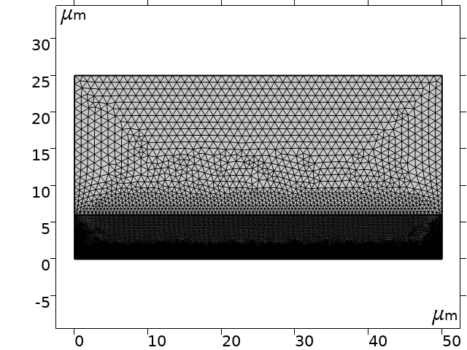
Mesh
A finer mesh near dendrite formation region

Slide 6
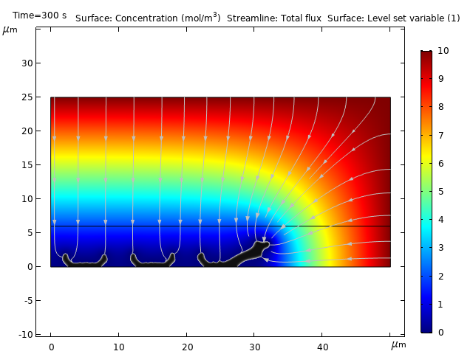
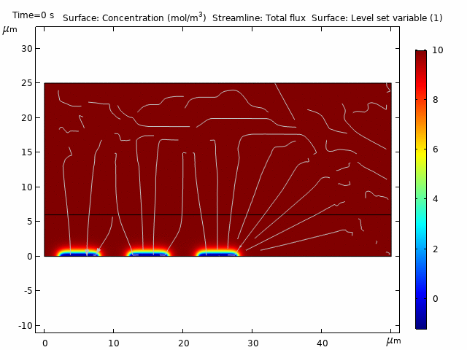
Model Results

Slide 7
Model Results
The model results demonstrate evolution of the dendrite formation and ionic concentration of copper ions with time.
The streamline plot for the total flux of copper ions and the surface plot for the level set variable indicating the dendrite formation region can be seen in the model results.
It can be seen that dendrite formation is more predominant for the peripheral electrode in MEA when compared to the inner electrodes in MEA, which is attributed to the higher diffusive flux at the peripheral electrode.

Slide 8
Reference
C. Lupo and D. Schlettwein, Modeling of dendrite formation as a consequence of diffusion-controlled electrodeposition, Journal of The Electrochemical Society, 166 (1) D3182-D3189 (2019).

