Slide 1
Eigenfrequency Shifts Caused by Temperature Changes
Notes:
You can use the heading from the application documentation for the title.

Slide 2
Background
In high precision applications, it may be necessary to take the shift in eigenfrequencies caused by changes in temperature into account
This can be easily be modeled in COMSOL Multiphysics
In this verification example, the following effects are studied:
  Stress stiffening
  Changes in geometry caused by thermal expansion
  Temperature dependent Young’s modulus

Slide 3
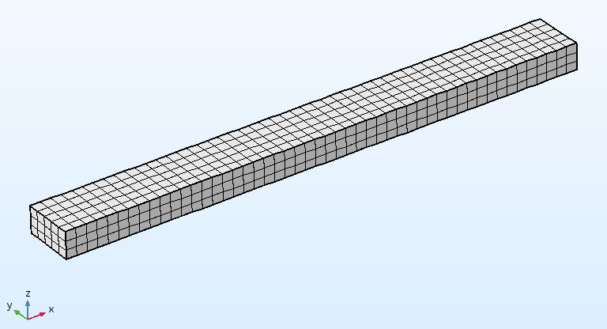
Geometry and Boundary Conditions
Rectangular beam
Two cases:
  Clamped: Both ends fixed
  Cantilever: Left end fixed
Thermal expansion with uniform ΔT

Slide 4
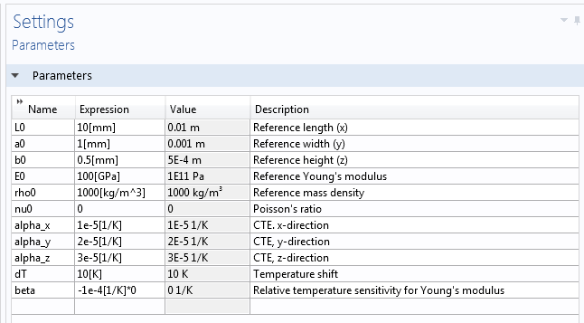
Parameters

Slide 5
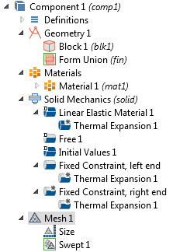
Model
Nodes are deactivated in different combinations in the studies

Slide 6
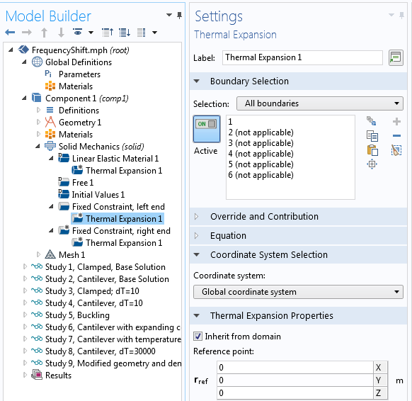
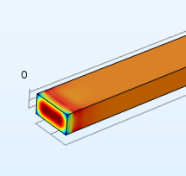
Thermal Expansion of Constraints
Avoid local stresses caused by inhibited thermal expansion

Slide 7
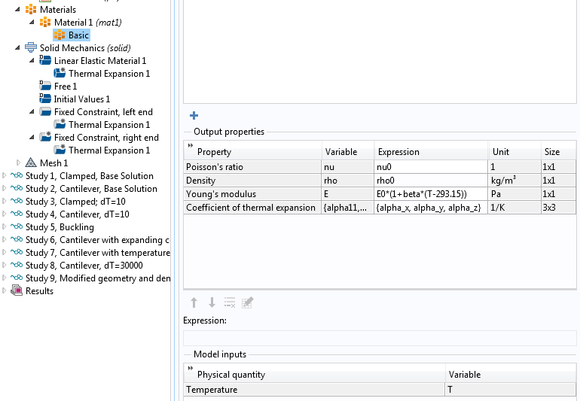
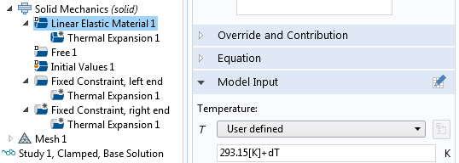
Temperature Dependent E

Slide 8
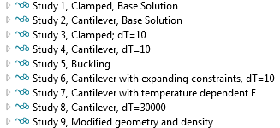
Studies
Study | Type | Boundary Conditions | ΔT | Expanding Constraints | Temperature dependent E
1 | Eigenfrequency | Clamped | 0 | No | No
2 | Prestressed Eigenfrequency | Cantilever | 0 | No | No
3 | Eigenfrequency | Clamped | 10 | No | No
4 | Prestressed Eigenfrequency | Cantilever | 10 | No | No
5 | Linear Buckling | Clamped | 10 | No | No
6 | Prestressed Eigenfrequency | Cantilever | 10 | Yes | No
7 | Prestressed Eigenfrequency | Cantilever | 10 | Yes | Yes
8 | Prestressed Eigenfrequency | Cantilever | 30000 | Yes | No
9 | Eigenfrequency (updated geometry and density) | Cantilever | 0 | No | No

Slide 9
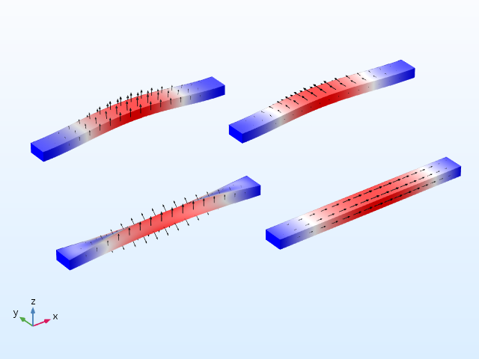
Mode Shapes, Clamped

Slide 10
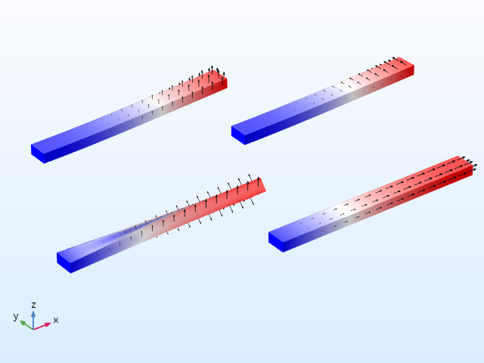
Mode Shapes, Cantilever

Slide 11
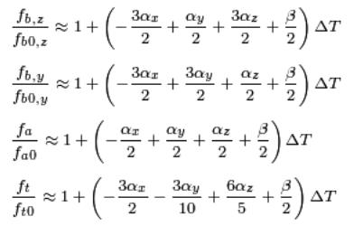
Expected Frequency Shifts
E=E₀(1+βΔT)
Indices
  Bending : b
  Twisting: t
  Axial: a

Slide 12
Results
Clamped: Dominated by stress softening
  Constrained expansion causes compressive stress
Cantilever: Very good fit to analytical values
  Local stresses at constraints affect results
Temperature dependence of E is important in practice
Even at extreme thermal expansion (30000 K), the prestressed eigenfrequency analysis gives correct values

Slide 13
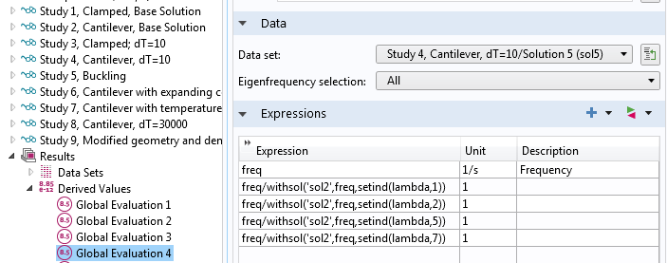

Evaluation
Frequency shifts:
  Global Evaluation
  withsol()

Slide 14
Frequency Shift, Cantilever, ΔT=10 K
Mode | Analytical | Fixed Constraint | Expanding Constraint
Bending, z | 1.00040 | 1.00039 | 1.00040
Bending, y | 1.00030 | 1.00028 | 1.00030
Twisting | 1.00025 | 1.00025 | 1.00026
Axial | 1.00020 | 1.00020 | 1.00020

Slide 15
Frequency Shift, Cantilever,
ΔT=10 K, Temperature dependent E
Mode | Analytical | Expanding Constraint
Bending, z | 0.99990 | 0.99990
Bending, y | 0.99980 | 0.99980
Twisting | 0.99975 | 0.99976
Axial | 0.99970 | 0.99970

Slide 16
Frequency Shift, Cantilever,
ΔT=30000 K
Mode | Thermal expansion + prestressed eigenfrequency | Larger geometry + lower density
Bending, z | 2.2309 | 2.2308
Bending, y | 1.8759 | 1.8759
Twisting | 1.6702 | 1.6695
Twisting, finer mesh | 1.6703 | 1.6701
Axial | 1.5292 | 1.5292

Slide 17
Frequency Shift, ΔT=10 K,
Cantilever and Clamped,
Mode | Cantilever | Clamped
Bending, z | 1.00039 | 0.9943
Bending, y | 1.00028 | 0.9986
Twisting | 1.00025 | 1.00006
Axial | 1.00020 | 1.00005
Stress softening in clamped beam due to compressive stress

