Slide 1
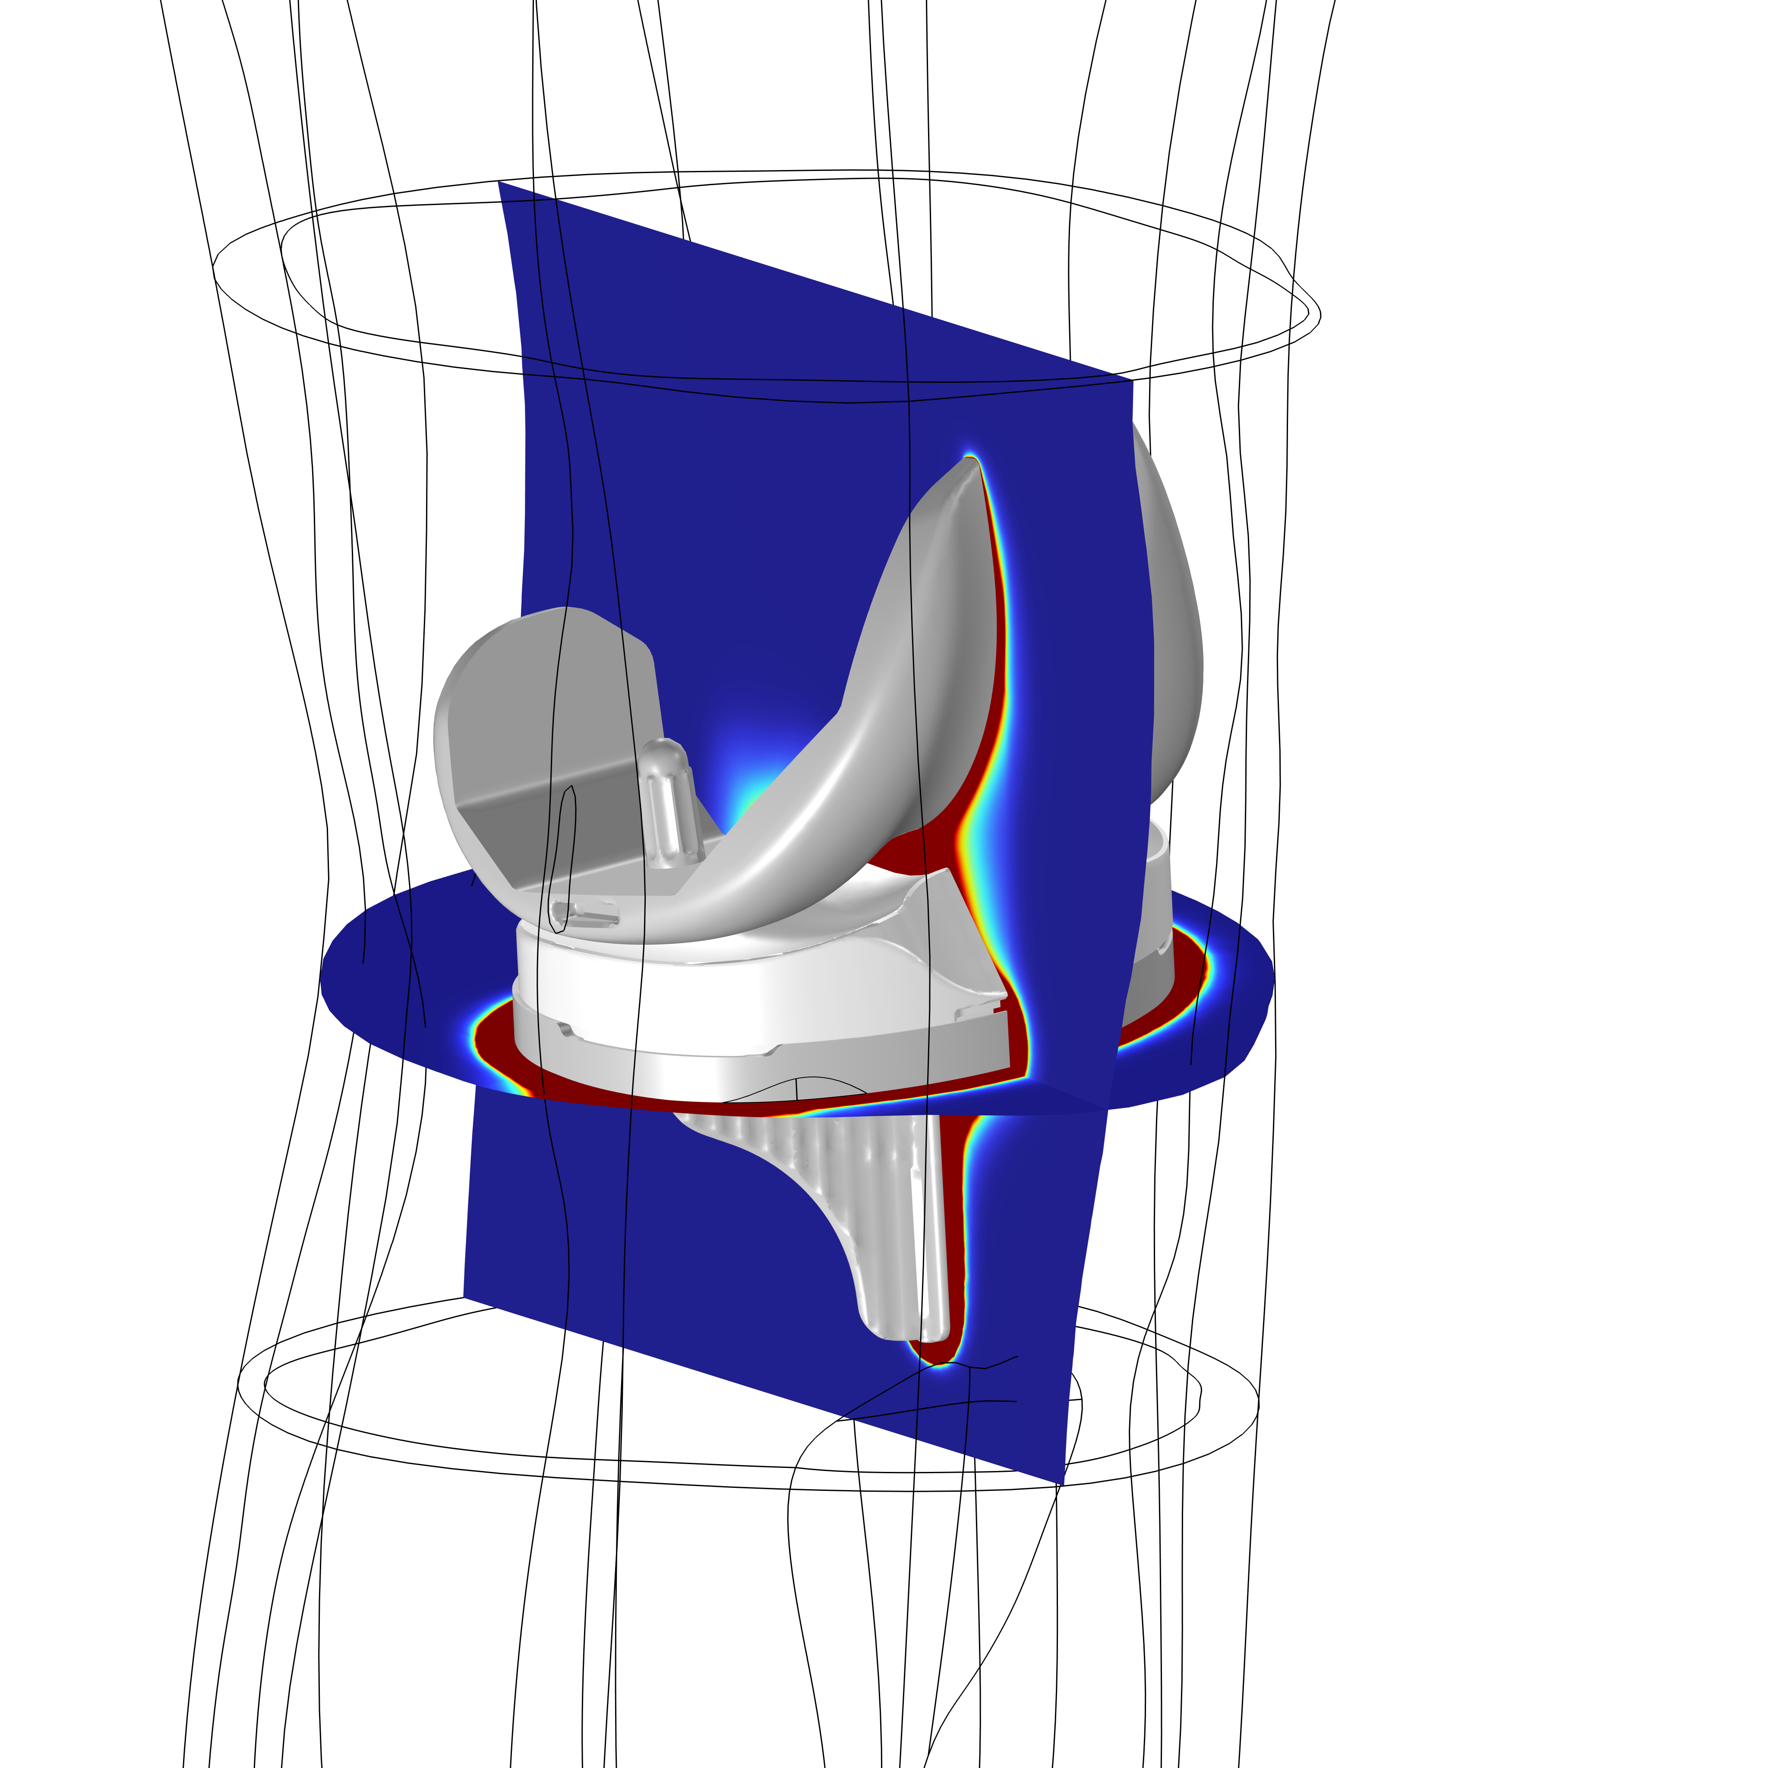
Electromagnetic Heating Simulation of Medical Treatment for Infections After Knee Replacement Surgery
Josh Thomas, Luke Gritter, and Kyle Koppenhoefer
from AltaSim Technologies
Bibin Prasad, John Tepper, and Rajiv Chopra
from Solenic Medical

Slide 2
Introduction
Notes:
Why this project?
What was the challenge?
What were the goals?

Slide 3
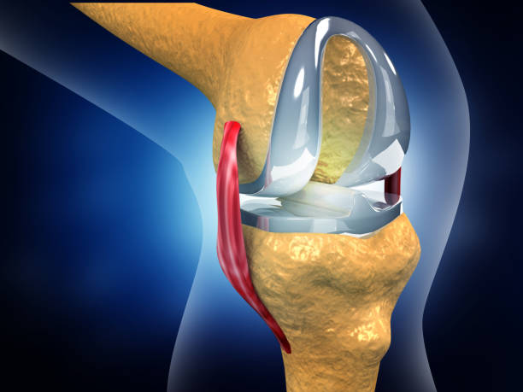
Project Challenge
Develop a device to therapeutically treat knee replacements
Notes:
Why this project?
What was the challenge?
What were the goals?
How does the customer feel? Excited about the possibilities, overwhelmed by the engineering needed to implement, and eager to get their product to market so they can help patients.
Healthy tissue may be damaged if system design is inappropriate

Slide 4
Project Situation
Start-up medical device company
Identified significant medical issue
Needed
  Successful first physical prototyping
  FDA approval of design
Customer lacked internal simulation capabilities
PROJECT GOALS:
Rapidly show proof of concept
Model to support FDA approval of the device
Notes:
Why this project?
What was the challenge?
What were the goals?

Slide 5
Methods and use of COMSOL Multiphysics®
Notes:
Why did we use modeling? Short timetable to develop prototype and extensive animal testing is expensive for FDA safety approval process
Why did we use COMSOL?
Ans:
1) Fundamental process combines electromagnetics and heat transfer. Multiphysics capabilities are excellent.
2) Development of cement regions crucial to accurate simulation of heating near implant. No CAD available. How to define? Customization of COMSOL to solve general PDEs allowed us to develop equations and solve

Slide 6
Model Summary
Current in a Helmholtz coil excites heating of implant metal
Temperatures near metal implants provide therapeutic benefit
Quantification of damage in tissue is critical for FDA

Slide 7
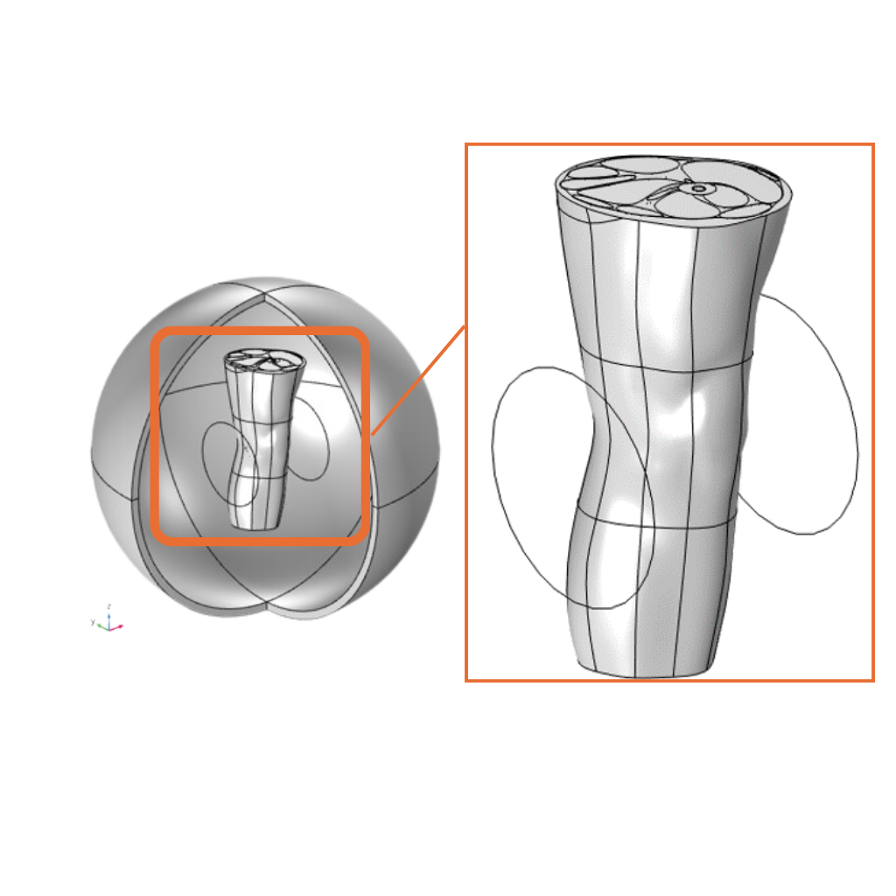
Geometry
Magnetic fields physics included in all regions including spherical air space around knee
Helmholtz coils on either side of knee
Surgically replaced knee joint and surrounding tissue from mid-calf to mid-thigh

Slide 8
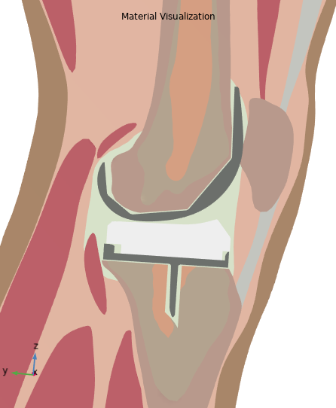
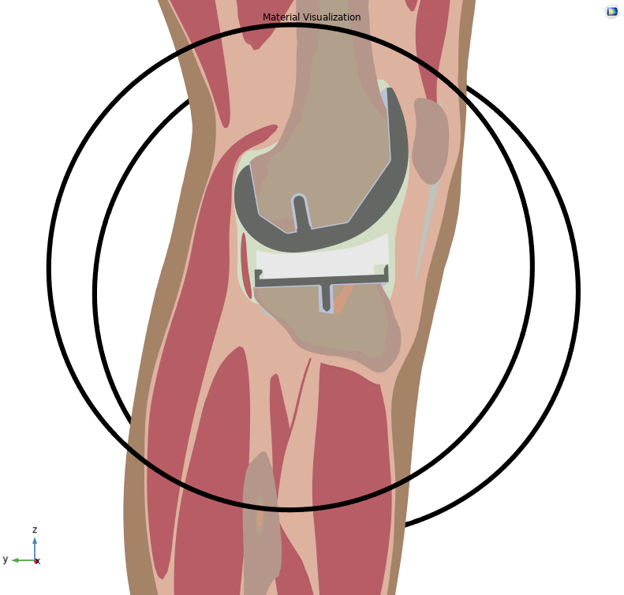
Detailed Anatomical Model
Individual tissues included
Femoral, tibial metal implant
Plastic insert

Slide 9
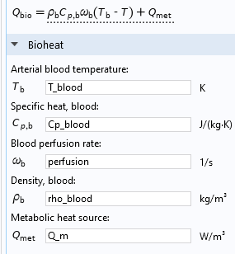
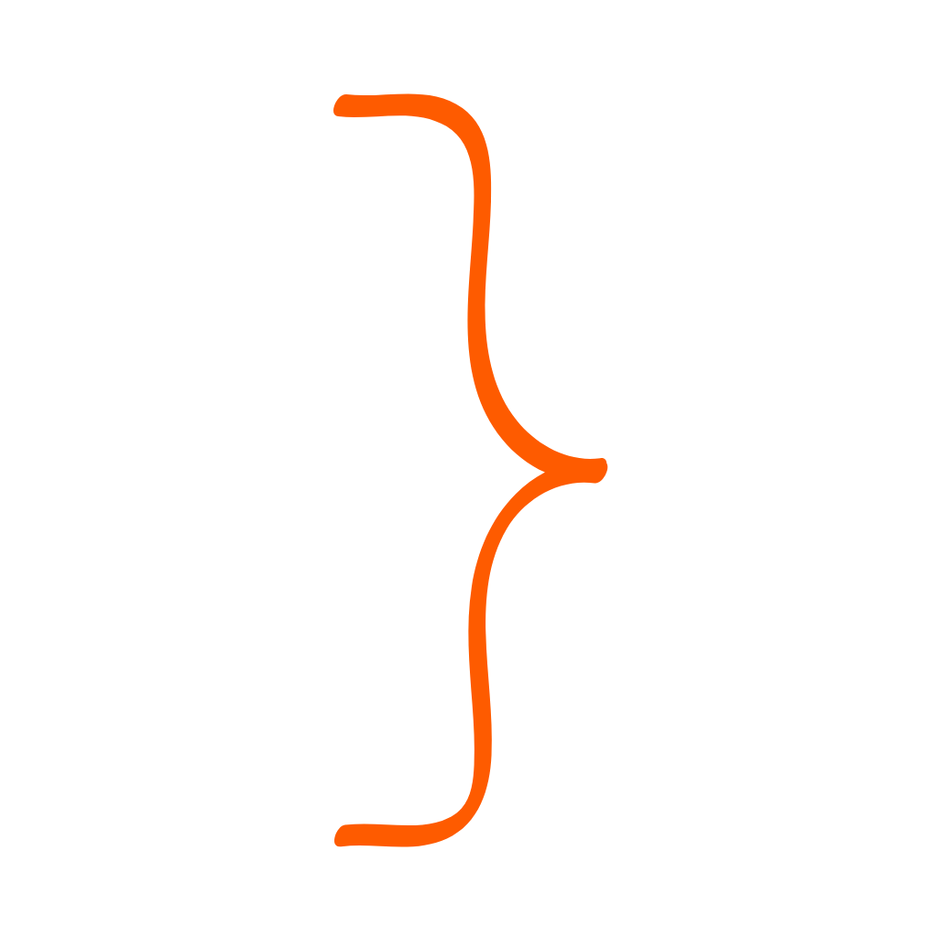
Bioheat Physics Included
Blood perfusion rate and Metabolic heat source specific to tissue type
Specific to tissue type from the literature

Slide 10
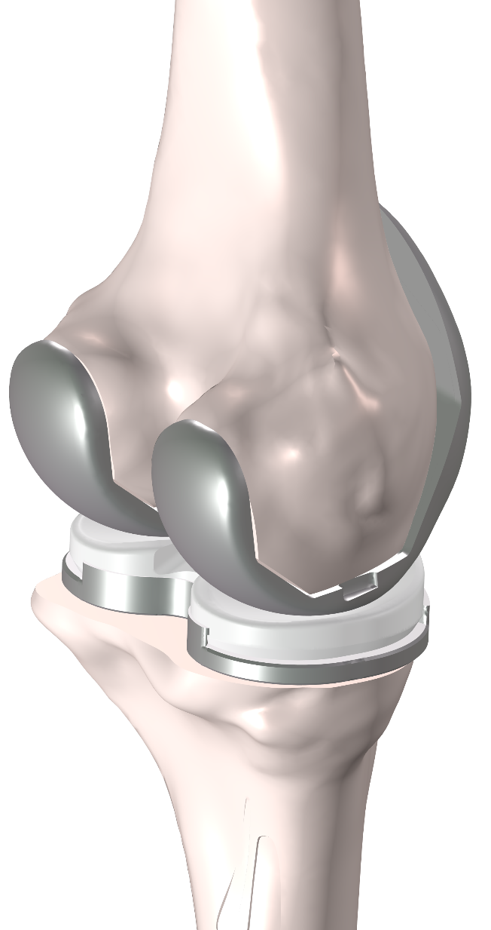
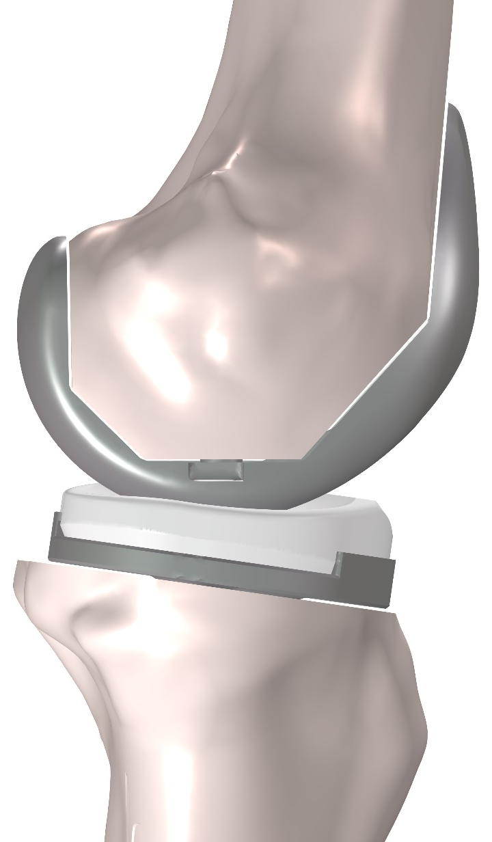
Cement Geometry
No CAD for cement regions that provide a permanent surgical connection between metal and bone
Custom PDE implementation to calculate the extent of cement gap fill between metal and bone
Notes:
Cement location specified using equation-based approach
Three-step process for including cement without explicit geometry:
Use PDEs to calculate proximity to bone and implant at all locations in relevant domains (solved as pre-processing step)
Define smoothed, distributed Boolean variable as function of proximity variables
Set up material properties to toggle between cement properties and synovial fluid properties as function of Boolean variable

Slide 11
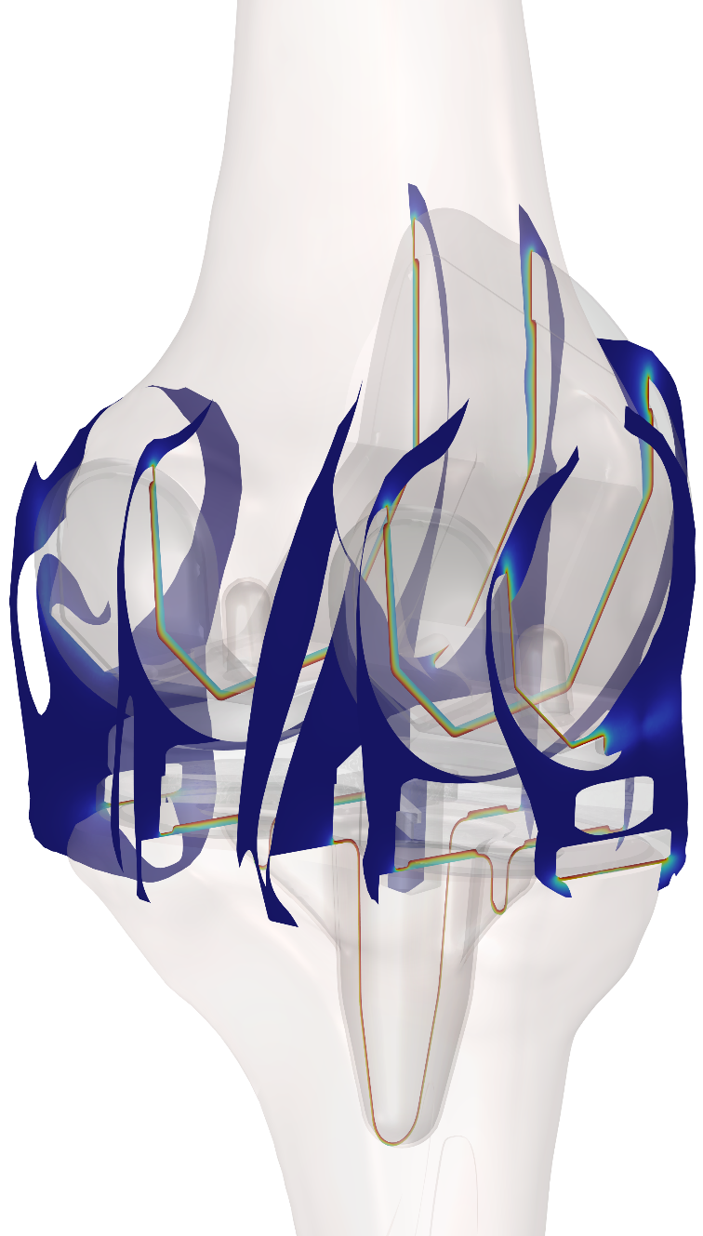
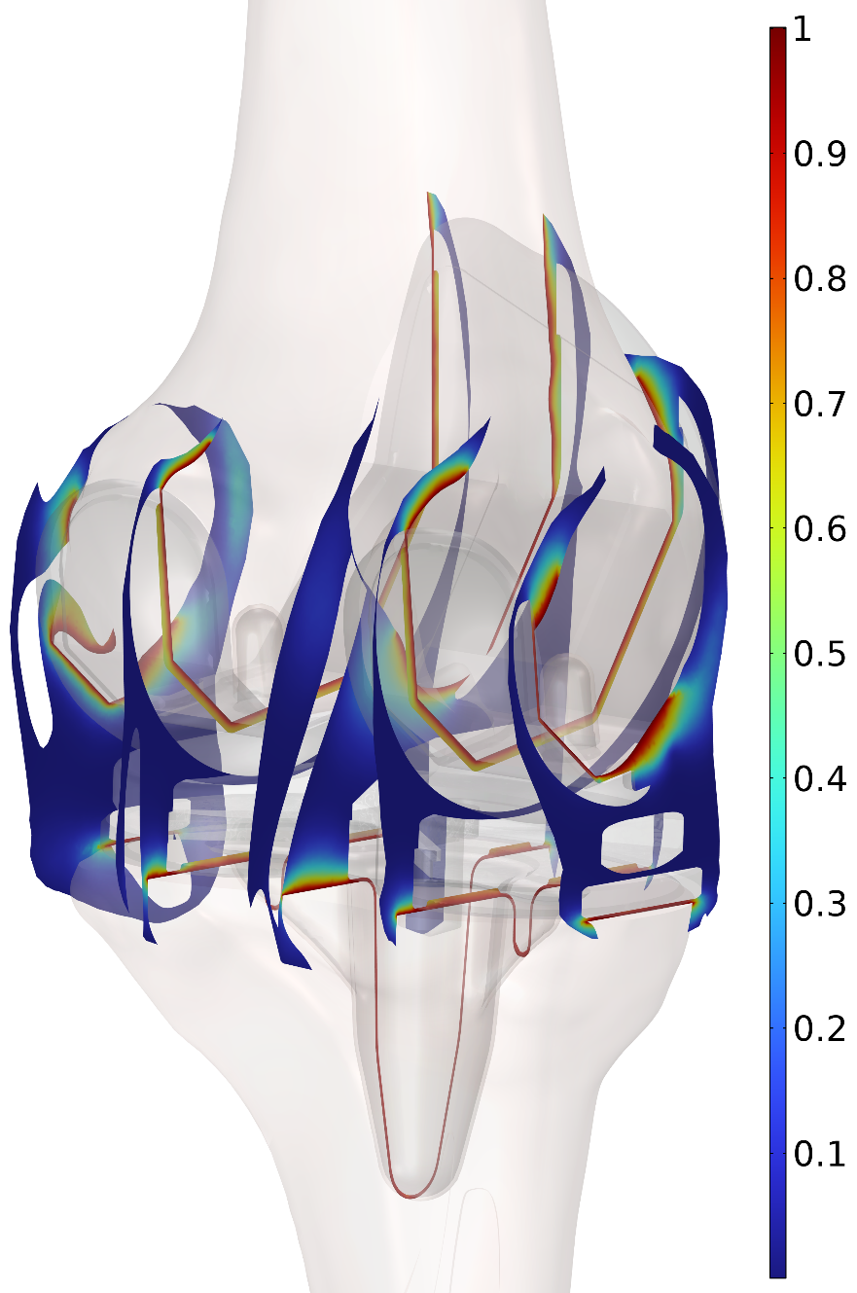


Used two reaction-diffusion equations to calculate proximity
Proximity to implant
Proximity to implant
Proximity to bone
Proximity to bone
PDEs for proximity variables p1 and p2:
C₁ and C₂ are smoothing factors on order of 1; h is local element size
Proximity variables are set to 1 on boundaries that contact cement
$$∇∙\left[−{\left(C_{1}∙h\right)}^{2}p_{1}\right]=−p_{1}$$
$$∇∙\left[−{\left(C_{2}∙h\right)}^{2}p_{2}\right]=−p_{2}$$

Slide 12
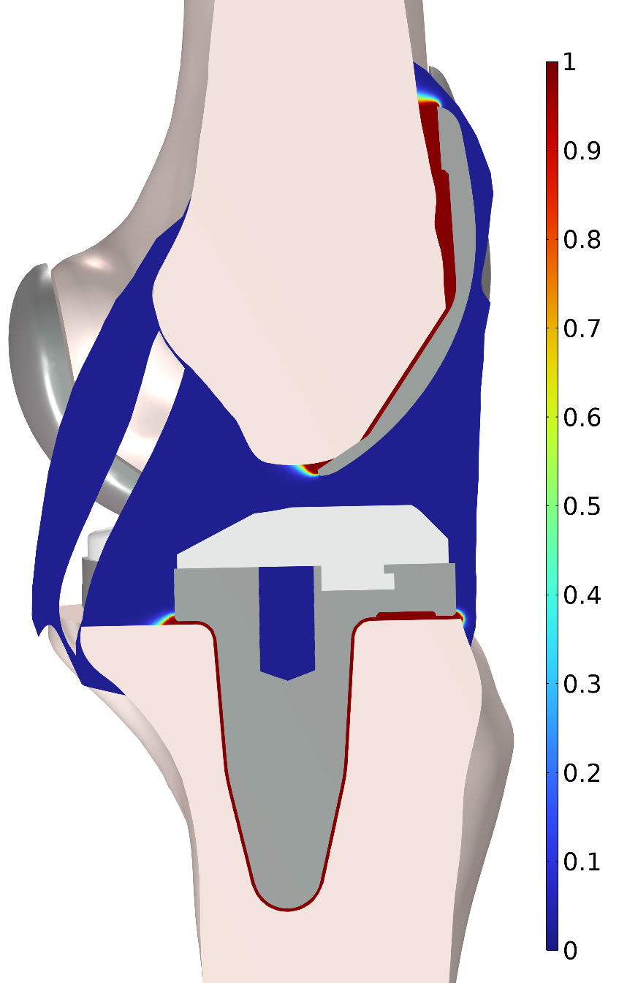


Calculated material properties from proximity variables
Red is cement, blue is synovial fluid
Boolean variable is function of product of proximity variables:
  Variable definition:
  Smooth transition from cement (φ = 1) to synovial fluid (φ = 0)
  Expression is arbitrary and visually tuned
Material properties smoothly transition between cement and synovial fluid:
$$φ=flc1hs\left({10}^{p_{1}p_{2}}−1.16 ,0.15\right)$$
$$k=k_{fluid}+\left(k_{cement}−k_{fluid}\right)φ$$

Slide 13
Calculated material properties from proximity variables
Red is cement, blue is synovial fluid
Boolean variable is function of product of proximity variables:
  Variable definition:
  Smooth transition from cement (φ = 1) to synovial fluid (φ = 0)
  Expression is arbitrary and visually tuned
Material properties smoothly transition between cement and synovial fluid:
$$φ=flc1hs\left({10}^{p_{1}p_{2}}−1.16 ,0.15\right)$$
$$k=k_{fluid}+\left(k_{cement}−k_{fluid}\right)φ$$

Slide 14
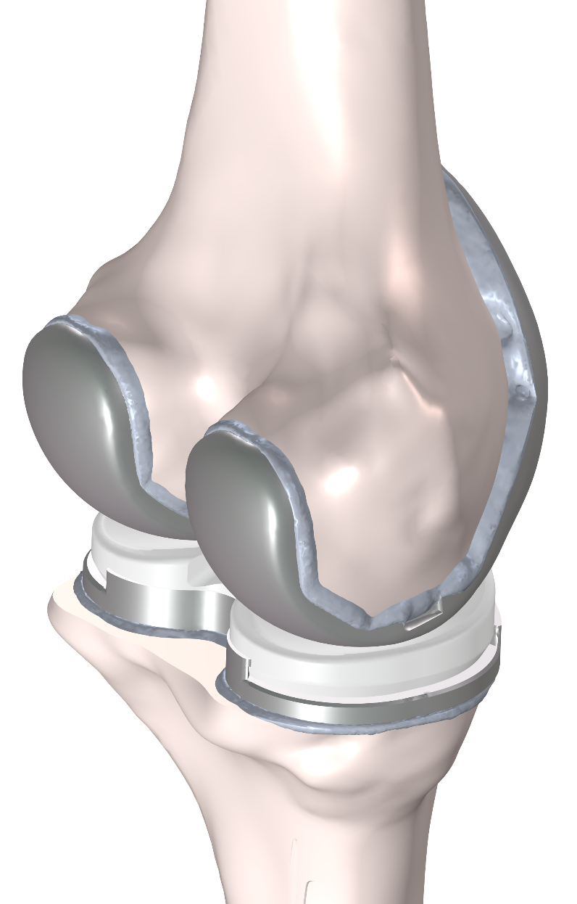
Approach Produces Cement Distribution
Cement fills all gaps between bone and implant
Overfill at edges is relatively small
Gives good approximation to expected cement distribution from “spread, press, wipe” process used by surgeons

Slide 15
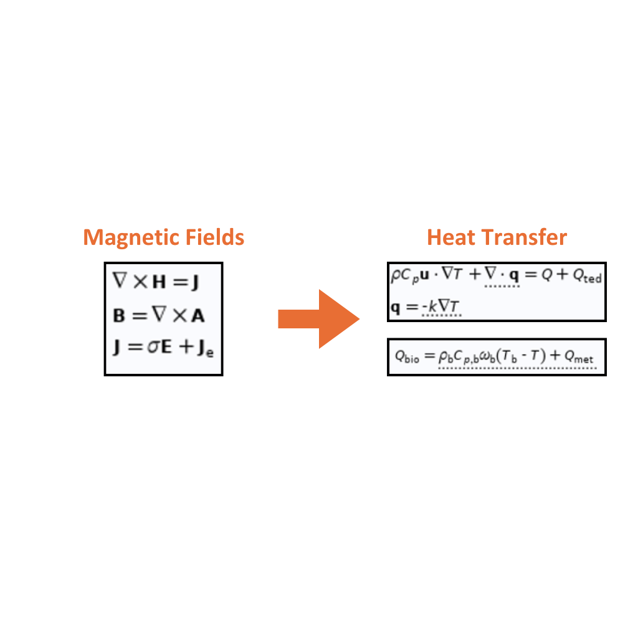
Multiphysics Analysis
Magnetic fields interact with metal implants causing heating
Frequency domain solution simulates heat source
Transient temperature rise simulated via energy equation with metabolic heating and perfusion cooling effect

Slide 16

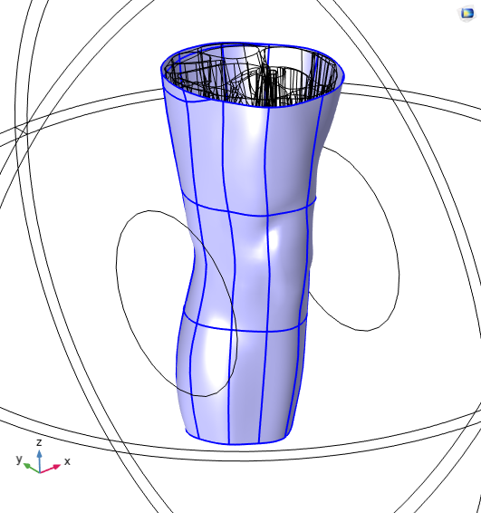
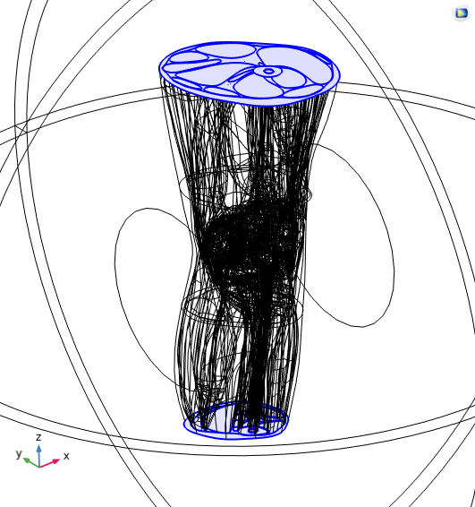
Thermal Boundary Conditions
Convective heat flux on outside of skin
h = 5 W/m²/K
T_{ext} = 30°C
Body temperature assumed at ends where the model is truncated
T_{body} = 37°C

Slide 17
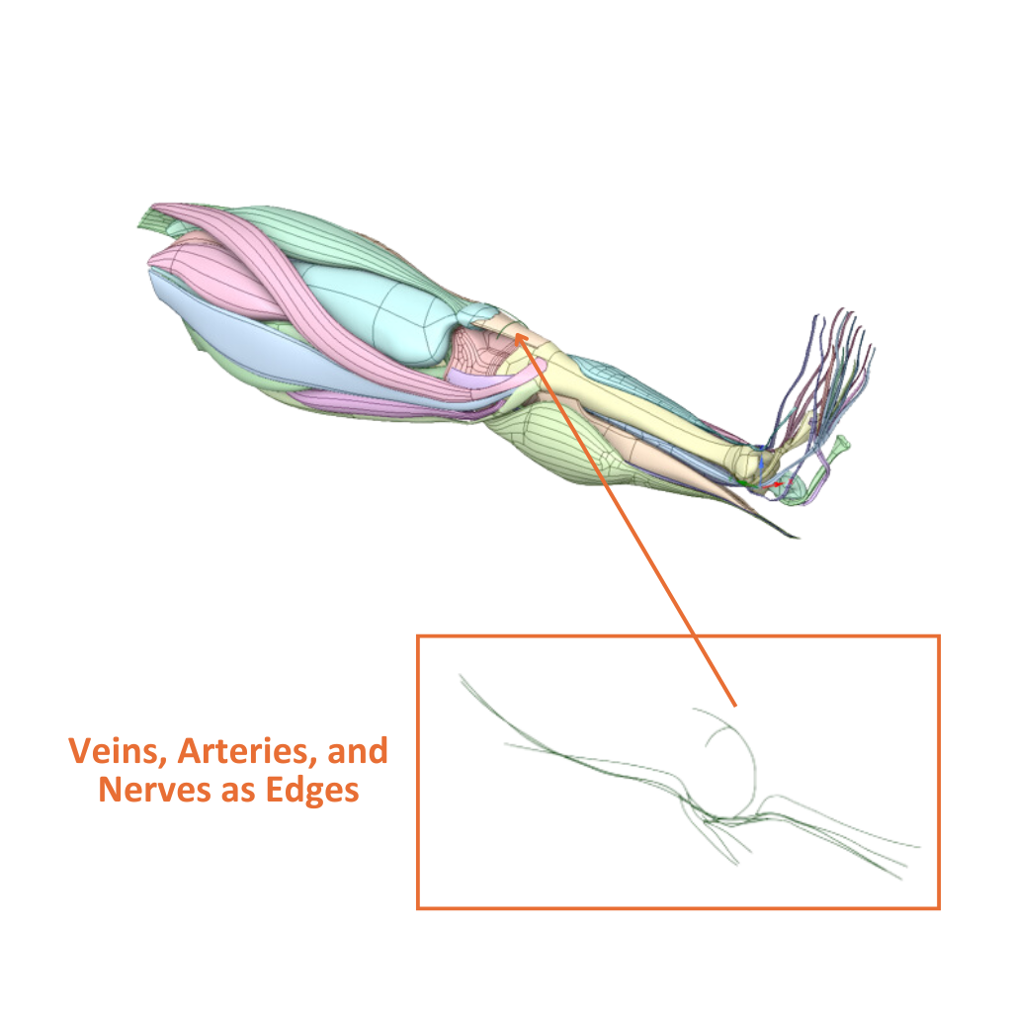
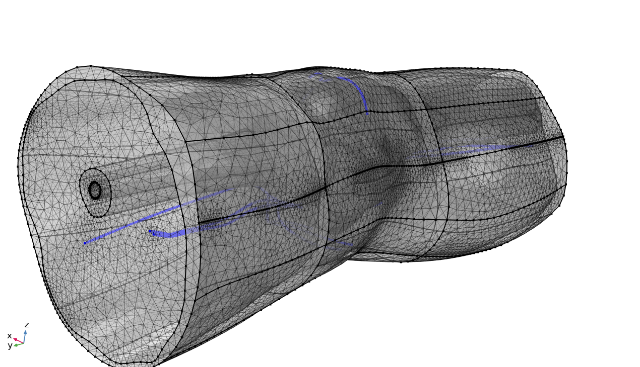


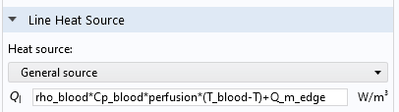
Arteries, Nerves, and Veins Added as 1D Edges
Notes:
Edges meshed conformal with surrounding tetrahedral elements
Physical radius of features represented by Thin Rod physics feature and line source for perfusion
Tangential conduction effects included based on cross sectional area and thermal conductivity of feature
1D heat source/sink equation applies perfusion cooling and metabolic heating

Slide 18
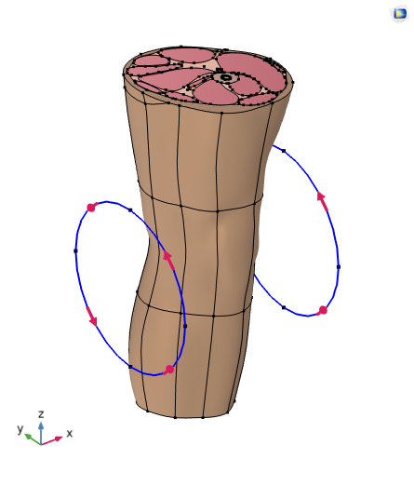
Physical Loading on System
Helmholtz coil
Applied current at a specified frequency

Slide 19
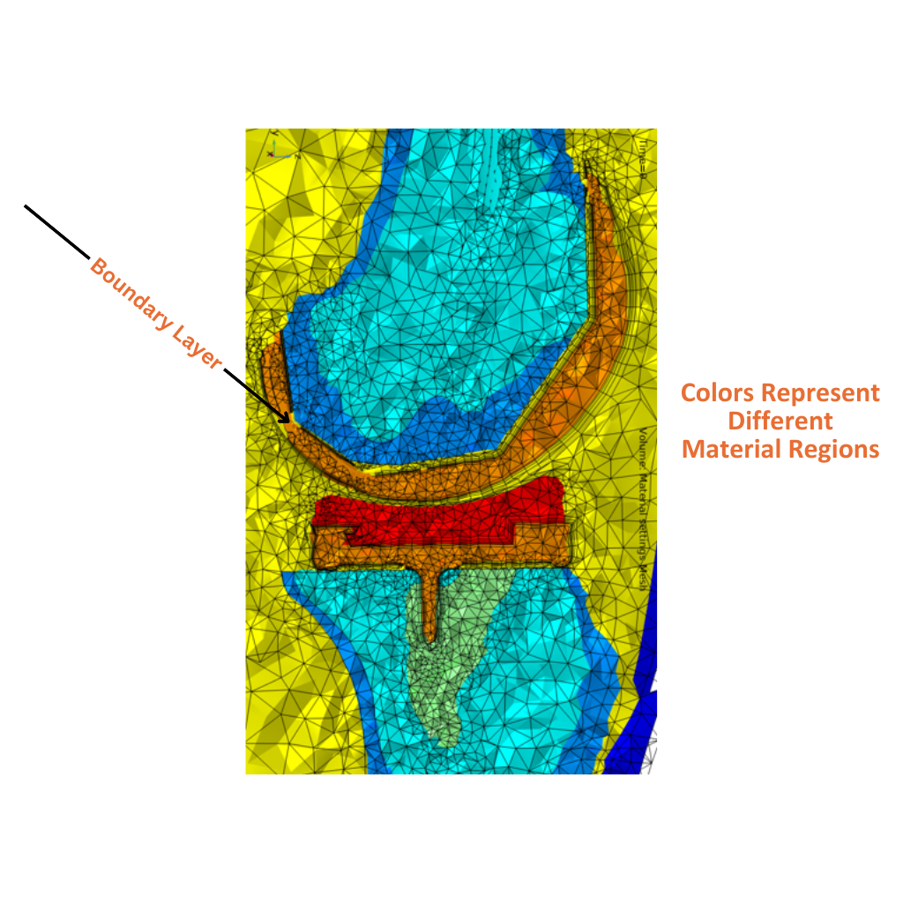
Meshing
Free tetrahedral baseline mesh
Boundary layer mesh added to efficiently discretize field gradients near the implant
Notes:
Frequency domain, mf, solves in 20 minutes using 263 GB RAM and ~30 minutes
Transient thermal solution for 3600 seconds of heating takes 100 GB RAM and ~6 hrs
Explicit event turns coil off when average surface temperature of metal reaches 75 °C

Slide 20
Results
Notes:
Expected vs obtained results
What did this study show?

Slide 21
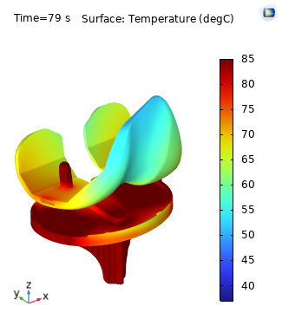
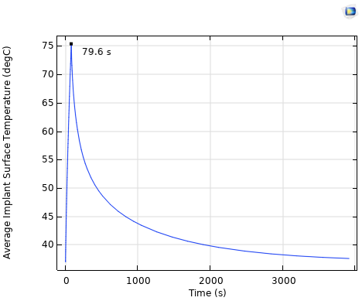
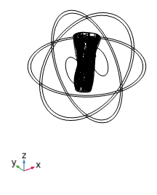
Thermal Results
Heating occurs for 79.6 seconds then cool down for the remainder of the hour

Slide 22
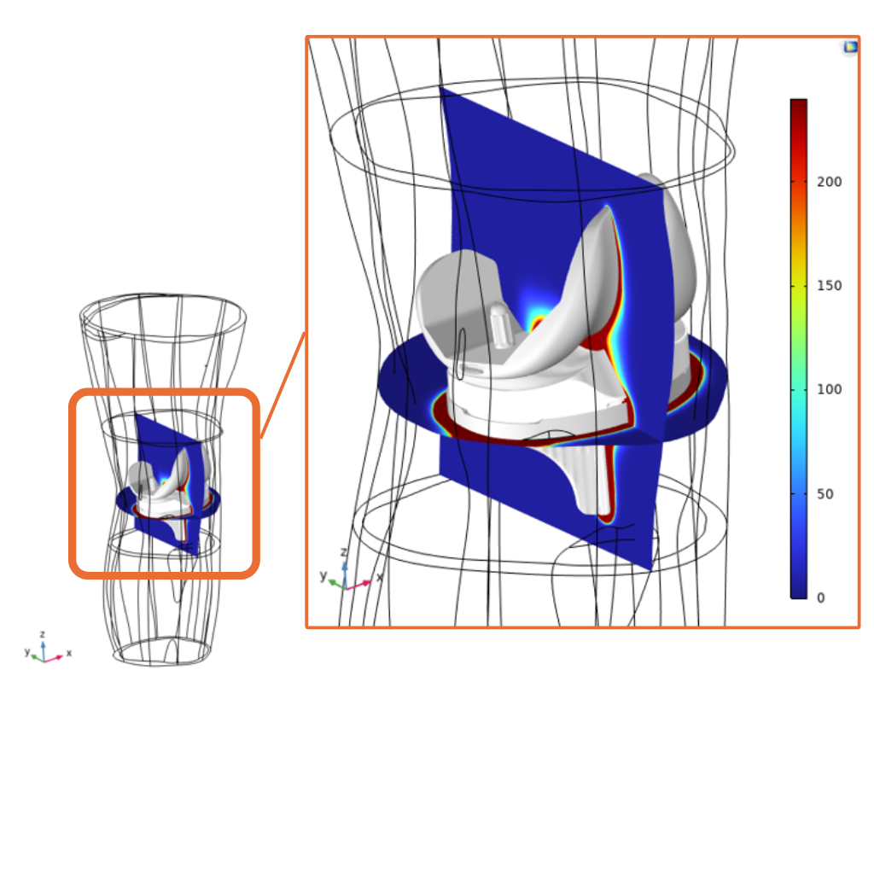
Damage Results
Cumulative Equivalent Minutes at 43°C, CEM43
Tissue damage after treatment

Slide 23
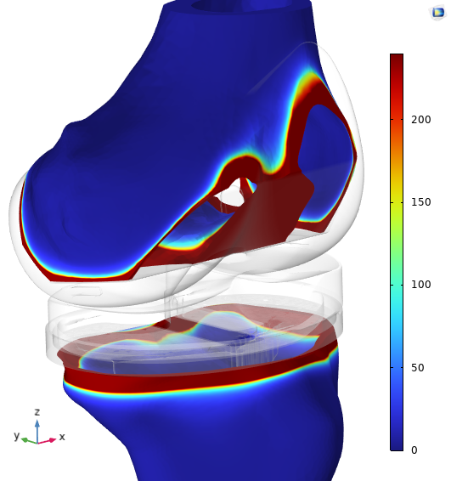
Cortical Bone Damage
Damage to the femur and tibia cortical bone
Notes:
Depth of damage compared to allowable by FDA
JT – Ask Solenic what FDA requirement is for safety in terms of damage to tissues?

Slide 24
Conclusions
Notes:
How did the results impact the project?
Include any quantifiable data points

Slide 25
AltaSim Technologies’ Solution
Became simulation team for customer
Developed simulations that produced workable design
Provided simulations to customer and trained internal engineers to develop additional simulations
Customer – Private equity / device under FDA review
Notes:
Multiphysics model developed of knee treatment
Customized use of COMSOL general equation solver structure leveraged to define cement layers
Novel procedure requires FDA approval
Simulations support approval process

Slide 26

Notes:
By (x1)demonstrating the impact of simulations on product design, (x2)developing applications that enable your
engineers to conduct additional simulations, (x3)training your engineers to develop their own simulations, and (x4) providing ongoing coaching for your engineers,

Slide 27




To get in touch call us at (614) 861-7015 or
email at info@altasimtechnologies.com or
visit https://altasimtechnologies.com/ to learn more.
Connect with Us!

