Slide 1
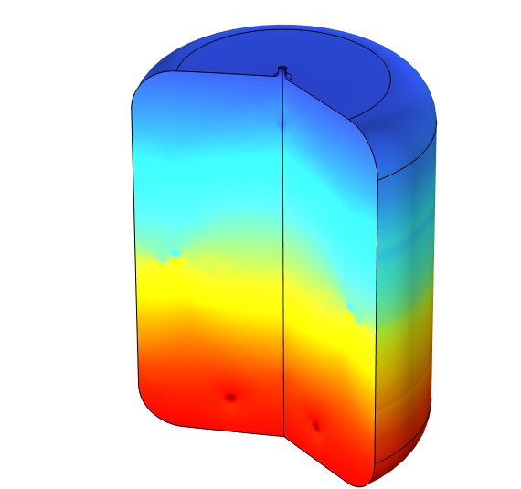

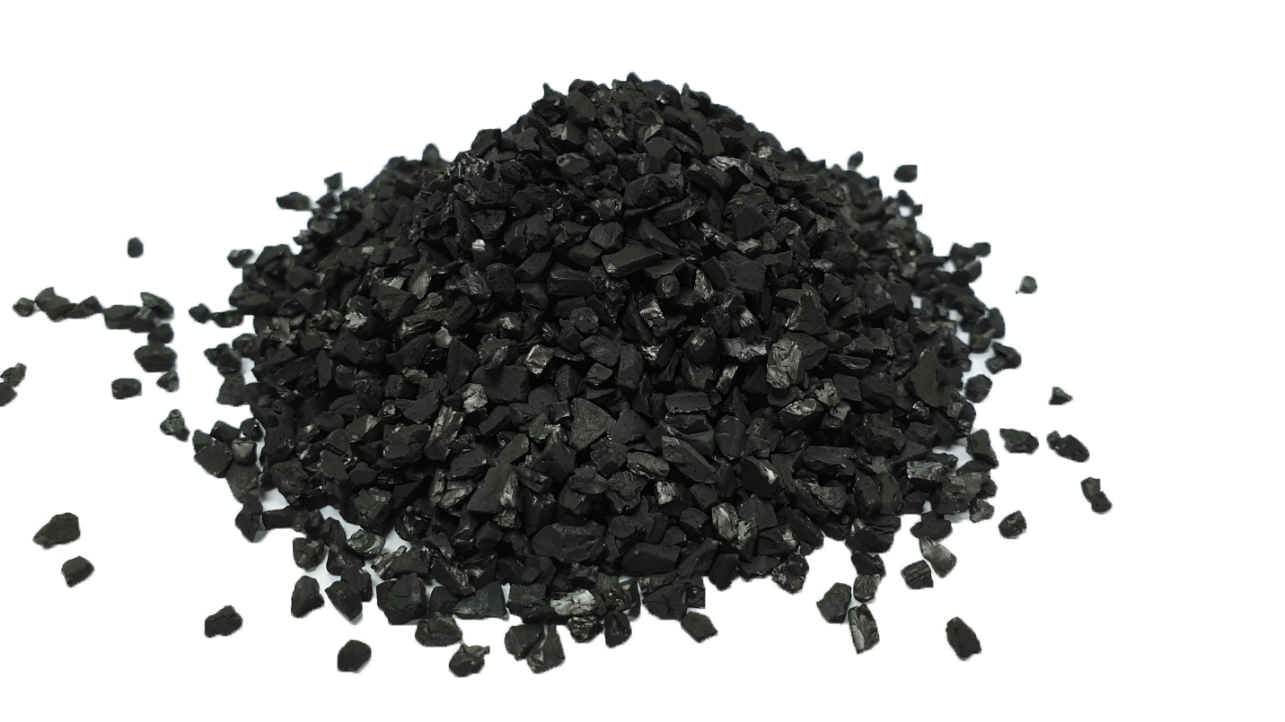
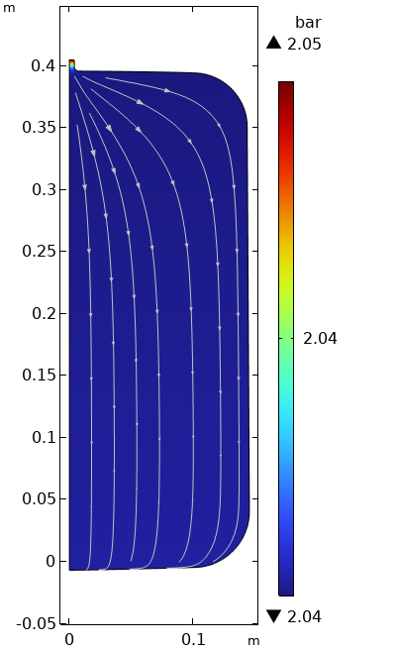
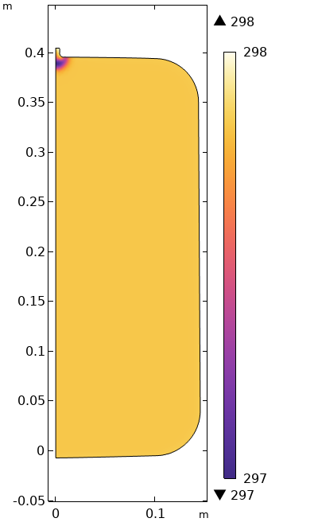
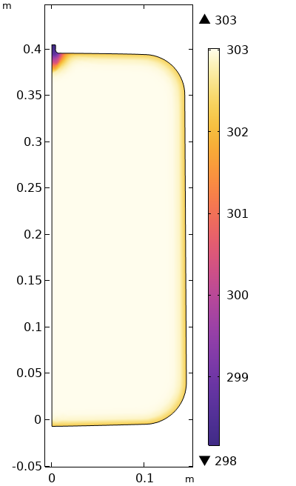
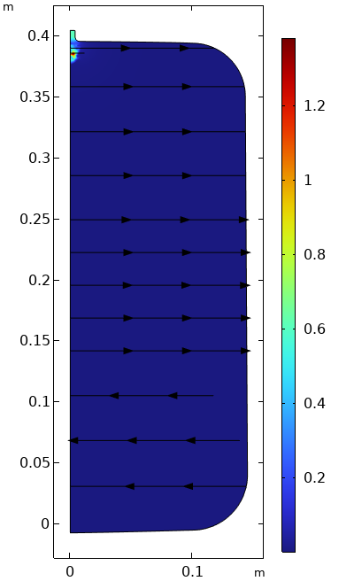



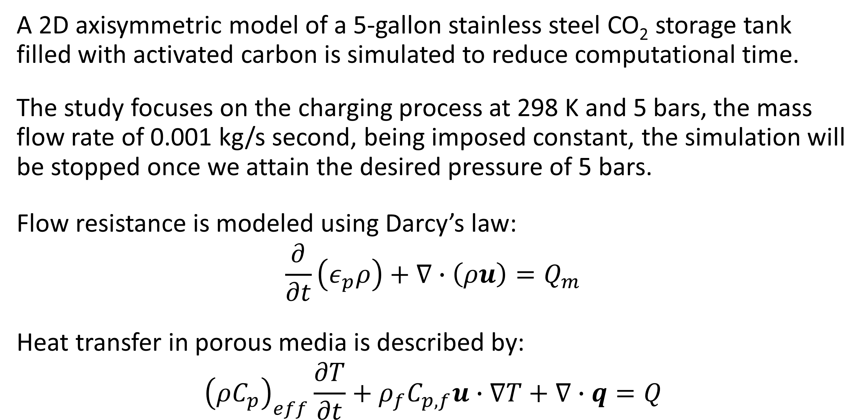
Simulation of Mass and Heat Transfer in Active Carbon CO₂ Storage Tank During the Charging Process
Enhance CO₂ gas storage, in activated carbon tanks, by understanding the dynamics of heat and mass transfer in porous media.
R. Ghawche^{1,2}, C. Lacroix², D. Grekov², S. Poncet¹, P. Pré²
1. Mechanical Engineering Dpt, Université de Sherbrooke, Sherbrooke, Canada
2. DSEE, IMT Atlantique, Nantes, France
Introduction
The intermittency of renewable energy has emphasized the need for advanced energy storage solutions. Compressed air energy storage (CAES) is one such method, where excess electricity compresses air for later use in turbines¹.
Recent research explores using CO₂ instead of air, as its critical point is closer to ambient temperature, easing condensation at high pressures, but requiring storage post-turbine discharge². To tackle CO₂ gas-phase storage, we are investigating porous materials called adsorbents. These materials increase CO₂ density, enabling more compact storage. However, adsorption is a dynamic phenomenon, where the heat of adsorption and the heating required for releasing the adsorbed gas will influence the heat and mass transfer in the system beyond normal tank discharge³.
This is why the effect of heat and mass transfer phenomena within a CO₂ storage tank filled with activated carbon on the adsorption dynamics is being modeled.
Methodology
A 2D axisymmetric model of a 5-gallon stainless steel CO₂ storage tank filled with activated carbon is simulated to reduce computational time.
The study focuses on the charging process at 298 K and 5 bars, the mass flow rate of 0.001 kg/s second, being imposed constant, the simulation will be stopped once we attain the desired pressure of 5 bars.
Flow resistance is modeled using Darcy’s law:
$$\frac{∂}{∂t}\left(ε_{p}ρ\right)+∇∙\left(ρu\right)=Q_{m}$$
Heat transfer in porous media is described by:
$${\left(ρC_{p}\right)}_{eff}\frac{∂T}{∂t}+ρ_{f}C_{p,f}u∙∇T+∇∙q=Q$$
FIGURE 1. Left: Active carbons particles. Right: Drawing of the simulated tank.
Results
K
K
m/s
A PDE-based finite element model was implemented and solved to analyze the pressure, temperature, and velocity distributions within the tank. Figure 2 illustrates the findings. In (a), the pressure distribution is mostly uniform, with slight variations near the reservoir inlet. The temperature distribution in (b) and (c) shows an increase due to the heat of adsorption and compression, with noticeable variations at the tank extremities caused by heat dissipation. The velocity profile in (d) at the end of charge reveals minor variations near the inlet. These results provide valuable insights into the mass and heat transfer processes within the tank. Further simulations, incorporating time-dependent parameter variations and advanced adsorption modeling, will be essential for improving the accuracy of the simulations.
(a)
(b)
(c)
(d)
FIGURE 2. Distribution within the tank of (a) pressure at 60 s, (b) temperature at 60 s, (c) temperature at 400 s, and (d) velocity at 400 s.
M. Cheayb, M.M. Gallego, S. Poncet, M. Tazerout, “Micro-scale trigenerative compressed air energy storage system: Modeling and parametric optimization study”, Energy Storage, vol. 26, 100944, 2019.
F. Dewevre, C. Lacroix, K. Loubar, S. Poncet, “Carbon dioxide energy storage systems: Current researches and perspectives”, Renewable Energy, vol. 224, 120030, 2024.
J. Xiao, Y. Liu, J. Wang, P. Bénard, R. Chahine, "Finite element simulation of heat and mass transfer in activated carbon hydrogen storage tank", International Journal of Heat and Mass Transfer, vol. 55, pp. 6864-6872, 2012.

