Slide 1
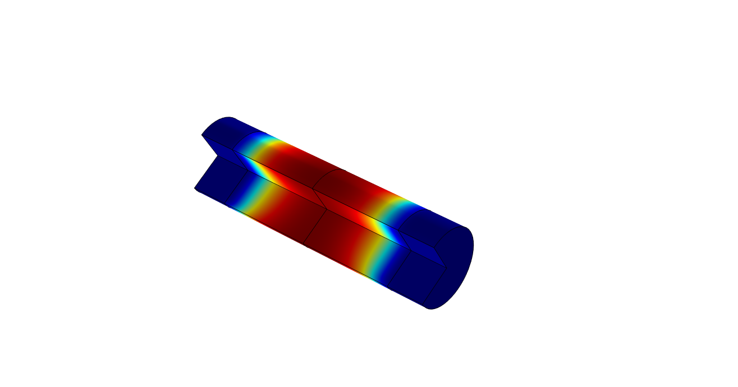
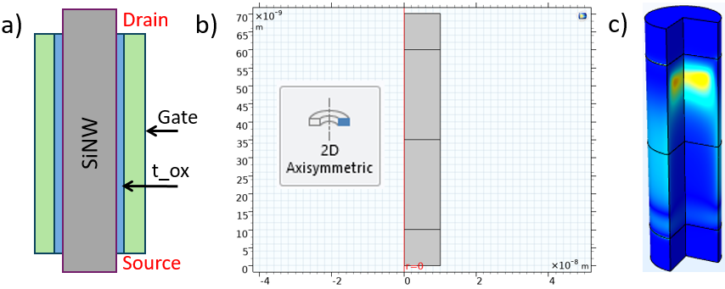
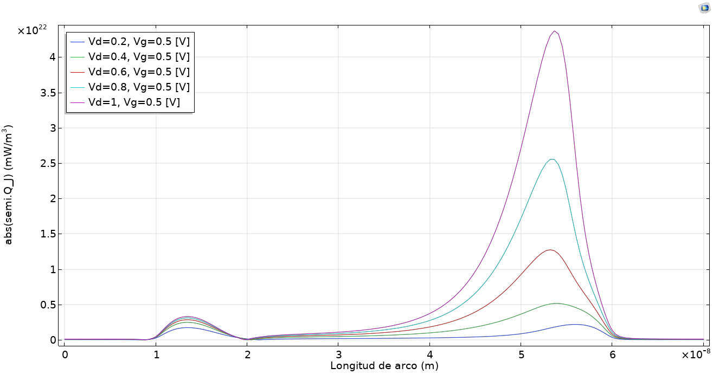

Self-heating effect in silicon nanowires field-effect transistors (SiNWT)
Self-heating effect in SiNWT may lead to a substantial increase in the effective operating temperature of the device, which degrades the device electrical performance and affects device reliability.
D. Caina¹
1. Facultad de Ciencias, Universidad Central del Ecuador, Quito, Ecuador
Abstract
The scaling of the technology to dimensions below ~45 nm, where short channel effects start to become significant, has required significant changes to the simple planar two-dimensional (2D) metal-oxide-semiconductor field-effect transistor (MOSFET). Nanowire Field-Effect Transistors are being investigated to solve short-channel effects (SCE) in future MOSFET technology. Silicon Nanowire Field-Effect Transistor (SiNWT) has attracted broad attention among them.
There are more and more devices per unit area, which results into increasing large amounts of heat generated per unit volume. Self-heating may lead to a substantial increase in the effective operating temperature of the device, which degrades the device electrical performance and affects device reliability. The present project aims to localize the hot spot in the SiNWT, and to plot the distribution of the heat in the channel of it.
Methodology
The schematic illustration and geometry of the SiNWT being simulated in this project is illustrated in Figure 1(a)(b). We used an axisymmetric geometry for defining the parameters in COMSOL, but the simulation results are computed for 3D dimensions. The gate, source and drain contacts are considered like electrodes, according the available boundary conditions in COMSOL.
The schematic view in 3D of SiMWT is illustrated in Figure 1(c), where the hot spot is located close to the drain side of the device.
FIGURE 1. (a) Schematic of SiNWT elements. (b) Geometry for COMSOL simulation. (c) 3D view of the simulated SiNWT and place where the hot spot is located.
Results
The location of the hot spot in the SiNWT was determined and showed by plotting the distribution of the heat in the channel with respect to the geometrical parameters of the SiNWT as depicted in Figure 2. The graphic shows high values at the drain side, where the hot spot is located.
The self-heating effect in SiNWT is due to the low thermal conductivity of the silicon at nanoscale. Thus, the heat inside the channel cannot dissipate easily.
Other results show that the diameter of SiNWTs is an important factor that influence the self-heating effect. For instance, the 8 nm radius has more heat in the channel than the one with 12 nm.
FIGURE 2. Distribution of the heat in the SiNWT channel, where the hot spot is located close to the drain side.
R. Wang, J. Zhuge, R. Huang, D. Kim, D. Park, and Y. Wang, "Investigation on Self-Heating Effect in Gate-All-Around Silicon Nanowire MOSFETs From Top-Down Approach", IEEE Electron Device Lett., vol. 30, no. 5, pp. 559–561, May 2009.
D. Vasileska, A. Hossain, K. Raleva, and S. M. Goodnick, "The role of the source and drain contacts on self-heating effect in nanowire transistors", J. Comput. Electron., vol. 9, no. 3–4, pp. 180–186, Dec. 2010.
C. Jeon et al., “Joule Heating to Enhance the Performance of a Gate-All-Around Silicon Nanowire Transistor”, IEEE Trans. Electron Devices, vol. 63, no. 6, pp. 2288–2292, Jun. 2016.

