Slide 1
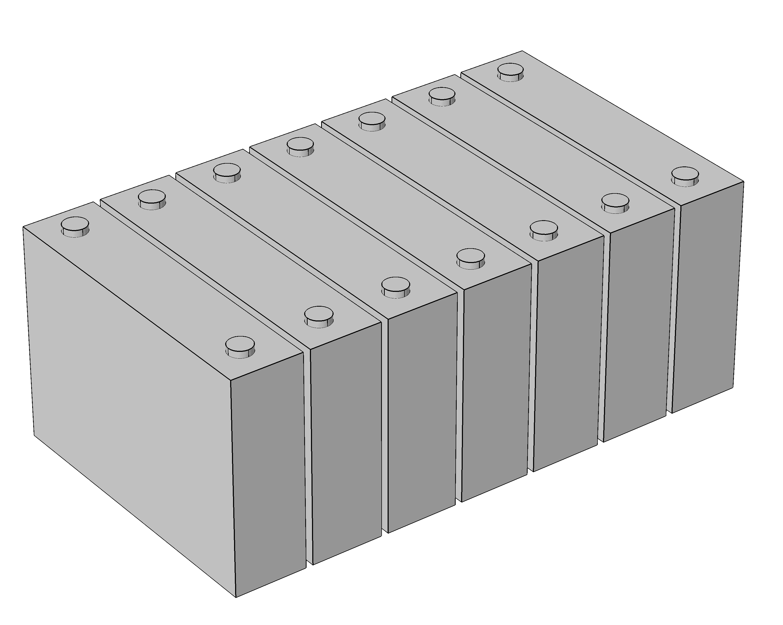
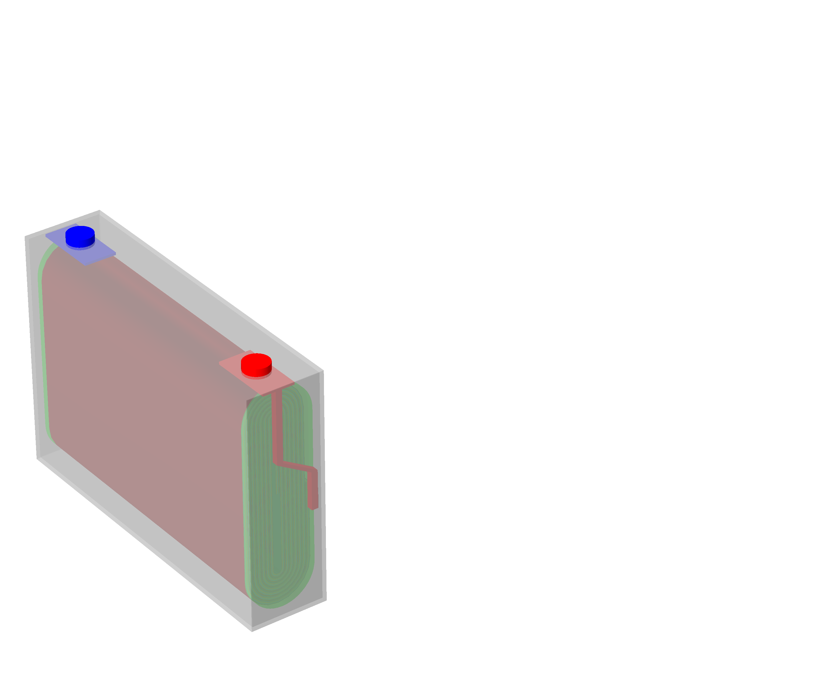
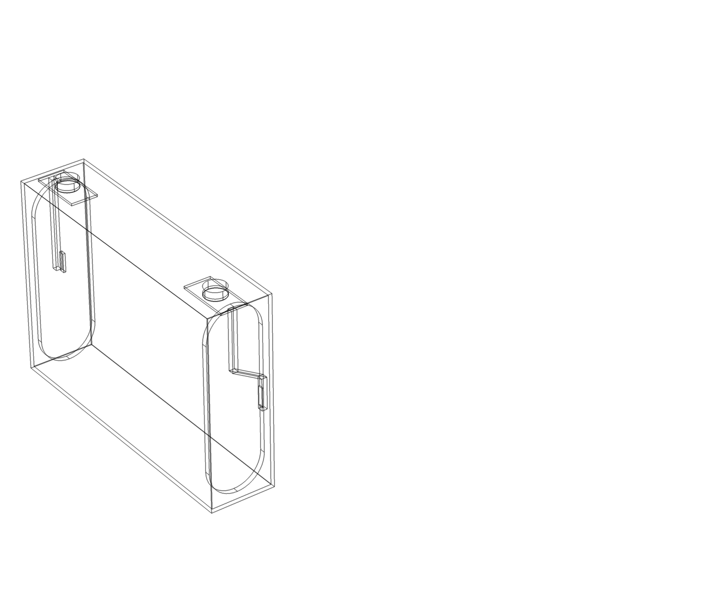
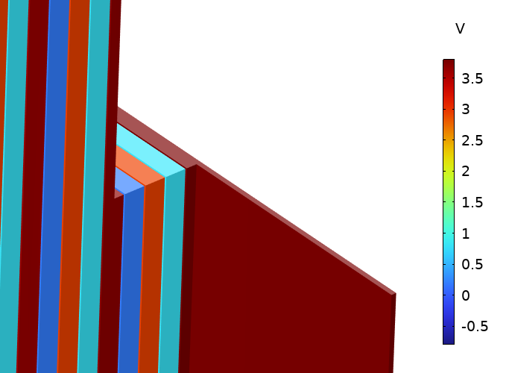

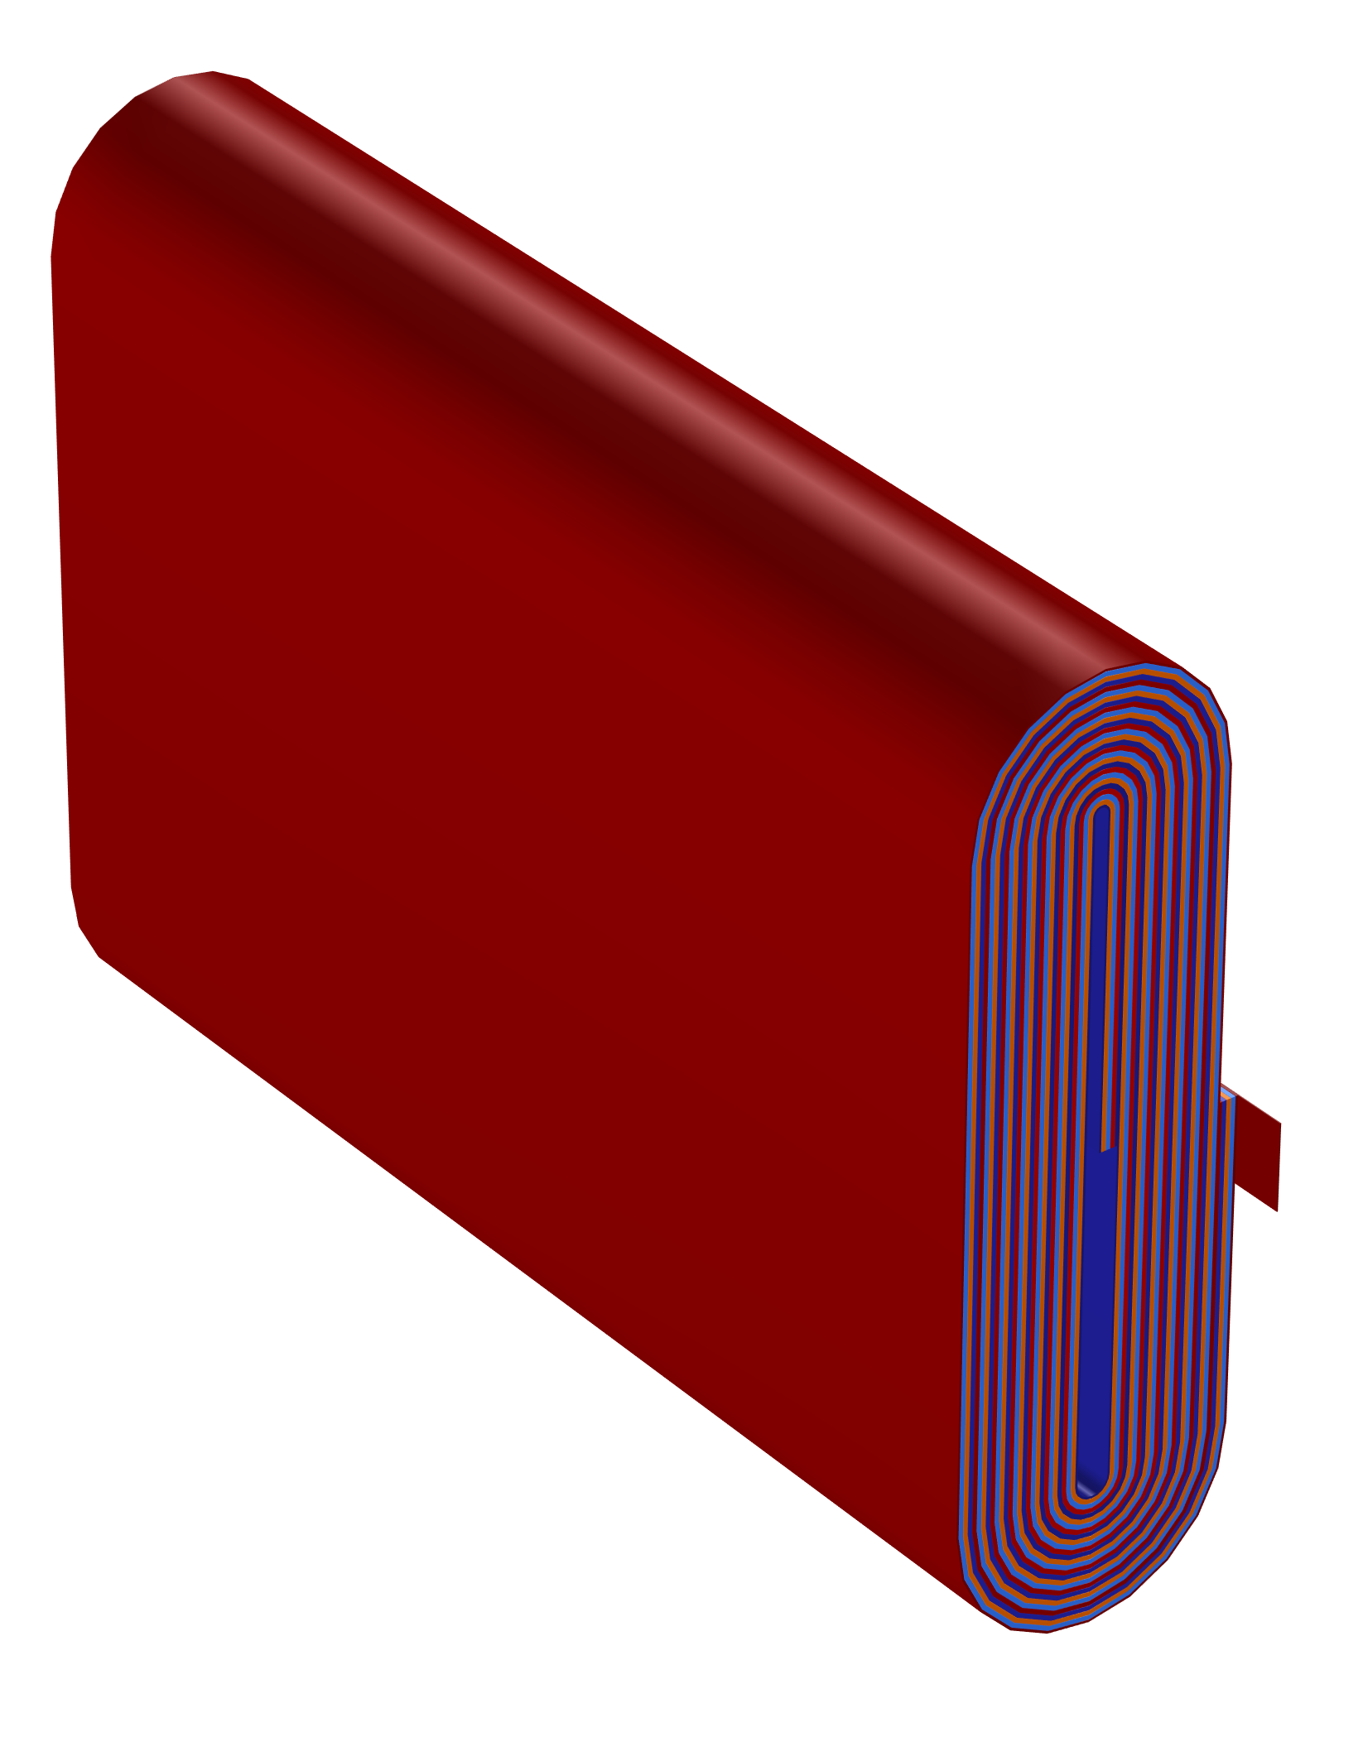
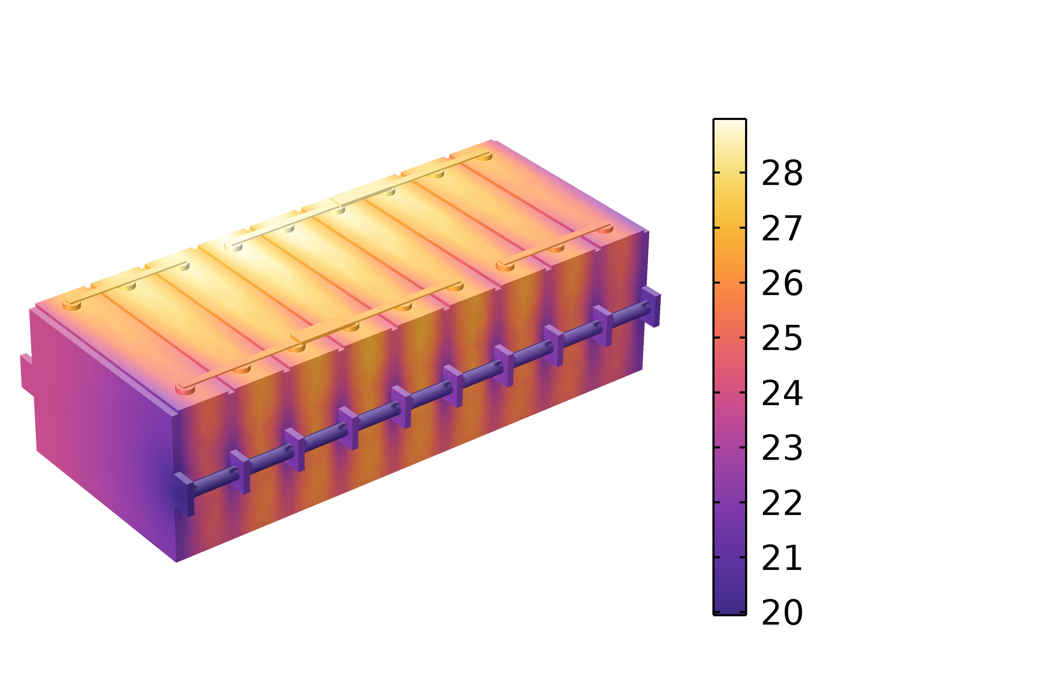
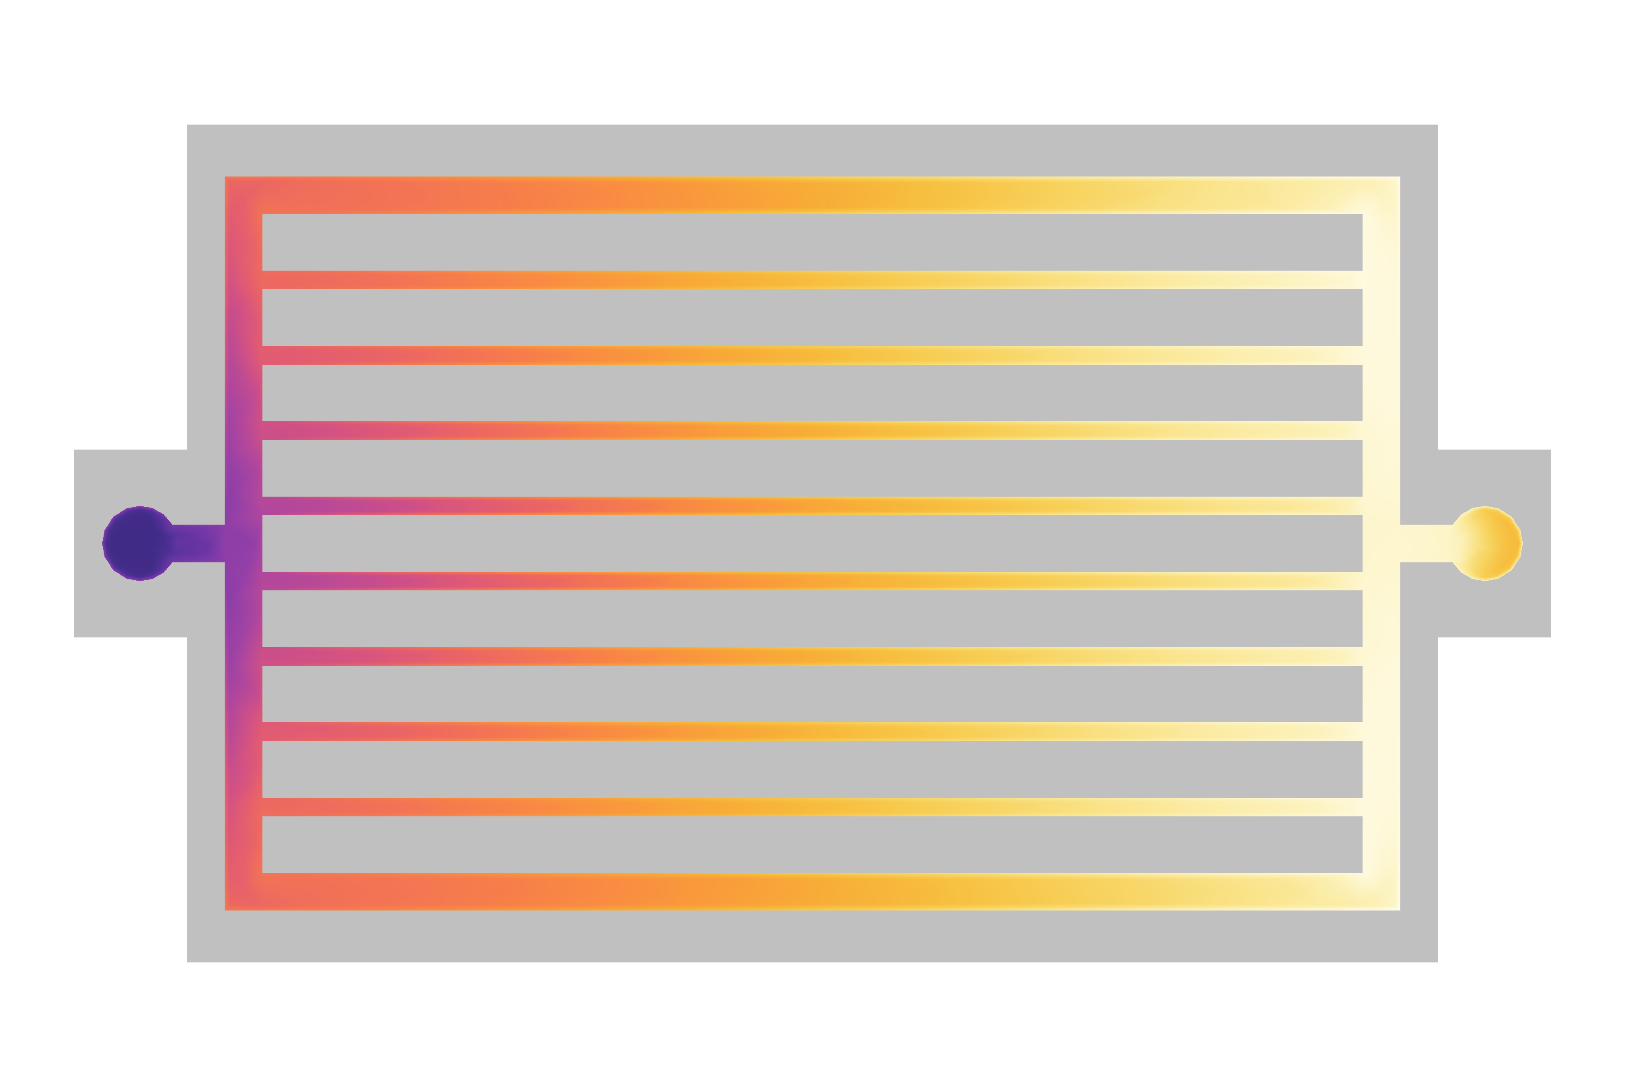
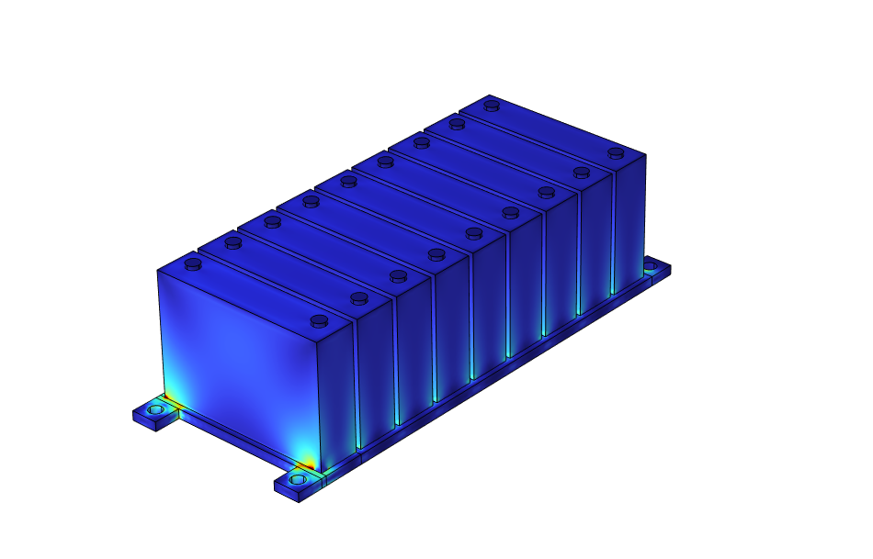
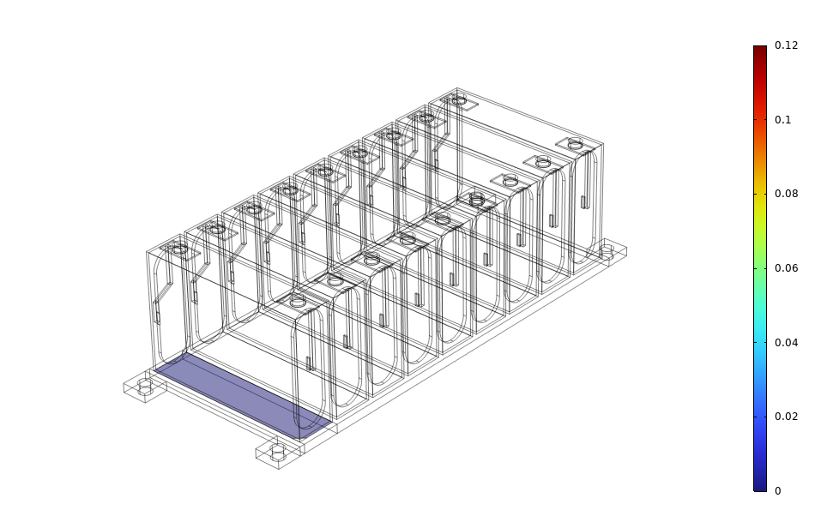
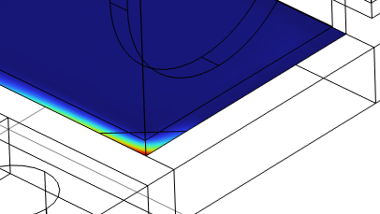


Multiphysics Simulation of Battery Cells and Packs for Electric Vehicles
Battery Pack
Voltage
Prediction of electrochemical, thermal, and mechanical response using COMSOL Multiphysics® can inform design and operating parameters to maximize lifetime and performance of battery systems.
Battery Cell
Joseph Barakat, Ph.D. jbarakat@veryst.com Veryst Engineering
Mark Oliver, Ph.D. moliver@veryst.com Needham, MA, USA
Matthew Hancock, Ph.D. mhancock@veryst.com
Introduction
Automotive companies striving to commercialize new battery technologies must solve various electrochemical, thermal, and mechanical challenges to meet safety, cost, and performance targets. Multiphysics simulation of battery cells and packs can help meet these challenges and, in so doing, provide insight into battery life and performance over a range of operating conditions.
Veryst used the Battery Design, CFD, Heat Transfer, and Structural Mechanics modules in COMSOL Multiphysics® to simulate various physical phenomena in battery cells and packs:
voltage response in hybrid pulse power characterization test ¹,
thermal management via liquid-cooled cold plates²,
adhesive stress and delamination under cyclic loading.
Warm
Fluid Out
Methodology
A multiphysics model of a lithium-ion battery pack consisting of multiple prismatic cells was developed for analysis using the Li-ion Battery interface. A single cell was subjected to a sequence of charge-discharge pulses to evaluate lifetime performance over the range of the battery’s useable capacity and to calibrate a Lumped Battery model using a Parameter Estimation study. This reduced-order model was used in conjunction with the Electrochemical Heating coupling feature to simulate the temperature distribution in a pack of connected cells (FIGURE 1). Heat generated by the cells was dissipated by liquid pumped through parallel fluidic channels in separating cold plates. Finally, the Solid Mechanics interface was used to predict stresses in a thermally conductive adhesive bonding the pack to a base cold plate under cyclic, torsional loading (FIGURE 2). Such load cycles, commonly encountered during service, can lead to fatigue debonding.
Temperature (°C)
Cool
Fluid In
FIGURE 1. Heat transfer simulations of a liquid-cooled battery pack reveals impact of coolant flow on temperature uniformity.
Results
Normal Stress
Lifetime performance simulations over 13 physical hours predicted that the internal resistances within the cell are dominated by activation polarization and ohmic losses, with little resistance to lithium-ion mass transfer. Thermal management simulations predicted that liquid flow rates of 500 ml/min were necessary to maintain a maximum battery temperature below 26°C. Adhesive stress analysis revealed that stress concentration at the corner of the pack can lead to delamination from the base plate after many load cycles. Simulations such as these can predict how changes in battery cell loading, pack configuration, thermal management system, and adhesive material selection would impact performance and life behavior during operation in electric vehicles.
Torsional Loading
FIGURE 2. Adhesive stress analysis reveals stress concentration near the corner of a battery pack under cyclic, torsional loading.
Christophersen, J. P. Battery Test Manual for Electric Vehicles (Rev. 3). Idaho National Laboratory. 2015. https://www.osti.gov/biblio/1186745
Xu, J., Chen, Z., Qin, J., & Minqiang, P. Appl. Therm. Eng. 203, 117871. 2022. https://doi.org/10.1016/j.applthermaleng.2021.117871

