Slide 1

Multiphysics Simulation of Battery Cells and Packs for Electric Vehicles
Joseph M. Barakat, Mark S. Oliver & Matthew J. Hancock
Veryst Engineering LLC, Needham, MA, USA
 jbarakat@veryst.com  www.veryst.com
COMSOL Conference 2024, Boston, MA, USA

Slide 2

Simulation for EV Battery Development
New battery technologies must satisfy certain targets prior to commercialization:
  Safety
  Cost
  Performance
Multiphysics simulation can help solve various challenges to meet these targets:
  Electrochemical
  Thermal
  Mechanical

Slide 3
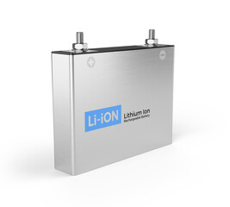
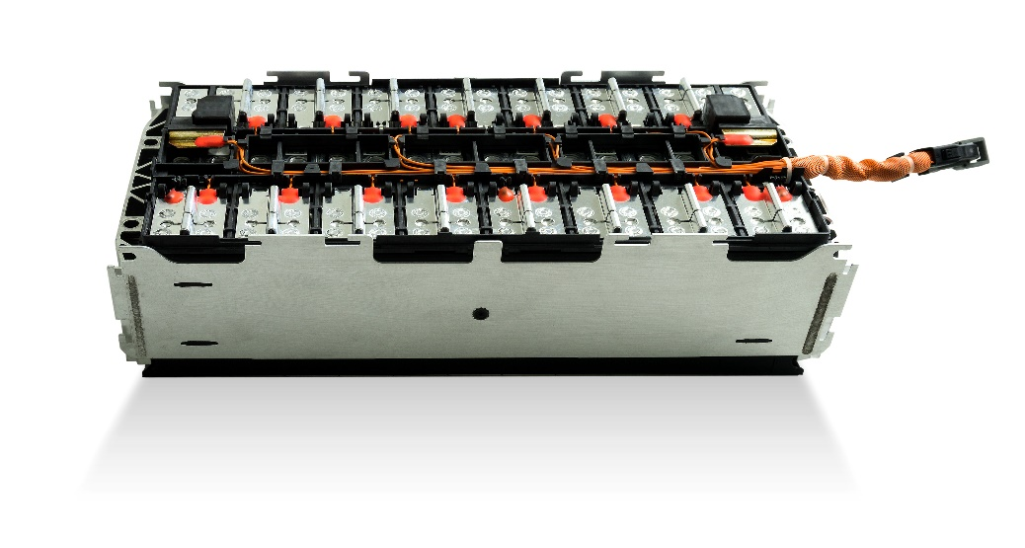
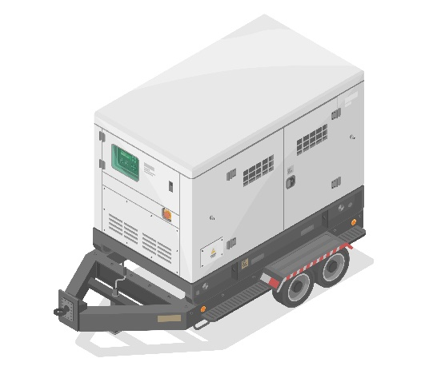
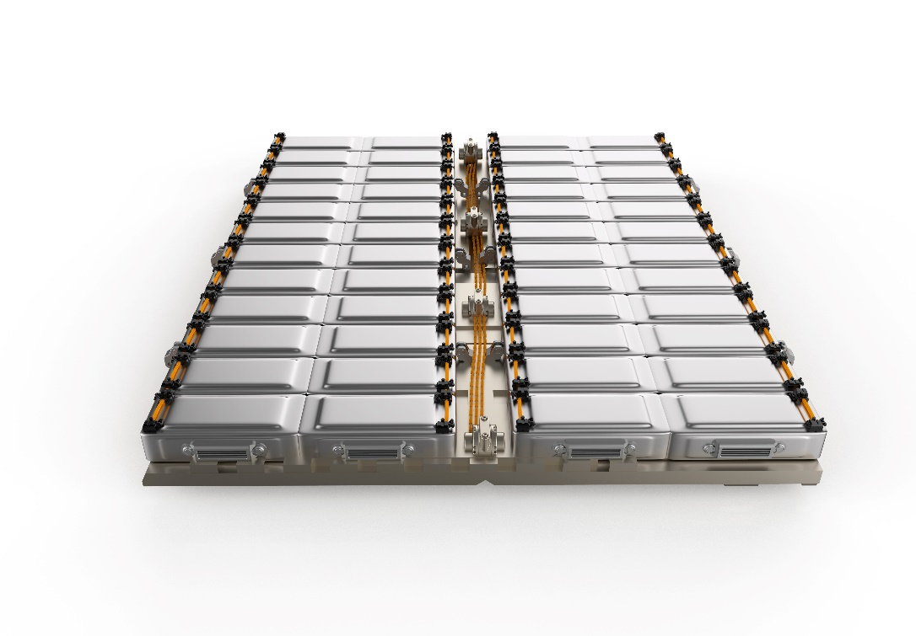

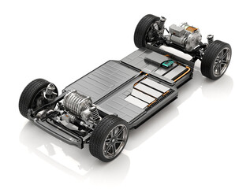
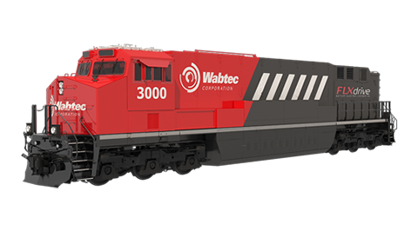
Increasing Battery System Performance
Cell-to-Module
Cell-to-Pack
Mobile Power
Cell-to-Chassis
Cell-to-Vehicle
Cell
Module
Vehicle
Innovation Drivers:
  Lower Cost
  Lower Weight
  Simpler Manufacturing
  Higher Energy Density
  Smaller Form Factor
Pack
Aircraft
Automotive
Rail

Slide 4



Multiphysics Challenges in Battery Systems
 | Electro- chemical | Thermal | Mechanical
Cell Level | Voltage losses Capacity fade and aging Lifetime performance | Heat dissipation | Volume expansion Internal stresses Delamination and cracking
Module Level | Cell-to-cell state of charge variability Voltage imbalances | Cell-to-cell temperature uniformity Cooling efficiency | Compact form factor Thermal stresses Aging and degradation
Pack Level | State of charge estimation Over-discharge | Module-to-module temperature uniformity Safety and thermal management | Lightweighting Structural adhesives Structural durability
Li+

Slide 5
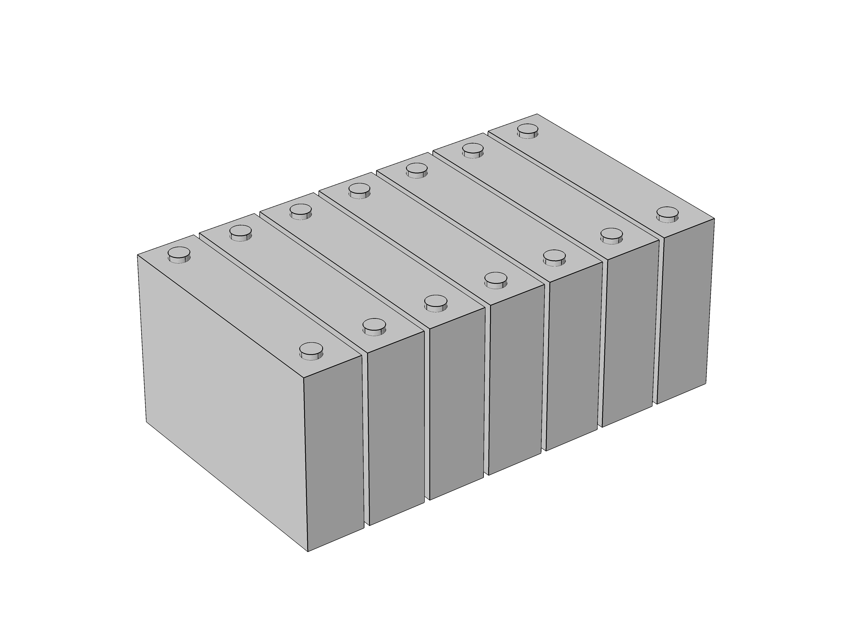
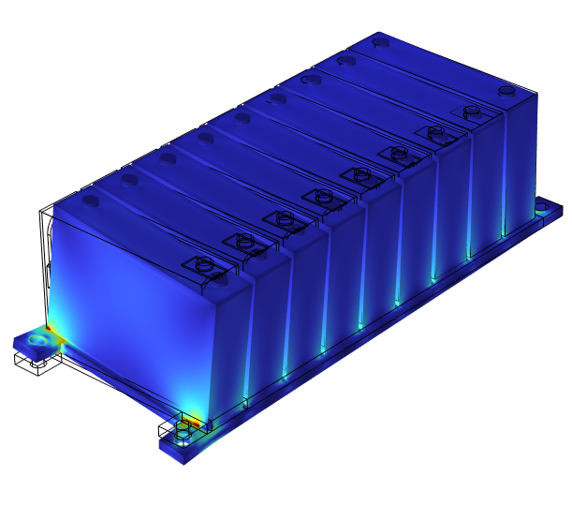
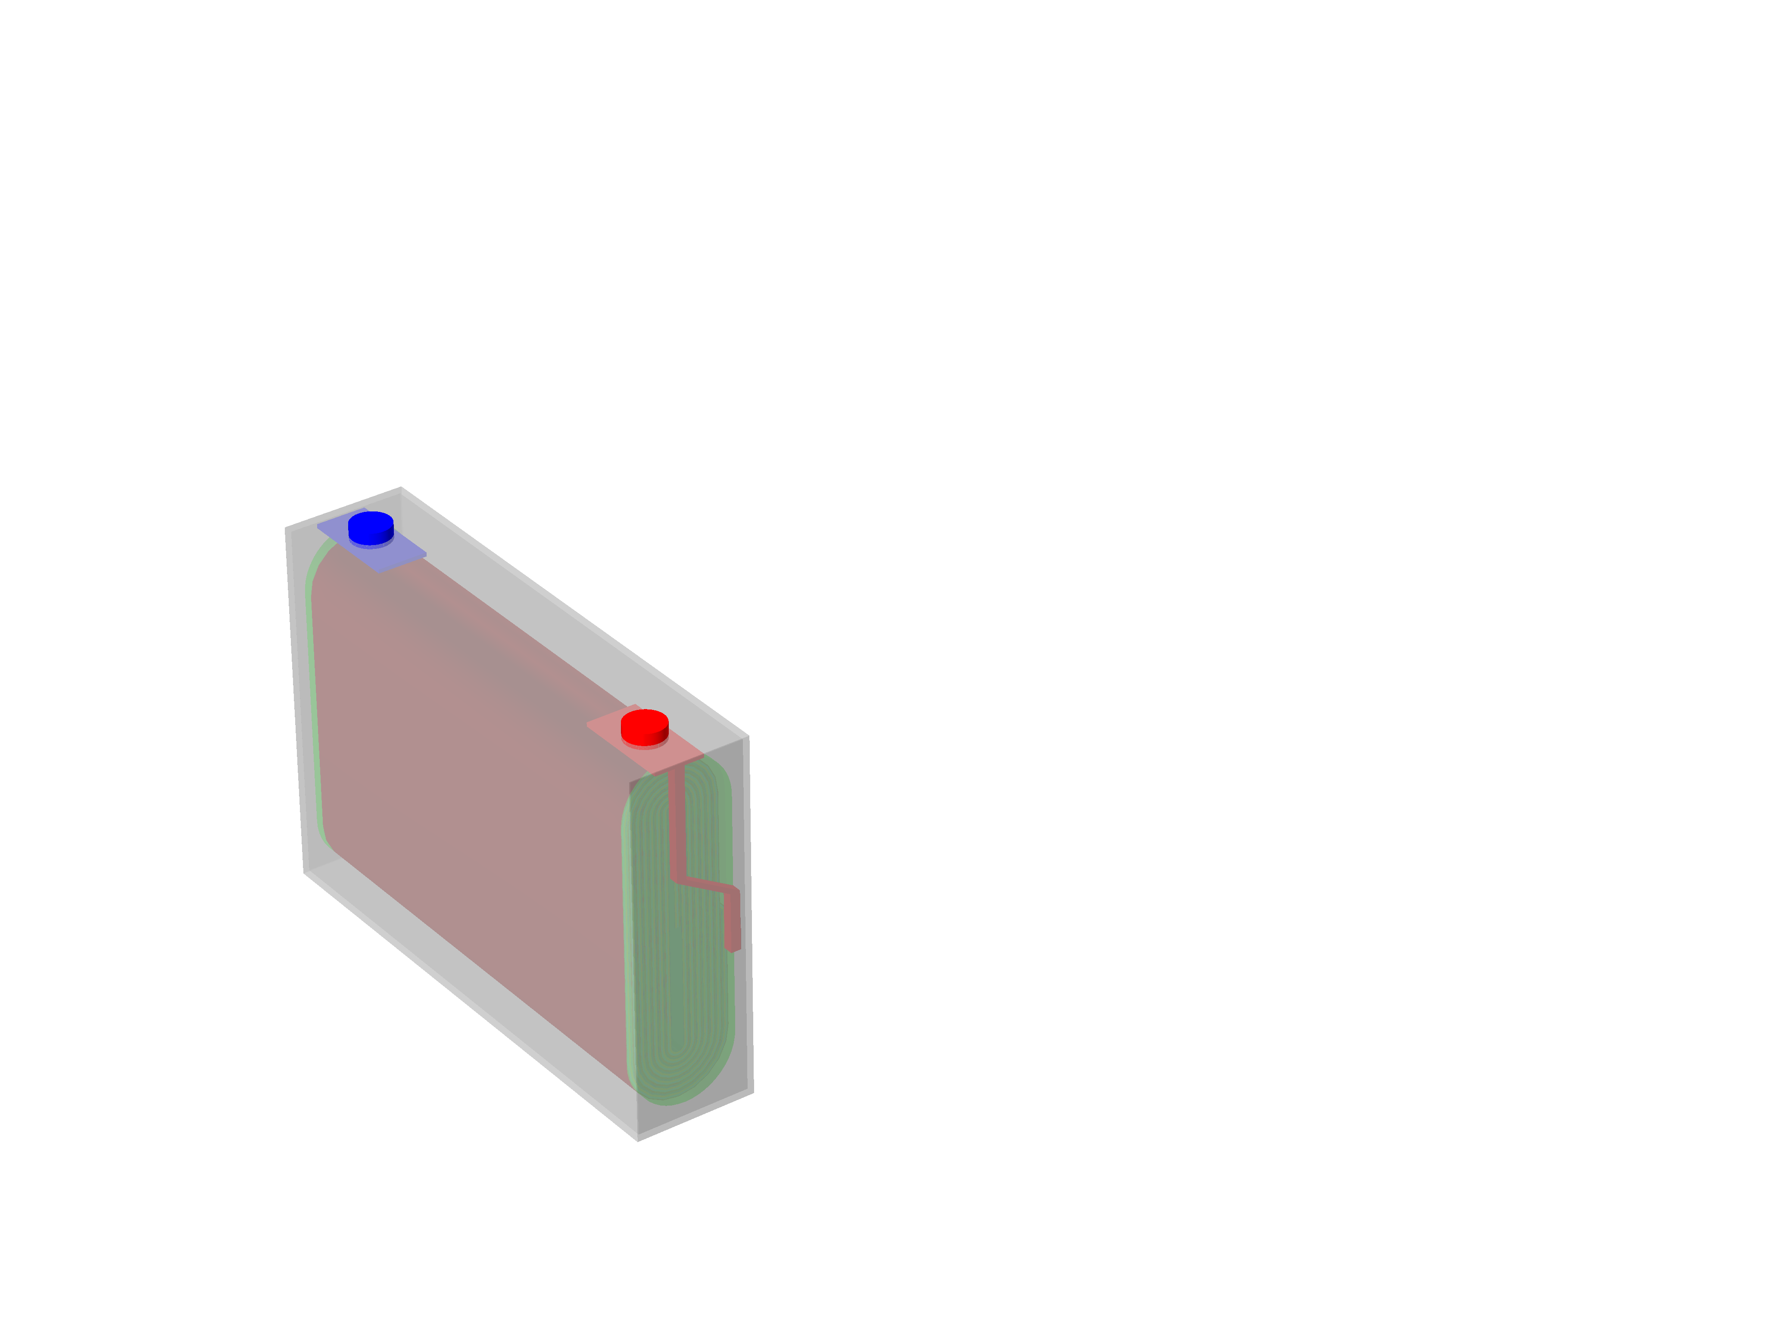
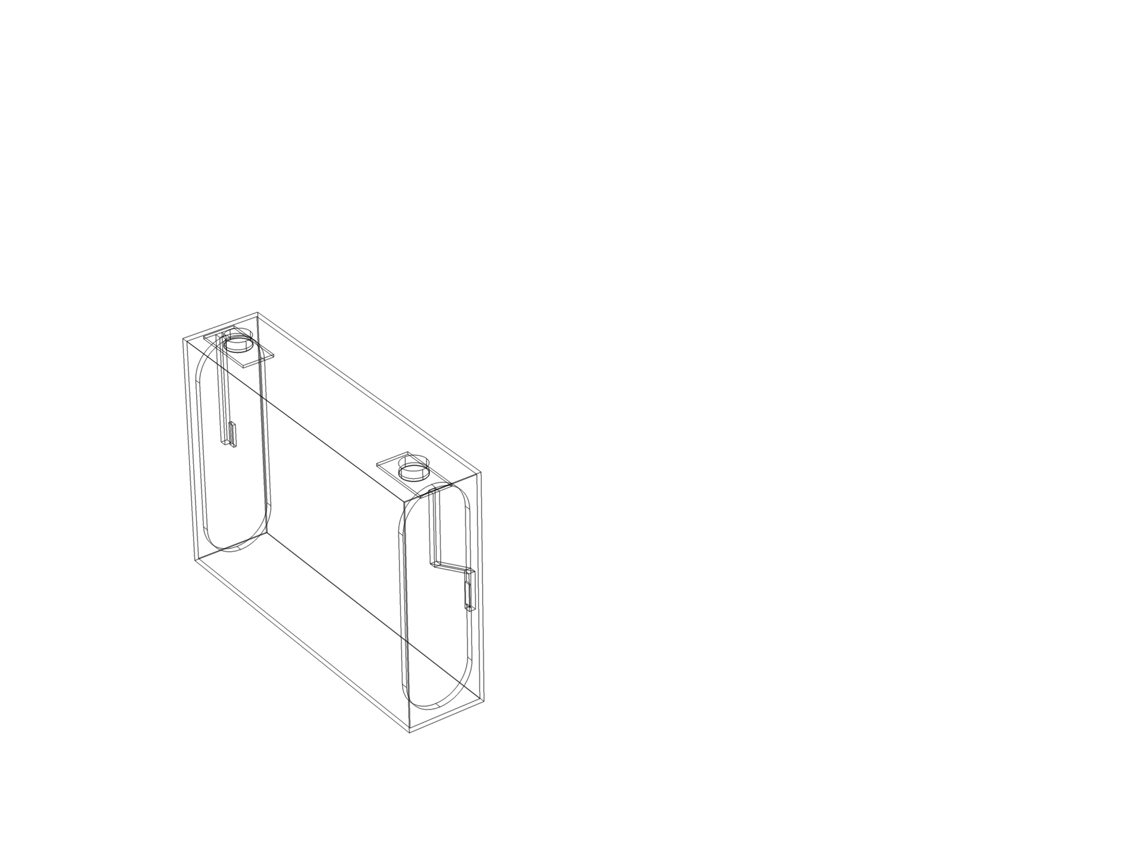
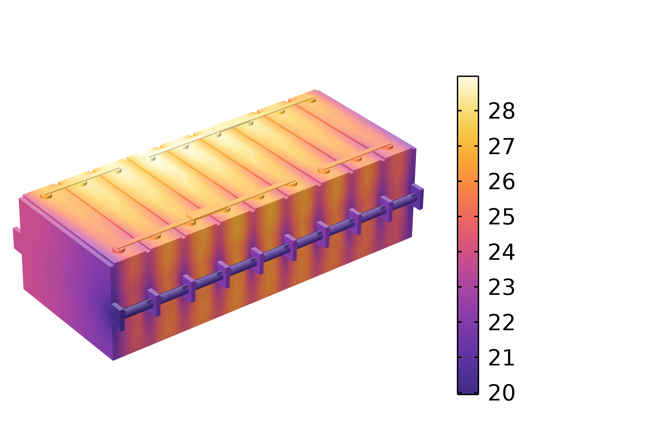
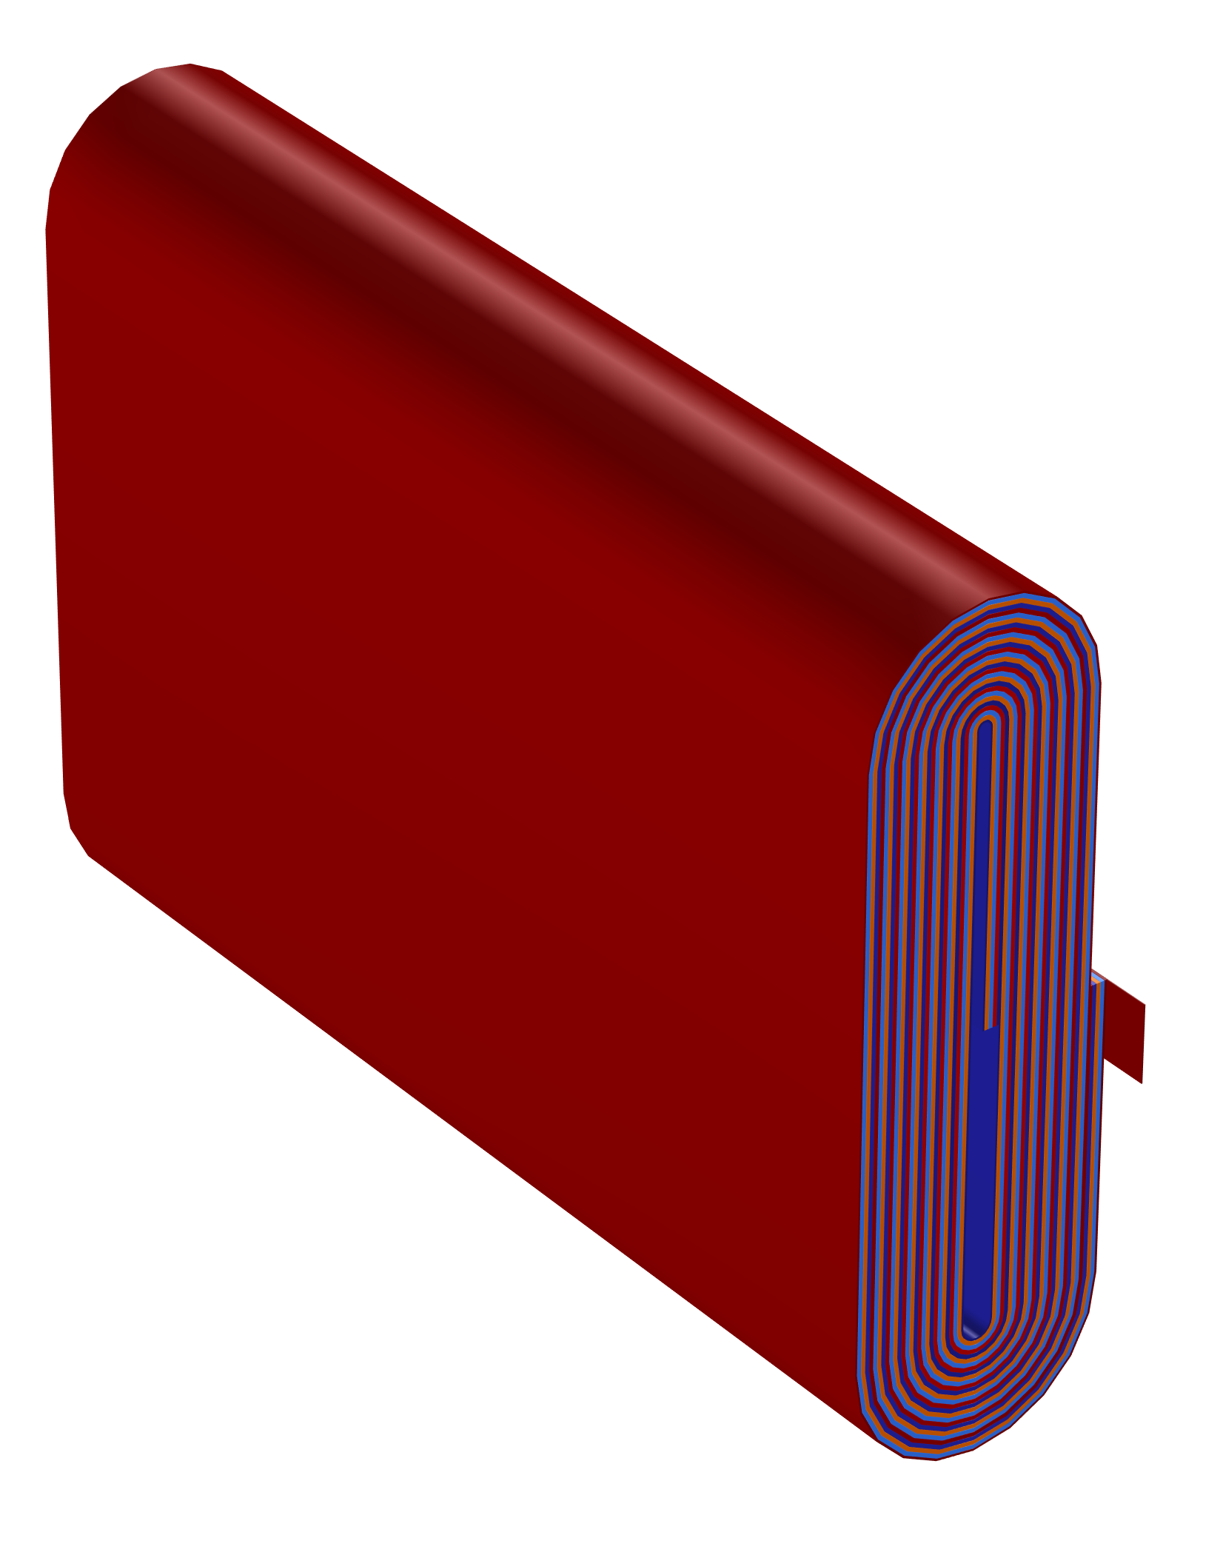
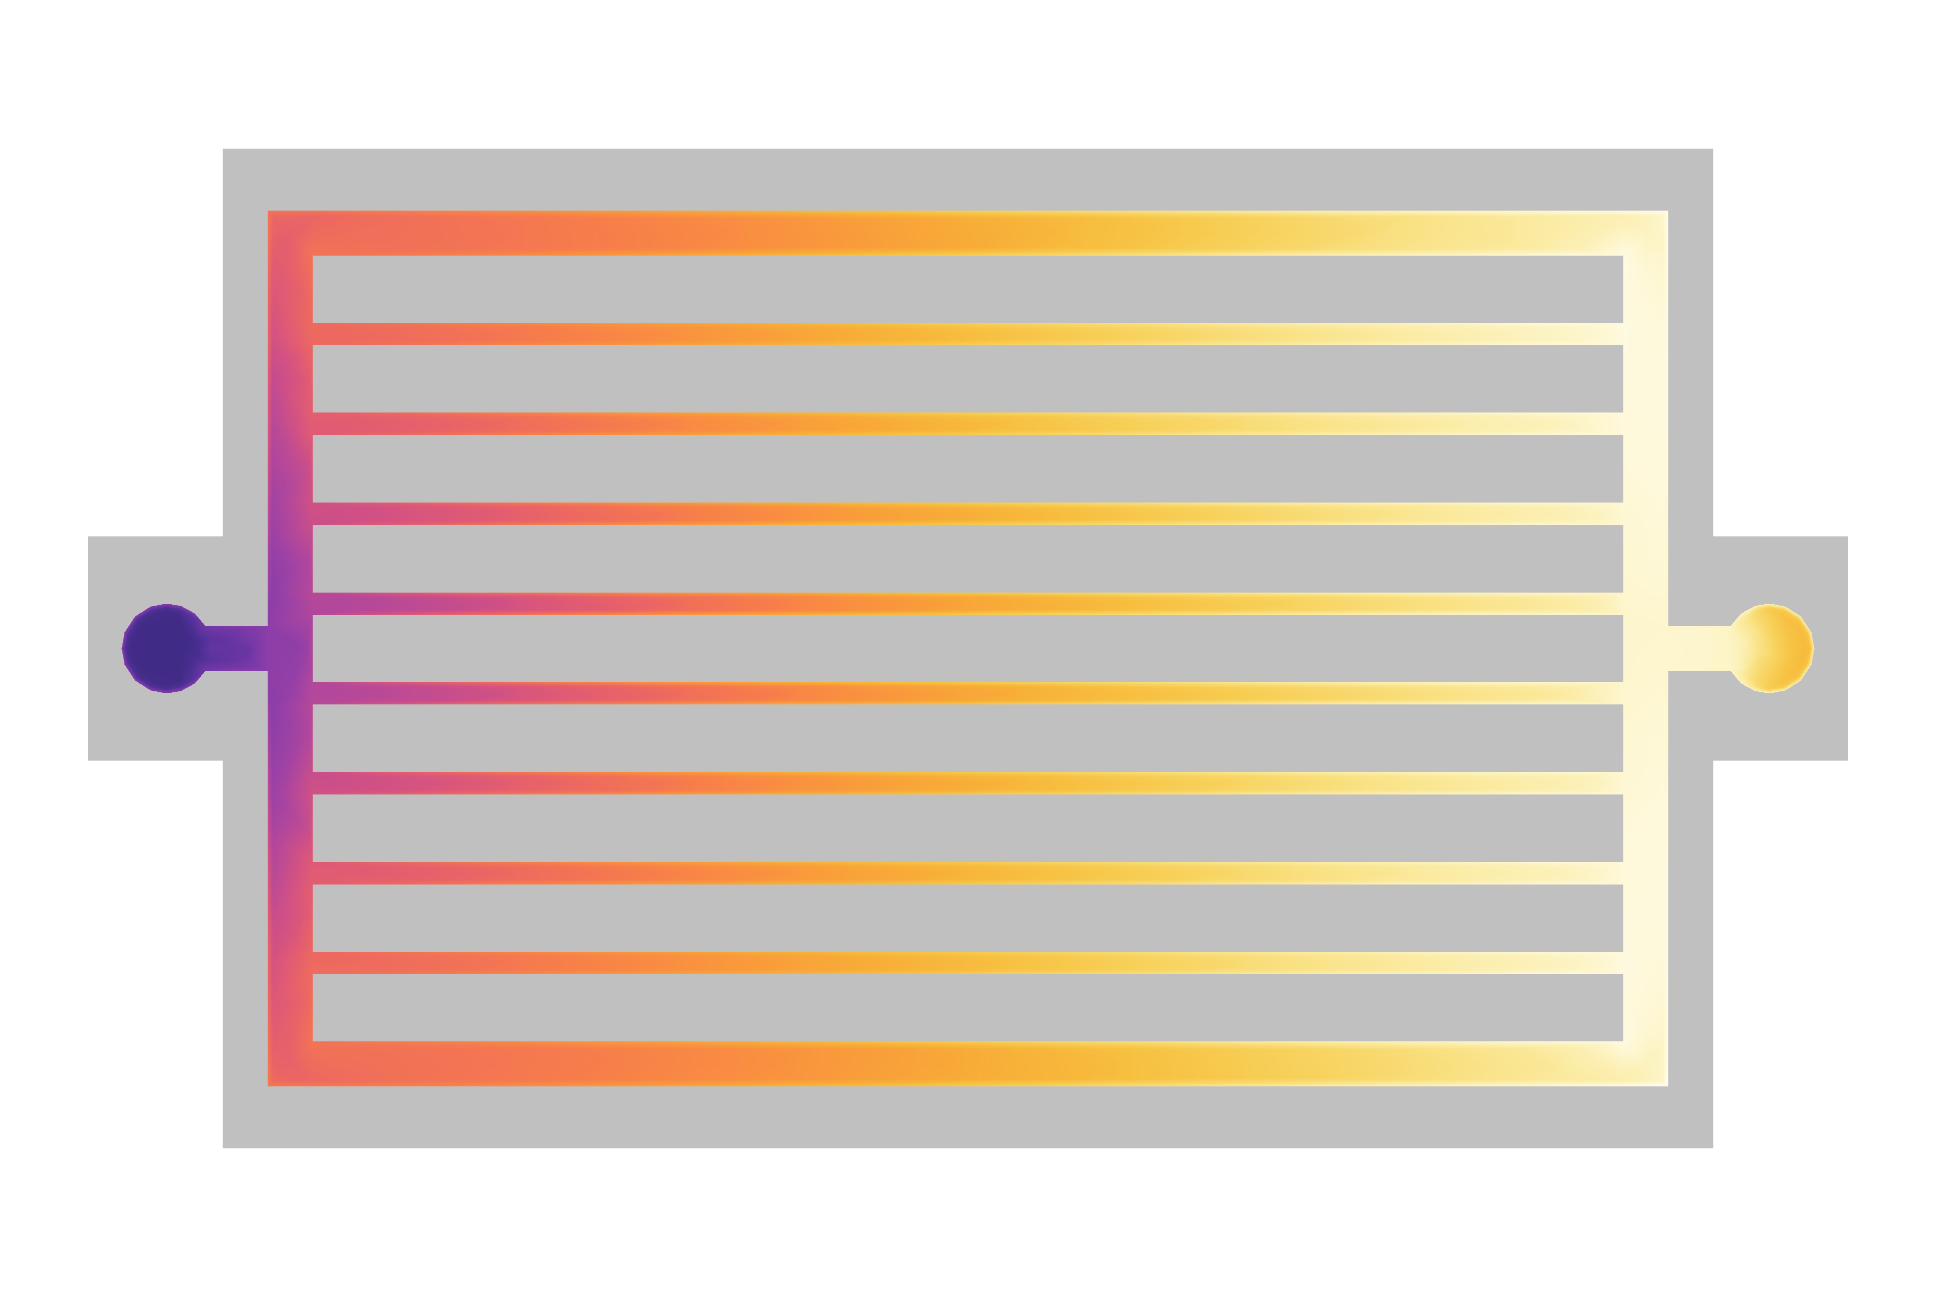
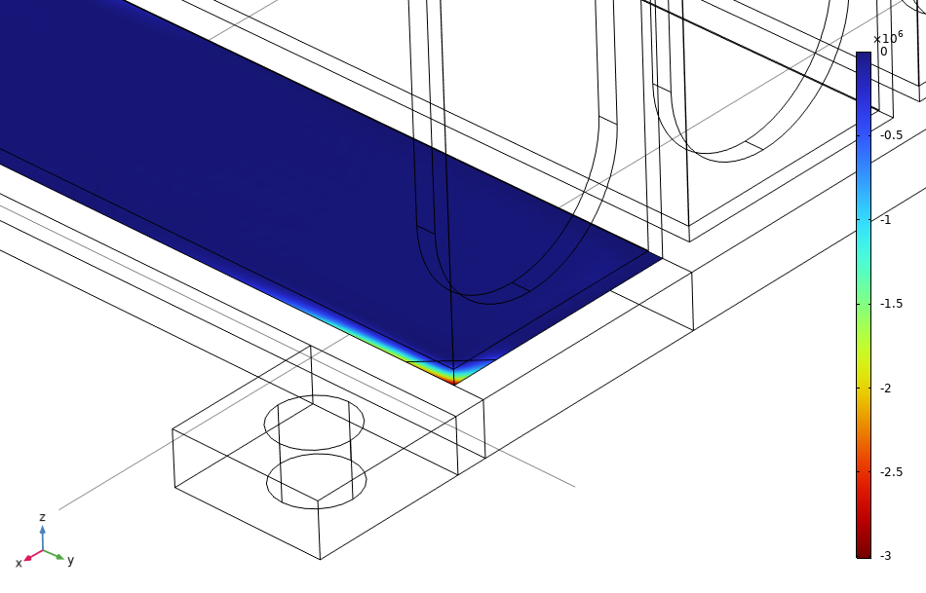
COMSOL Multiphysics® Simulations
I think
Lifetime Performance
Thermal Management
Structural Durability
Li+

Slide 6
COMSOL Multiphysics® Simulations
Lifetime Performance
Thermal Management
Structural Durability
Li+

Slide 7
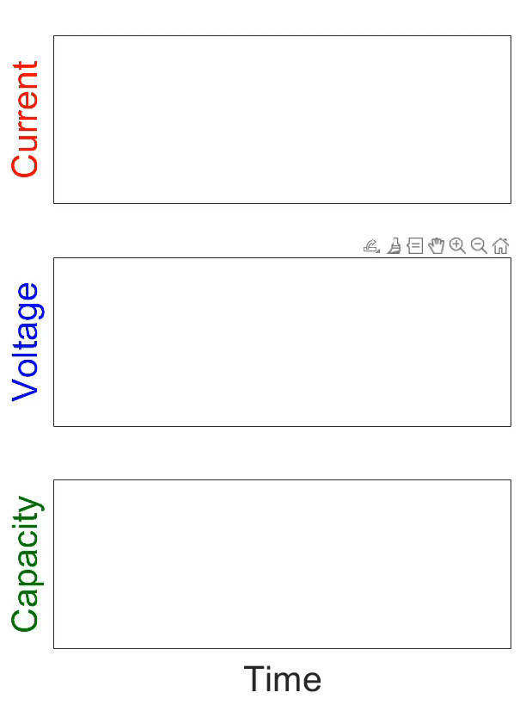
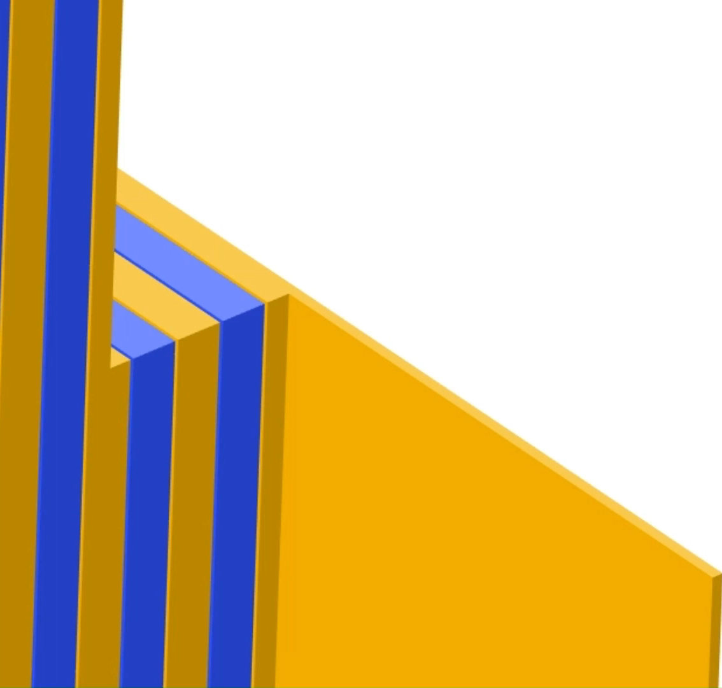
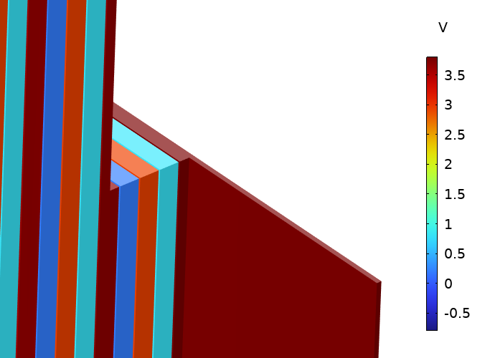
Simulating the Hybrid Pulse Power Characterization (HPPC) Test
Li+
HPPC test = sequence of charge + discharge pulses to measure battery’s life performance.
Veryst simulated cell voltage response over 13 hours (simulation time << experimental time).
Voltage
V
4
0

Slide 8
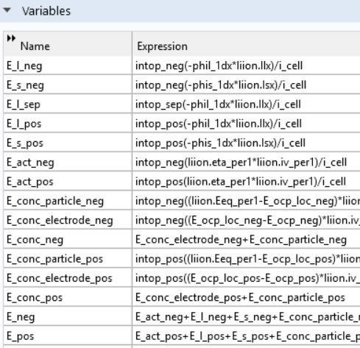
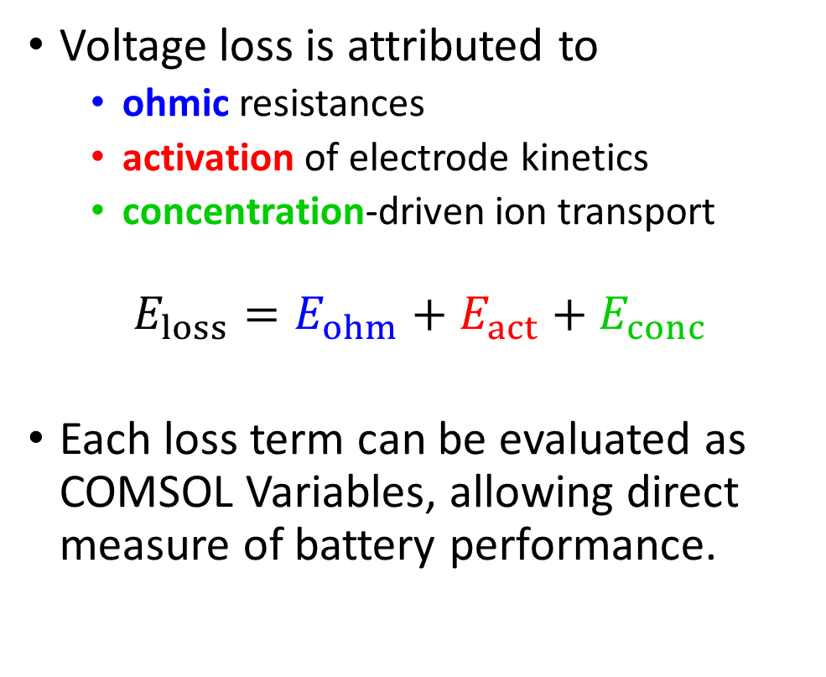
Direct Calculation of Voltage Losses
Li+
Voltage loss is attributed to
  ohmic resistances
  activation of electrode kinetics
  concentration-driven ion transport
$$E_{loss}=E_{ohm}+E_{act}+E_{conc}$$
Each loss term can be evaluated as COMSOL Variables, allowing direct measure of battery performance.

Slide 9
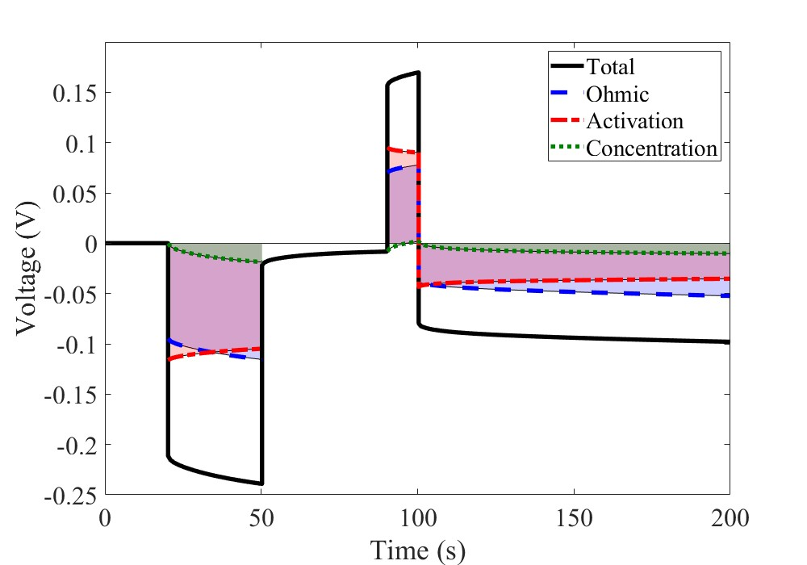
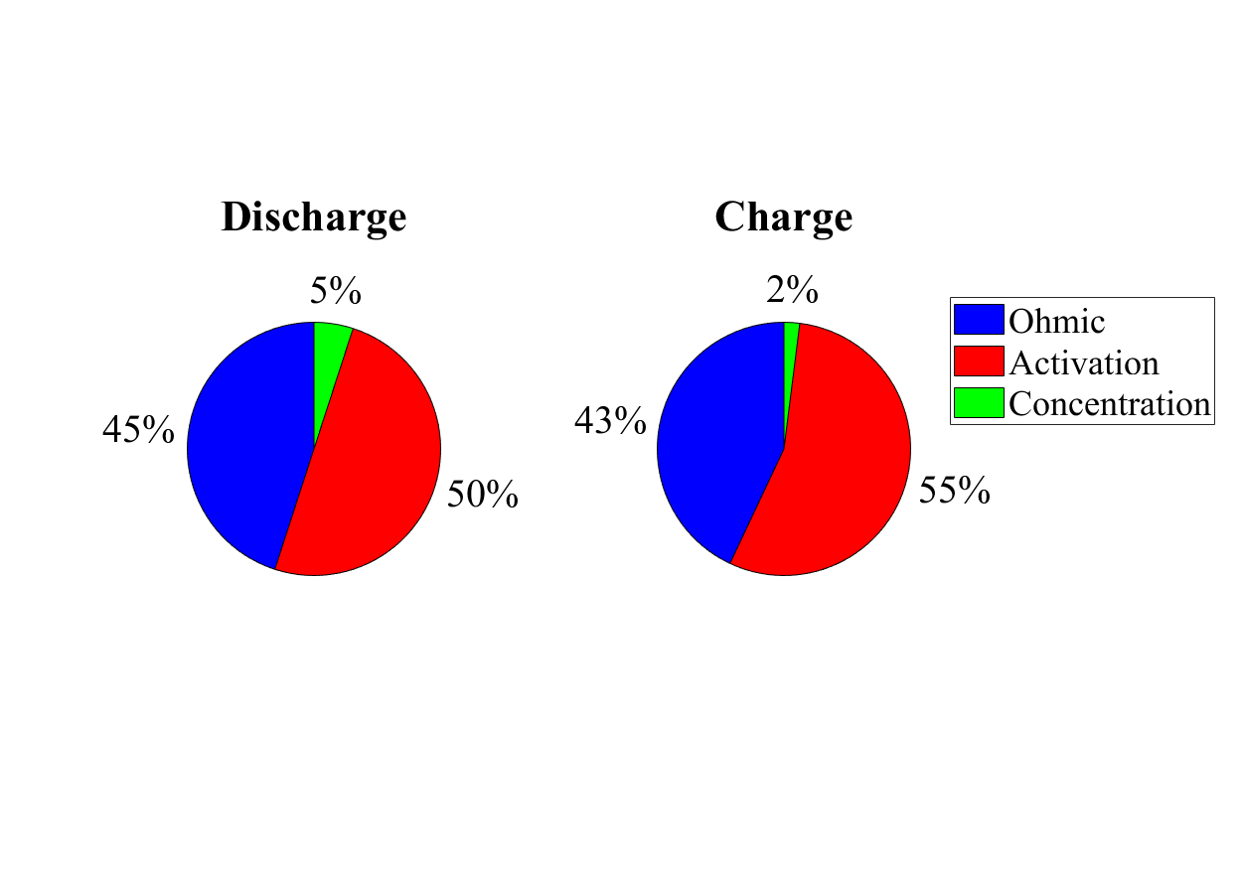
Results: Charge vs. Discharge Response
Li+
Discharge
Charge
0.15
Charge
Total
Ohmic
Activation
Concentration
5%
2%
Discharge
Ohmic
0
45%
43%
Voltage (V)
50%
55%
Activation
Concentration
Capacity Increment
Activation polarization is the dominant source of loss.
-0.25
0
100
200
Time (s)
Key factors that affect performance are electrode material selection, electrode microstructure, and electrolyte conductivity and stability.

Slide 10
COMSOL Multiphysics® Simulations
Lifetime Performance
Thermal Management
Structural Durability
Li+

Slide 11
Simulating a Liquid-Cooled Battery Pack
Warm
Fluid Out
Batteries generate significant heat, require active cooling.
Simulations can predict cooling rates to guide thermal design.
Veryst simulated temperature distribution in a liquid-cooled battery pack to determine optimal coolant flow rates.
Cool
Fluid In
Temperature (°C)

Slide 12
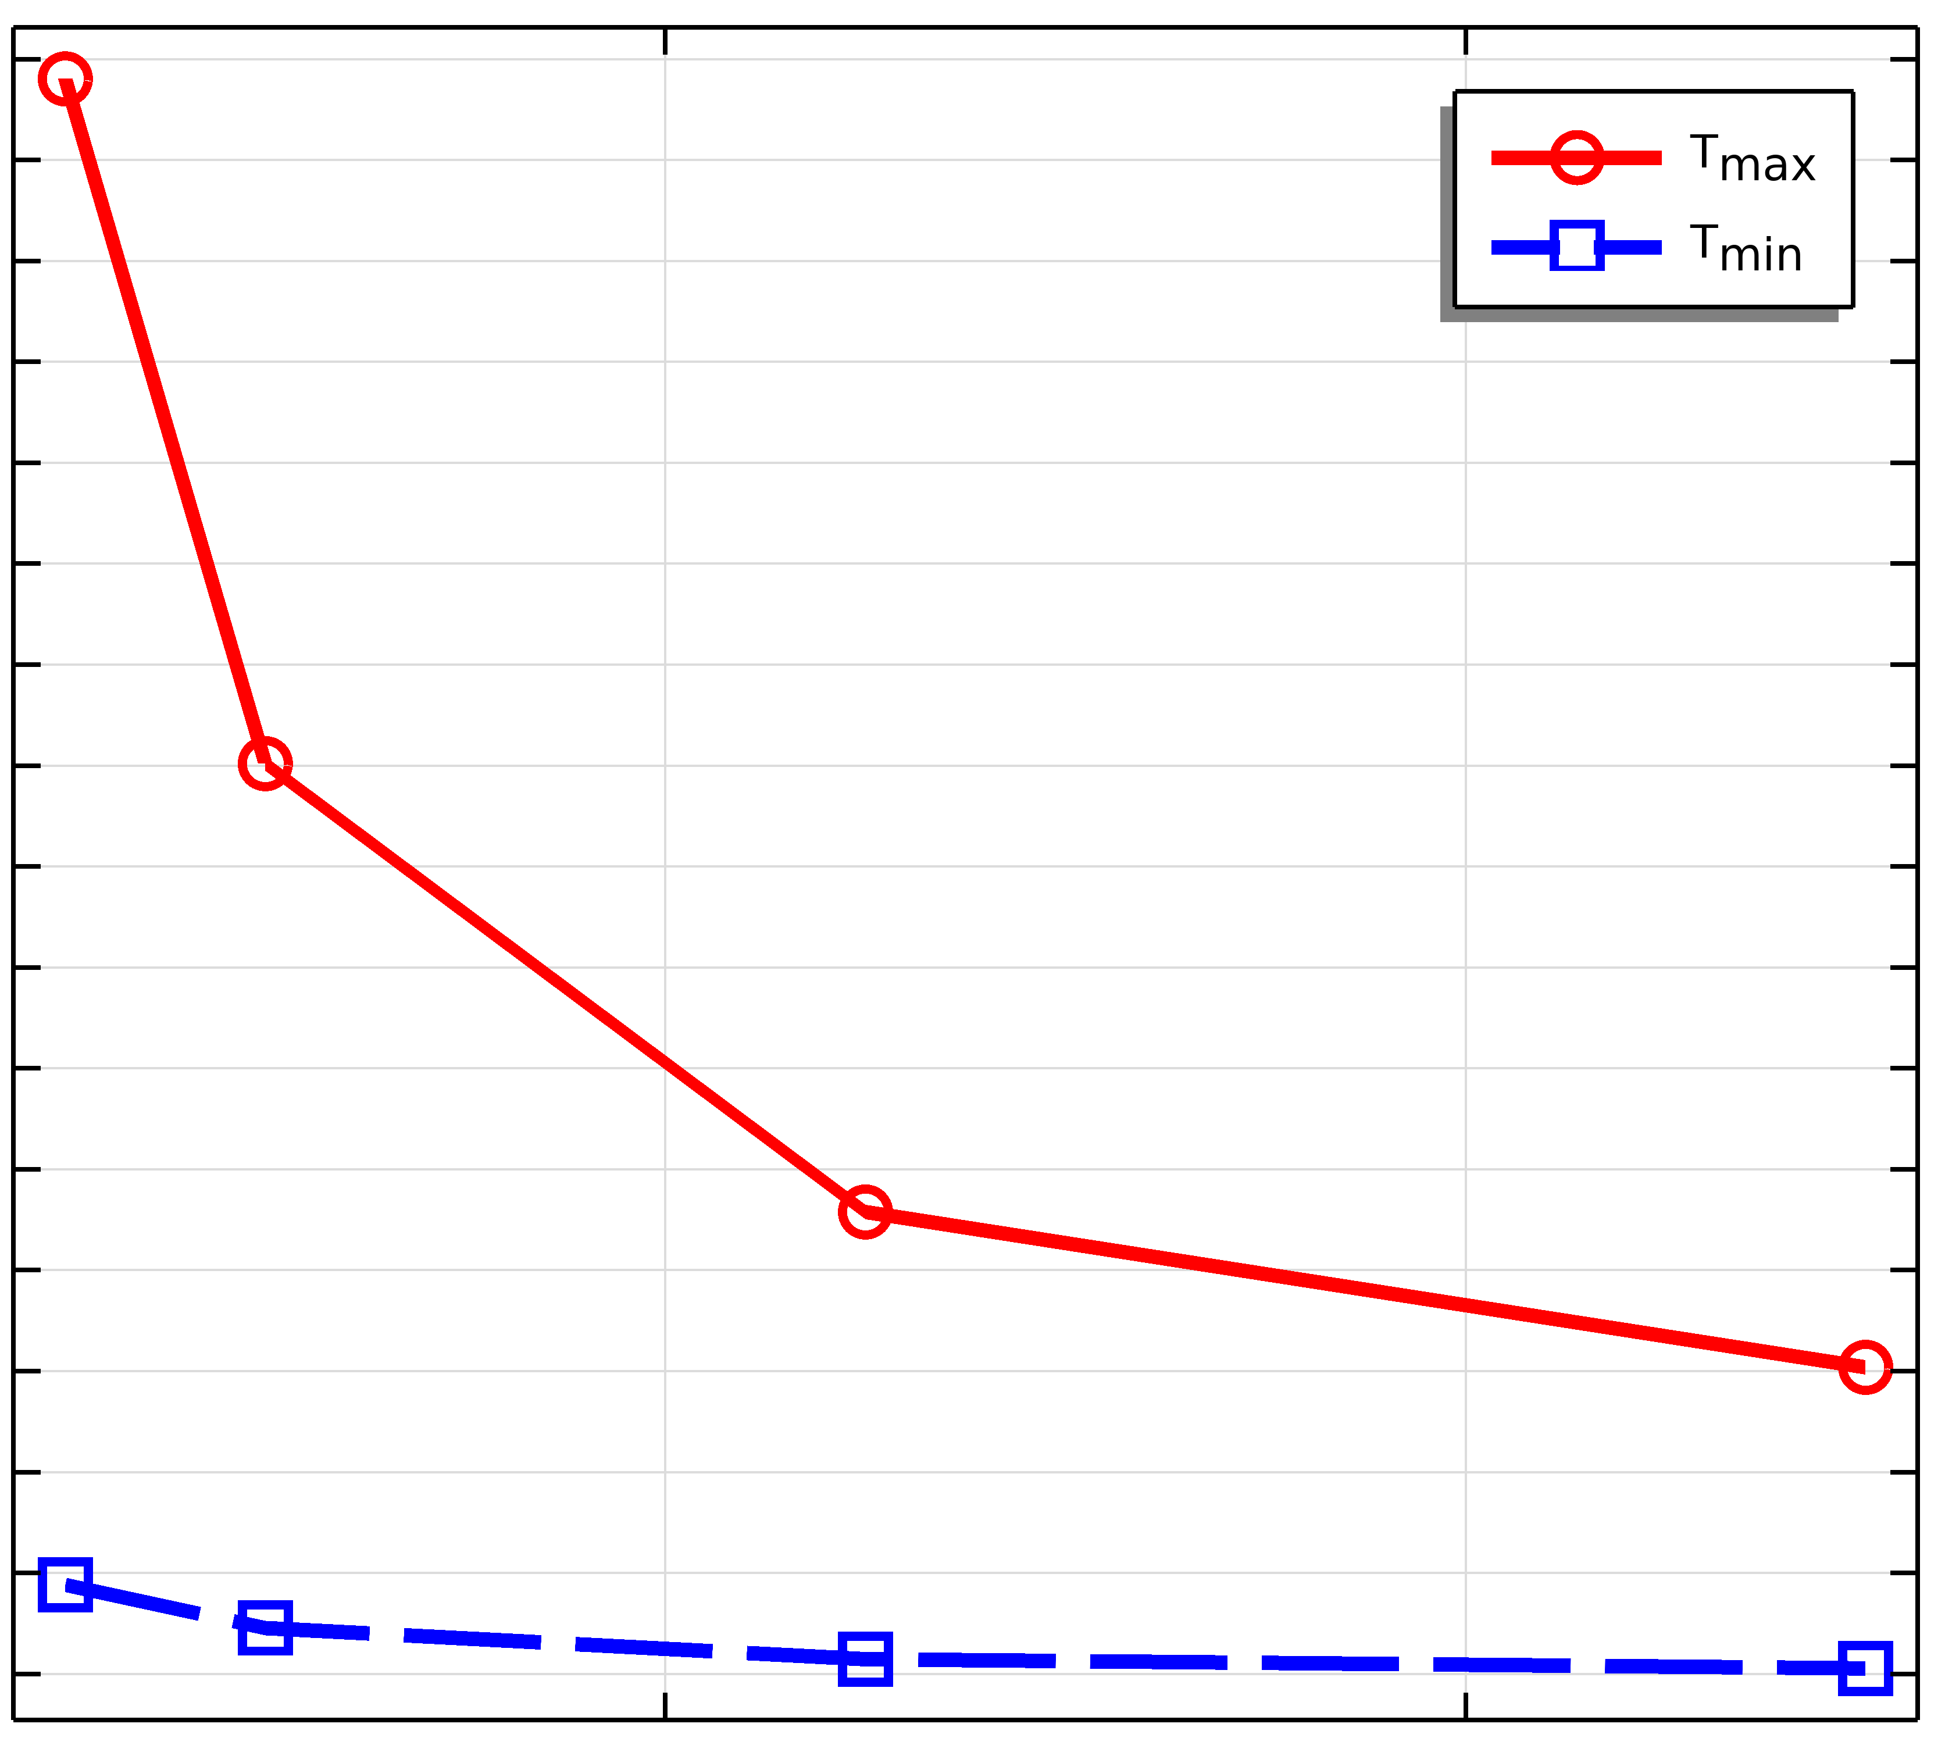
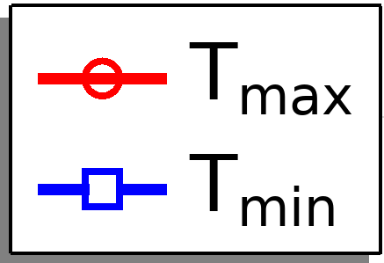
Results: Selecting Flow Rate to Achieve Target Battery Temperature
Line plots of maximum and minimum temperature show higher flow improves uniformity.
Flow rates > 500 ml/min required to maintain temperature < 26°C.
Key factors that influence cooling:
  Coolant selection & flow rate
  Cooling plate selection
  Thermal adhesive selection
50
40
Battery Temperature (°C)
30
20
200
400
Liquid Flow Rate (ml/min)

Slide 13
COMSOL Multiphysics® Simulations
Lifetime Performance
Thermal Management
Structural Durability
Li+

Slide 14
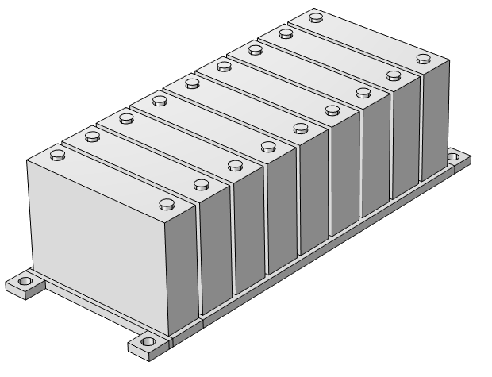
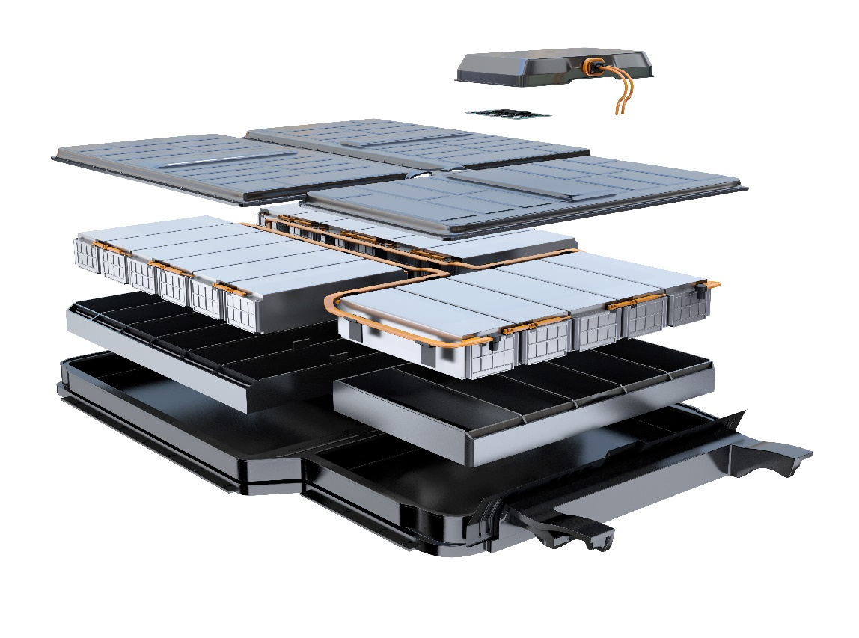
Simulating Adhesive Bonds in Packs
Adhesives applications in batteries:
  Cell-to-cell bonding
  Cell-to-cold plate bonding
  Sealed enclosures
Veryst simulated adhesive stresses due to cyclic, torsional loading typically encountered during service.
Greater Structural Integration
Higher Mechanical Demands on Adhesive Bonds
Cell
Greater Risk of Adhesive Failure
Thermally Conductive Adhesive
Cold Plate

Slide 15
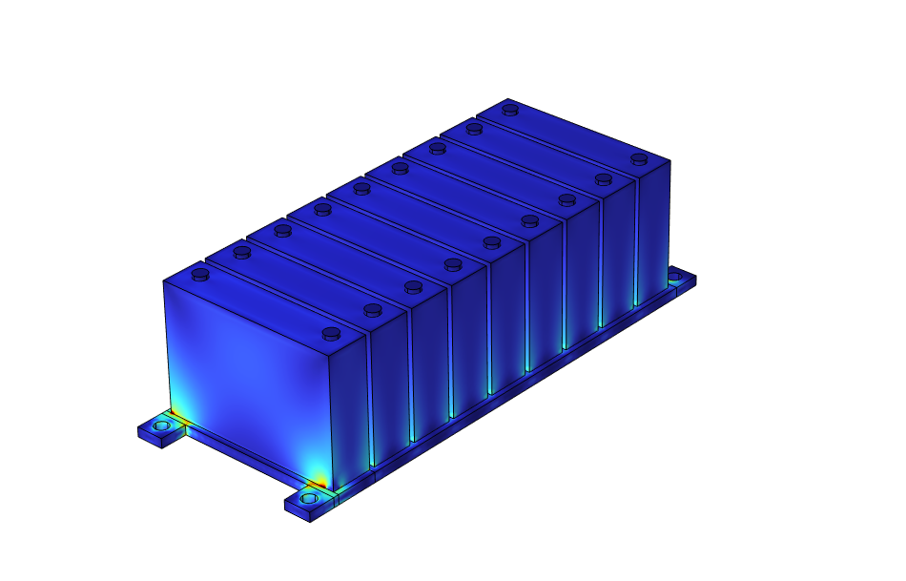
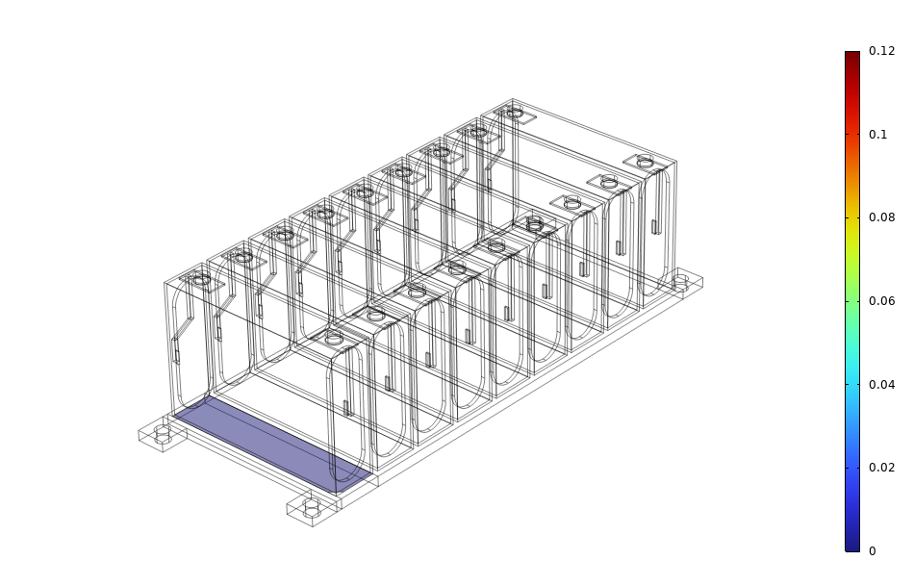
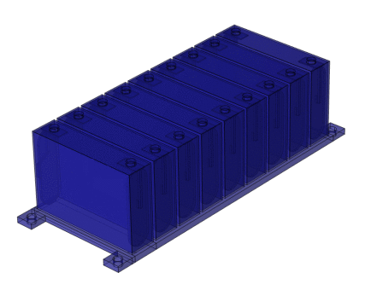
Results: Adhesive Stress Analysis
Stress analysis necessary to assess risk of fatigue debonding in cyclically loaded structures.
Adhesive Bond Area
Normal Stress
Torsional Loading
Stress Concentration at Corner
Load, T
Stress, σ
Time, t
Cycles to Failure, N

Slide 16
Conclusions
Multiphysics simulation can help solve electrochemical, thermal, and mechanical problems for battery and automotive developers.
In this presentation, Veryst used COMSOL Multiphysics® to predict…
  internal resistances in a battery pack over range of useable capacity,
  optimal coolant flow rates to maintain desired operating temperature,
  adhesive stresses under cyclic loading that can lead to fatigue debonding.
Simulations such as these can be used to inform battery design and operating parameters to optimize performance and life behavior.

