Slide 1
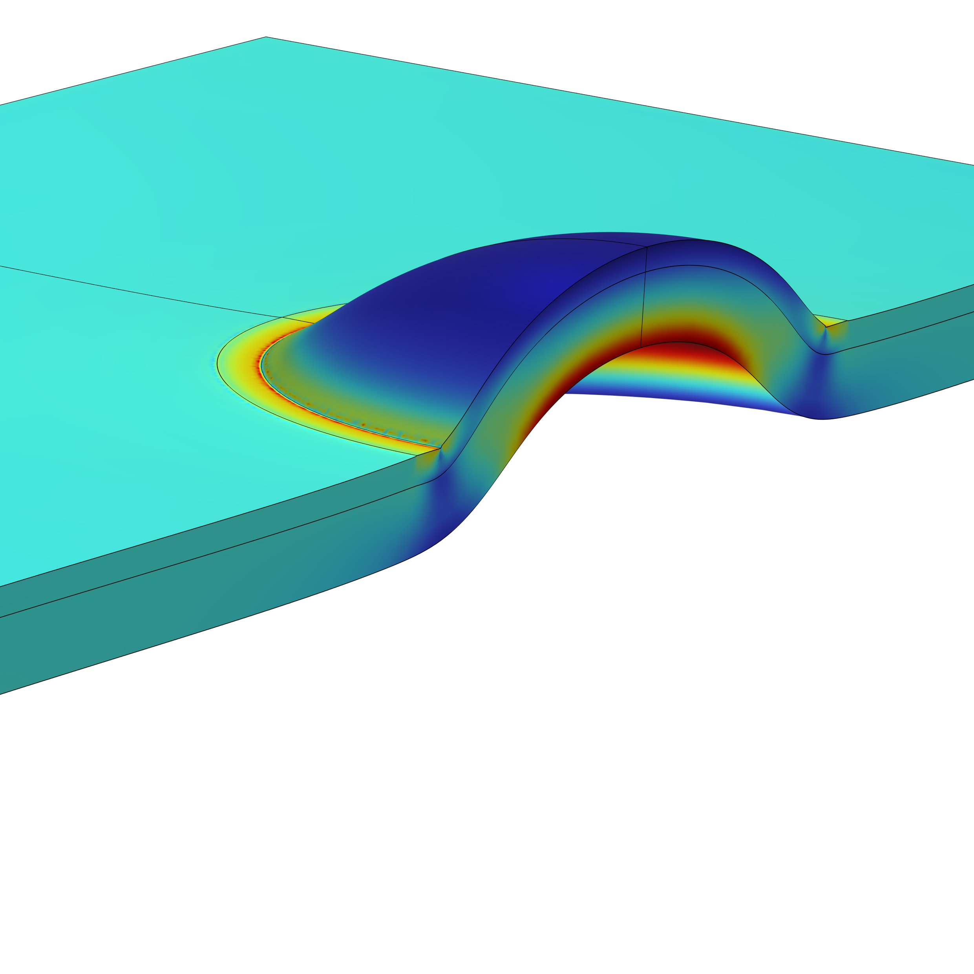
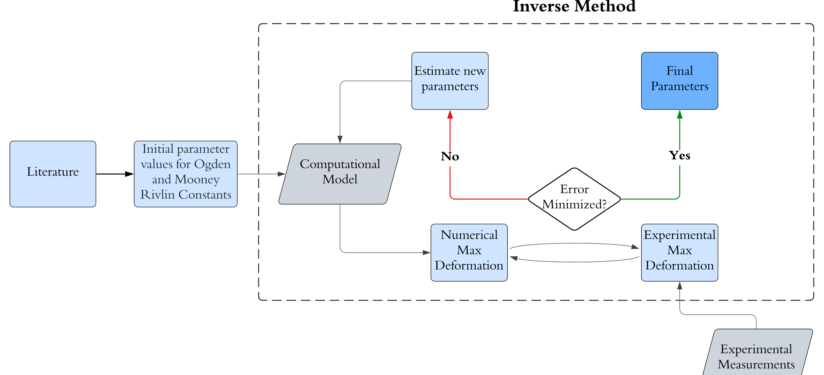
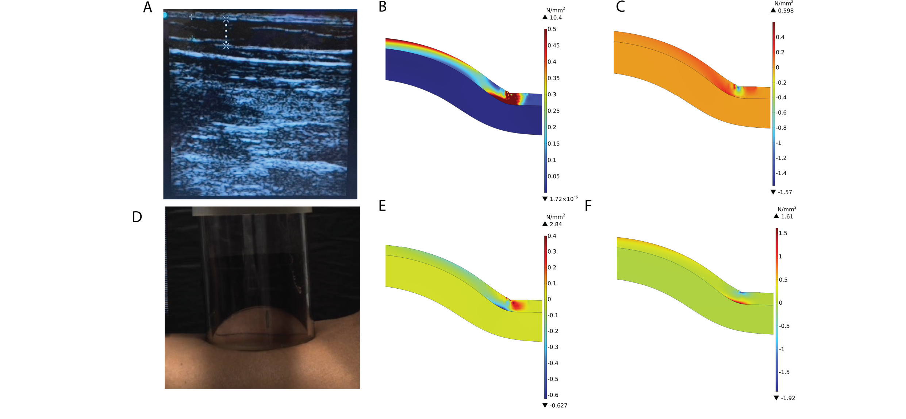


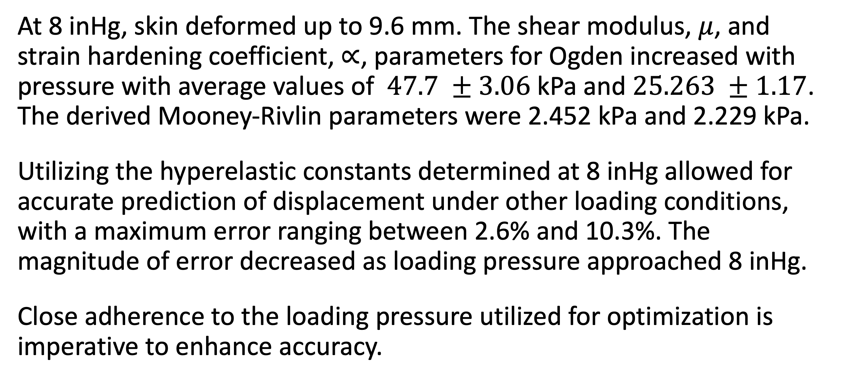
Mechanical Characterization of Skin Undergoing Large Deformations Due to Suction
Modelling the mechanical response is crucial for understanding the internal distribution of stress in tissue under suction pressure.
Etim, E.¹, PintoRodriguez, E.², Lozano, J. J.³, Frangineas, G.³, Franco, W.¹⁴
1. Department of Biomedical Engineering, University of Massachusetts Lowell, Lowell, USA.
2. Department of Mechanical Engineering, University of Massachusetts Lowell, Lowell, USA.
3. Advanced Development, Allergan Aesthetics, an AbbVie company, Pleasanton, California, USA.
4. Department of Dermatology, University of Massachusetts Chan Medical School, Worcester, USA.
Abstract
Skin, the largest organ in the body, comprises three major layers: the epidermis, dermis, and hypodermis. Its complex microstructure results in non-linear stress-strain responses when subjected to large deformations, necessitating non-linear constitutive relations like the Mooney Rivlin and Ogden models to reproduce these responses accurately. However, existing models for studying responses under suction pressure are predominantly 2D and for small deformations.
To address this gap, we developed a 3D computational model to investigate the mechanical properties of the dermis and hypodermis under suction pressure that results in large deformations. This work aims to numerically evaluate the changes in tissue mechanical properties based on varying suction pressures.
Methodology
Suction pressure up to 8 inHg was applied on the volar forearm using a circular aperture of 50 mm. The maximum skin deformation was recorded using a camera. Ultrasound images were taken to obtain the thickness of the hypodermis.
A 3D stationary, multi-layered, symmetric model was developed to determine the bulk mechanical properties of each tissue layer by employing the inverse method. The Ogden model was used for the dermis and the Mooney-Rivlin model was used for the hypodermis.
The hyperelastic constants for both layers were determined by minimizing the error in predicted deformation using the linear least squares method.
FIGURE 1. Flow chart to determine the Ogden (𝜇, 𝛼) and Mooney-Rivlin ($c_{1}, c_{2}$) hyperelastic constant for each tissue layer
Results
At 8 inHg, skin deformed up to 9.6 mm. The shear modulus, $μ$, and strain hardening coefficient, $∝$, parameters for Ogden increased with pressure with average values of $47.7 ±3.06$ kPa and $25.263 ±1.17$. The derived Mooney-Rivlin parameters were 2.452 kPa and 2.229 kPa.
Utilizing the hyperelastic constants determined at 8 inHg allowed for accurate prediction of displacement under other loading conditions, with a maximum error ranging between 2.6% and 10.3%. The magnitude of error decreased as loading pressure approached 8 inHg.
Close adherence to the loading pressure utilized for optimization is imperative to enhance accuracy.
FIGURE 2. A) Ultrasound Image of hypodermis (5 mm). B) Von Mises Stress. C) Normal stress in Y. D) Elongation of skin under suction pressure of 8 inHg. E) Shear stress. F) Normal stress in X.
1.Joodaki H, Panzer MB. Skin mechanical properties and modeling: A review. Proceedings of the Institution of Mechanical Engineers, Part H: Journal of Engineering in Medicine. 2018;232(4):323-343.
2. Tham LM, Lee HP, Lu C. Cupping: from a biomechanical perspective. J Biomech. 2006;39(12):2183-93.
3. Störchle, P., Müller, W., Sengeis, M. et al. Measurement of mean subcutaneous fat thickness: eight standardised ultrasound sites compared to 216 randomly selected sites. Sci Rep 8, 16268 (2018).

