Slide 1
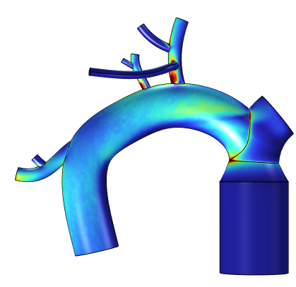
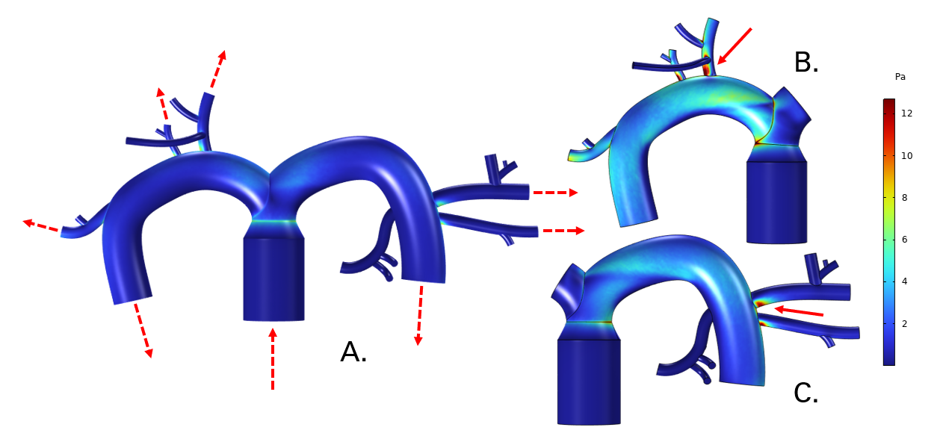

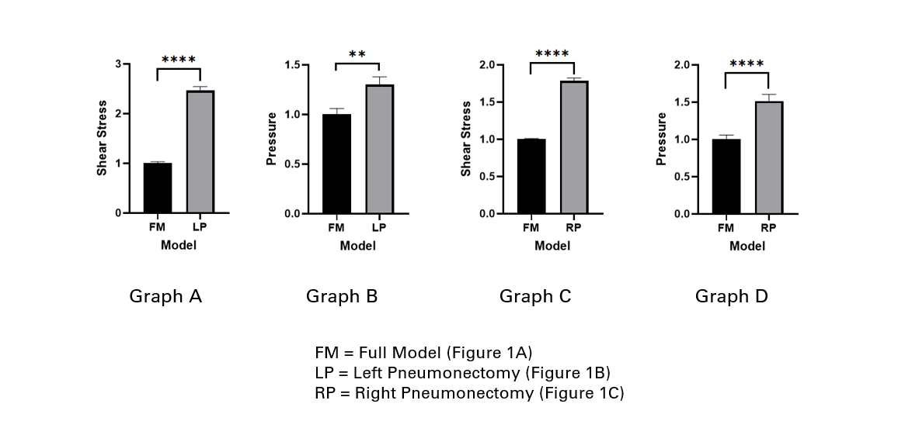

Evaluating Shear Stress and Pressure Changes in the Pulmonary Vasculature Post-Pneumonectomy
Simulating fluid flow in three virtual models of the pulmonary vasculature; a full pulmonary vasculature model and two post-pneumonectomy variations. Shear stress and pressure changes reflects potential vessel remodeling post-pneumonectomy.
M. S. Long¹, A. B. Waxman², F. N. Rahaghi², S. Ji.¹, C. T. Holm¹, S. A. Mensah¹ 1. Worcester Polytechnic Institute, Worcester, MA, USA 2. Brigham and Women’s Hospital, Boston, MA, USA
Abstract
A pneumonectomy is an invasive, high-risk surgical procedure to remove the right or left lung. While this procedure can be life-saving for some patients, it is associated with significant morbidity and a range of postoperative complications. The removal of one lung places a considerable burden on the remaining lung, as it must now handle the entire cardiac output, which results in increased pressure and shear stress within the pulmonary vasculature. These changes in hemodynamics can lead to significant alterations in the vascular wall of the remaining lung. The increased pressure may cause the blood vessels to remodel, thickening and stiffening in response to the heightened mechanical forces¹. Additionally, the increased shear stress could potentially damage the endothelial cells lining the blood vessels, impairing their function and leading to further complications². Understanding the relationship between pneumonectomies and vascular changes is essential for improving outcomes and guiding postoperative care strategies.
Methodology
A simplified 3D model of the pulmonary vasculature was created in SolidWorks® using dimensions from patient data and literature³. Two variations of the full model were created: remaining vasculature after a left and a right pneumonectomy. A time dependent study utilizing the piecewise functions below used pressure values from real patient data, provided by collaborators at BWH, set as boundary conditions for each model, respectively. The surface volume data of shear stress and pressure representing the interface of the fluid domain and blood vessel wall geometry from all models were analyzed in MATLAB®.
Figure 1. These three models are the results of the shear stress. A. is the full model with dashed lines at the inlet and outlets of the vasculature to show flow direction. The “stump” geometry in B. and C. are not considered outlets but the flow direction remains the same. B. is the remaining vasculature after a left pneumonectomy. C. is the remaining vasculature after a right pneumonectomy. The solid lines indicate vessels of interest with significant changes in shear stress and pressure.
Results
The results presented in Figure 1 show that after both right and left pneumonectomies, there was an increase in shear stress at the vascular bifurcations in the model. Additionally, these bifurcations also exhibited increased pressure. Specific locations in both the full and pneumonectomy models demonstrated significantly higher shear stress and pressure values. The fold change data, depicted in Figure 2, further illustrates this.
The analysis confirms a significant increase in shear stress and pressure at bifurcations when comparing the pneumonectomy models to the full model.
Figure 2. These graphs compare the fold change for shear stress and pressure. Graph A illustrates a very significant increase in shear stress when comparing the FM to the LP model at the location indicated by the arrow in Figure 1B. Graph B illustrates a significant increase in pressure when comparing the FM to the LP model at the same location as Graph A. Graph C illustrates a very significant increase in shear stress when comparing the FM to the RP model at the location indicated by the arrow in Figure 1C. Graph D illustrates a very significant increase in pressure when comparing the FM to the RP model at the same location as Graph C.
P. Boutouyrie et al, “Arterial Stiffness and Cardiovascular Risk in Hypertension”, Circulation Research, vol. 128, no. 7, 864-886, (2021), https://www.ahajournals.org/doi/full/10.1161/CIRCRESAHA.121.318061
K. Katoh, “Effects of Mechanical Stress on Endothelial Cells In Situ and In Vitro”, International journal of molecular sciences, vol. 24,22, 16518, (2023), https://doi.org/10.3390/ijms242216518
U. Bozlar et al, “Pulmonary artery diameters measured by multidetector-row computed tomography in healthy adults”, Acta Radiologica, vol. 48, no. 10, 1086-1091, (2017)

